Slide 1
SOIL FOUNDATION AND ENGINEERING
Chapter 1
INTRODUCTION

Slide 2
Father of Soil Mechanics Dr. Karl Terzaghi
Soil Mechanics It is defined as the branch of science which deals with the study of soil, its behavior and its application as an engineering material.
SOIL ENGINEERING (GEOTECHINCAL ENGINEERING)
“ The branch of science which deals with the application of Soil mechanics to solve practical problems is known as Soil Engineering or Geotechnical Engineering.”
FOUNDATION ENGINEERING
It is defined as “the branch of Civil Engineering, which deals with the design, construction, maintenance and renovation of footings, foundation walls, pile foundation, caissons and other structural members which form the foundation of buildings and other structures.”

Slide 3
APPLICATION OF SOIL ENGINEERING
The fundamental role of Soil in Soil Engineering can be discussed;
(1) as a foundation material
(2) as a construction material

Slide 4
APPLICATION OF SOIL AS A FOUNDATION MATERIAL
1. BUILDING : The foundation of all types of buildings are supported on soil. Foundation are required to transmit the load of the super structure, safely and efficiently to the soil. The ideal foundation material are sands, gravel, stiff clays, rock etc.
(2) ROADS : Soil is also used as a foundation material in the construction of roads. It is known as Subgrade. A road pavement is a hard type of crust, which is constructed over soil(Subgrade) for providing a smooth and strong surface on which vehicles can move. Sufficient strength of subgrade is necessary for construction of strong and durable roads.

Slide 5
(3). OTHER STRUCTURES : Soil is used as a foundation material for the construction of important civil engineering structures like dams, bridges, culverts, overhead water tanks etc. Strength characteristics of soil in terms of safe settlement and safe bearing pressure must be studied properly to design these structures of utmost national importance.
APPLICATION OF SOIL AS A CONSTRUCTION MATERIAL
1. EARTHEN DAMS : Earthen dams are huge structures in which soil is used as a construction material. These type of dams are built for creating reservoirs. Since the failure of an earthen dams can lead to great loss of life and property, extreme care should be taken in its design and construction. A thorough and a deep knowledge of soil engineering field is required for safe, economical, impermeable and stable construction of an earthen dams.

Slide 6
(2) BRICKS : The most common building material of construction industry is manufactured from soil. The sun-dried bricks moulded from clay are burnt in kilns at high temperature to produce quality bricks. Knowledge of plasticity characteristics and volumetric shrinkage of soil is essential to manufacture first class bricks of desired compressive strength.
(3) EMBANKMENTS : For the construction of road embankments, soil is used as a filling material. These type of earth filling embankments should be designed with proper care, so that there is no movement of soil in downward direction to cause instability of slope.
(4) OTHER STRUCTURES : Some of the other examples that illustrate the use of soil as a constructional material are given below:
(a) Soil plays a very major important role in the construction of earth retaining structures like retaining walls, bulk heads etc.
(b) As a construction material, soil has a vast application in the construction of tunnels, earthen bunkers, earthen dwellings (mud houses), stone ware pipes, earthen ware etc.

Slide 7
ORIGIN OF SOIL
“An unconsolidated material composed of soil particles produced by the disintegration of rocks.”
Soils are formed by weathering of rocks due to mechanical disintegration or chemical decomposition.

Slide 8
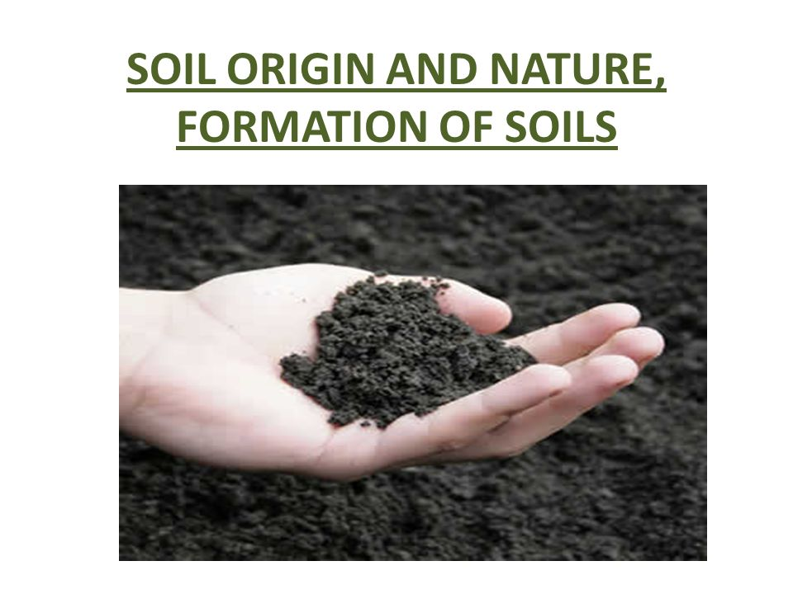

Slide 9
FORMATION OF SOIL
Soil are formed by the process of weathering of the parent rock. The weathering of rocks take place by either process of physical disintegration or chemical decomposition of rocks.
PHYSICAL DISINTEGRATION
1. Change of temperature : Rock is a natural aggregate of different type of minerals. These minerals have different coefficients of thermal expansion. Due to temperature change, these minerals or contract unequally and such repeated action result in the development of stresses.
2. Force of freezing water : Water enters in the small pores and minute fissures of rocks and gets frozen in cold climates. Large stresses develop in the cracks due to wedging action of ice formed and rocks get broken into small pieces.

Slide 10
3. Action of roots : Roots of trees and plants generally grow in the cracks and fissures of the rocks and induce stresses on the rocks. As a result, disintegration of rocks occur and soil are formed. However the presence of roots of plants in the soil improves its strength characteristics.
4. Abrasion : Abrasion of rocks occur under the action of different geological agencies like water, wind, glacier etc. This abrasion action (wear and tear due to fast movement or rubbing action) result in the formation of soil.

Slide 11
CHEMICAL DECOMPOSITION
1. Hydration : It is a common process or rocks decay in which water combines with the rocks minerals and result in the formation of new chemical compound. The process of hydration is more intense in humid climates as compared to arid i.e. dry climates.
2. Oxidation : It is similar to the rusting of steel. In this process, oxygen ions combine with rock minerals to cause chemical decomposition. This process of oxidation occurs frequently in rocks containing iron. During oxidation, the following reaction occurs;
4 Fe + 3 O2 -------------- 2Fe2O3
3. Carbonation : It is a chemical process in which carbon dioxide in the atmosphere combines with water to form carbonic acid which reacts with rock minerals to bring about chemical decomposition. Example Limestone can easily be dissolved by water containing carbonic acid. During carbonation, the following reaction takes place,
CaCO3 + CO2 + H2O ------------------ Ca(HCO3)2

Slide 12
4. Solution : Some of the rock minerals get dissolved in water and form a Solution. Soils are formed by chemical decomposition of solution. For example, carbonate rock get dissolved in water in the presence of carbon dioxide. These solution are carried to new locations when they are deposited as soil precipitates with new chemical composition.
5. Hydrolysis : In this process of chemical decomposition, water dissociate into hydrogen ions (H+) and hydroxyl ions (OH-) and hydrogen ions replace the metallic ions of rock minerals to form new and stable rock minerals with new chemical composition.

Slide 13
GEOLOGICAL CLASSIFICATION OF SOIL
It is divide into two large group
1. Residual Soils 2. Transported Soils
RESIDUAL SOILS
Residual soils are those that remain at the place of their formation as a result of weathering of parent rocks.
TRANSPORTED SOILS
Transported soils are those, which are found at location far away from their place of formation. The transporting agencies of such soils are water, wind, glaciers etc. Transported soils are of following types;
(a) Water transported soils (b) Wind transported soils
(c) Glaciers transported soils (d) Gravity transported soils
Water Transported Soils (Alluvial Deposits): “All type of soils carried and deposited by water are know as water transported soils.”

Slide 14
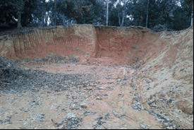

Slide 15
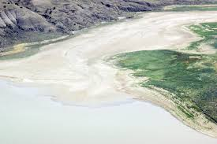
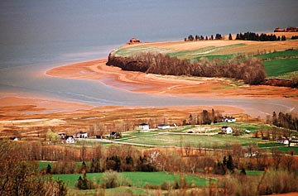
1. Lacustrine Soil : All type of soils formed, hen the flowing water carries products of weathering to lakes are known as lacustrine soils.
2. Marine Soils : Marine soils are formed when the flowing water carries soils (products of weathering) to ocean or sea.

Slide 16
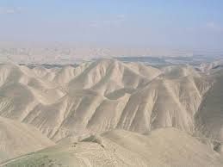
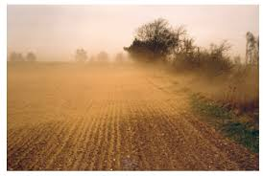
(b) Wind Transported Soils (Aeolian Deposits) : “All types of soils carried and deposited by wind are known as wind transported soils.” These deposits are also known as Aeolian deposits. Aeolian deposits are of two type;
1. Loess : Loess may be defined as soft silt deposits made by wind.

Slide 17
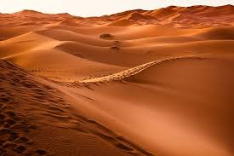
2 Sand dunes : The small hills (hillocks) or mounds formed by accumulation of sand in deserts and beach areas are known as sand dunes.

Slide 18
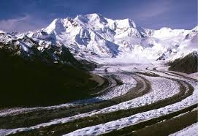
(c) Glacier Transported Soils (Glacial Drifts) : “Soils of heterogeneous nature transported and deposited by moving glaciers are known as Glaciers transported soils or Glaciers soils.

Slide 19
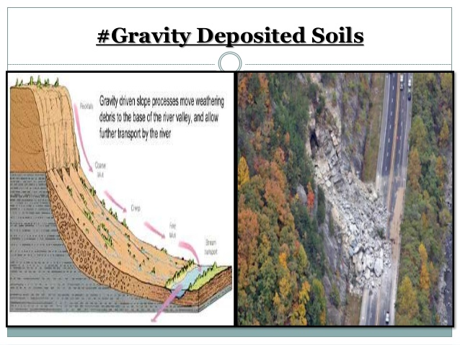
(d) Gravity Deposited Soils : Soil rock fragments transported through short distances under the action of gravity and deposited at the foot of cliffs or steep slopes are known as gravity deposited soils.

Slide 20
ENGINEERING CLASSIFICATION OF SOIL
Based on the engineering classification, soil may be grouped as ;
Coarse grained soil or Granular soil
Fine grained soil or Cohesive soil
Organic soil
(1) Coarse grained soil : The soil which consists of coarser size particles . and hard rock particles and 50% or more of the total material (soil) by weight is retained on 75 micron IS sieve. Sand, gravel, cobbles are the common examples of coarse grained soil. A granular soil has the following significant engineering properties.

Slide 21
(a) It is an excellent foundation material
(b) It is the best embankment material
(c) it is the best backfill material for retaining walls
(2) Fine grained Soil : The soil which consists of finer size particles or fine grains is termed as fine grained soil. In this type of soil, more than 50% of the total material passes 75 micron IS Sieve. Fine grained soils have following significant engineering properties.
1. It possesses lo shear strength
2. It is plastic and compressible
3. It is impervious practically
4. It shrinks upon drying and expands upon wetting.
(3) Organic Soil : The soil which contains a large percentage of organic matter and particles of decomposed vegetation matter is known as organic soil.

Slide 22
The significant engineering properties of organic soils are :
1. It has a low shear strength.
2. it is often permeable.
3. it is highly compressible.
4. It is the poorest foundation material.
SOIL PROFILE
A soil profile is a vertical section through the ground along the line of exploration depicting different soil layers.
Engineering Significance of Soil Profile :
1. It is gives the type and nature of different soil layers present in the entire soil strata
2. It show the thickness and sequence of individual soil strata.

Slide 23
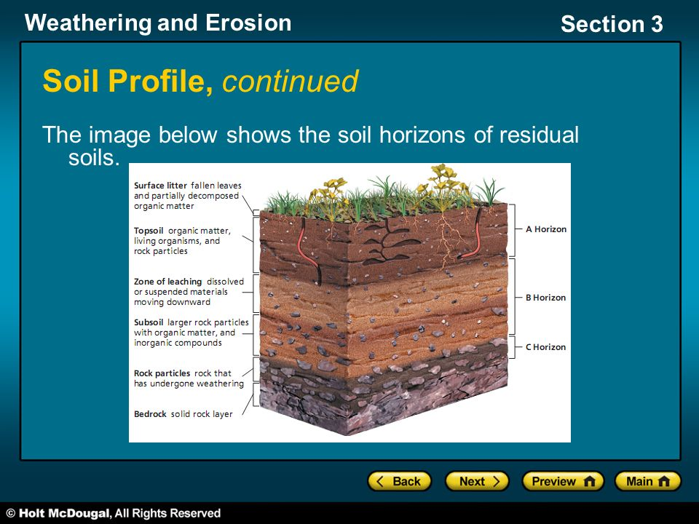

Slide 24
3. It indicates the position of water table.
4. It indicates the deposition of different soil material by weathering agencies on the original soil deposit.
5. It indicates hardness or softness of strata at respective depths.
6. it gives the rough idea of foundation depth at which soil of sufficient bearing capacity is available for construction purpose
7. It gives the position, where sample is taken, whether disturbed or undisturbed.

Slide 25
BLACK COTTON SOILS :
Properties of Black Cotton Soils :
1. Black cotton soils chiefly consist of clay mineral montmorillionite.
2. These soil range from light grey to dark grey and black in colour.
3. They are highly expansive in nature.
4. The underlying bed rock for black cotton soils is basically basalt or trap.
5. Due to expansive nature, these soils are subjected to high shrinkage and swelling on adsorption of water.
6. Black cotton soils show polygonal cracking after drying. The smaller the polygon, greater is the amount of clay fraction.
7. These are called cotton soil as they are very suitable for growing cotton.

Slide 26
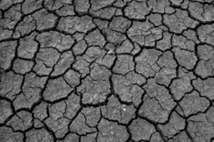
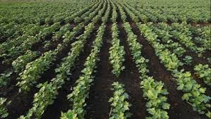

Slide 27
NAMES OF ORGANISATIONS DEALING WITH SOIL WORK IN INDIA
1. Central Soil Salinity Research Institute, Karnal (Haryana)
2. Central Soil and Material Research Station, New Delhi.
3. Central Soil and Water Conservation Research and Training Institute, Dehradun (Uttrakhand)
4. Central Road Research Institute, Okhla (New Delhi).
5. Indian Agricultural Research Institute, New Delhi.

Slide 28
Chapter 2

Slide 29
CONSTITUTE OF SOIL
Soil consists of three constitute, viz solid particles, air and water which blended together to form a complete material
PHASE DIAGRAM FOR SOIL
The diagram which represents the different constitute of soil separately for easy understanding is termed as phase diagram
THREE PHASE DIAGRAM
The diagram which represent the three constitute of soil i.e. solids, air and water is known as three phase diagram

Slide 30
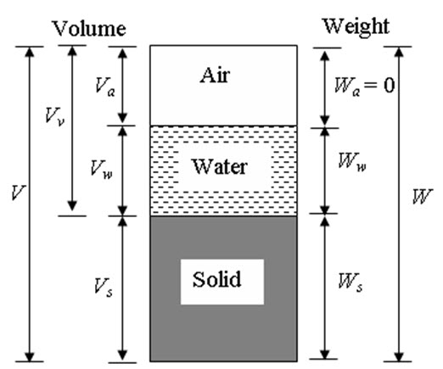

Slide 31
TWO PHASE DIAGRAM:
The diagram which represent only two constitute of soil is termed as two phase diagram.
Although soil is three phase system, it becomes a two phase system in following to cases
Soil is absolutely dry: In this case soil mass consists only soil grain and air
Soil is fully saturated: In this phase soil mass consist soil grain and water.

Slide 32
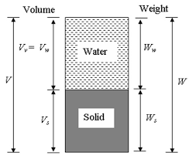
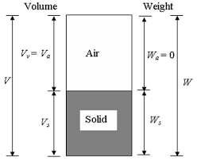

Slide 33
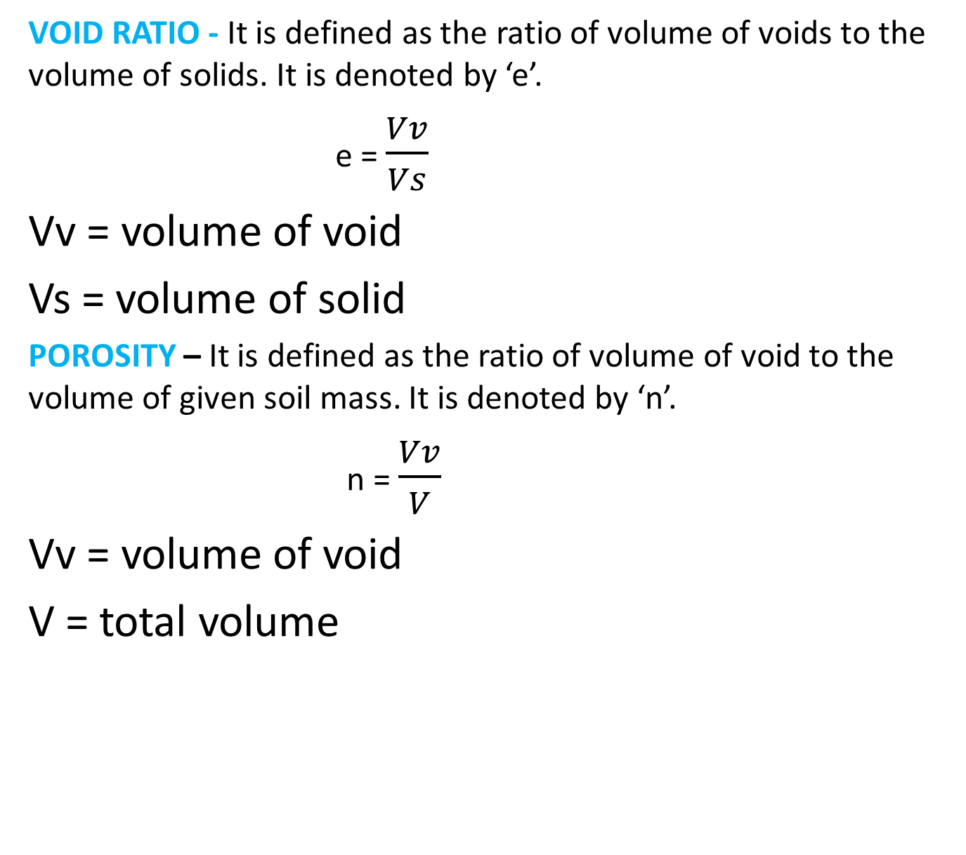
SOIL PROPERTIES AND THEIR INTER RELATIONSHIP
VOID RATIO - It is defined as the ratio of volume of voids to the volume of solids. It is denoted by ‘e’.
e = $\frac{Vv}{Vs}$
Vv = volume of void
Vs = volume of solid
POROSITY – It is defined as the ratio of volume of void to the volume of given soil mass. It is denoted by ‘n’.
n = $\frac{Vv}{V}$
Vv = volume of void
V = total volume

Slide 34
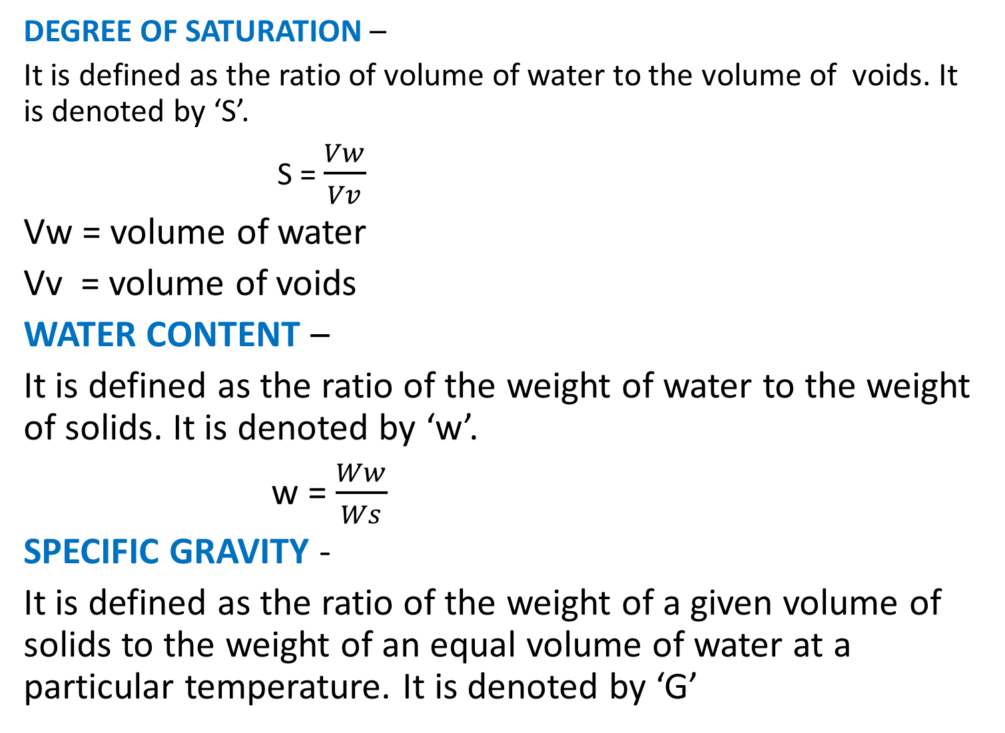
DEGREE OF SATURATION –
It is defined as the ratio of volume of water to the volume of voids. It is denoted by ‘S’.
S = $\frac{Vw}{Vv}$
Vw = volume of water
Vv = volume of voids
WATER CONTENT –
It is defined as the ratio of the weight of water to the weight of solids. It is denoted by ‘w’.
w = $\frac{Ww}{Ws}$
SPECIFIC GRAVITY -
It is defined as the ratio of the weight of a given volume of solids to the weight of an equal volume of water at a particular temperature. It is denoted by ‘G’

Slide 35
CHAPTER – 4
FLOW OF WATER THROUGH
SOIL

Slide 36
PERMEABILITY AND ITS CONCEPT
The property of a soil which permits the flow of water through it is called the Permeability.
IMPORTANCE OF PERMEABILITY
To calculate the rate of settlement of buildings and other structures.
To determine yield of wells.
To analyses seepage through dams and levees.
To design the filters required to prevent soil piping in hydraulic structures.
To study losses from irrigation canals.
To solve the problem of water logging in certain areas by constructing suitable under drains for lowering the water table.
To study stability of slopes and drainage of soils.
HYDRAULIC GRADIENT
It is defined as the loss of head (h) per unit length of flow of water through the soil. It is denoted by i.
i = h/L = h1-h2/L
DARCY’S LAW
This law states that “ For a laminar flow in soils, the velocity of flow (v) is proportional to its hydraulic gradient (i)”.

Slide 37
Limitations of Darcy’s Law
Darcy’s law is valid only for laminar flow in soils.
In fine grained soils such as silt and clay, the dimensions of interstices are very small and flow is laminar, so Darcy’s law is generally applicable. In coarse grained soils like sand, the flow is also laminar, but for gravels, where interstices are very large, flow may be turbulent for extremely fine grained particles such as colloids, the interstices are very small and velocity is very low, so Darcy’s law is not possible.
COEFFICIENT OF PERMEABILITY
From Darcy’s Law,
v = ki
or I = v/k
If I = 1, then, k = v
Coefficient of permeability k is defined as “the average velocity of flow through the total cross-sectional area of soil under unit hydraulic gradient”.
Units of k, : The dimensions of k are same as those of velocity.
It is expressed in mm/sec or cm/sec or m/day.

Slide 38
FACTORS AFFECTING PERMEABILITY
The following factors affect the permeability of soil;
1. Void ratio 2. Particle size (Grain size)
3. Structure and stratification of soil 4. Shape of particles
5. Temperature 6. Degree of saturation
7. Water impurities
1. Void ratio (e) : Greater the void ratio, higher is the value of coefficient of permeability.
2. Particle size (grain size) : Larger the particle size of soil higher is the value of coefficient of permeability. It varies as square of grain size.
3. Structure and stratification of soil : Stratified soil deposits also have greater permeability parallel to the plane of stratification as compared to unstratified deposits.
4. Shape of particles : The permeability of a coarse grained soil also depends upon the shape of particles. It is inversely proportional to the specific surface area. As the angular particles have greater specific surface area as compared with the rounded particles, the angular particles are less permeability than rounded particles for the same void ratio.

Slide 39
Temperature : The coefficient of permeability increase with increase in temperature due to reduction in the viscosity.
Degree of saturation : The coefficient of permeability of a fully saturated soil is always greater than the partially saturated soils.
Water impurities : Presence of any foreign matter in water reduces the permeability of soils as it has a tendency to plug the flow of water passage.
MEASUREMENT OF PERMEABILITY OF SOIL IN THE LABORATORY
The commonly used methods for determining the coefficient of permeability k in the laboratory are;
1. Constant Head Permeability Method.
2. Falling Head Permeability Method.
The apparatus used in soil laboratory for determining the coefficient of permeability of soil is termed as permeameter.
CONSTANT HEAD PERMEABILITY TEST
This test is used for determining the coefficient of permeability of coarse grained soils like gravel and sand. The apparatus used for the test is constant head permeameter. This test is known as constant head permeability test because water is allowed to flow through the soil sample under a constant head in this test.

Slide 40
PROCEDURE :
1. Fill the soil sample inside the permeameter and place the porous discs and rubber stopper in the position as shown.
2. Measure the length of soil sample and area of ppermeameter where D is the inside diameter of permeameter.
3. The soil sample inside the permeameter should be fully saturated.
4. Allow the water to pass through the soil sample under a constant head (h). This constant head is maintained by keeping under control the water level of supply tank and collecting tank. As soon as water passes through the soil sample from supply tank, its level decrease, which is kept constant by regulating the flow of water from a tap.
5. From the collecting tank, water overflows in the measuring cylinder.
6. Measure the quantity of water (Q) collected in the measuring cylinder in a given time(t), when steady flow is reached.

Slide 41

G = $\frac{γ}{}$

Slide 42
h

