Slide 1
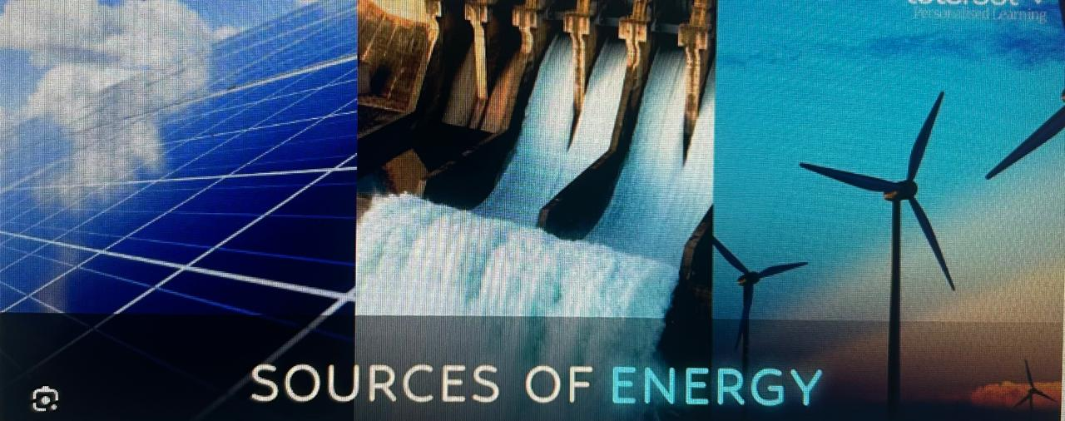
NON-CONVENTIONAL ENERGY SOURCE
Electrical Engineering Semester: 2nd
Prepared By:
VIKASH KUMAR
(Lecturer Electrical Engineering)
GOVERNMENT POLYTECHNIC
LOHARU (BHIWANI)

Slide 2
LEARNING OUTCOMES
After undergoing the subject, the students will be able to:
Explain the importance of non-conventional energy sources for the present energy scenario.
Classify various non-conventional sources of energy
Explain principle of solar photovoltaic energy conversion and the applications of solar energy in different fields.
Explain basic conversion technologies of biomass, wind energy, geo-thermal, tidal energy, hydro energy and its applications.
Explain direct energy conversion systems like magneto hydrodynamics and fuel cells and its applications.
DETAILED CONTENTS
1. Basic of Energy: (06 periods)
Classification of Energy-primary and secondary energy, commercial and non-commercial energy, importance of non conventional energy sources, present scenario, future prospectus, energy scenario in India, sector-wise energy consumption (domestic, industrial, agriculture etc.)
2. Solar Energy:
(12 periods)
Principle of conversion of solar radiation into heat, photo-voltaic cell, electricity
generation, application of solar energy like solar water heaters, solar furnaces, solar cookers, solar lighting, solar pumping.
Bio-energy: (10 periods)
Bio-mass conversion technologies- wet and dry processes. Methods for obtaining energy from biomass. Power generation by using gasifiers.
Wind Energy: (10 periods )
Wind energy conversion, windmills, electricity generation from wind types of wind mills, local control, energy storage.
Geo-thermal and Tidal Energy: (10 periods)
Geo-thermal sources, Ocean thermal electric conversion, open and closed cycles, hybrid

Slide 3
cycles. Prime movers for geo-thermal energy conversion. Steam Generation and electricity
generation.
6. Magneto Hydro Dynamic (MHD) Power Generation:
(04 periods)
7. Fuel Cells: (08 periods)
Design and operating principles of a fuel cell, conversion efficiency, work output and
e.m.f of fuel cells, applications.
8. Hydro Energy – Mini & Micro hydro plants :

Slide 4
CHAPTER-1
BASICS OF ENERGY
  Energy: -
The energy of a body is its capacity to do work. It is measured the total amount of work that the body can do.
    Different forms of energy:-
      Electrical Energy
      Mechanical Energy (kinetic and potential)
      Chemical Energy
      Heat Energy(thermal)
      Nuclear Energy
      Light(radiant)
The S.I unit of energy is Joule or KJ or Watt.h.
  Classification of Energy:-
Primary Energy sources
Secondary Energy sources
Primary Energy sources :
The Energy of sources which can be used directly as they appear in nature.
Example: - wood, coal, oil, natural gas etc.
Secondary Energy sources :
These sources of energy derive from transformation of primary Energy Sources.
Example:- petrol, that derives from the treatment of crude oil etc.

Slide 5
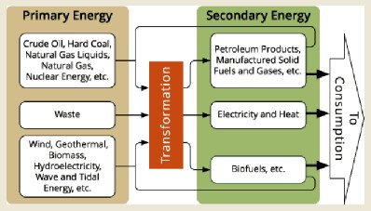
Fig 1.1: Primary and secondary energy sources
  COMMERCIAL AND NON-COMMERCIAL ENERGY:
    Commercial Energy: - The sources of energy are available to user at some cost. These are generally exhaustible.
Example: - coal, petrol, gas, etc.
    Non-Commercial Energy:- The sources of energy are available to user at free of cost.
These are generally renewable.
Example:- solar energy, firewood.
  Advantages of Electrical Energy over the other forms of Energy:-
Energy in the form of Electrical Energy is most easy to use. The following advantages of Electrical Energy:-
It is pollution free and environment friendly.
Electrical energy can be easily converted into other forms of energy.
iii.
It can be easily transmitted.
Efficiency of transmission in high.
Voltage can be easily stepped up or stepped down as per the requirement.
Control of appliance using Electrical Energy is easy and safe.
1.5 Renewable Energy sources:-
The sources of energy which are being produced continuously in nature and are in exhaustible are called renewable sources of energy (or) non-conventional energy.

Slide 6
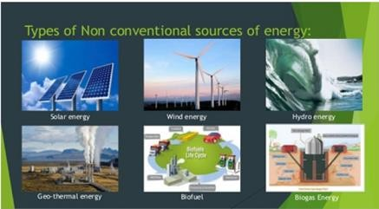
Solar Energy
Wind Energy
Tidal Energy
Bio-Gas
Geo- Thermal Energy
Hydro Energy
Fig 1.2: Types of non conventional source of energy
  Importance of Non-conventional source of Energy:
    The power plants based on renewable do not have any fuel cost and hence negligible running cost.
    Renewable energy has low energy density. Thus there is no problem of pollution or ecological balance problem.
  Present Scenario, Future Prospects and Energy Scenario in India:
In 1982 India was created, a separate Department of Non-Conventional Energy Sources (DNES) in the Ministry of Energy to look after all the aspects relating to New and Renewable Energy. The Department was upgraded into a separate Ministry of Non-Conventional Energy Sources (MNES) in 1992 and was rechristened as Ministry of New and Renewable Energy (MNRE), in October 2006.To support the Ministry, there are five institutions consisting of three autonomous bodies i.e National Institute of Solar Energy (NISE), National Institute of Wind Energy (NIWE) and National Institute of Bio Energy (NIBE) and two public sector undertakings i.e. Indian Renewable Energy Development Agency (IREDA) and Solar Energy Corporation of India (SECI).

Slide 7
In India, use of renewable energy is increasing day by day. Government of India
announced in the year 2015, a target for 175 GW cumulative renewable power installed capacity by the year 2022. A capacity of 85.90GW has been set up by December 2019 constituting more
than 23% of the total installed capacity. India has 4th and 5th global positions in the wind and solar power deployment respectively. Since 2013-14 till December 2019, the renewable power deployment has more than doubled. Annually more than 10 millions man-days employment is being created in the sector. Solar power capacity has increased by more than 14 times in the last five years from 2630 MW to 37505 MW in December 2019. Solar water heaters and rooftop systems have been promoted in certain government, commercial and residential areas through regulatory intervention such as mandates under building by-laws and its incorporation in the National Building Code. Off-grid and rooftop solar applications have been promoted through the provision of subsidies from the central government.
India has large renewable energy potential from sources such as wind, solar, biomass, small hydro, etc. As per estimates, India has a wind potential of more than 300 GW at a hub height of 100 meter, solar potential of ~750 GW, assuming 3% wasteland is made available, small hydro potential of ~ 20 GW, and bio-energy potential of 25 GW. Further, there exists significant potential from decentralized distributed applications for meeting the hot water requirement for residential, commercial and industrial sector through solar energy and also meeting cooking energy needs in the rural areas through biogas. Renewable energy also has the potential to usher in universal energy access.
Figure 1.3 shows the installed power generation capacity (MW) in India through renewable energy sources upto 31.12.2019.

Slide 8
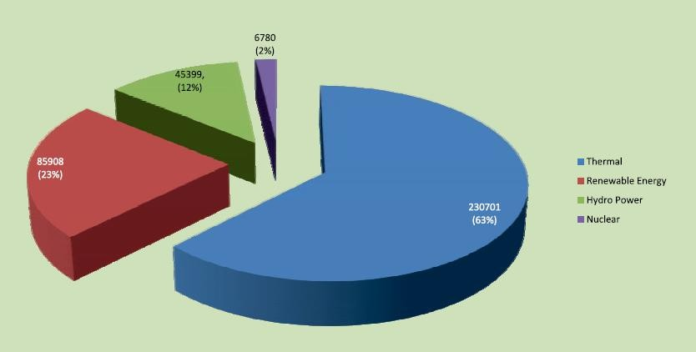
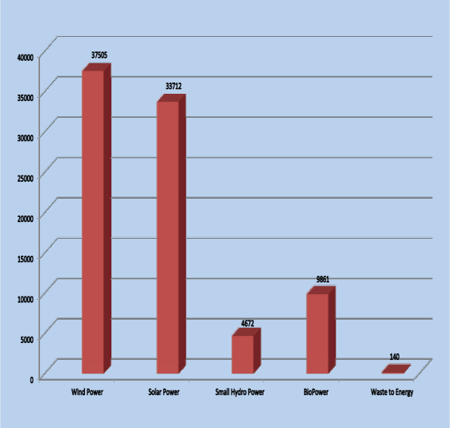
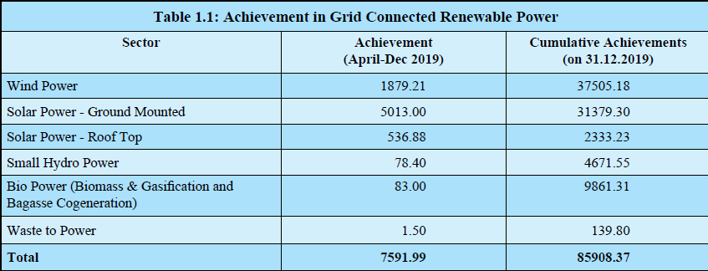
Fig1.3: India-source wise installed power generation capacity (MW) upto 31.12.2019
During the year 2019-20 a total of 7,591.99 MW renewable energy capacities has been added in the country till 31.12.2019 as given in Table 1.1.
Solar Energy Potential and Achievements:
As on 31-12-2019, a total solar power capacity installed is 33,730 MW. Fig 1.4 shows the top 10 states in solar Installation as on 31.12.2019 and table 1.2 shows the state wise solar energy potential in the country.

Slide 9
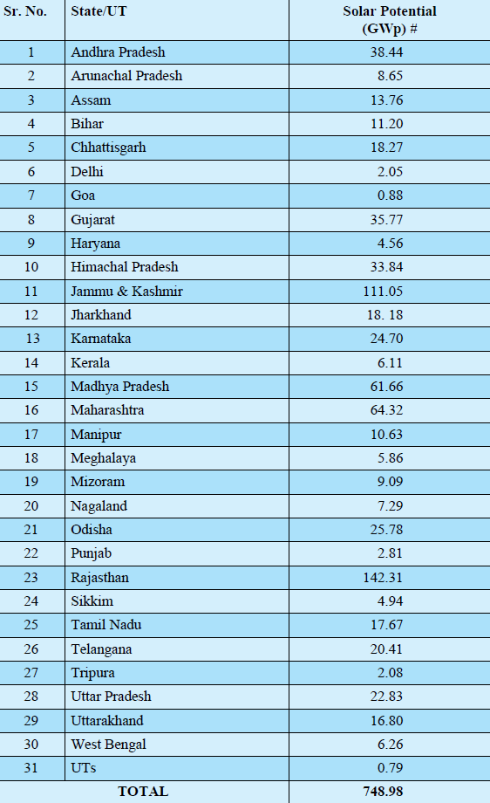
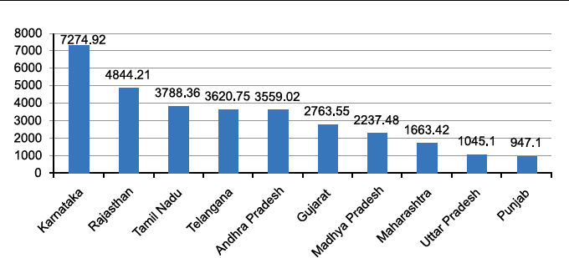
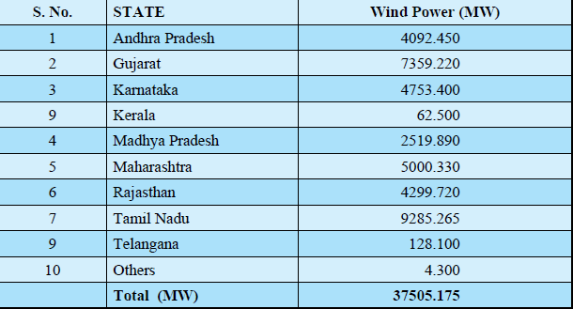
Figure 1.4: Top 10 States in Solar Installation)
Table 1.2: State-wise estimated Solar Energy Potential in the Country
(capacity in MW as on 31-12-2019
Wind Energy Potential and Achievements
The installed capacity of grid-interactive wind power in the country as on 31.12.2019 is 37.50 GW and state-wise installed capacity (in MW) is shown in Table 1.3
Table 1.3 State wise Wind Power installed as on 31.12.2019
BIOMASS POWER / BAGASSE BASED CO-GENERATION (UPTO MARCH 2020) GRID - CONNECTED:
Ministry has been promoting Biomass Power and Bagasse Co-generation
Programme with the aim to recover energy from biomass including bagasse, agricultural residues such as shells, husks, de-oiled cakes and wood from dedicated energy plantations for power
generation. The potential for power generation from agricultural and agro-industrial residues is

Slide 10
estimated at about 18,000 MW. Power generation through bagasse cogeneration in sugar mills is
estimated at around 8,000 MW. Thus the total estimated potential for biomass power is about 26,000 MW. Over 500 biomass power and cogeneration projects with aggregate capacity of
9186.50 MW have been installed in the country up to December 2019.
A cumulative capacity of 9186.50 MW has been commissioned so far mainly in the states of Tamil Nadu, Uttar Pradesh, Karnataka, Andhra Pradesh, Maharashtra, Chhattisgarh, West Bengal and Punjab.
SMALL HYDRO POWER:
Small Hydro Power projects are further categorized into small, mini and micro hydel projects based on their capacity as follows:
Micro hydel ≤ 0.1 MW
Mini hydel > 0.10 MW to ≤ 2.00 MW Small Hydel > 2.00 MW to ≤ 25.00 MW
The estimated potential of small/mini/micro hydel projects in the country is 21133.65 MW from 7133 sites located in different States of India. The national target for SHP is to achieve a cumulative capacity of 5000 MW by 2022, under overall targets of achieving a cumulative grid connected Renewable Energy Power Projects of 175,000 MW. Against this target of achieving an aggregate capacity of 5000 MW by the year 2022, an aggregate capacity of 4671.557 MW been achieved by 31st December 2019 through 1127 small hydropower projects.
1.8 SECTOR-WISE ENERGY CONSUMPTION (Domestic, Industrial, agriculture etc):
Consumption of Coal and Lignite:
The estimated total consumption of raw coal by industry has increased from 549.57MT during 2008-09 to 896.34 MT during 2017-18 with a CAGR of 5.01% The annual growth
rate from 2016-17 to 2017-18 is 7.06% (Table 1.4).
Consumption of Lignite increased from 31.85 MT in 2008-09 to 45.82 MT in 2017- 18(Table 1.4).
Consumption of Lignite in Electricity Generation sector is the highest, accounting for about 83.7% of the total lignite consumption (Table 1.5).
The maximum consumption of raw coal is in Electricity generation, followed by steel industry. Industry-wise estimates of consumption of coal shows that during 2017-18,
electricity generating units consumed 576.19 MT of coal, followed by steel & washery

Slide 11
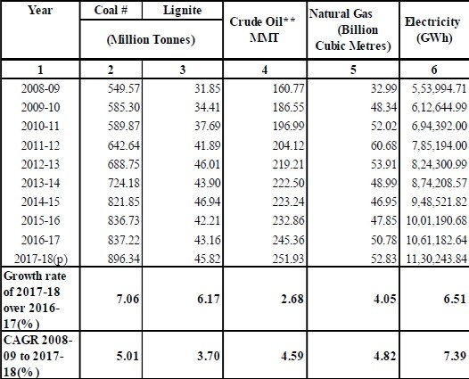
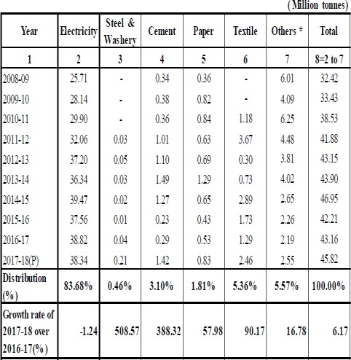
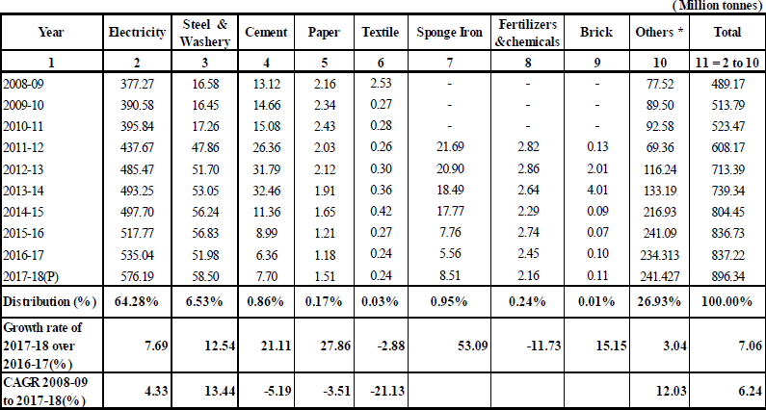
industries (58.50 MT), sponge iron industries (8.51 MT) and cement industries (7.70 MT)
(Table 1.6)
Table 1.4: Consumption of Energy Sources in India
Table 1.5 Industry wise Consumption of Lignite in India
Note: (P) - provisional, GWh = Giga Watt hour = 10⁶ x Kilo Watt hour , CAGR: compound annual growth rate; Sources:1. Office of Coal Controller, Ministry of Coal 2. Ministry of Petroleum & Natural Gas.3. Central Electricity Authority
Table1.6: Trends in Industry wise Consumption of Raw Coal in India
Consumption of Crude Oil and Natural Gas:
The estimated consumption of crude oil has a steady increased from 160.77 MMT during 2008-09 to 251.93 MMT during 2017-18 with CAGR of 4.59%. It increased from
245.36MMT in 2016-17 to 251.93 MMT in 2017-18 registering a growth of 2.7% (Table 1.4).

Slide 12
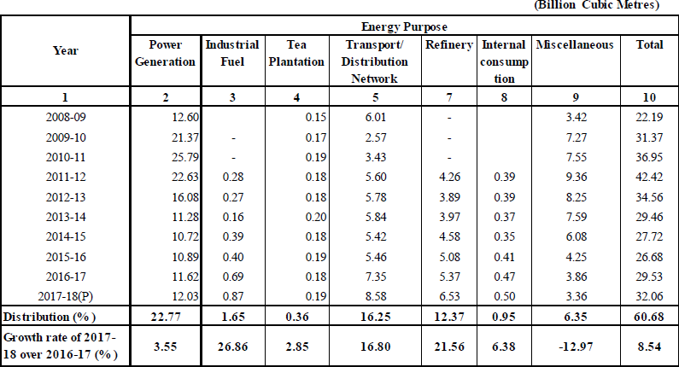
The maximum use of Natural Gas is in fertilizers industry (27.78%) followed by power
generation (22.77%) and 16.25% natural gas was used for domestic fuel for transport sector. (Table 1.7).
Table 1.7 INDUSTRYWISE OFF-TAKE OF NATURAL GAS IN INDIA
Consumption of Petroleum Products:
High speed diesel oil accounted for 39.3% of total consumption (Excluding refinery fuel and loses) of all types of petroleum products in 2017-18. This was followed by Petrol (12.7%), Pet Coke (12.4%) LPG (11.3%), Naphtha (6.1%) .
Sector-wise consumption of different petroleum products reveals that Reseller/Retail contributes 54% in the total consumption followed by Domestic sector with contribution 18 %.

Slide 13
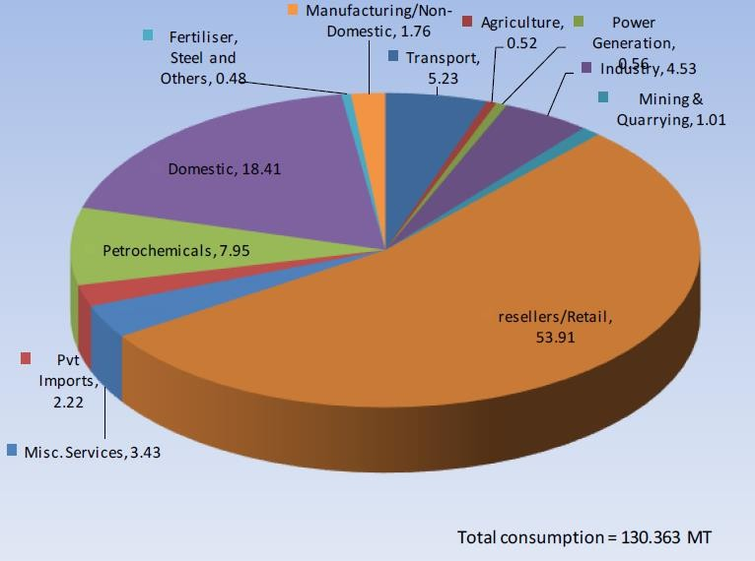
Fig 1.5: Sector-wise Consumption of Petroleum Products during 2017-18
Consumption of Electricity:
The estimated electricity consumption increased from 553995 GWh during 2008-09 to 11, 30,244GWh during 2017-18, showing a CAGR of 7.39%. The percentage increase in electricity consumption is 6.51% from 2016-17 (10, 61,183GWh) to 2017-18 (11, 30,244
GWh) (Table 1.7).
Of the total consumption of electricity in 2017-18, industry sector accounted for the largest share (41.48%), followed by domestic (24.20%), agriculture (18.08%) and commercial sectors (8.51%).
The electricity consumption in industry sector and domestic sector has increased at a much faster pace compared to other sectors during 2008-09 to 2017-18 with CAGRs of 8.39% and 7.58% respectively(Table 1.7)

Slide 14
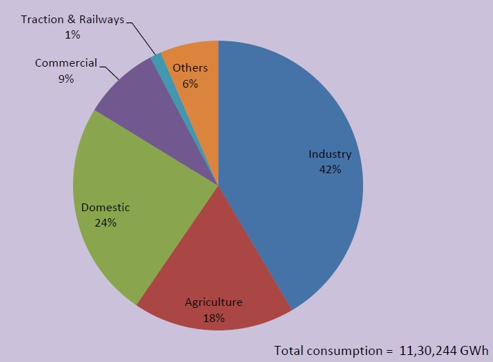
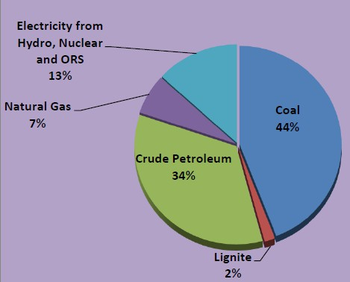
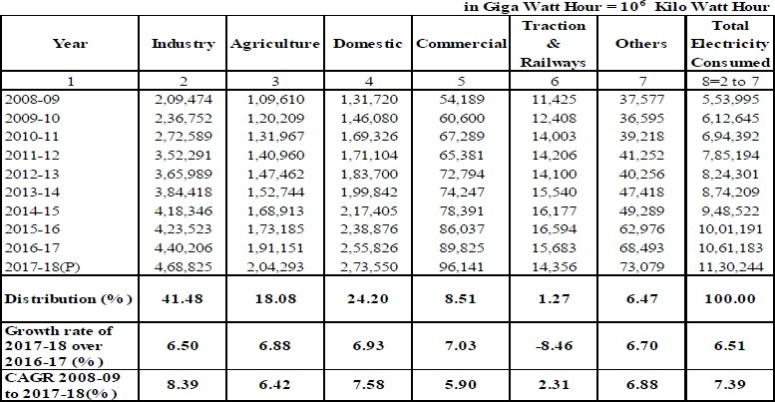
Fig 1.6: consumption of Electricity by sector
Fig 1.7: source wise consumption of Energy during 2017-18
in India during 2017-18
Table 1.7: Consumption of Electricity by Sectors in India

Slide 15
CHAPTER-2
SOLAR ENERGY
2.1 SOLAR ENERGY:
Solar is related with sun. Power or Energy obtained from sun is called solar energy. It is natural source of energy.
Types of Rays: -
Sunlight (rays/radiations) consists of three types of rays:
  Ultraviolet Rays: It has shortest wavelength and is invisible to naked human eye. Most of ultra violet rays emitted by the sun are absorbed by the upper layers of the atmosphere.
  Visible Rays: It is visible light and consists of seven colors.
iii.
Infrared Rays: It has shortest wavelength and is invisible to naked
human eyes. About 33% of energy received from sun in the form of infra-
red rays and produces heat on the earth surface.
2.2 Principle of Conversion of Solar radiation into Heat Energy:-
Solar radiation is converted into heat on the basis of Green House Effect.
Step1: Solar radiation reaches the earth atmosphere some of this is reflected back into space.
Step 2: The reset of sun’s energy is absorbed by the land and the oceans, heating the earth.
Step3: Heat (infrared radiation) radiates from Earth towards space.
Step4: Some of this heat is trapped by greenhouse gases in the atmosphere, keeping the Earth warm enough to sustain life.
Step5: Human activities such as burning fossile fuels (coal, oil and natural gas), agriculture and land clearing are increasing the amount of greenhouse gases (carbon dioxide, methane, nitrous oxide, ozone, cholorofluorocarbons etc) released into
atmosphere.
Step6: This is trapping extra heat, and causing the Earth’s temperature to rise.

Slide 16
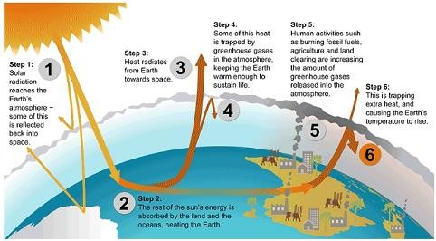
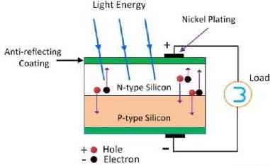
Figure : 2.1 Green house effect
2.3 PHOTO-VOLTAIC CELL:-
It is a semiconductor device which convert energy sunlight directly into Electrical energy is called photo voltaic cell. The voltage induces by the PV cell depends on the intensity of light incident on it. The name photovoltaic is because of their voltage producing capability.
CONSTRUCTION:
The semiconductor materials like arsenide, indium, cadmium, silicon, selenium and gallium re used for making the PV cells. Mostly silicon and selenium are used for making the cell.
As shown in fig below the upper surface of the cell is made of the thin layer of the p-type material so that the light can easily enter into the material. The metal rings are placed around p-type and n-type material which acts as their positive and negative output terminals respectively.
Fig 2.2: P-N junction solar cell

Slide 17
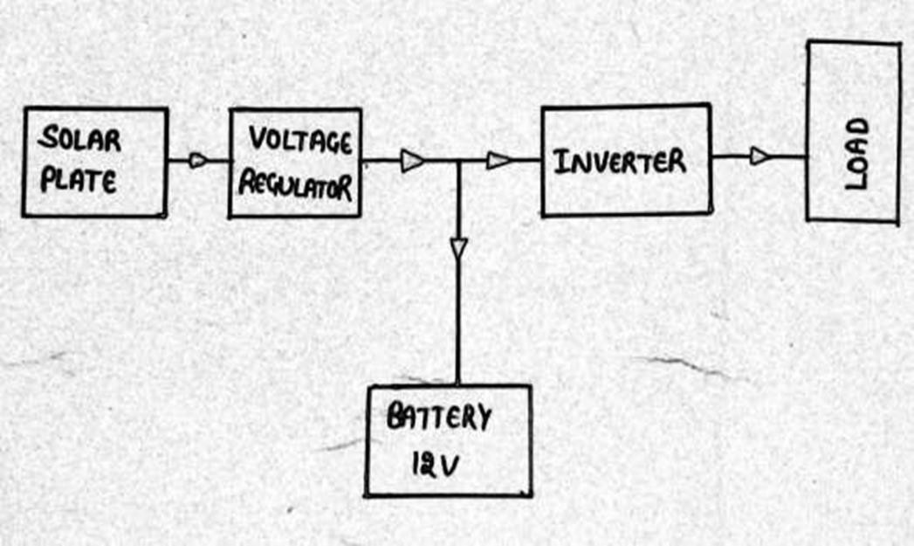
The output voltage and current obtained from the single unit of the cell is
very less. The magnitude of the output voltage is 0.6V and that of current is 0.8A.Different combinations of cell (series, parallel and series –parallel combination) are
used for increasing the output efficiency.
WORKING OF PHOTO- VOLTAIC CELL:-
When the semiconductor materials absorb lights, the electrons of the materials starts emitting. This happens because the light consists small energise particles
called photons. When the electrons absorb the photons, they become energized and start moving into the material. Because of the effect of an electric field, the particles move only in the one direction and develop current. The semiconductor materials have the metallic electrodes through which the current goes out of it.
As shown in fig 2.2, when light fall on the p-n junction the electrons starts moving from one region to another.
2.4 GENERATION OF ELECTRICITY FROM PHOTO-VOLTAIC CELL
As shown in figure 2.3 below that how the electricity is generated by photo voltaic cell. It consists of:-
Solar plate.
Voltage regulator
Inverter
Battery 12v
Load
Fig 2.3: Generation of electricity by PV cell

Slide 18
Solar plate: it is the combination (series, parallel and series – parallel
combination as per requirement) of several PV cell.
Voltage regulator: It maintains the solar voltage.
iii.
12V battery: it is used to store electrical energy obtained from solar cell.
iv. Inverter: It converts DC into AC
2.5 APPLICATION OF SOLAR ENERGY
Solar water heater: -
Solar water heating system (SWHS) is a device which supplies hot water at 60°C to 80°C using only solar thermal energy without any other fuel. It has three main components, namely,
  Solar Collector(flat plate collector )
  Insulated hot water storage tank and
iii.
Cold water tank with required insulated hot water pipelines and
accessories.
In the case of smaller systems (100 – 2000 litres per day), the hot water reaches the user end, by natural circulation for which the storage tank is located above the collectors. In higher capacity systems, a pump may be used for forced circulation of water.
Construction:
  Flat plate collector: The solar radiation is absorbed by Flat Plate Collectors which consist of an insulated outer metallic box covered on the top with glass sheet. Inside
there are blackened metallic absorber (selectively coated) sheets with built in channels or riser tubes to carry water. The absorber absorbs the solar radiation and transfers the heat to the flowing water.
  Hot Water Storage Tank: The tanks are generally made of stainless steel to avoid corrosion and are insulated to reduce heat losses. They are also fitted with electrical heater as a backup during monsoon days. The tanks may also be made of G.I.
iii.
Cold Water Tank & Pipelines: Cold water comes from the over head tank. Hot water
from the system is transferred to various utility points through insulated pipelines. A
heat exchanger may be provided when the water is hard.

Slide 19
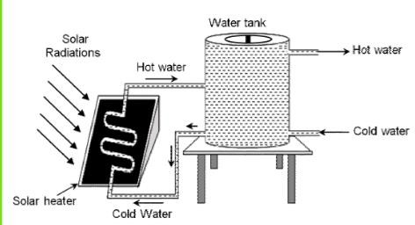
Fig 2.4 Solar water heater system
Working:
The cold water present in the water storage tank enters the copper pipe joined to
it at the bottom and pass slowly through the solar collector plate. The sun rays fall on the solar collector plate, it absorb the solar radiation and transfer the heat energy to the cold water flowing through it. The hot water comes out from the other end of the copper pipe and enters the upper part of the water storage tank as shown in fig 2.4. This hot water is replaced by the cold water present in the tank. In this way, all the water present in the storage tank gradually heated up. In the tank, hot water being lighter remains in the upper part. From the upper part of storage tank, the hot water is supplied to a tap for use.
  Advantages of solar water heater:-
    Longer life spent 12-15 years.
    Heat the water at 80°C
  Disadvantages of solar water heater:-
    Initial cost is high.
    Depend on whether condition.
    Occupies large space.
2. Solar furnace:-
A solar furnace is a device that creates heat (high temperature) by concentrating solar radiation through the use of reflectors.
This is achieved by using a curved mirror (or an array of mirrors) acting as a parabolic reflector to concentrate light (insolation) on to a focal point as shown in fig 2.5 below . The temperature at the focal point may reach upto 3,000 degree Celsius, and this heat can be
used to generate electricity, melt steel or make hydrogen fuel.

Slide 20
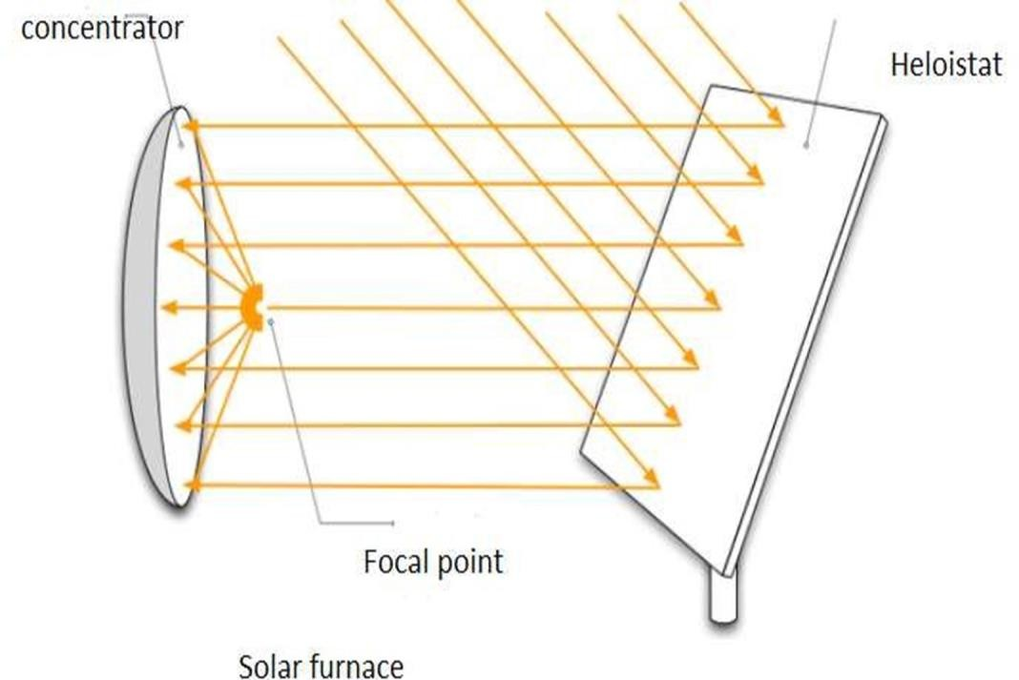
Figure 2.5: solar furnace
Advantages:
  Huge heat capabilities
  Lack of required fuel
  Easy to use
  No running cost
Disadvantages:
  High initial cost
  Unreliable sunshine.
Solar cooker:-
The most commonly used form of solar cooker is the box –type solar cooker. A box type solar cooker consists of the following components.
  Black Box: The box is an insulated metal or wooden box which is painted black from the inside to absorb more heat.
  Glass cover: A cover made two sheets of toughened glass held together in an aluminum frame is used as a cover for box.
iii.
Plane Mirror reflector: The plane mirror reflector is fixed to the box with the
help of hinges. The mirror reflector can be positioned at any desired angle to the
box. The mirror is positioned so as to allow the reflected sunlight to fall on the glass cover of the box.

Slide 21
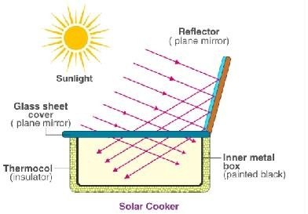
iv. Cooking containers: A set of aluminum containers blackened from the outside are
kept in Box
Figure 2.6 solar cooker
Working:
The solar cooker placed in sunlight and a plane mirror reflector is adjusted in such a way, so that the strong beam of sunlight enters the solar box through the
glass sheet. The blackened metal surfaces in the wooden box absorb infra-red radiations from the beam of sunlight and heat produced raises the temperature of a blackened metal surface to about 100 degree Celsius.
The food absorbs heat from the black surface and gets cooked. The thick glass sheet does not allow the heat to escape and thus, helps in raising the temperature in the box to a sufficiently high degree to cook the food.
Advantages:
  It has no fuel requirement. This saves cost as well as the environment
  Food vitamins do not get destroyed when heated
  No maintenance cost.
Disadvantages:
  It is less useful in cloudy weather.
  It takes longer time to cook food than a conventional stove or oven
  It might get difficult to cook thick foods.
4. Solar lighting:-

Slide 22
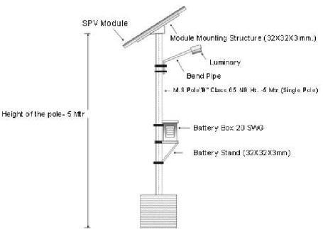
Solar lights work with the help of photovoltaic effect. Solar cells are an important
part of solar light because, it can only convert sunlight into direct current (DC) and then converting it to usable alternating current (AC) with the help of inverter which is used by
most of home appliances.
Generation of electricity from solar cell is already discussed in section 2.4
The solar street lights are widely used in rural areas and where there is problem of electricity. The solar street lights also work on the principle of the photovoltaic cell. These days it is common to see solar street lamps along these ides of roads as shown in fig 2.7. It absorbs the solar energy during daytime and converts into electrical energy, which is stored in the battery. At the nighttime the map starts automatically and it consumed the electricity already stored in the battery. During the day time the battery gets recharged and the process keeps on repeating every day.
Fig 2.7: solar street lighting system
Solar pumping:-
Solar pumping system operates on power generated using solar PV system. The photovoltaic array converts the solar energy into electricity, which is used for running the motor pump set. The pumping system draw water from the open well, bore well, stream,
pond, canal etc. The system requires a shadow free area for installation of the solar panel.
  CONSTRUCTION OF SOLAR PUMPING:-
It consists of
    Solar panel: It store the energy from solar

Slide 23
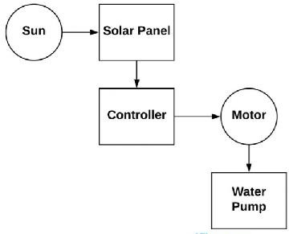
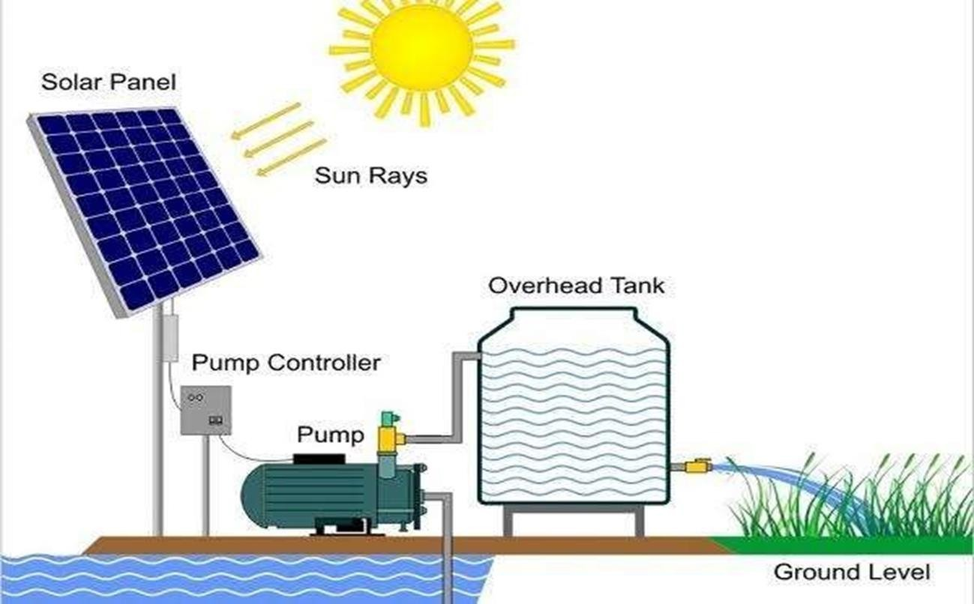
ii. Water pump: This pump is basically electric pump uses the electricity
which is received from the solar panels to work
iii.
Electric motor: It manage the alternating or direct current
iv. Controller: It is used to adjust the output power as well as speed.
Fig 2.8: Block diagram of solar pumping system
Fig 2.9 solar pumping system working
Working:
When the solar energy drops sun rays on the PV panels then the solar panel converts the solar energy into electrical energy. Then electrical energy supplies to the electrical motor to operate the pumping system using cables. By the revolution of the

Slide 24
shaft which is fixed to the pump, start to pick up the water from the open well, bore well,
stream, pond, canal etc and supplies to the fields.
Advantages:
  No fuel cost-a sit uses available free sunlight
  No electricity required
iii.
Longer operating life
Highly reliable and durable
Easy to operate and maintain
Eco-friendly
Disadvantages:
  It is expensive
  The output of the panel will depend on the weather
  It requires a water storage tank as well as battery
Applications:
  Water supply for animals
  Water supply for irrigation, gardens etc
  Water supply for cooking and drinking water supply.

Slide 25
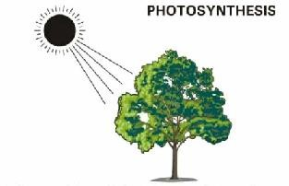
CHAPTER-3 BIO ENERGY
3.1 BIO-MASS
It is an organic matter which is produce by microrganism, trees and plants both terrestrial (plants grown on land) & aquatic (plant grown in water) residue etc.
The energy obtained from biomass is called Bio Energy. It is produced from
photo-synthesis as shown in below. In the process of photosynthesis, plants convert radiant energy from the sun into chemical energy in the form of glucose or sugar.
Figure 3.1: photosynthesis
Solar energy+ carbon dioxide +water —>glucose +oxygen Light + 6CO2 + 6H2O —> C6H12O6 + 6O2
We can obtain the Bio energy from biomass in three ways
Firstly burn the biomass directly and convert it into heat energy.
Secondly, bio mass is converted into methanol and ethanol used as liquid fuels.
Thirdly biomass is aerobically processed to obtain a gaseous fuel called bio gas.
3.2 Bio-Gas: -
It is the mixture of gases produced by the breakdown of organic matter in the
absence of oxygen (aerobically), primarily it consists of methane (CH4) and carbon dioxide (CO2).

Slide 26
Biogas can be produced from agriculture waste, manure, municipal waste, plant
material, sewage, green waste of food waste. Biogas is a renewable energy source. In India, it is also known as ‘Gobar Gas’.
Application of Bio gas
  It is used in house for using food purpose
  Lighting/ Electricity
  Running small engine or transport fuels
3.2 METHODS FOR OBTAINING ENERGY FROM BIO-MASS
Bio mass can be used directly as fuel or by converting into liquid or gaseous fuel.
According to conversion of biomass, it can be grouped as shown in fig 3.2
Thermal conversion method:
  Direct Combustion
Thermo chemical conversion method:
  Pyrolysis
  gasification
Biochemical conversion method:
  anaerobic digestion
  fermentation
Thermal conversation method:
  Combustion:
It is the process of burning of biomass directly to obtain heat. The energy obtained is used for cooking, heating buildings and generating steam.
In biomass power plants biomass is burned in a boiler to produce high pressure steam, which in turn drives a turbine to generate electricity.

Slide 27
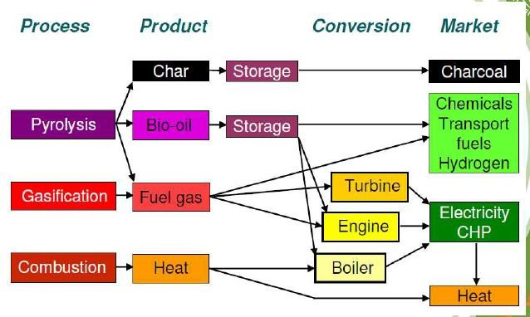
Energy efficiency is in such plants could be anywhere between 7 to 27%.
However, if biomass is mixed with any fossile fuel, especially coal, efficiency goes up to 30- 40%.Burning biomass along with a conventional fossil fuel, especially coal, is called co-firing.
2. THERMAL CHEMICAL CONVERSION METHOD:
Thermo-chemical processes do not produce useful energy directly, but under controlled temperature and oxygen conditions. These processes are more convenient and cost effective than the thermal processes. They convert biomass feedstock into energy carriers, such as producer gas, oils or methanol. They are used in internal combustion engines and gas turbines.
Figure 3.2: Thermo-chemical conversion method
A. Pyrolysis:
Pyrolysis generates biomass energy by heating (not burning) biomass under controlled conditions of high temperature, low or no oxygen, and certain pressure.
End product: The most common end product of pyrolysis is charcoal, which is extensively used in metallurgical processes. Other end products of pyrolysis are liquid or gas. Examples of liquid products are water, tar and oil. Gaseous products include hydrogen, methane and carbon monoxide.
Dry Biomass char + (CO, CO2, H2, H2O (g), CH4) + tars + Ash

Slide 28
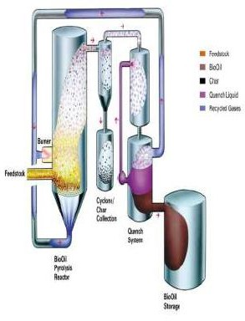
Figure 3.3: Pyrolysis conversion method
Gasification:
Gasification is a process that converts the carbonaceous material into CO (Carbon
Monoxide), H2 (Hydrogen) and CO2 (carbon dioxide). It is obtained at high temperature with a controlled supply of oxygen or steam. This resulting gas mixture is called synthesis gas or producer gas and is a fuel itself. The synthesis gas may be burned directly in gas engines or used to produce methanol and hydrogen.
  GASIFIER :
It is an equipment which convert biomass such as wood waste, agriculture waste, human waste, into biogas with high efficiency .This performs the function of gasification process.
    Steps for gasification : As shown in fig 3.4
DEHYDRATION PROCESS: - Carbonaceous material is derived under 100°C this process is called Dehydration process.
PYROLYSIS:-Carbonaceous material goes for pyrolysis process (at 300°C) char is obtained.
iii.
After combustion of char in the presence of oxygen, it forms carbon dioxide (CO2)
gas.

Slide 29
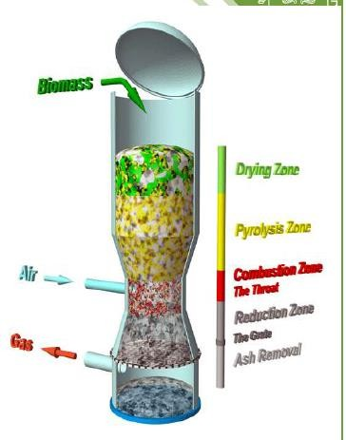
When gasification process of char takes place in the presence of carbon and steam
to produce carbon monoxide (CO) and Hydrogen (H2).
Thereafter Biomass is obtained .It contains H2, CO,CO2
Figure 3.4: Gasification conversion method
ADVANTAGES OF GASIFIER:-
  Easy maintenance
  Easy to obtain
  Easy to construction
  Better reliable
TYPES OF GASIFIER
  Up drought gasifier
  Down drought gasifier
  Fluidised bed gasifier
UP DROUGHT GASIFIER :
In this type of gasifier air enters from below the combustion chamber and synthetic gas leaves from the top of the gasifier as shown in fig below 3.5. In this number of ash content left.

Slide 30
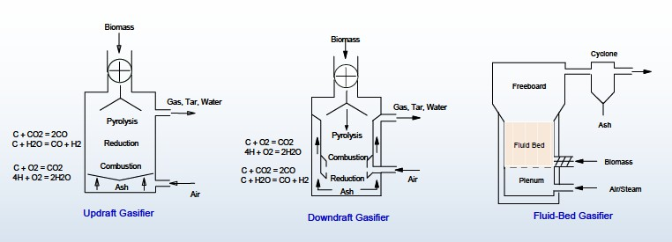
ii. DOWN DROUGHT GASIFIER :
In this type of gasifier air enter into the combustion chamber from the top and gas leaves at the bottom as shown in figure below 3.5.
iii.
FLUIDISED BED GASIFIER:
In this type of biomass is fed into a bed of hot inert particles such
as sand which kept in fluidised state with air bellowing vertical from bottom as shown in figure below 3.5. Operating temperature is kept the range of 700°C to 1000°C.
Figure 3.5: updraft, downdraft and fluid bed gasifier
BIO- CHEMICAL CONVERSION METHOD
Biochemical conversion of biomass involves use of bacteria, microorganisms and enzymes to breakdown biomass into gaseous or liquid fuels, such as biogas or bioethanol.
The most popular biochemical technologies are
  Anaerobic digestion
  Fermentation
i. Anaerobic Digestion
Anaerobic digestion is the natural biological process which stabilizes organic waste in the absence of air and transforms it into biofertilizer and biogas. It is
a reliable technology for the treatment of wet, organic waste.

Slide 31
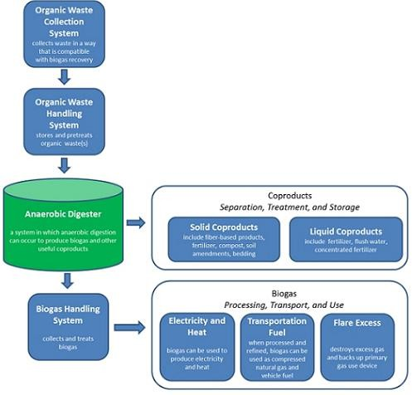
Organic waste from various sources is biochemically degraded in highly
controlled, oxygen-free conditions circumstances resulting in the production of biogas which can be used to produce both electricity and heat.
Anaerobic digestion plants are simple in construction .For producing the biogas; wet sewage sludge, manure (human and animals), animal dung, green plants and crop residues are kept in the hole for about 10 days .It requires at least 80% moisture. After few days biogas is produced due to bacteria decomposition. This
biogas contains CO2, methane and H2S.This gas can be used directly or by converting it into synthetic natural gas by removing CO2.
The main drawback of this process is that a large quantity of waste left but now days this waste can be used as animal feeding and bio fertilizer after removing its
toxicity.
Figure 3.6: Anaerobic Digestion conversion method

Slide 32
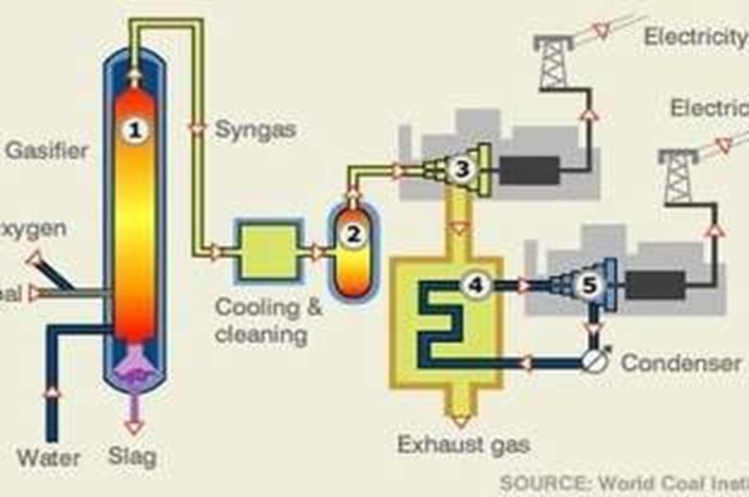
ii. Fermentation:
It is a process of decomposition of complex molecules of organic compound under the influence of micro-organism (ferment) such as yeast, bacteria, enzymes etc.
The example of fermentation process is the conversion of grains and sugar crops into ethanol and CO2 in presence of yeast. The ethanol is distilled and dehydrated to obtain a higher concentration of alcohol to achieve the required purity for the use as automotive fuel. The solid residue from the fermentation process can be used as cattle-feed and in the case of sugar cane; the bagasse can be used as a fuel for boilers or for subsequent gasification.
3.3 GENERATION OF POWER BY USING GASIFIER
The block diagram of power generation by using gasifier as shown. In figure below3.7.
Figure 3.7: generation of power using gasifier
It consists of following:-
Gasifier : it is already explained in 3.2
Cylinder: - synthetic gas is obtained from gasifier and it is cleaning before feeding to cylinder. After feeding the gas in cylinder, it can be use that any place, even in a house for electricity by using mini biogas generators.

Slide 33
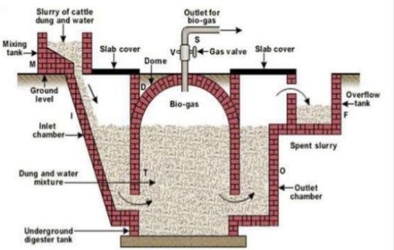
3. Biogas Generator: - A generator that operates on bio mass instead liquid fuels is called
biogas generator.
3.4 BIOGAS PLANT:
It works on the anaerobic digestion or fermentation process. Biogas is obtained by manure, sewage, municipal waste, plants, and agriculture waste and cow dung.
The fixed dome biogas plant is shown below in fig 3.8 .It consist of underground brick masonry compartment (fermentation chamber) with a dome on the top for gas storage.
Fermentation chamber and gas holder are combined as one unit.
Figure 3.8: fixed dome Biogas plant
In this process biomass mixed with water is filled in the underground digester tank
through inlet chamber. In case of overflow, biomass goes into overflow tank through outlet chamber.
After few days due to bacteria reaction on biomass, biogas is produced which is collected from outlet pipe. It can be used directly or can be stored in the tanks.
Advantages :
  Cost of plant is less compare to floating drum type plant
  Loss of heat is negligible since these are constructed underground

Slide 34
iii.
No corrosion problems as in fixed dome type.
iv. It is maintenance free.
Disadvantages:
  Need skilled labour to operate.
  Gas production per m³ of digester volume is less.
  Gas is produced at variable pressure.

Slide 35
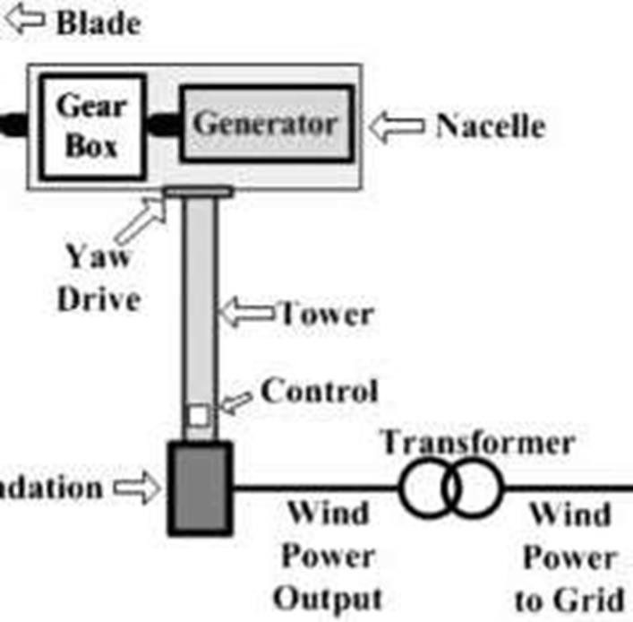
CHAPTER-4
WIND ENERGY
  Wind:-
Air in motion is called wind and energy obtained from wind is called wind
energy.
  wind energy conversion
Wind energy can be converted into electrical energy in wind plants. It generally referred as WECS stands for wind energy conversion system.
The main components of a wind power plant:
    Wind turbine
    Yaw
    Coupler
    Hydraulic transmission
    Electrical generator
Fig 4.1 Wind Energy Conversion system
Wind Turbine: This component convert wind kinetic energy into mechanical energy. Blades of the turbine are mounted on the shaft.
Yaw: This component is used to change the direction of rotation using gears.
iii.
Coupler: This component is used to couple turbine with generator.
iv. Hydraulic Transmission: This component is used to transfer mechanical energy
from top to bottom components.

Slide 36
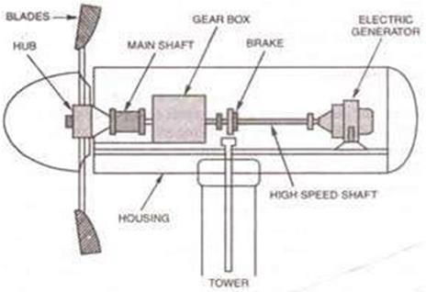
v. Electric Generator: This component converts mechanical Energy into Electrical
Energy.
4.3 Wind Mills
It is a wind turbine (Blades) which convert kinetic energy of the wind into
rotary mechanical energy.
It works on the principle of momentum. Momentum= mass * velocity
Figure 4.2 wind turbine
Lift Force:
When flowing air with momentum strike the downward side of the blade with low pressure it exert the force on the blade of rotor and turn the rotor. This exerted force is called as Lift Force.
Lift force always act perpendicular to the direction of air flow as shown in fig 4.3.
Drag Force:
An axial force act in the direction of wind flow is known as Drag force. For efficient operation lift force should be more than drag force.

Slide 37
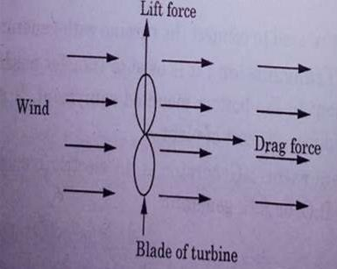
Figure 4.3: Lift and Drag Force
4.4 Types of Wind Mills:
Wind mill or Wind turbine can be classified according to the axis of rotation of
turbine.
Horizontal Axis Wind Turbine
Vertical Axis Wind Turbine
Horizontal axis wind turbine :
A turbine that rotates parallel to the direction of wind is called Horizontal axis wind turbine.
  Types of Horizontal Axis Wind Turbine (HAWT) :
    Single Blade Horizontal Axis Wind Turbine
    Double Horizontal Axis Wind Turbine
    Multiple Horizontal Axis Wind Turbine
Single Blade Horizontal Axis Wind Turbine:
It is also known as Mono Blade Horizontal Axis Wind Turbine. It consists of a long blade of around 10 m mounted on the hub. Single Blade is balanced by
using weigh arm as shown in diagram 4.4 (a).
Double Horizontal Axis Wind Turbine:

Slide 38
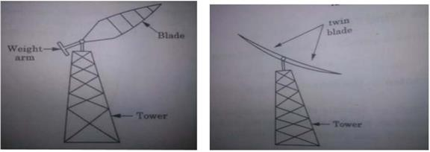
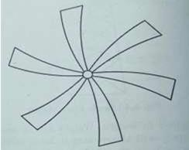
This type of turbine has two blades mounted on the hum as shown in fig
4.4 (b).
c) Multiple Horizontal Axis Wind Turbine:
In this type of turbine many blades are mounted on the hub as shown in fig
4.4 (c).
Figure 4.4 (a) Single blade HAWT ;(b) Double blade HAWT;(c) Multiple blade HAWT
Advantages of HAWT :
  It has high efficiency.
  It faces the maximum wind so that turbine collects maximum amount wind energy.
  In HAWT less vibration occurs.
Vertical Axis Wind Turbine (VAWT) :
A turbine whose axis of rotation of blade is perpendicular to the direction of wind is called vertical axis wind turbine.
  Types of Vertical Axis Wind Turbine (VAWT) :
It consist of two types
    Savonius turbine
    Darrieus type turbine
a) Savonius type VAWT:

Slide 39
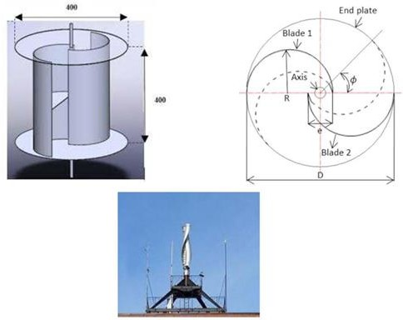
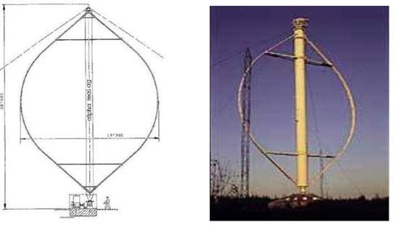
The Savonius turbine is S-shaped if viewed from above. It consists of two half cylinder
facing in opposite directions as shown in fig 4.5.
Fig 4.5 Savonius Type VAWT
b) Darrieus Wind Turbine:
The Darrieus turbine is the most famous vertical axis wind turbine. It is
characterized by its C- shaped rotor blades which give it its eggbeater appearance. It is normally built with two or three blades.
Figure 4.6 : Darrieus Type VAWT

Slide 40
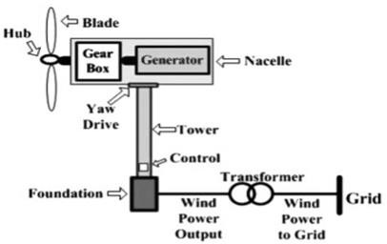
Advantages of VAWT :
  VAWT system has lower noise during operation.
  It may be designed without any starting device.
  Generator is kept on earth so it is easy to maintain.
  Do need large space
Disadvantages of VAWT:
  VAWTs may need guy wires to hold it up.
  They have relative high vibration because the air flow near the ground creates turbulent flow.
  compared to horizontal axis wind turbines VAWT are very less efficient
4.5 Electricity Generation from Wind Energy :
Wind turbines convert the kinetic energy in the wind into mechanical power. This mechanical power is converted into electric power using a generator as shown in fig 4.7 below and in block diagram shown in fig 4.8.
Figure 4.7: Schematic diagram of Electricity generation from wind energy
Wind Turbine
Gearing &coupling
Generator
To load
Speed
Controller
Figure 4.8: Block diagram of Electricity generation from wind energy

Slide 41
4.6 Classification of Wind Power Plants:
Based on the axis of rotation:
  Horizontal Axis wind turbine
  Vertical Axis wind turbine
Size or Capacity of Plant:
Small wind power plant: These are having a generation capacity of 10 to 50 Kw having rotor diameter of wind turbine 1 to 15m.
Medium wind power plant: These are having a generation capacity of 50 to 500 Kw
having rotor diameter of wind turbine 15 to 50m.
Large wind power plant : These are having a generation capacity of 50MW to 150 MW
According to Power Output:
  D.C Wind power plant
  A.C wind power plant
According to speed:
  Constant speed wind power plant
  Variable speed wind power plant
According to utilization:
  Directly connected to load
  Battery storage
  Grid connected system
4.7 Selection of site for a wind power plant:
Plant must be away from city and forest area.
Plants are always installed in flat area because wind velocity is high in this area.

Slide 42
Cost of land for the site should be minimum as possible
High annual average wind speed
Availability of anemometry data
Altitude of the proposed site
Nearness of site to local centre/users
4.8 Energy Storage:
Wind turbine operation is not reliable at very high cost and very low speed. The power has low demand, excess wind energy would be stored for use at other time
Wind energy can be stored by:-
Battery:
There are three important types of large-scale BES. These are: lead-acid (LA); nickel-cadmium (NiCd); sodium-sulphur (NaS). These operate in the same way as conventional batteries, except on a large scale, i.e. two electrodes
are immersed in an electrolyte, which allows a chemical reaction to take place so current can be produced when required.
Flywheel energy storage:
A flywheel energy storage (FES) device is made up of a central shaft that holds a rotor and a flywheel. This central shaft rotates on two magnetic bearings to reduce friction contained within a vacuum to reduce aerodynamic drag losses. Flywheels store energy by accelerating the rotor/flywheel to a very high speed and
maintaining the energy in the system as kinetic energy. Flywheels release energy by reversing the charging process so that the motor is then used as a generator. As the flywheel discharges, the rotor/flywheel slows down until eventually coming to a complete stop.

Slide 43
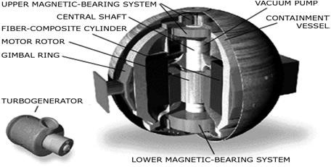
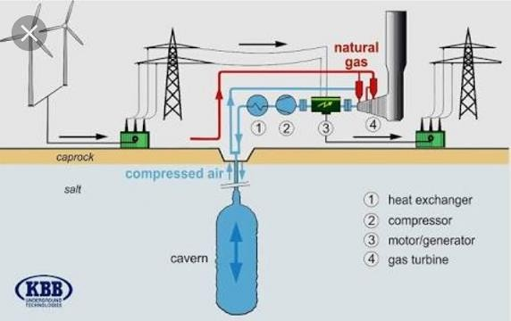
Figure 4.9 : Flywheel energy storage device
c) Compressed air storage :
Compressed air energy storage (CAES) systems compress air using electricity during off-peak times, and then store the air in underground caverns.
During peak demand, the compressed air from the storage is drawn and fired with natural gas in a combustion turbine to generate electricity. This method uses only a
one third of the natural gas used in conventional methods. Because CAES plants require some sort of underground reservoir, they are limited by their locations.
Figure 4.10: compressed air storage system
d) Hydrogen Fuel cell:
Hydrogen fuel cells can also be used to store excess energy. A hydrogen generator is used to electrolyse water using power generated from the wind turbine,

Slide 44
storing the resulting hydrogen and converting it back to electricity using a fuel cell
power system when needed.

Slide 45
CHAPTER-5
GEO-THERMAL AND TIDAL ENERGY
5.1 Geo-Thermal Energy:-
The word geothermal comes from the Greek words geo (earth) and thermal
(heat). So, geothermal energy is heat from within the earth.
Energy present in the form of heat in the earth crust is called geo thermal energy.
It is renewable source of energy because inner part of earth will continue to heat up.
We can use the steam and hot water produced inside the earth to heat buildings or generates electricity.
Geothermal energy is generated in the earth's core, about 4,000 miles below the
surface. Temperatures hotter than the sun's surface are continuously produced inside the earth by the slow decay of radioactive particles, a process that happens in all rocks. The earth has a number of different layers:
The core itself has two layers: a solid iron core and an outer core made of very hot melted rock, called magma.
The mantle which surrounds the core and is about 1,800 miles thick. It is made up of magma and rock.
The crust is the outermost layer of the earth, the land that forms the continents and ocean
floors. It can be three to five miles thick under the oceans and 15 to 35 miles thick on the continents.
The earth's crust is broken into pieces called plates. Magma comes close to the earth's surface near the edges of these plates. This is where volcanoes occur. The lava that erupts from
volcanoes is partly magma. Deep underground, the rocks and water absorb the heat from this magma. The temperature of the rocks and water get hotter and hotter as you go deeper underground.

Slide 46
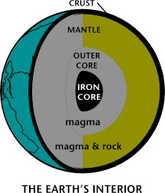
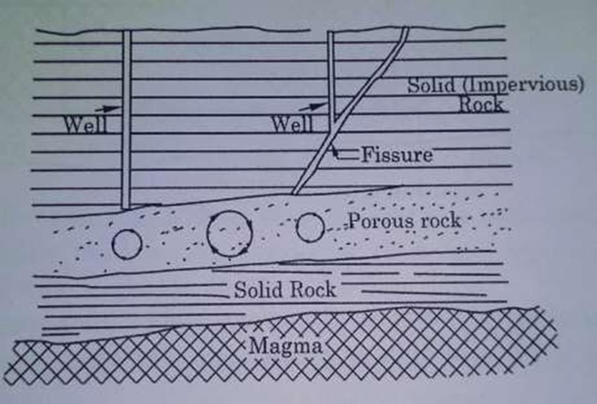
Figure 5.1 Earth interior
5.2 Various Geo-Thermal Energy Sources:
Hydro thermal convective system
Geo pressure resources
Hot dry rocks
Magma resources
a) Hydro Thermal Convective System :
The word Hydro is related to water and thermal is related to heat. In this system water is heated by its Contact with hot rocks. Thickness of earth crust above magma is 30km.Due to internal earth pressure magma is raised upto an impervious rock above this layer where water has penetrated from a distance. So, water is heated up due to convection. Hence , we collect hot water from earth surface.

Slide 47
Figure 5.2: Hydro Thermal Convective System
Hydro thermal source are further sub divided into:
Vapour dominated system
Liquid dominated system
Vapour dominated system(Dry steam):
When the geothermal resource produce a saturated or superheated vapor, the steam is collected from the production wells and sent to a conventional steam
turbine as shown in fig 5.3. Before the steam enters the turbine, appropriate measures are taken to remove any solid from the steam flow, as well as corrosive substance
contained in the process (typically removed with water washing). Steam after passing through turbine , condenses in the condenser and is re-injected back to the earth.
Liquid dominated system :
Liquid dominated power plants are also referred to as flash steam power
plants; as they conduct flash steam by pressurizing hot water from the surface of the earth. Such power plants operate using water reservoirs with temperature greater than 360 degree Fahrenheit. These reservoirs are found in specific locations like mantle hot spots, near volcanoes.

Slide 48
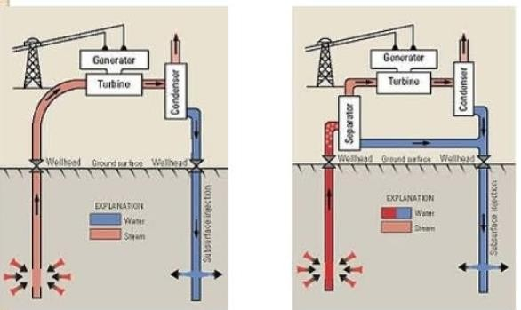
Figure 5.3: Vapour dominated power plant; fig 5.4 flash steam power plant
Geo pressure system
Petro thermals resources
Magma resources
5.3 Prime Mover for Geo-Thermal Energy Conversions:-
Prime mover is also called turbine. A machine that converts the kinetic energy of steam into mechanical energy is called turbine or prime mover
Prime mover can be classified:
Impulse turbine
Reaction turbine
a) Impulse turbine: -
It is a turbine the total pressure of steam converted into kinetic energy by nozzle.
The kinetic energy derives a wheel turbine

Slide 49
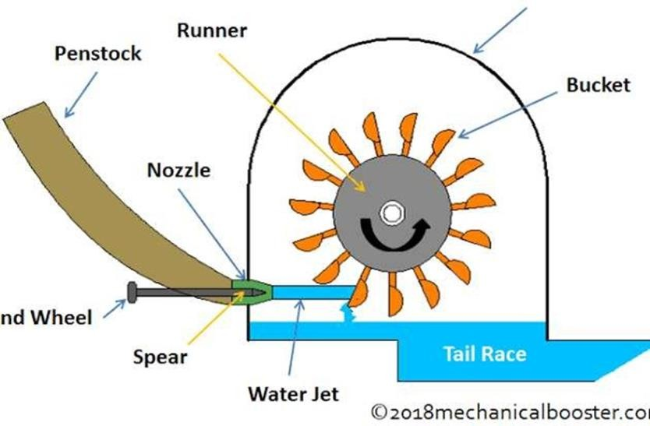
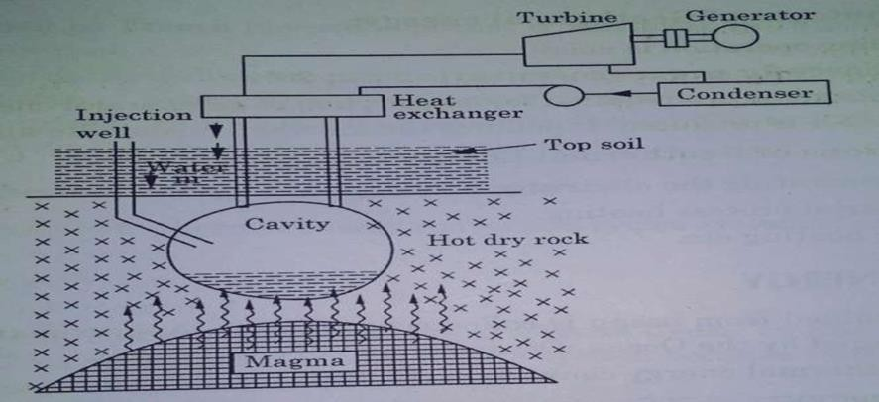
Figure 5.5 Impulse Turbine
b) Reaction Turbine:
In reaction turbine steam enter with partly pressure and velocity into turbine.
They are several types: - Francis turbine, Kaplan turbine
5.4 Power Generation by Geo Thermal Resources:-
Figure 5.6 Power Generations by Geo Thermal Resources
5.5 Advantage and disadvantages of Geo-Thermal energy:-
Advantages:-
  Small Maintenance Cost
  Brilliant Efficiency
  Highly Sustainable
  Increase in Employment
  Reduction in Noise Pollution
  It is More Reliable

Slide 50
vii.
It Saves the Non-renewable Fossil Fuel Sources
Disadvantage
Environmental Issues. There is an abundance of greenhouse gases below the surface of the earth, some of which mitigates towards the surface and into the atmosphere.
Surface Instability (Earthquakes)
iii.
Expensive
Location Specific
Sustainability Issues
5.6 Application of GEO-THERMAL energy:
We can use the steam and hot water produced inside the earth to heat buildings or generates electricity. Geothermal energy is a renewable energy source because the water
is replenished by rainfall and the heat is continuously produced inside the earth.
5.7 Ocean Energy:-
Energy can be obtained from ocean is called ocean Energy. Approximately 70% area the earth is covered by the ocean. Ocean sources are:
Ocean thermal energy conversion
Tidal energy
Wave energy
Ocean thermal energy conversion(OTES) :
Solar energy is energy from the sun that is absorbed by the water of ocean according to Lambert law of absorption .It state that each layer of equal thickness of water absorbs the same fractions of light that passes through it.
  Ocean Thermal Energy Conversion Cycle
    open cycle system
    close cycle system

Slide 51
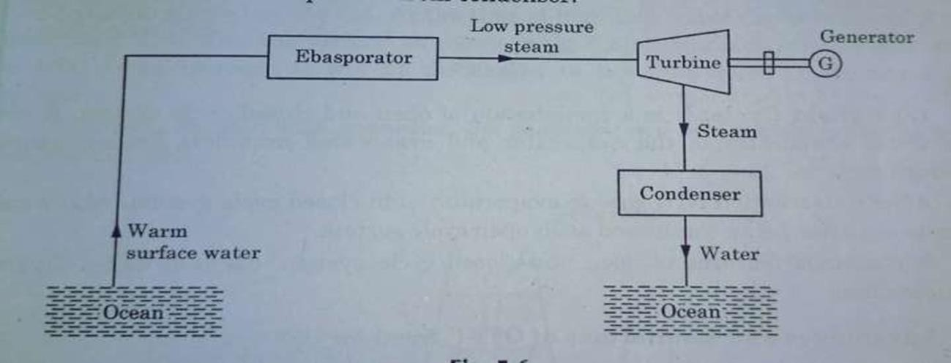

iii.
hybrid cycle system
i. Open cycle system
Figure 5.7 OTES open cycle system
ii. Closed cycle system
Figure 5.8 OTES closed cycle system
iii.
Hybrid cycle
It is a combination of closed cycle and open cycle system. Warm sea
water evaporated in the evaporator ammonia pass through turbine.
Advantages and limitations of OTES system:
  Advantages
    It is renewable sources of energy
    No fuel is used
    OTES systems more economical

Slide 52


Limitations
  Steam has low pressure so large size of turbine required
  Less efficiently
  Overall cost is high
Application of OTES
  Chemical treatment plant
  For electricity generation
  Hydrogen production by means of electrolysis
ii. Tidal Energy
Tides in the sea are the result of gravitational effect of heavenly bodies like sun and moon on the earth. Due to fluidity of water mass the effect of this force becomes
apperant in the motion of water which slow a periodic change in level.
Working of Tidal power plant:
Figure 5.9Tidal Power plant

Slide 53
Advantage of Tidal energy
  Free from pollution
  Free mood of nature
  Free from disturbing the eco system
Limitations of Tidal energy:
  High initial cost
  Sea water is corrosive
  Output is not constant it varies with tides.
  Conversion device is complicated
Sea Waves :
iii.
Energy is obtained from waves of ocean in the form of kinetic energy depend
upon the shape of wave.

Slide 54


CHAPTER-6
Magneto Hydro Dynamic (MHD) Power Generation
  Magneto Hydro Dynamic:
Magneto hydro dynamic is a technique in which heat is directly converted into electricity. It is based on Faraday's law of electromagnetic induction. But it produces only DC power.
    Working of MHD generator :
It works on Faraday's law of electromagnetic induction when a magnetic field changes across a conductor an emf is induced in it which produce a electric current this is also
the principle of generator.
Figure 6.1: MHD Generator Figure 6.2 Electrical Equivalent circuit of MHD
Advantages and disadvantages of MHD
  Advantages:-
    Efficiency of MHD generator is around 60%
    It generate large amount of power
    It is renewable source of energy
  Disadvantages:-
    There is problem of availability of conducting Gas or any other fluid.
    Difficult to fabricate MHD generator
6.2 Types of MHD generation system
Open cycle MHD power generation system
Closed cycle MHD power generation system
a) Open cycle MHD power generation system :

Slide 55


Combustion chamber burns the fuel in presence of O2 at 1000°C. This hot and
pressurized fluid ionize the gas. Then gas is passed through a nozzle to increase its velocity.
Figure 6.3: Open cycle MHD power generation system
b) Closed cycle power generation system:
In closed cycle MHD system conducting fluid is used again and again to form a closed cycle instead of exhausting the fluid in atmosphere.
Combustor and heat is used to heat the argon or helium gas at 1900°C.This gas is slowed down by diffuser and cool into pre cooler.
Figure 6.3: closed cycle MHD power generation system

Slide 56
CHAPTER-7
FUEL CELLS
  Fuel Cell:
A fuel cell is like a battery in that it generates electricity from an electrochemical reaction. Both batteries and fuel cells convert chemical energy into electrical energy and also, as a by-product of this process, into heat.
Fuel cells can produce electricity continuously for as long as fuel and oxygen are
supplied.
  Design and operation Principal of fuel cell:
For any type of fuel cell, there are mainly following segments
    Two electrode(anode, cathode)
    Electrolyte that separates the two electrodes is an ion conducting material which facilities the free passage of ions.
The electrolyte used depends upon the types of fuel cell .Whatever the type of fuel cell their basic operation is always same.
At anode (an oxidation reaction):
At anode-catalyst (mainly platinum powder) oxidizes the hydrogen fuel and turning the fuel into positively charged ion and negatively charged electron.
2H2 4H⁺+4e⁻
Out of these, the ions make way through the electrolyte to the cathode.
At cathode (a reduction reaction):
As soon as they reach the cathode, they combine with the oxidant (oxygen) and then react with the oxidant to produce water.
O2+4H⁺+4e⁻ 2H2O
Overall reaction:
2H2+O2 2H2O
The electrons pass through a wire producing the electricity. Nickel is mostly used as the cathode catalyst. Thus the electricity is formed at the load and water is obtained as the by-product.

Slide 57


Figure 7.1: Generic Hydrogen Fuel Cell Operation
Though a fuel cells generate only small DC voltages (0.7 volts) at full load , which are then combined in series to achieve substantial voltage and power capacities.
Fuel cells differ from batteries in the nature of their anode and cathode. In a battery, the anode and cathode are metals; zinc or lithium is typically used for the anode and metallic oxides for the cathode. In a fuel cell, the anode and cathode are composed of gases often in contact with
a platinum cata-lyst to promote the power generating reaction. Hydrogen or a hydrogen-rich gas mixture is typically used as the anode and oxygen or air as the cathode.
7.3 Types of Fuel cells:
Fuel cell types are generally classified according to the nature of the electrolyte they use.
Each type requires particular materials and fuels and is suitable for different applications.
Hydrogen oxygen fuel cell
Alkaline fuel cell- alkaline solution electrolyte such as KOH.
Phosphoric acid fuel cell (PAFC): electrolyte is phosphoric acid.
Solid Proton Exchange Membrane Fuel cell: Electrolyte is polymer electrolyte membrane fuel cells and their electrolyte consists of the proton exchange membrane.
Molten carbonate Fuel cells: electrolyte as molten carbonate
Solid oxide fuel cell(SOFC): electrolyte is ceramic ion conducting electrolyte in solid oxide form
vii.
Direct methanol fuel cell

Slide 58
All fuel cells are based around a central design using two electrodes separated by a
solid or liquid electrolyte that carries electrically charged particles between them. A catalyst is often used to speed up the reactions at the electrodes.
7.4 Conversion efficiency of Fuel cell:
Fuel cell efficiency is described as the ratio of the electrical energy produced to the heat that is produced by burning the fuel.
From the basic definition of efficiency: η = W / Qin
Energy produced by 1 mole of liquid water from hydrogen and oxygen gases is
56.67 kcal at room temperature whereas heat energy of the reaction under the same condition is 68.26Kcal.
%age η = (56.67/68.26) *100= 83%
Theoretical efficiency of conversion of heat energy into electrical energy in a hydrogen-oxygen fuel cell is 83%. But practically efficiency of pure hydrogen-oxygen fuel cell in the range of 50 to 60%.
7.6 Advantages and Disadvantages of Fuel Cell:
Advantages:
  Renewable Energy source
  High Efficiency- when utilizing co-generation, fuel cells can attain over 50 to 60
% energy efficiency
  Good reliability- quality of power provided does not degrade over time.
  Noise- offers a much more silent and smooth alternative to conventional energy production.
e) Environmentally beneficial- greatly reduces CO2 and harmful
pollutant
emissions.
Size reduction- fuel cells are significantly lighter and more compact
Low Maintenance
Simple and safe
Static device , no moving parts
Light weight
Disadvantages of Fuel Cells:
Fuel cell systems suffer the following disadvantages:

Slide 59

Hydrogen is currently very expensive, not because it is rare ,but because it ’s
difficult to generate, handle, and store, requiring bulky and heavy tanks.
Very high capital cost.
Technology of fuel cell is under development and not available to all countries.
Fuel cells require relatively pure fuel, free of specific con-taminants. These contaminants include sulfur and car-bon compounds, and residual liquid fuels (depending on the type of fuel cell) that can deactivate the fuel cell catalyst.
Fuel cells require complex support and control systems.
Fuel cell systems are heavy. Fuel cells themselves are not excessively heavy, but the combined weight of the fuel cells, their support systems and their fuel storage is presently greater than for a comparable internal combustion engine system.
7.7 Applications:
Stationary Power plants: it is adequate to service isolated neighborhoods or to provide emergency backup power to critical facilities, such as hospitals.
Submarines: Fuel cells systems are attractive for military submarine applications due to their low noise and infrared signatures. In many ways, fuel cells are a logical replacement for the banks of batteries currently used to power many submarines.
Figure: Submarine Fuel Cell Power plant
Vehicles :
  Buses are the most commercially advanced of all fuel cell applications to date.

Slide 60

Cars represent the ultimate market for fuel cell manufacturers due to the quantities
involved worldwide. Some automotive manufacturers have made commitments to introduce fuel cell vehicles to the market in the early years
d) Portable Power Systems: Portable fuel cell systems can potentially be used in many applications that currently rely on batteries. Commercial units that provide up to 1.2 kW (4100 Btuh) of electrical power are now available.
Figure : Portable Fuel Cell Systems
They have been used to power many space expeditions
These electrochemical cells can also be used to power several electronic devices.

Slide 61
CHAPTER-8.
HYDRO ENERGY- MINI AND MICRO HYDROPLANTS
  Micro hydro power (MHP)
A micro hydro power plant is a type hydro electric power scheme that produces upto 100 KW of electricity from such system is using a flowing steam or water
flow.
The electricity from such system is used to power up isolated homes or communication and is sometimes connected to the public grid. Hilly areas with natural water falls on the dam-toe or canal drops are suitable sites for micro-hydropower plants.
Micro- hydropower plants produce nearly constant input power. The only variation result in change of seasons due to the seasonal climate changes and water flow rate. So overall for a certain season, the power is almost constant.
Usually micro hydro installations do not have a dam and reservoir, like large hydroelectric plants has required ,only relying on a minimal flow of water is available all the year like natural stream, river or perhaps a waterfall.
Run-of-River micro hydro power system consists of these basis
components.
    Water conveyance- channel, pipeline or pressurized pipeline (penstock) that delivers the water.
    Turbine, pump or waterwheel- it transforms the energy of flowing water into rotational energy
    Alternator or generator- it transforms the rotational energy into electricity. The micro-hydropower can be installed with induction generator and synchronous generator. For both on-grid and off –grid modes induction generator gives advantages such as low cost and robust construction. However, synchronous generator is used in off-grid mode.
    Control Mechanism- to provide static electrical power. It is called governor.
    Transmission line- to delivers power to its destination

Slide 62



Figure: Micro and Mini Hydro power plant
Advantages:
High efficiency (70-90 %).
High capacity factor i.e time generating power throughout the year(typically greater than 50% compared with 10% solar and 30% for Wind)
Slow rate of change; the output power varies only gradually from day to day(no from minute to minute)
It is a long-lasting and robust technology; systems can readily be engineered to last for 50years or more.
Micro hydro most of cases are considered to run –of –river. In other words, any dam or barrage is quite small, usually just a weir, and little or no water is stored. So that low impact on the surrounding ecology.
Dis-Advantages:

Slide 63
Microhydro systems are limited mainly by characteristics of the site.The
most direct limitation comes from small sources with minuscule flow.
Likewise, flow can fluctuate seasonally in some areas. Lastly, though
perhaps the foremost disadvantage is the distance from the power source to the site in need of energy.
The distributional issue as well as the others is key when considering using a micro hydro system.
8.2 Mini Hydro Plants:
A mini –Hydro plant is usually able to produce upto 200kW of electricity per turbine, only using natural flow of water.
In small rural community or just for a single remote household, a mini – hydro power plant can be the perfect solution to provide electricity to people.
It is mainly seen as a function that next to the river. The water will only pass through via a bypass canal to the turbine, but it will be directed back into the stream.

