Slide 1




5th Semester Electrical Engg.
Power system

Slide 2

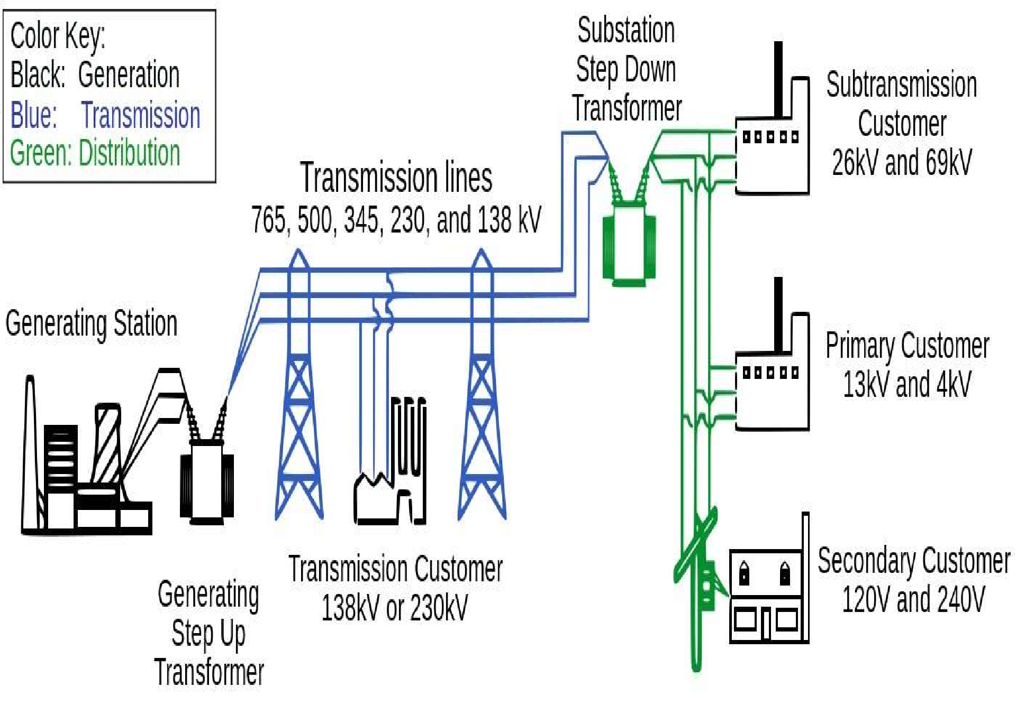

Slide 3
Chapter-01
Power Generation

Slide 4
RESOURCES OF ENERGY
Resources of energy can be categorized into two category
Renewable energy sources
Non renewable energy sources.
Renewable energy
Renewable energy is derived from natural processes that are replenished constantly such as solar, wind, ocean, hydropower, biomass, geothermal , biofuels ,tidal, hydrogen etc.

Slide 5
Non Renewable Energy
Coal, Oil and Natural gas are the non-renewable sources of energy.
They are also called fossil fuels as they are products of plants that lived thousands of years ago.
Fossil fuels are the predominantly used energy sources today.
India is the third largest producer of coal in the world, with estimated reserves of around 315,148.81 million tones of Geological Resources of Coal(as of 1.4.2017).
Coal supplies more than 58% of the country's total primary energy requirements.
India consumes about 210 MT of crude oil annually, and more than 70% of it is imported. Burning fossil fuels cause great amount of environmental pollution

Slide 6
Difference between conventional & non-conventional sources
Conventional sources
Non-Conventional sources
Conventional sources of energy (e.g. coal, petroleum and natural gas) are non-renewable sources of energy.
They have been in use since a long time. For example, firewood and coal have been in use since a long time.
Most of these energy sources (e.g. coal and firewood) cause pollution when used.
They are common and widely used sources (e.g. thermal power).
Non-conventional sources of energy (e.g. solar and wind energy) are renewable sources of energy.
These sources have recently developed and are still developing. For example, the technology of producing electricity from solar panels has recently developed.
They do not cause any pollution (e.g. solar energy, geothermal energy etc.)
They are comparatively new sources of energy and hence are not widely used. For example, solar panels and wind mills are not widely used.

Slide 7
Sources of Energy
Sun
The heat energy of sun is converted into electrical energy by solar panels
Wind
wind energy is utilized by windmills and converted into electrical energy.
Ocean Tides
There is a tremendous energy in ocean tides and waves which is used to generate electrical energy.

Slide 8
Water
Electrical energy can be generated by driving water turbines or water wheels, coupled to generators.
Fuels
The heat energy of these fuels is converted into mechanical energies by using steam engines or turbines and further converted into electrical energy.
Nuclear energy
The heat energy is liberated from fission of Uranium and other fissionable materials is further converted into mechanical than to electrical energy.

Slide 9
Power Plants
A power station, also referred to as a power plant or powerhouse and sometimes generating station or generating plant, is an industrial facility for the generation of electric power.
Most power stations has one or more generators (a rotating machine that converts mechanical power into electrical power) of required specifications.

Slide 10
Different Types of Power Plants
Thermal power Plant
Hydroelectric power plant
Diesel power plant
Gas power plant
Nuclear power plant

Slide 11
Thermal Power Plant
A thermal power station is a power station in which heat energy of coal is converted to electric power by rotating generator coupled with steam turbine.
In this plant water is heated, turns into steam and spins a steam turbine which drives an electrical generator coupled with the shaft of turbine.

Slide 12
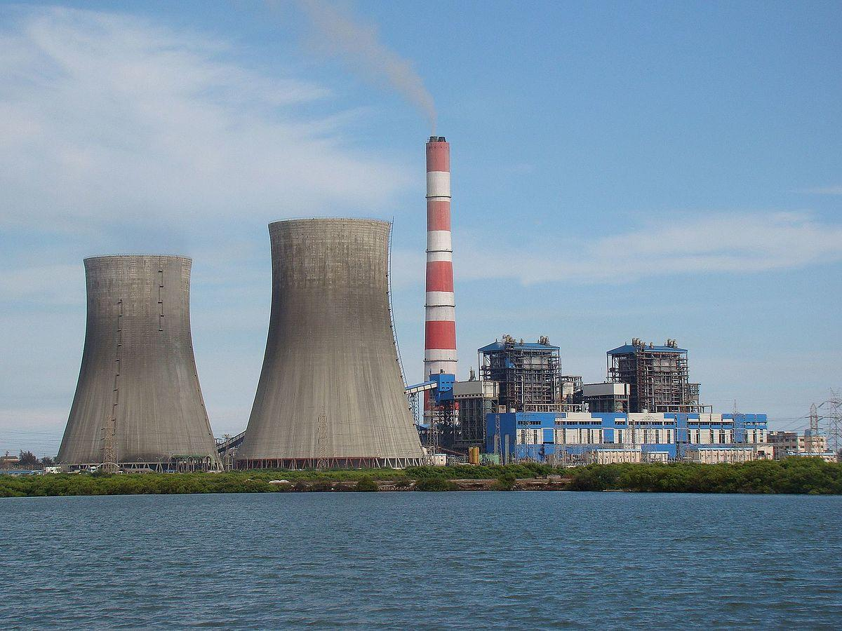

Slide 13
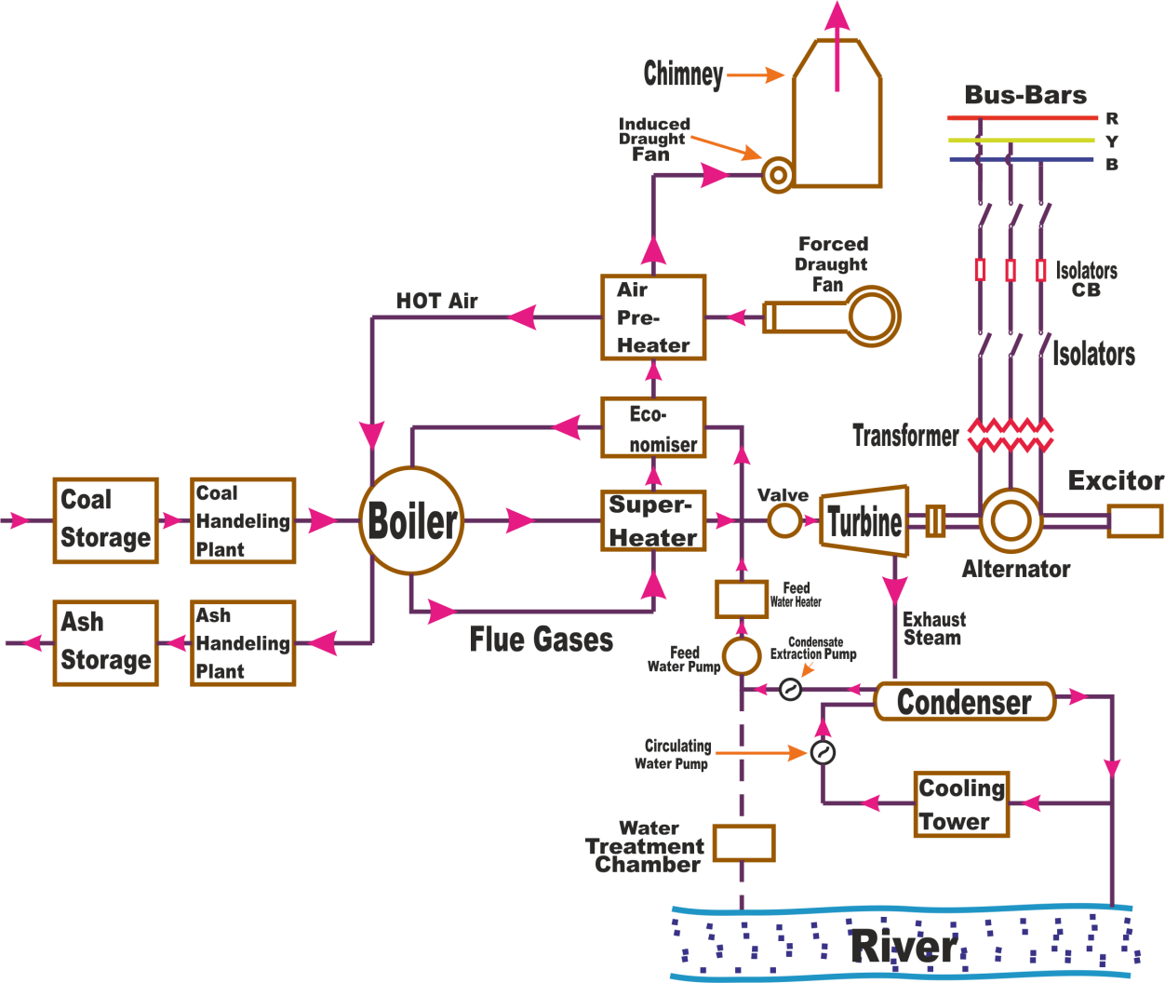
Flow Diagrams of Thermal Power Plant

Slide 14
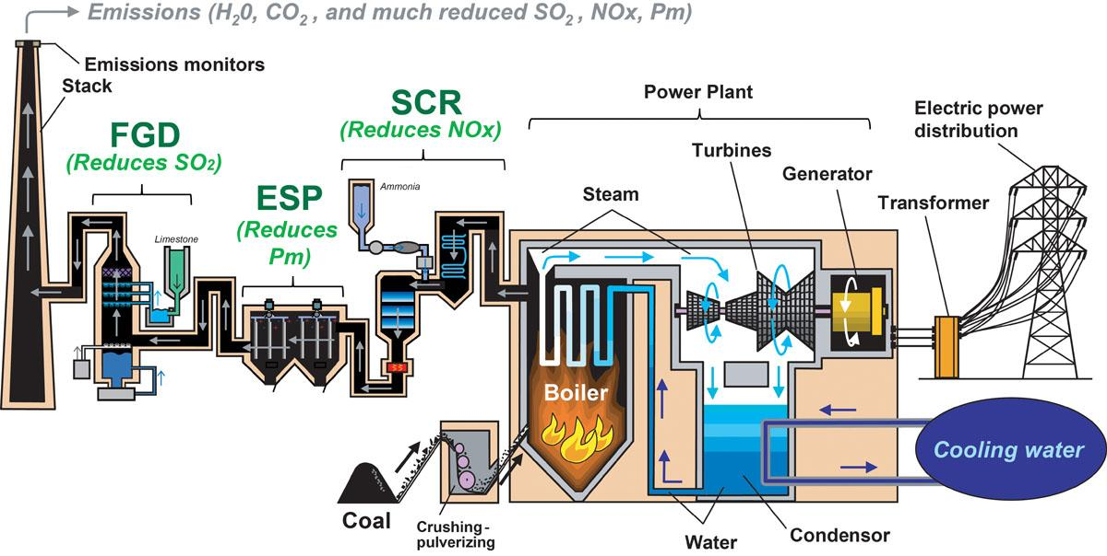

Slide 15
Working of Thermal Power Plant
Working of thermal power plant may be divided into four main cycle.
Fuel and ash circuit
Air and fuel gas circuit
Steam circuit.
Cooling and feed water circuit.

Slide 16
1. Fuel and Ash circuit:
Fuel (coal) is delivered to the plant by the help of rail and automatic unloading is carried out by the help of tipplers ,then coal is conveyed to the coal handling plant where it is crushed in to powder form by the help of pulverization mills. After this coal is feed into the furnace of boiler and complete combustion of coal take place under controlled process. The ash resulting after coal combustion collects at the back of boiler and is removed to ash storage by means of scrap conveyers.

Slide 17
2. Air and flue gases circuit:
Air is taken from the atmosphere by forced draught fan through the air pre-heater, in which it is heated by the heat of the fuel-gases passing to chimney. the gases after passing through the economizer, super heater, air pre-heater precipitators is finally exhausted through chimney by the help of ID fan.
3. Feed water and Steam circuit:
The steam coming out from the turbine is condensed by the help of condenser is extracted by the pumps and forced to low pressure heater. Then this water is passed through the economizer where it is heated up by the heat of flue gases and finally supplied to the boiler .

Slide 18
4. Cooling water circuit:
Water taken from a river or natural lake/pond is used to condensation of steam in condenser. During the passage its temp rises and heat is again extracted in cooling tower. The circulation of cooling water to the condenser help in maintaining a low pressure in the condenser.

Slide 19
Selection of Site for Thermal Power Plant
Availability of coal:
A thermal plant of 400MW, capacity requires nearly 6000 tons of coal every day. Power plant should be located near coal mines so as to reduce the cost of coal transport.
Ash Disposal Facilities:
Ash comes out in hot condition and handling is difficult. The ash can be disposed into sea or river.

Slide 20
Water Availability :
Water consumption is more as feed water into boiler, condenser and for ash disposal.
Water is required for drinking purpose.
Hence plant should be located near water resource like lake, river etc.
Transport Facility :
Transport facility should be there for the transport man/material and machinery.

Slide 21
Public Problems:
The plant should be far away from residential area to avoid nuisance from smoke, fly ash and noise.
Nature of Land :
Many power plants have failed due to weak foundations.
Land (soil) should have good bearing capacity to withstand dead load of plant.

Slide 22
Thermal Pollution:
Thermal plants produce 40 million kJ of heat to the environment through condenser water and exhaust gases.
Thermal pollution of atmosphere can be reduced using the low grade energy exhausted steam.
Noise Pollution:
The sources of noise in a power plant are turbo alternators, fans and power transformers.
Sound proofing can be done to reduce the noise.

Slide 23
Advantages and Disadvantages
Advantages
Disadvantages
Less initial cost as compared to other generating stations.
It requires less land as compared to hydro power plant.
The fuel (i.e. coal) is cheaper.
The cost of generation is lesser than that of diesel power plants.
It pollutes the atmosphere due to the production of large amount of smoke. This is one of the causes of global warming.
The overall efficiency of a thermal power station is low (less than 30%).

Slide 24
Hydroelectric Power Plant
Hydroelectric power plants derive energy from the force of moving water and harness this energy for useful purposes.
In modern technology, hydropower moves turbines that pass on their energy to a generator which then produces electric power.
Hydropower is a type of renewable energy, and once the power plant is constructed it produces little to no waste.

Slide 25
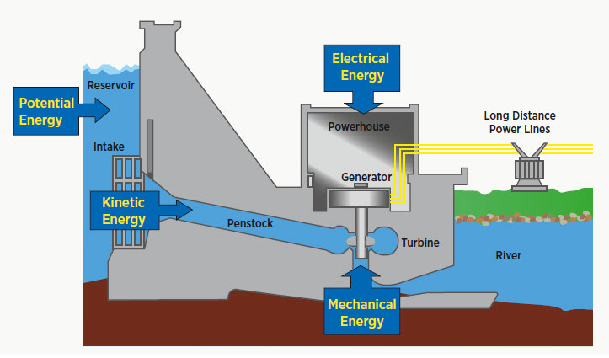
Hydroelectric Power Plant

Slide 26
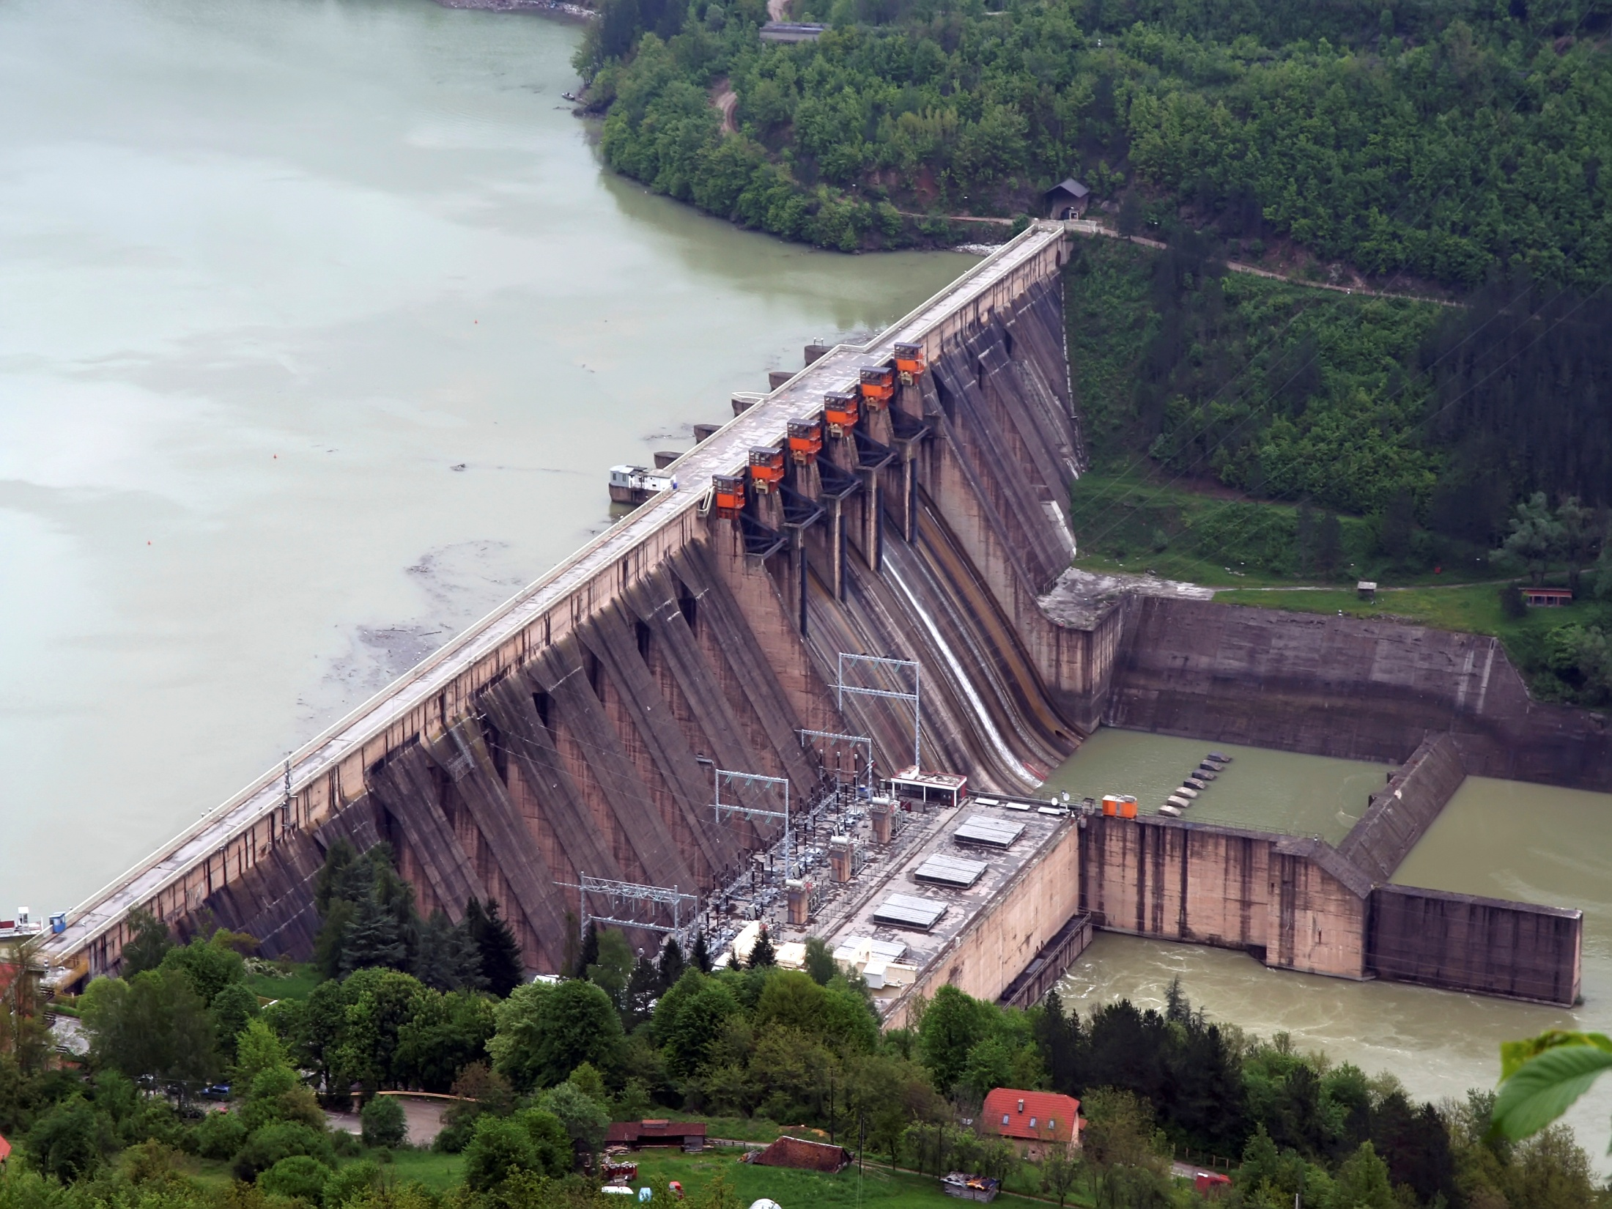

Slide 27
COMPONENTS OF HYDRO ELECTRIC POWER PLANT:
Reservoir :
Water is collected during and stored in the reservoir in rainy season.
  Dam:
A barrier constructed to hold back water and raise its level, forming a reservoir used to generate electricity or as a water supply.
A dam is built across the river with an adequate water head.

Slide 28
Penstock :
It is a passage through which water flows from reservoir to turbine penstock may be natural tunnel or steal pipe of heavy duty.
Surge Tank :
It is installed along the penstock (between turbine and reservoir)
To control or regulate the sudden water over flow and to protect the penstock from bursting.
It reduces the pressure and avoids damage to the penstock due to the water hammer effect.

Slide 29
Water Turbine:
Water turbines such as Pelton, Kaplan and Francis are used to convert pressure and kinetic energy of flowing water into mechanical energy . Turbine selection depends on the water head available.
Draft Tube:
It is connected to the outlet of the turbine.
Tailrace:
It refers to the downstream level of water discharged from turbine.

Slide 30
Generator :
It is a machine used to convert mechanical energy into electrical energy. Generally salient pole generators are used in hydro power plant.
Step up Transformer:
It is used to step up the voltage level of generated voltage suitable for transmission of electric power.

Slide 31
Advantages and Disadvantages
Advantages
The running cost is less.
It is very neat and clean.
It has longer life.
It is a quick starting plant.
It helps in irrigation purpose and also controls floods.
Disadvantages
It requires a high capital cost .
It depends on rain or catchment area .
It requires high cost of transmission line.

Slide 32
Site selection for hydroelectric power plant
Sufficient quantity of water at a certain height.
Transportation facilities.
Possibility of stream diversion during construction period.
Possibility of constructing a dam to store the water at least possible cost.
The land should be cheap in cost, rocky and should have sufficient strength to bear the heavy structure load.

Slide 33
Nuclear Power plant
A nuclear power plant is a thermal power station in which the heat source is a nuclear reactor. As is typical of thermal power stations, heat is used to generate steam that drives a steam turbine connected to a generator that produces electricity.
Nuclear power plants use heat produced during nuclear fission to heat water. In nuclear fission, atoms are split apart to form smaller atoms, releasing energy.
Fission takes place inside the reactor of a nuclear power plant. At the center of the reactor is the core, which contains uranium fuel.

Slide 34
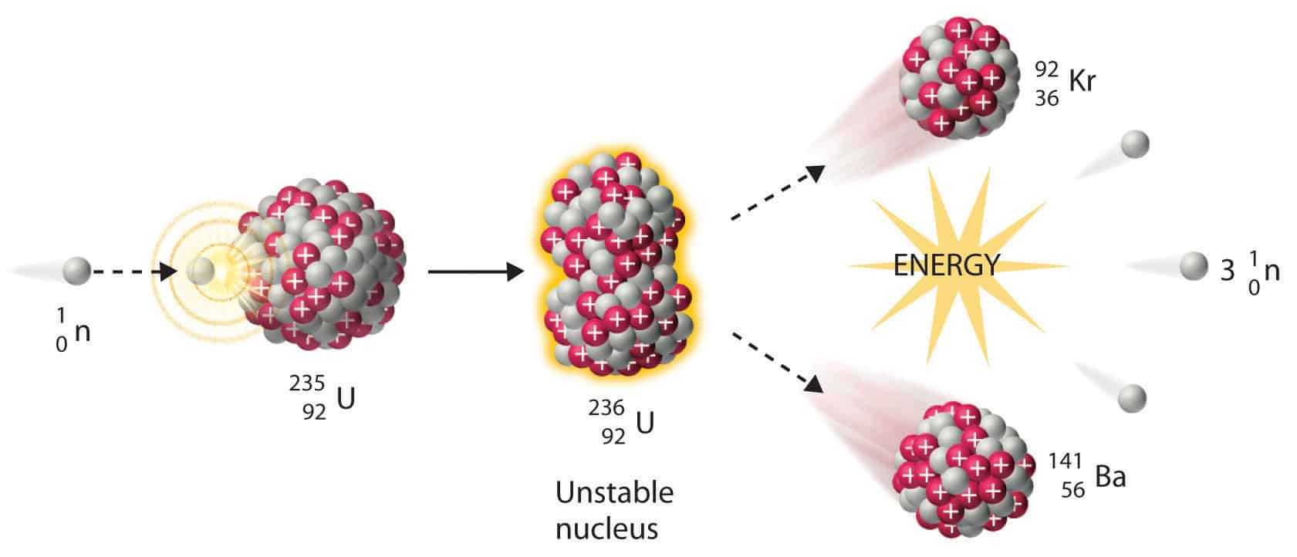
Fission Reaction

Slide 35
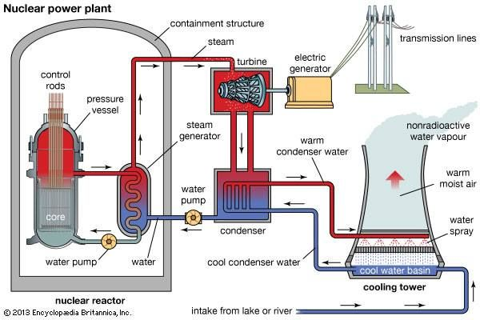

Slide 36
Nuclear power plants generate electricity in a very similar way to other traditional power plants, differing in the type of fuel used. All electricity generation plants produce heat that turns water into steam, which drives a turbine connected to a generator and subsequently produces electricity.
Uranium, a naturally radioactive element abundantly found in most rocks, is used as fuel to power nuclear reactors.
In a nuclear reactor, uranium atoms are split into smaller parts by changing their molecular structure using the fission process. The energy released during this split creates heat to produce steam, which is used by a turbine generator to generate electricity.

Slide 37
The nuclear fission process is an extremely efficient way to produce power – one uranium pellet, the size of a fingertip, produces the same amount of energy as 480 liters of oil or 1 ton of coal.
Nuclear energy is one of the most environmentally friendly methods of producing electricity, as nuclear plants do not burn fossil fuels thus they do not produce greenhouse gas emissions.

Slide 38
Site selection for Nuclear power Plant
(1)Cost of Transmission of Energy:
Power plant should be located as near to the load centre as possible. This reduces the transmission costs and losses in transmission.
(2)Requirement of Space:
The space and building requirements of the power plant is another point to be considered. If the building and space required are both large, the cost of land as well as building will be large.
(3)Availability of Site for Water Power:
In deciding the type of power plant for a given location, it is desirable to investigate whether any suitable source of water and sites are available for the development of hydroelectric power plant.

Slide 39
(4)Transportation Facilities:
The location of a power plant is dependent to some extent on the availability of transportation facilities. It is necessary to have a railway, line available and extended to the yard for bringing in heavy machinery for installation in the beginning and for bringing in fuel-coal or oil as well as material required for maintenance.
(4)Availability of Cooling Water:
This power plant needs larger quantities of cooling water than diesel and gas turbine power plants. Water is circulated through condenser tubes to condense the steam and to maintain a high vacuum in the turbine condenser for high efficiency.

Slide 40
(5)Disposal of Waste:
In case of nuclear power plants, the disposal of products (radioactive in nature) is a big problem. They have either to be disposed off in a deep trench or in a sea away from the seashore.
(6)Equitable Growth of Different Areas:
It has been seen that availability of power from a nearby source in an area encourages setting up of heavy industries in that area and consequently, the ancillary industries are also to come up.
(7) Pollution and Noise:
A site for a power plant near a load centre may be objectionable from the point of view of noise and pollution. The fuel and waste is radioactive in nature so should be away from population area.

Slide 41
Diesel Power Station
In a diesel power station, diesel engine is used as the prime mover. The diesel burns inside the engine and the products of this combustion act as the working fluid to produce mechanical energy. The diesel engine drives alternator which converts mechanical energy into electrical energy.

Slide 42
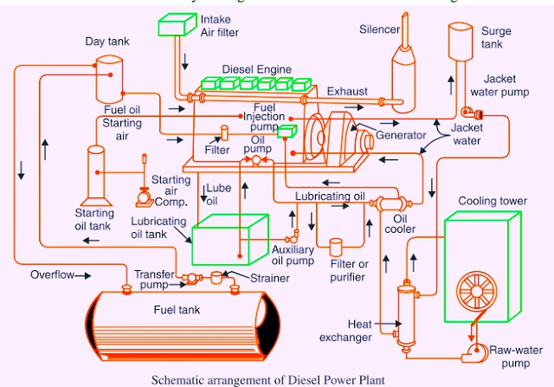

Slide 43
For generating electrical power, it is essential to rotate the rotor of an alternator by means of a prime mover. The prime mover can be driven by different methods. Using diesel engine as prime mover is one of the popular methods of generating power. When prime mover of the alternators is diesel engine, the power station is called diesel power station.
The mechanical power required for driving alternator comes from combustion of diesel. As the diesel costs high, this type of power station is not suitable for producing power in large scale in our country.
But for small scale production of electrical Power, and where, there is no other easily available alternatives of producing electric power, diesel power station are used.

Slide 44
Comparison of various types of power plants
Comparison of Different types of electric power plants can be done on the basis of running cost, site, starting ,maintenance etc as shown in the chart.

Slide 45
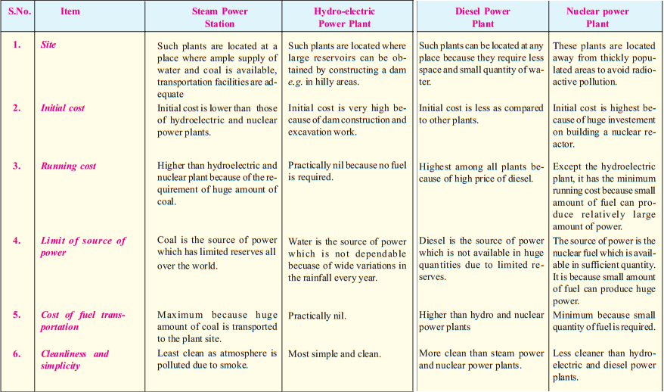

Slide 46
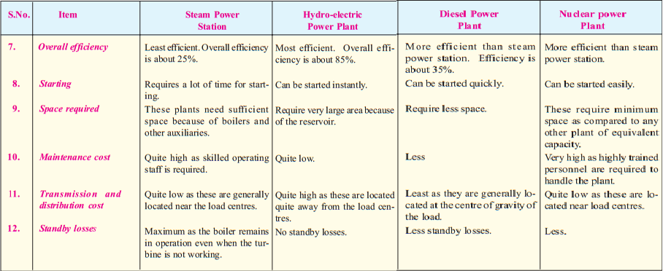

Slide 47
Chapter - 02
Economics of Generations

Slide 48
Introduction
The art of determining the cost of production of electrical energy per unit is known as ECONOMICS OF POWER GENERATION.
INTEREST: The cost of use of money is known as interest.
DEPRECIATION : The decrease in value of power plant equipment and building due to constant use is known as depreciation.
Classification Of Cost Of Electrical Energy
Fixed cost
Semi fixed cost
Running cost

Slide 49
Fixed Cost of Electricity
Fixed Cost :
In every manufacturing unit there is some hidden expenditure which fixed. This is same for manufacturing one unit or thousand units of the items. In electric generating station like manufacturing unit, there are some hidden costs which independent of the quantity of electricity produced.
These fixed expenditures are mainly due to an annual cost to run the organization, interest on capital cost and tax or rent of the land on which the organization established, salaries of high officials and interests of loans (if any) on the capital cost of the organization. Like these main costs, there are many others expenditures which do not change whether the rate of production of electrical energy units is less or more.

Slide 50
Semi-Fixed costs
There is another type costing for any manufacturing or production or any similar type of industries. These costs are not strictly fixed and also not fully dependent on the number of items manufactured or produced. These costs depend on the size of the plant. These actually depend on the assumption of a maximum number of items which can be produced from the plant at a time during peak demand period. That means the forecasted production demand of the plant determines how big will be the manufacturing or production plant. Likewise, the size of an electrical generating plant depends on the maximum demand of the connected load of the system

Slide 51
If the maximum demand of the load is quite higher than the average demand of the load, then the power generating plant should be constructed and well equipped to fulfill that maximum demand of the system even the peak demand lasts for less than an hour. This type of costs is referred as semi-fixed cost.
It is directly proportional to the maximum demand on the power station. The annual interest and depreciation on capital investment of building and equipment, taxes, salaries of management and clerical staff, expenditure for installation etc. come under semi-fixed costs.

Slide 52
Running Cost of Electricity
Running Cost of Electricity:
The concept of running cost is quite simple. It solely depends on the number of units produced or generated. In power generating plant the main running cost is the cost of fuel burnt per unit of electrical energy generation.
The cost of lubricating oil, maintenance, repairs and salaries of operating staff are also accounted under running cost of the plant.
Since these charges are directly proportional to the number of units generated. For generating more units of electrical energy required running expenditures are more and vice versa.

Slide 53
SOME IMPORTANT TERMS
CONNECTED LOAD : The sum of continuous rating of all electrical equipment connected to the supply system is known as Connected Load.
MAXIMUM DEMAND : It is the greatest demand or load on power station during given period is known as MAXIMUM DEMAND.
DEMAND FACTOR : The ratio of maximum demand on power system to the connected load is called DEMAND FACTOR. Its value is always less than 1.
AVERAGE LOAD: The average of load occurring on power station in given period (day, month, year) is known as AVERAGE LOAD.

Slide 54
LOAD FACTOR: The ratio of average load to the maximum demand is known as LOAD FACTOR. Its value is always less than 1.
DIVERSITY FACTOR : The ratio of sum of individual maximum demand to the maximum demand on power station is called DIVERSITY FACTOR. Its value is always greater than 1.
PLANT CAPACITY FACTOR: It is the ratio of actual energy produced to the maximum energy that could have been produced during a given period is known as PLANT CAPACITY FACTOR.

Slide 55
PLANT USE FACTOR : The ratio of KWH generated to product of plant capacity and no. of hours for which plant was in operation.
PLANT CAPACITY FACTOR = STATION output in kwh/ plant capacity . Hours of use
UTILIZATION FACTOR : It is defined as the ratio of maximum demand on power station to the rated capacity of power station.
POWER FACTOR : It is the ratio of true power to the apparent power.
Power factor = TRUE POWER/ APPARENT POWER

Slide 56
Load curve
Load curve determines the load variation during different hours of the day. It indicates the peak load which determines the maximum demand on the power station. The area under the load curve gives the total energy generated in the period under consideration.
In a power system, a load curve or load profile is a chart illustrating the variation in demand/electrical load over a specific time.
Generation companies use this information to plan how much power they will need to generate at any given time.

Slide 57
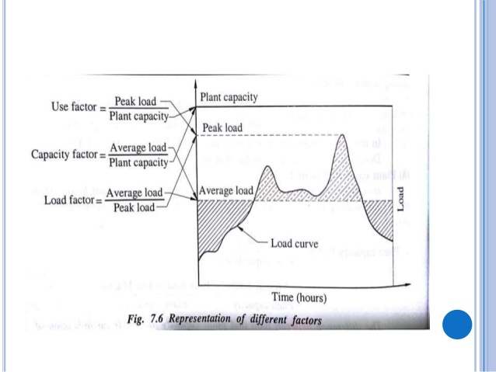

Slide 58
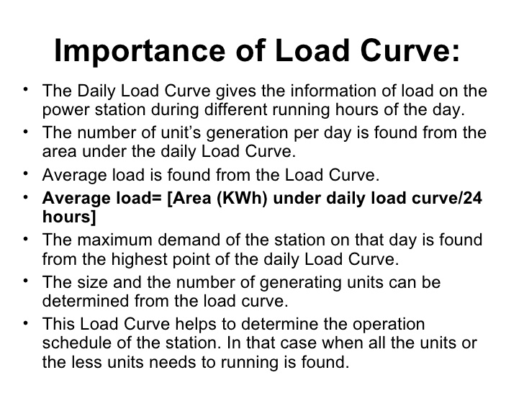

Slide 59
IMPORTANCE OF LOAD FACTOR AND DIVERSITY FACTOR
(1) Load factor : Load factor is the ratio of average load to maximum load on the power plant.
The load factor will increase if the average load increases without the increase in maximum load. Thus, the total number of units of energy generated (kWh) at higher load factor would increase.
But the annual fixed charges per unit of energy generated would reduce with the increase in load factor. Hence, the annual fixed charges per unit of energy generated would reduce with the increase in load factor. As a result the overall cost per unit of energy generated reduces.

Slide 60
(2)Diversity factor: The diversity factor is the ratio of the sum of the maximum demands of the individual consumers and simultaneous maximum demand of the whole group during a particular time.
At higher diversity factor the cost of generation is less because if the D.F. is high, the sum of individual demand is more than max demand. Hence capacity of the station can be kept lesser, this will decrease the initial investment on the erection of plant.

Slide 61
Base load and Peak load plant
Load is the amount of power in the electrical grid.
Base load is the level that it typically does not go below, that is, the basic amount of electricity that is always required.
Peak load is the daily fluctuation of electricity use. It is usually lowest in the wee hours of the morning and highest in the early evening as shown in load curve.

Slide 62
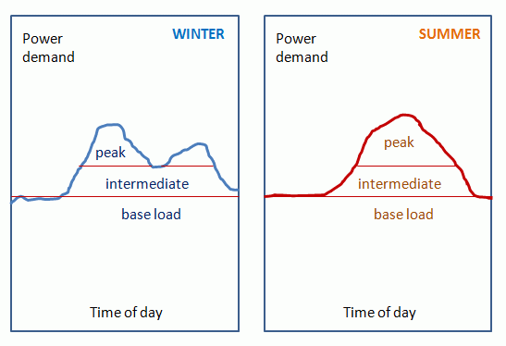
Gas turbine and Diesel power plants operate economically only for peak load and Thermal power plant is suitable only for base load. Hence such power loads should not be supplied from single power plant. Explanation: Capability of quick start is the essential requirement for peak load plant. Plants having low cost of running and have large production capacity like nuclear are used as base load and vice versa for peak load plants.

Slide 63
Interconnection of the power plants
The Power Plants are interconnected to get overall economy this inter connection of plants also known as grid system. It has following advantages:
It enhanced the reliability of the supply.
Diversity factor is improved
Economy is improved because the plant having more efficiency can be employed as the ‘Base loads Plant "and vice versa for peak load plant.
The old plants cant feed the load independently but as a member of grid can perform better.
in case of failure or maintenance of the plant whole load of the plant can be transferred to other plant

Slide 64
Regional grid and National Grid
Regional Grid – The Regional grid is formed by interconnecting the different transmission system of a particular area through the transmission line.
National Grid – It is formed by interconnecting the different regional grid

Slide 65
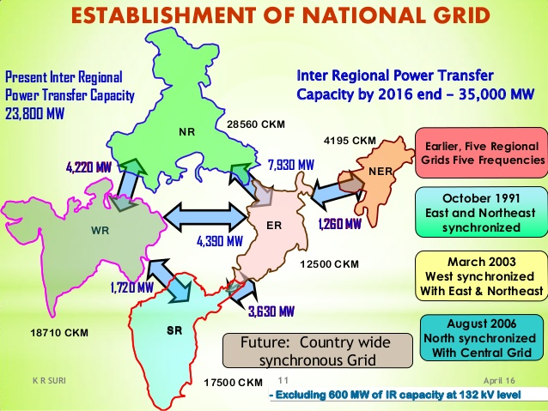

Slide 66
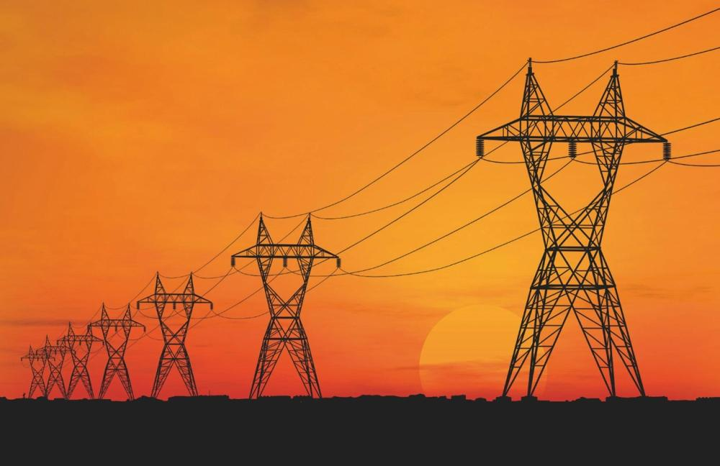
Chapter-3
Transmission

Slide 67
Transmission of Power
Power transmission is the movement of electrical energy from its place of generation to a location where it is applied to perform useful work ie. at load centre.

Slide 68
Layout of Power system
A power system consists of the following stages :-
Power station
Primary Transmission
Secondary Transmission
Primary Distribution
Secondary Distribution

Slide 69
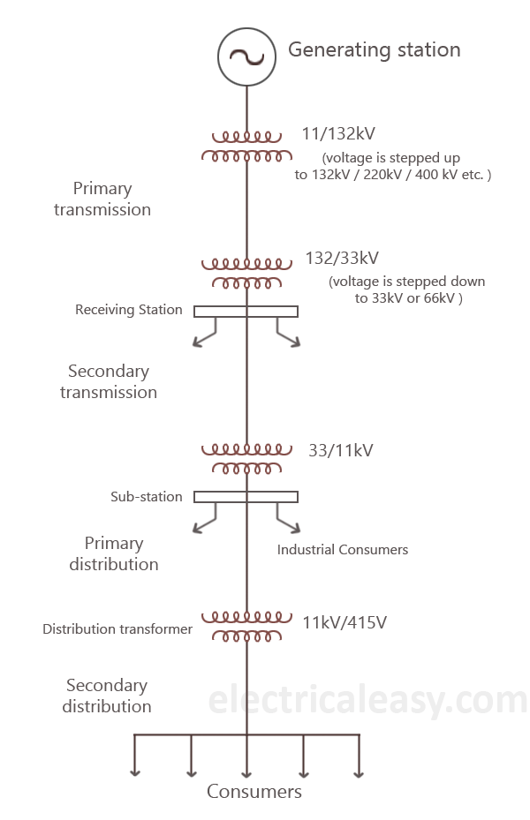
Key diagram of Transmission system

Slide 70
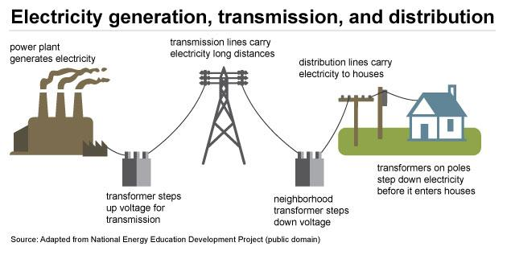

Slide 71
Primary Transmission and Secondary Transmission
Primary Transmission- High voltages of the order of 66kv, 132kv, 220kv, 400kv are used for transmitting power by 3 phase 3 wire overhead system. This is supplied to substations usually at the outskirts of major distribution centre or city.
Secondary Transmission - On the outskirts of the city, there are sub-station which step down the primary transmission voltage to 66kv or 33kv and power is transmitted at this voltage. This forms the secondary transmission system, 3 phase wire system is used.

Slide 72
CLASSIFICATION OF TRANSMISSION LINES
VOLTAGE
  UHV (1000KV)
  EHV (745 KV)
  High voltage transmission voltage (200KV)
  Medium voltage transmission voltage (132KV)
DISTANCE
  Short length T.L (< 50 km)
  Medium length T.L ( 50-150 km)
  Long length T.L (>150 km)
A.C OR D.C : The transmission line may be ac or dc depending upon the application.

Slide 73
SELECTION OF TRANSMISSION VOLTAGE
MORE INSULATION : Higher the voltage, more insulation
HIGH TOWERS : Clearance between ground and conductors is more for high voltages.
LONGER CROSS ARM : Clearance between conductors is more for greater transmission voltages.

Slide 74
Advantages of high voltage for transmission
The Advantages of High Transmission Voltage at high voltages due to the following reasons :
(i) Reduces volume of conductor material: Consider the transmission of electric power by a three-phase line.Let
P = power transmitted in watts
V = line voltage in volts
cos Φ = power factor of the load
l = length of the line in metres
R = resistance per conductor in ohms
ρ = resistivity of conductor material
a = area of X-section of conductor

Slide 75
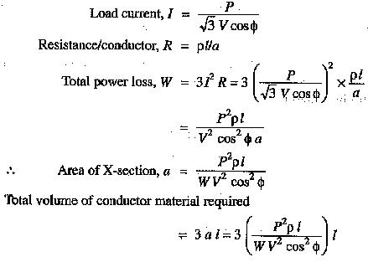
It is clear from exp. (i) that for given values of P,l,ρ and W, the volume of conductor material required is inversely proportional to the square of transmission voltage and power factor. In other words, the greater the transmission voltage, the lesser is the conductor material required.

Slide 76


(ii)Decreases percentage line drop
As J, ρ and l are constants, therefore, percentage line drop decreases when the transmission voltage increases.
(iii) Increases transmission efficiency: Due to decrease in the losses overall efficiency will improve.

Slide 77
(iv) Improvement in voltage regulation: Due to decrease in the % voltage drops ,overall voltage will improve.

Slide 78
Limitations of high transmission voltage:
From the above discussion, it might appear advisable to use the highest possible voltage for transmission of power in a bid to save conductor material. However, it must be realized that high transmission voltage results in
the increased cost of insulating the conductors
the increased cost of transformers, switchgear and other terminal apparatus.
Therefore, there is a limit to the higher transmission voltage which can be economically employed in a particular case. This limit is reached when the saving in cost of conductor material due to higher voltage is offset by the increased cost of insulation, transformer, switchgear etc. Hence, the choice of proper transmission voltage is essentially a question of economics.

Slide 79

Overhead Transmission system
It is less safe.
It is less expensive.
Fault occurs frequently.
They are not restricted by the landscape.
It gives shabby look.
It is more flexible.
Fault points can be easily located.
Can be easily repaired.
They can be operated upto 400 kv or higher.

Slide 80
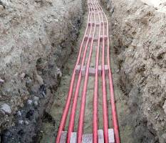
Underground system
It is more safe.
Less affected by bad weather.
It is more expensive.
Very rare chances of faults.
Take up less right-of-way.
Its appearance is good as wires are not visible.
Faults points cannot be easily located.
Cannot be easily repaired.
It can work only upto 66kv due to insulation difficulty.

Slide 81
DC TRANSMISSION
Advantages
Disadvantages
1. It requires only two conductors as compared to three for a.c transmission.
2. There is no inductance, capacitance, phase displacement and surge problems in d.c. transmission.
3. A d.c. transmission line has better voltage regulation.
4. There is no skin effect in a d.c. system. Therefore, entire cross-section of the line conductor is utilized.
5. For the same working voltage, the potential stress on the insulation is less in case of d.c. system.
6. A d.c. line has less corona loss.
7. The high voltage d.c transmission is free from the dielectric losses.
8. There are no stability problems.
1. Electric power cannot be generated at high d.c voltage due to commutation problems.
2. The d.c. voltage cannot be stepped up for transmission of power at high voltages.
3. The d.c switches and circuit breakers have their own limitations.

Slide 82
AC TRANSMISSSION
ADVANTAGES
DISADVANTAGES
1. An a.c line requires more copper than a d.c. line.
2. The construction of a.c transmission line is more complicated than a d.c transmission line.
3. Due to skin effect in the a.c system, the effective resistance of the line is increased.
4. An a.c line has capacitance. Therefore, there is a continuous loss of power due to charging current even when the line is open.
5. An a.c line has corona loss.
1. The power can be generated at high voltages.
2. The maintenance of a.c substations is easier and cheaper.
3. The a.c voltage can be stepped up or stepped down by the transformers with ease and efficiency. This permits to transmit power at high voltages and distribute it at safe potentials.

Slide 83
Components of Transmission line
Line supports – These may be poles or towers, which keep the conductors at a suitable height from the ground level.
Conductors are either solid round, stranded or bundled. Stranding provides flexibility. These may be of copper, aluminum, A.C.S.R or of any other composition.
Insulators are suspend the energized phase conductors and insulate them from grounded tower.
Cross arms are made of wood or steel angle section. They provide support to the insulators.

Slide 84
Lightning Arrestor is used to discharge excessive voltage built upon the line to earth due to lightning.
Phase plates are provided to distinguish the various phases.
Earth wire run on the top of the towers to protect the line against the lightning discharge.
Fuses and Isolating switches are used to isolate different parts of the overhead system.
Barbed wire is wound around over some portion of the pole or tower as anti-climbing device.

Slide 85
Line Supports
The line supports used for transmission and distribution of electric power .
These are also known as poles and towers. Poles are used for L.T lines and towers are used for H.T lines. These can be of following types –
Wooden poles - These are used in rural areas for L.T lines. These are preferred due to their low cost and natural insulating properties.
Steel poles - These are used in urban areas for distribution of electric power. These are of different shapes : (a) Tubular (b) Rail poles (c) Steel joists.

Slide 86
R.C.C. poles – These are also used in urban areas. These have the advantage of longer life, free from insects and atmospheric effects. They have good appearance and less maintenance.
Steel towers – These are used to transmit bulk power at high voltages. They have greater mechanical strength, longer life and can withstand the severe climatic conditions and used for long span.

Slide 87
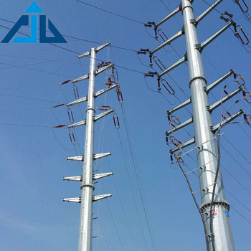
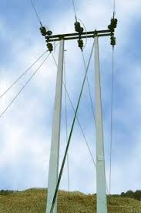
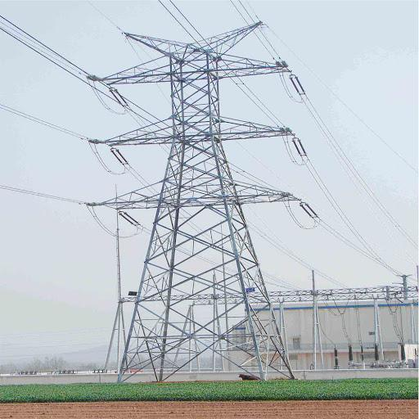
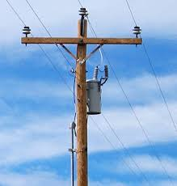

Slide 88
Conductor materials
The most commonly used conductor materials for overhead lines are –
Copper – This is an ideal conductor material for transmission and distribution of electrical power, but due to high cost and non-availability in abundance, it has limited applications.
(b) Aluminum – This conductor material is next to copper. It is cheaper than copper and is used where straight lines are required, due to non-flexibility.

Slide 89
A.C.S.R (Aluminum Conductor Steel Reinforced) – These conductors have a central core of galvanized steel whereas aluminum conductors form the outer layer. They are mechanically strong and lighter in weight. Therefore these can be used for longer spans.
AAC - All Aluminum Conductor.
AAAC - All Aluminum Alloy Conductor.
ACAR - Aluminum Conductor Aluminum-Alloy Reinforced.

Slide 90
Economic choice of conductor size
Kelvin’s Law:
The most economical area of conductor is that for which the total annual cost of transmission line is minimum.
The transmission line cost forms major part in the annual charges of a power system.
Depreciation
Repair and maintenance
Loss of energy in the line due to its resistance
The cost towards the production of the lost energy is considered

Slide 91
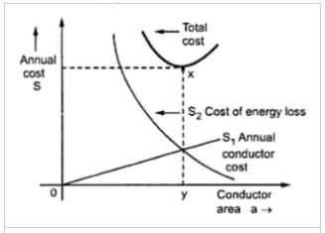
If we decreases the area of the conductor in order to reduce the capital cost, the line losses increase.
Similarly, if we increase the conductor cross-section to save the cost towards copper loss in the line, the weight of copper increases and hence the capital cost will be more.
Because of the above reasons, it is difficult to find the economical size of the conductor. But it becomes easy with the help of Kelvin's law.

Slide 92
Limitations of Kelvin's Law
This law has many problems and limits as we are selecting the cross-section from an economical point of view.
It is not easy to estimate the energy loss in the line without actual load curves, which are not available at the time of estimation.
Kelvin's law did not consider many physical factors like voltage regulation, corona loss, temperature rise etc.
The assumption that annual cost on account of interest and depreciation on the capital outlay is not 100% true.
The conductor size determined by this law may not be always practicable one.

Slide 93
The rates of interest and depreciation may vary from time to time.
The diameter of the conductor may be so small as to cause high corona loss.
The conductor may be too weak to stamp from mechanical point of view.
Cost of insulation in cables is assumed to be independent of the cross-section of the conductor which is only an approx. assumption.

Slide 94
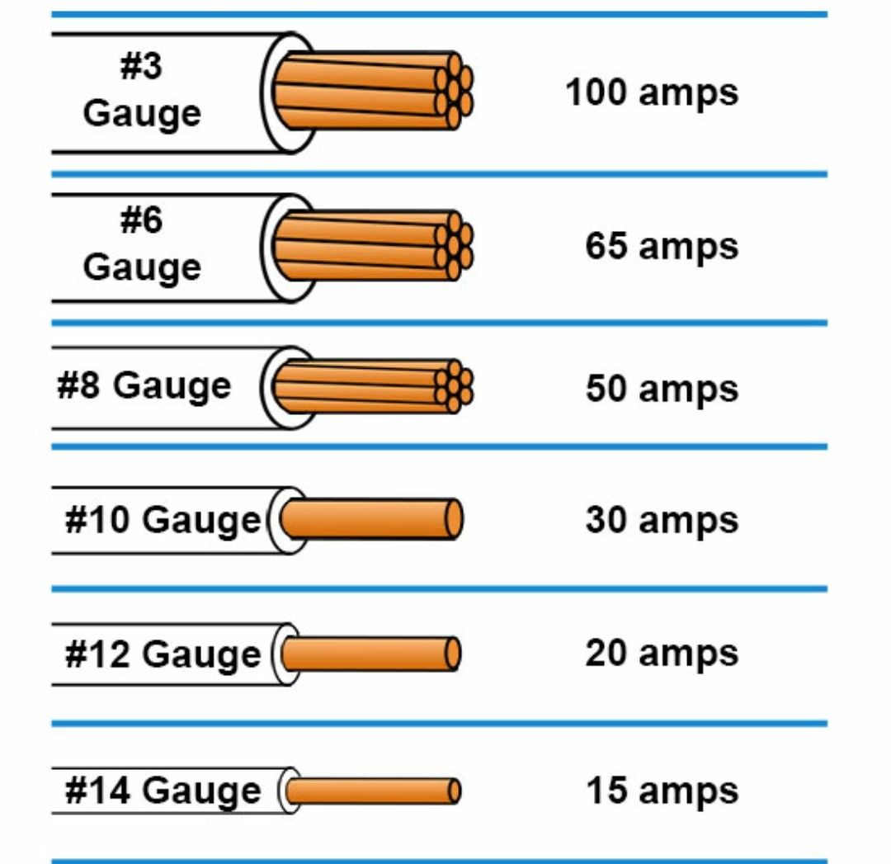
Conductor sizes

Slide 95
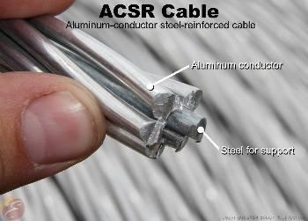
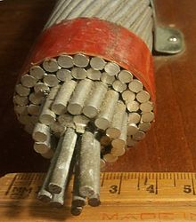

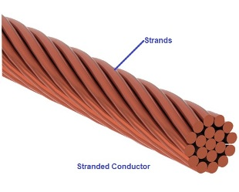
..

Slide 96


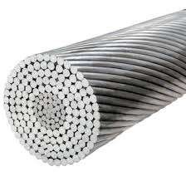
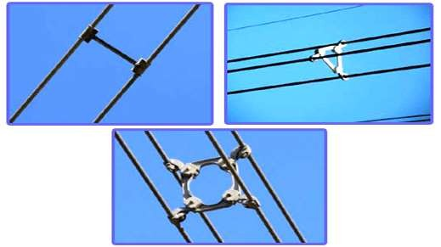

Slide 97
Insulator
Insulators are used for providing Mechanical Support and Electrical Isolations. Main types are:
Pin Type
Shackle type
Disk Type(Suspension and Strain Type)

Slide 98
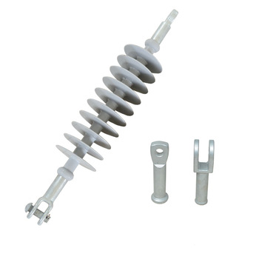
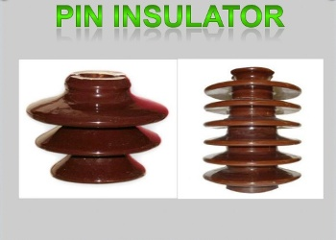
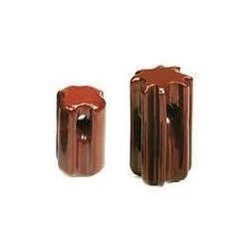
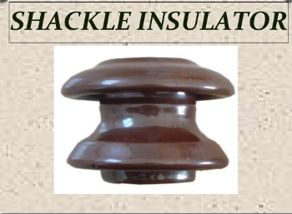
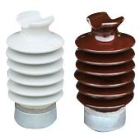
INSULATORS

Slide 99

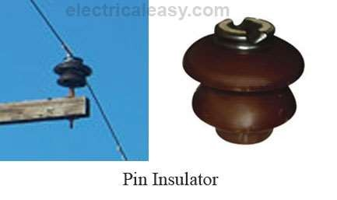
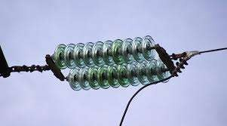
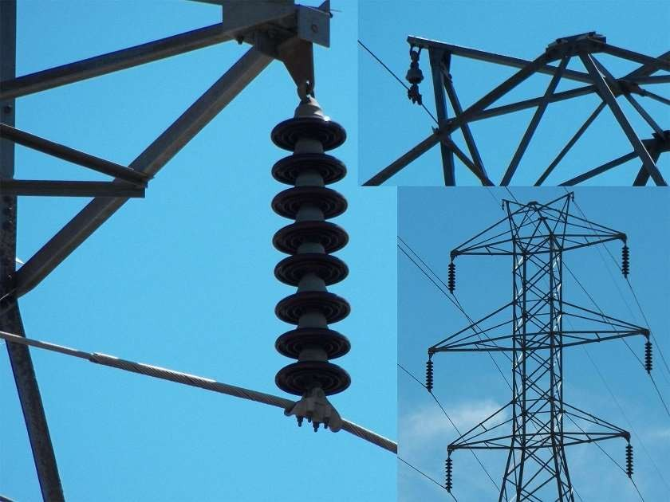

Slide 100
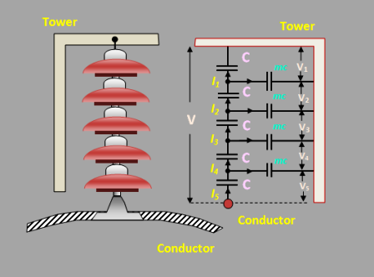
String Efficiency of Insulator
When the voltage is applied across the Suspension insulator string, it is unequally distributed across the individual unit. The disc near the line conductor is extremely stressed and takes the maximum voltage in the absence of stress. The voltage distribution on insulator string determines the flashover voltage and the voltage at which the localized corona and radio interference produced.

Slide 101

The string efficiency is defined as the ratio of voltage across the string to the product of the number of strings and the voltage across the unit adjacent string.
Where, V = voltage across the whole string
n = number of insulator discs in the string
v₁ = voltage across the lowest unit connected to the line conductor.

Slide 102
Methods of Improving the String Efficiency
For the adequate performance of transmission line, it is essentials that the voltage distribution across the line should be uniform. The different methods have been attempted to get the uniform distribution of voltage along the insulators to fully utilize its strength. The following methods are explained below.
Use of Long Cross Arm:
The non-uniformity in the potential distribution is due to stray capacitance between the lines and the ground. This can be reduced by using the long cross arm. The long cross arm increases the conductor spacing and the inductive reactance voltage drop. But the economy does not permit the use of very long cross arms.

Slide 103
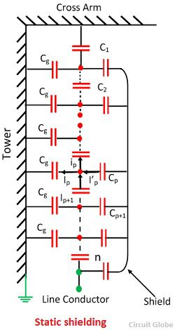
Capacitance Grading or Grading of the unit:
In this method, the insulators have different dimensions, and each insulator has different capacitances. The line-end unit has got the greatest capacitance, while the top unit get the smallest. By properly selecting the capacitance of the units the voltage distribution can be made uniform. The figure below shows the string of suspension insulators and the various capacitances.

Slide 104
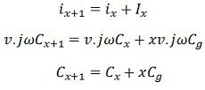
Let, v = voltage across each unit of the string.
C_{x} = self-capacitance of x the unit from the top.
C_{x+1} = self-capacitances of (x+1) the unit from the top.
This method raises the difficulties in selecting the unit for long string and it is only used for high voltage lines.

Slide 105
Uses of Grading Rings or Static Shielding
The method of using the grading or guard ring has proved to be very effective by equalizing the voltage distribution. The figure below-shown the arrangement of the guard ring. The ring or shields are fitted to the bottom insulator hardware or to the clamp and connected to the line.

Slide 106

The grading ring increases the stray capacitance to the line of the line-end units, and decreases the stray capacitance to earth, and thus help in making the voltage distribution uniform. Consider path link P from the top. Let C
Consider path link P from the top. Let C_{p} be the capacitance from the shield the pth link. Applying KCL at P.
The grading ring is circular or oval in shape and made of galvanized tube or pipe. The combination of an arcing horn at the top and grading ring at the bottom provides a very good protection for the string against power frequency and lightning flashovers.

Slide 107
Parameters of Transmission Line
The transmission line has mainly four parameters, resistance, inductance, capacitance and shunt conductance. These parameters are uniformly distributed along the line. Hence, it is also called the distributed parameter of the transmission line.

Slide 108
Inductance of Transmission Line
In the medium and long transmission lines inductance (reactance) is more effective than resistance. The current flow in the transmission line interacts with the other parameter, i.e the Inductance. We know that when current flow within a conductor, magnetic flux is set up. With the variation of current in the conductor, the number of lines of flux also changes, and an emf is induced in it (Faraday’s Law). This induced emf is represented by the parameter known as inductance.

Slide 109
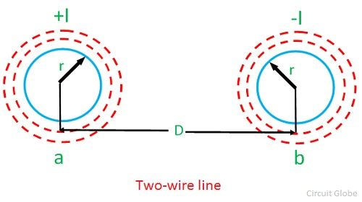
Inductance of a two-wire line:
Considered a single phase line consisting of two conductors (phase and neutral) a and b of equal radius r. They are situated at a distance D meters. The cross sections of conductors are shown in the diagram below.

Slide 110


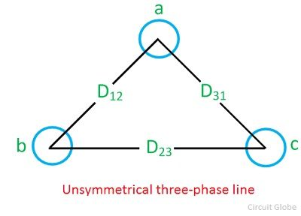
Inductance per conductor is given by
Inductance per conductor in case of three phase system

Slide 111
Capacitance of the Line
Capacitance in a transmission line results due to the potential difference between the conductors. The conductors get charged in the same way as the parallel plates of a capacitor. Capacitance between two parallel conductors depends on the size and the spacing between the conductors.

Slide 112

Capacitance of a Single Phase transmission line
Consider a Capacitance of a Single Phase Two Wire Line consisting of two parallel conductors A and B spaced d meters apart in air. Suppose that radius of each conductor is r meters.
Capacitance is given as=

Slide 113

Capacitance of the symmetrical three-phase line is given as:

Slide 114
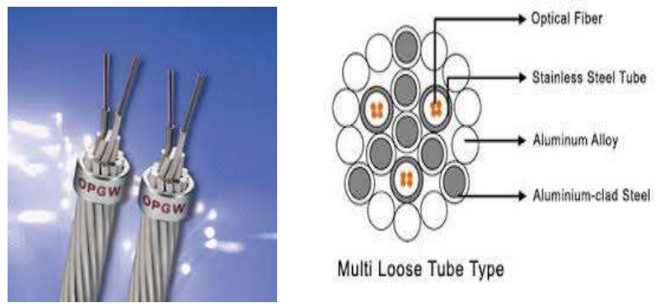
EARTH WIRE
Earth wire provided above the phase conductor across the line and grounded at every tower.
◉ It shield the line conductor from direct strokes
◉ Reduces voltage stress across the insulating strings during lightning strokes

Slide 115
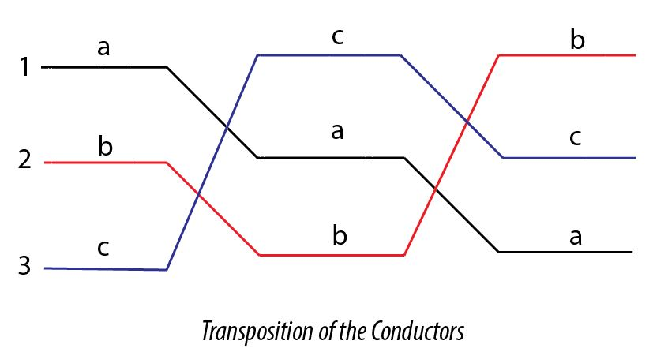
Transposition of Conductors
The process of changing the positions of conductors ( spaced unsymmetrically) of a three phase overhead line at regular distances in order to make the line constants of three phases symmetrical, is called transposition of conductors.
It is must, when long AC transmission line is to be erected.
Because voltage unbalance in long transmission line becomes remarkable and cannot be tolerated.

Slide 116
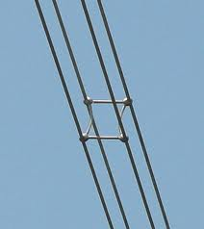
BUNDLE CONDUCTOR
A bundle conductor is a conductor made up of two or more conductors. It is used to transmit bulk power at reduced losses.
These are used on Extra high voltage lines to reduce corona effect and radio interference.
Bundle conductors consist of three or four conductors for each phase, separated from each other by means of spacers at regular intervals. Thus they do not touch each other.

Slide 117
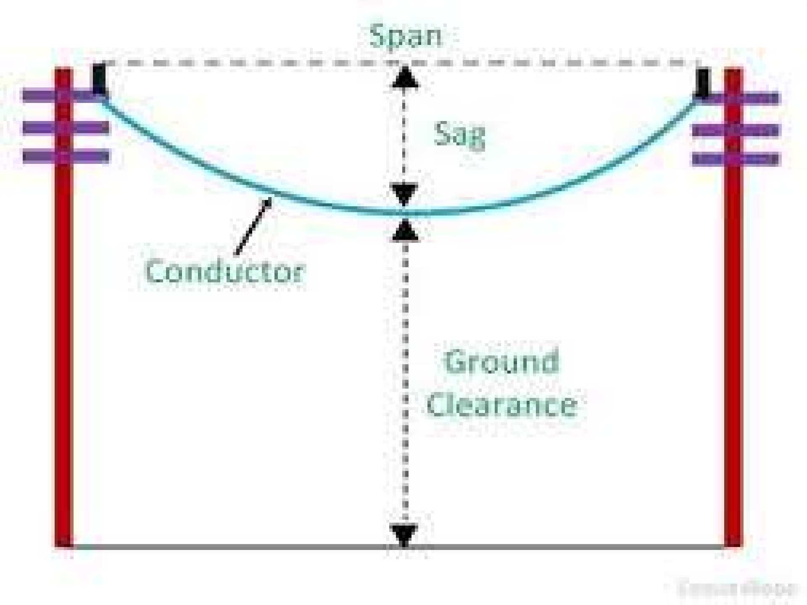
SAG
Sag in overhead Transmission line conductor refers to the difference in level between the point of support and the lowest point on the conductor.
Therefore, in order to have safe tension in the conductor, they are not fully stretched rather a sufficient dip or Sag is provided.

Slide 118
Factors affecting SAG
(i)Weight of conductor.
(ii) Location of the conductor.
(iii) Length of the span.
(iv) Temperature.
(v) Tensile strength.
(Vi) Tension.

Slide 119
Calculation of SAG
Suppose, AOB is the conductor. A and B are points of supports. Point O is the lowest point and the midpoint. Let,
L = length of the span, i.e. AB
w is the weight per unit length of the conductor
T is the tension in the conductor
We have chosen any point on conductor, say point P.
The distance of point P from Lowest point O is x.
y is the height from point O to point P.

Slide 120

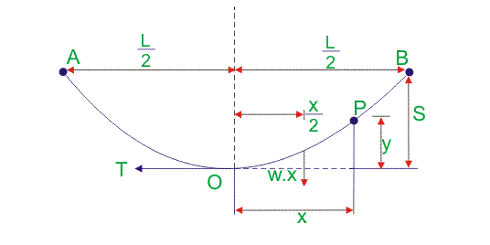

1. When Supports are Equal
Equating two moments of two forces about point O as per the figure above we get,

Slide 121
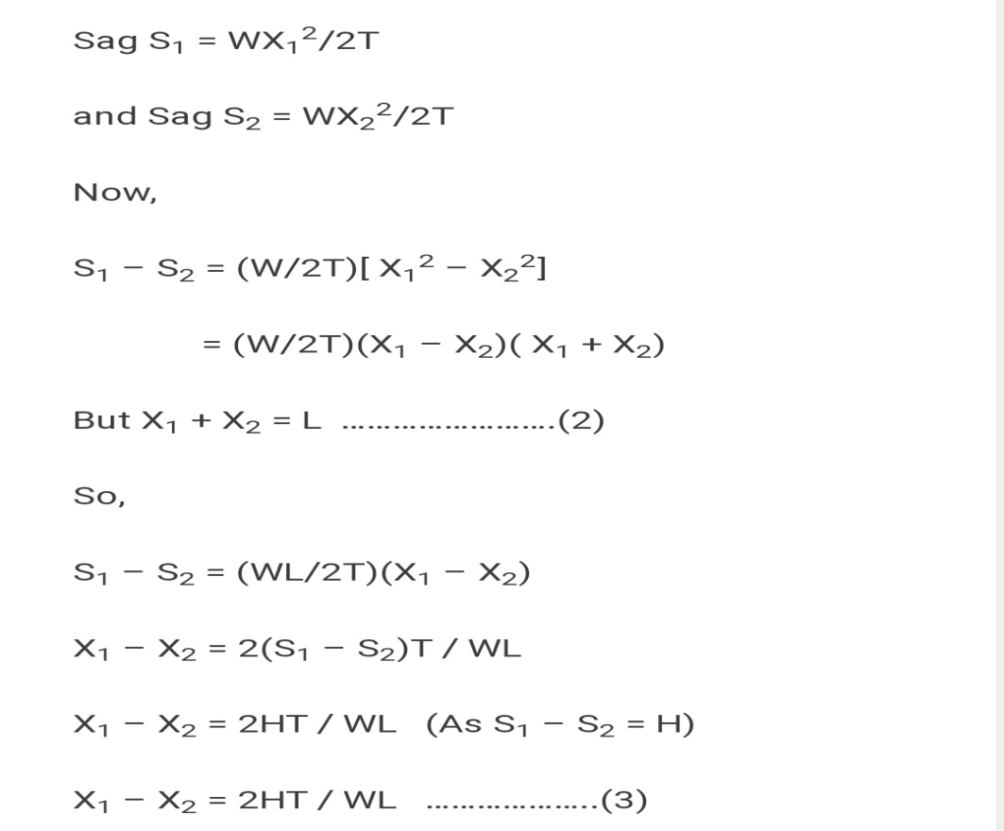


2. When Supports are Unequal
In hilly area supports for overhead transmission line conductor do not remain at the same level.
Fig. Unequal Supports

Slide 122
Importance of SAG
Sag is mandatory in transmission line conductor suspension. The conductors are attached between two supports with perfect value of sag. It is because of providing safety of the conductor from not to be subjected to excessive tension.
In order to permit safe tension in the conductor, conductors are not fully stretched; rather they are allowed to have sag.
If the conductor is stretched fully during installation, wind exerts pressure on the conductor, hence conductor gets chance to be broken or detached from its end support. Thus sag is allowed to have during conductor suspension.

Slide 123

Voltage regulation of transmission line
Voltage regulation of transmission line is defined as the ratio of difference between sending and receiving end voltage to receiving end voltage of a transmission line between conditions of no load and full load. It is also expressed in percentage.
Where, V_{s} is the sending end voltage per phase and V_{R} is the receiving end voltage per phase.

Slide 124


Effect of load power factor on regulation of transmission line:
For lagging load
For leading load
Power factor is lagging or unity, and then VR is increased and goes to be positive.
Power factor is leading, and then VR is decreased and goes to be negative.

Slide 125

Efficiency of Transmission Line
Transmission efficiency is defined as the ration of receiving end power P_{R} to the sending end power P_{S} and it is expressed in percentage value.
cosθ_{s} is the sending end power factor.
cosθ_{R} is the receiving end power factor.
V_{s} is the sending end voltage per phase.
V_{R} is the receiving end voltage per phase.

Slide 126

In case of medium and long transmission line

Slide 127

Corona Losses in transmission line
Corona is a phenomenon caused by the partial discharging caused by high electrical stress collided with gas molecules in the air when electrical field stress exceeds critical level cause of audible noise, frequency noise to communication system and power loss in overhead transmission line.

Slide 128
Corona discharge can cause an audible hissing or cracking noise as it ionizes the air around the conductors. The corona effect can also produce a violet glow, production of ozone gas around the conductor, radio interference, and electrical power loss.
The corona effect occurs naturally due to the fact that air is not a perfect insulator – containing many free electrons and ions under normal conditions. When an electric field is established in the air between two conductors, the free ions and electrons in the air will experience a force. Due to this effect, the ions and free electrons get accelerated and moved in the opposite direction.
The charged particles during their motion collide with one another and also with slow-moving uncharged molecules. Thus the number of charged particles increases rapidly. If the electric field is strong enough, a dielectric breakdown of air will occur and an arc will form between the conductors.

Slide 129
Factors Affecting Corona Loss
The main factors affecting corona discharge are:
Atmospheric Conditions
Condition of Conductors
Spacing Between Conductors

Slide 130
1. Atmospheric Conditions
The voltage gradient for dielectric breakdown of air is directly proportional to the density of air. Hence in a stormy day, due to continuous air flow, the number of ions present surrounding the conductor is far more than normal, and hence it’s more likely to have electrical discharge in transmission lines on such a day, compared to a day with the fairly clear weather.

Slide 131
2. Condition of Conductors
This particular phenomenon depends highly on the conductors and its physical condition. It has an inverse proportionality relationship with the diameter of the conductors. i.e., with the increase in diameter, the effect of corona on power system reduces considerably. Also, the presence of dirt or roughness of the conductor reduces the critical breakdown voltage, making the conductors more prone to corona losses. Hence in most cities and industrial areas having high pollution, this factor is of reasonable importance to counter the ill effects it has on the system.

Slide 132
3. Spacing Between Conductors
As already mentioned, for corona to occur in the spacing between the lines effectively should be much higher compared to its diameter, but if the length gets increased beyond a certain limit, the dielectric stress on the air reduces, and consequently, the effect of corona reduces as well. If the spacing is made too large, then corona for that region of the transmission line might not occur at all.

Slide 133
Method of Reducing Corona Loss
Corona discharge can be reduced by:
Increasing the conductor size: A larger conductor diameter results in a decrease in the corona effect.
Increasing the distance between conductors: Increasing conductor spacing decreases the corona effect.
Using bundled conductors: they increase the effective diameter of the conductor – hence reducing the corona effect.

Slide 134

Using Corona rings: The electric field is stronger where there is a sharp conductor curvature. Because of this corona discharge occurs first at the sharp points, edges, and corners. Corona rings reduce the corona effect by ‘rounding out’ conductors (i.e. making them less sharp). They are used at the terminals of very high voltage equipment (such as at the bushings of high voltage transformers). A corona ring is electrically connected to the high voltage conductor, encircling the points where the corona effect is most likely to occur. This encircling significantly reduces the sharpness of the surface of the conductor – distributing the charge across a wider area. This in turn reduces corona discharge.

Slide 135

Ferranti Effect
Ferranti effect is due to the charging current of the line. When an alternating voltage is applied, the current that flows into the capacitor is called charging current. A charging current is also known as capacitive current. The charging current increases in the line when the receiving end voltage of the line is larger than the sending end.

Slide 136
Capacitance and inductance are the main parameters of the lines having a length 240km or above. On such transmission lines, the capacitance is not concentrated at some definite points. It is distributed uniformly along the whole length of the line.
When the voltage is applied at the sending end, the current drawn by the capacitance of the line is more than current associated with the load. Thus, at no load or light load, the voltage at the receiving end is quite large as compared to the constant voltage at the sending end.

Slide 137
Transmission Losses
Conductor Loss
Radiation Loss
Dielectric Heating Loss
Coupling Loss
Corona Loss
To reduce conductor loss simply shorten the transmission line or use a larger diameter wire. Conductor loss depends somewhat on frequency because of a phenomenon called the skin effect.
The skin effect is the tendency of an alternating electric current (AC) to distribute itself within a conductor so that the current density near the surface of the conductor is greater than that at its core. That is, the electric current tends to flow at the "skin" of the conductor.

Slide 138
Coupling loss occurs whenever a connection is made to or from transmission line or when two sections of transmission line are connected together.
In a conductor carrying alternating current, if currents are flowing through one or more other nearby conductors, such as within a closely wound coil of wire, the distribution of current within the first conductor will be constrained to smaller regions. The resulting current crowding is termed the proximity effect.

Slide 139
Distribution System
Chapter-4

Slide 140
Electric Power Distribution
Electric power distribution is the final stage in the delivery of electric power; it carries electricity from the transmission system to individual consumers.
The basic types of Electric power distribution are:
DC Distribution System.
AC Distribution System.

Slide 141

Layout of HT and LT Distribution System

Slide 142

Components of Distribution system
Feeder:
A feeder is a conductor which connects the sub-station or local generating station to the area where the power is distributed. Generally, no tapping are taken from the feeder, so the current is remain same throughout. The main consideration in the design of a feeder is current carrying capacity.
Distributor:
A distributor is a conductor from which tapping are taken for supply to the consumer. While designing the distributor , voltage drop along its length is the main consideration
These service mains are tapped from different points of distributors.

Slide 143

Connection schemes of distribution system
The Radial distribution system is the cheapest to build, and is widely used in sparsely populated areas. A radial system has only one power source for a group of customers. A power failure, short-circuit, or a downed power line would interrupt power in the entire line which must be fixed before power can be restored.

Slide 144

Ring Main Distribution System
The drawback of a radial electrical power distribution system can be overcome by introducing a ring main electrical power distribution system. In this system, one ring network of distributors is fed by more than one feeder.
In this case, if one feeder is under fault or maintenance, the ring distributor is still energized by other feeders connected to it. In this way, the supply to the consumers is not affected even when any feeder becomes out of service.

Slide 145

Interconnected Distribution system
When a ring main feeder is energized by two or more substations or generating stations, it is called as an interconnected distribution system. This system ensures reliability in an event of transmission failure. Also, any area fed from one generating stations during peak load hours can be fed from the other generating station or substation for meeting power requirements from increased load.

Slide 146
Power cables
Electric power can be transmitted or distributed either by overhead transmission systems or by underground cables. Cables are mainly designed for a specific requirement. Power cables are mainly used for Transmission and distribution purposes. It is an assembly of one or more individually insulated conductors, usually held together with an overall sheath. The assembly is used for transmission and distribution of electrical power.
Electrical power cables may be installed as permanent wiring within buildings, buried in the ground, and run overhead or exposed.

Slide 147
Construction of Power Cable
There are various parts of a cable to be taken care of during construction. The power cable mainly consists of
Conductor
Insulation
LAY for Multi core cables only
Bedding
Beading/Armouring (if required)
Outer Sheath

Slide 148

Conductor
Conductors are the only power carrying path in a power cable. Conductors are of different materials. Mainly in the cable industry, we use copper (ATC, ABC) and aluminum conductors for power cables
Insulation
The insulation provided on each conductor of a cable by mainly PVC (Poly Vinyl Chloride), XLPE (Cross linked Polyethylene), RUBBER (Various Types of Rubber). The insulating material is based on operating temperature.

Slide 149
Beading (Inner Sheath)
This portion of the cable is also known as the inner sheath. Mostly it is used in Multi-core cables. It works as a binder for insulated conductors together in multi-core power cables and provides bedding to armor/braid.
Armoring
There are mainly G.I wire armouring, G.I steel strip armoring. it is done by placing G.I wires, G.I, or steel strips one by one on inner sheath. armoring is a process that is done mainly for providing an earthing shield to the current-carrying conductors as well as it is also used for earthing purposes of the cable for safety.

Slide 150
Beading
ANNEALED TINNED COPPER WIRE, NYLON BRAID, COTTON BRAID are mainly used for this purpose. Braiding is the process which gives high mechanical protection to cable and also used for earthing purpose
Outer Sheath
This is the outermost cover of the cable normally made of PVC (Poly Vinyl Chloride), RUBBER (Various Types of Rubber), and often the same material as the bedding. It is provided over the armor.

Slide 151

Cable laying methods
1. Direct laying:
This method of laying underground cables is simple and cheap and is much favoured in modern practice. In this method of laying underground cables, a trench of about 1·5 meters deep and 45 cm wide is dug. The trench is covered with a layer of fine sand (of about 10 cm thickness) and the cable is laid over this sand bed. The sand prevents the entry of moisture from the ground and thus protects the cable from decay. After the cable has been laid in the trench, it is covered with another layer of sand of about 10 cm thickness.
The trench is then covered with bricks and other materials in order to protect the cable from mechanical injury.

Slide 152

2. Draw-in System
In this method of laying underground cables, conduit or duct of glazed stone or cast iron or concrete are laid in the ground with manholes at suitable positions along the cable route. The cables are then pulled into position from manholes. Fig. below shows a section through four-way underground duct line. Three of the ducts carry transmission cables and the fourth duct carries relay protection connection, pilot wires
Care must be taken that where the duct line changes direction; depths, dips and offsets are made with a very long radius or it will be difficult to pull a large cable between the manholes. The distance between the manholes should not be too long so as to simplify the pulling in of the cables. The cables to be laid in this way need not be armored but must be provided with serving of hessian and jute in order to protect them when being pulled into the ducts.

Slide 153
3. Solid System:
In this method of laying underground cables, the cable is laid in open pipes or troughs dug out in the earth along the cable route. The toughing is of cast iron, stoneware, asphalt or treated wood. After the cable is laid in position, the toughing is filled with a bituminous or asphaltic compound and covered over. Cables laid in this manner are usually plain lead covered because toughing affords good mechanical protection.

Slide 154
Advantages and Disadvantages Underground System Over Overhead System
1.Public safety
If we comment about public safety keeping in view both underground and overhead then it is obvious that underground system is more safe publicly as all the distribution wiring is underground.
2.Flexibility
The overhead system is more flexible as compared to underground as we can modify overhead system whenever needed but underground once place then its modification is not possible for modification new instrumentation is required.
3.Initial cost
The components used in underground like cables, manholes and other components are more expensive as compared to overhead. So underground is more expensive. Normally underground system has five to ten times more cost than overhead system.

Slide 155
4.Faults
The probability of faults in underground is least as qualitative insulation is provided here. But faults occurrence will be more for the overhead distribution system as many environmental factors affect the overhead distribution system
5.Appearance
The appearance of underground system is better as compared with overhead as in underground all wiring system is invisible so public is forcing different companies to turn overhead to underground system.
6.Fault location and repairs
Normally in underground system fault location is extremely tough task and furthermore after fault location fault repairing is further difficult task but in overhead fault location and repairing is much easy and simple.
7.Interference with communication circuits
The electromagnetic interference occurs in overhead of the system with telephones lines. But such interference is not associate with underground system.

Slide 156
8.Maintenance cost
The maintenance cost for underground system is very negligible as chance of fault due to various factors are small and this cost is associated to overhead system to the considerable amount.
9.Useful life
The useful life for overhead system is less whereas for underground this is more and more long. The useful life for underground system is almost 50 years and almost 25 years for overhead distribution system.
10.Current carrying capacity and voltage drop
An overhead system has considerably large amount of current carrying capacity as compared with underground system of the same conductor material and same area of cross section.

Slide 157
Faults in Underground Cables
The following types of faults are mainly occurs in underground cables:
Open-circuit fault – A break in the conductor of a cable is called open-circuit fault. ...
Short-circuit fault –When an insulator fails, it is due to the 2 conductors of a multi-core cable coming in contact with each other electrically, which indicates short-circuit failure.
Earth Fault –f a cable’s conductor comes in contact with the earth (ground), then it is called as earth fault.

Slide 158
Murray Loop Test
Murray loop test is the most common and accurate method for locating earth faults and short-circuit faults. However, to perform the Murray loop test, it is necessary that a sound (good) cable runs along the faulty cable.
This test employs the principle of Wheatstone bridge for fault location.

Slide 159
To perform the Murray loop test, the alongside sound cable and the faulty cable are shorted with a jumper conductor at the far end. The test side end is connected through a pair of resistors to a voltage source. Also, a null detector or galvanometer is connected between the two conductors at the test end. The circuit diagram is as shown in the image below.
Once the connections are made as shown in the above circuit, adjust the values of R₁ and R₂ so the null detector/galvanometer shows zero reading. That is, bring the bridge to the balance. Now, in the balanced position of Wheatstone bridge, we have,

Slide 160



Now, if r is the resistance of each cable, then
R_{x} + R_{y} + R_{g} = 2r
Putting this in the above equation,

Slide 161

We know, the value of resistance is proportional to the length of the cable. Therefore the value of R_{x} is proportional to the length L_{x}. Therefore
Where L is the total length of the cable under test. (The value of L is proportional to the value of R_{g}.)

Slide 162
Varley Loop Test
Varley loop test is also for locating short-circuit and earth faults in underground cables. This test also employs the principle of the Wheatstone bridge. However, the difference between Murray loop test and Varley loop test is that, in Varley loop test resistances R₁ and R₂ are fixed, and a variable resistor is inserted in the faulted leg. If the fault resistance is high, the sensitivity of Murray loop test is reduced and Varley loop test may be more suitable.

Slide 163

To perform Varley loop test, connections are done as shown in the circuit diagram below. Resistors, R₁ and R₂ are fixed and the resistor S is variable. In this test, the switch K if first thrown to the position 1. Then the variable resistor S is varied till the galvanometer shows zero deflection (i.e. bridge is balanced). Lets say, the bridge is balanced for the value of S equal to S₁ Then,

Slide 164


Now, the switch K is thrown to the position 2 and the bridge is balanced by varying the resistor S. Say, the bridge is balanced at the value of resistor S is equal to S₂. Then,
Since the values of R₁, R₂, S₁ and S₂ are known, R_{x} can be calculated. When R_{x} is known, the distance from the test end to the fault point L_{x} can be calculated as,
L_{x} = R_{x}/r
Where, r = resistance of the cable per meter.

Slide 165
SUBSTATIONS
Chapter-5

Slide 166

Substation
The electrical substation is the part of a power system in which the voltage is transformed from high to low or low to high for transmission, distribution, transformation and switching.
The power transformer, circuit breakers, bus-bar, insulator, lightening arrestor are the main components of an electrical substation.

Slide 167
Classification of Substations by Design
1. Indoor Type Substations – In such type of substations, the apparatus is installed within the substation building. Such type of substations is usually for the voltage up to 11 KV but can be raised for the 33 KV or 66 KV when the surrounding air is polluted by dust, fumes or gasses, etc.
2. Outdoor Substations – These substations are further subdivided into two categories
Pole Mounted Substations – Such Substations are erected for distributions of power in the localities. Single stout pole or H-pole and 4-pole structures with relevant platforms are operating for transformers of capacity up to 25 KVA, 125 KVA, and above 125KVA.
Foundation Mounted Substations – Such types of substations are used for mounting the transformers having capacity 33,000 volts or above.
Grid substation- is a large installation where 275 kV and 400 kV overhead power lines or underground cables are switched and where electricity is transformed to 132 kV for distribution to surrounding areas

Slide 168

Layout of 33/11KV substation

Slide 169

Layout of 11KV/400V substation

Slide 170
POWER FACTOR
Chapter-6

Slide 171
Power Factor
In electrical engineering, the power factor of an AC electrical power system is defined as the ratio of the real power flowing to the load to the apparent power in the circuit
Power factor is the ratio of resistance to the impedance of the connected load.
Power in ac system =V.I.cosø
Power factor =cosø
Its value varies between 0 to 1.

Slide 172




Slide 173
Disadvantage of low power factor
Greater conductor size
Large copper losses
Poor voltage regulations
Large KVA rating of the equipment

Slide 174
Causes of Low PF
The main cause of low p.f. is Inductive Load. As in pure inductive circuit, Current lags 90° from Voltage, this large difference of phase angle between current and voltage causes zero power factor. eg Inductive Loads are like:
Arc Lamps
Computer Systems
Induction motors
Electric Furnaces

Slide 175
Importance of Power Factor Improvement
Power Factor is very important because of below mentioned points:
Real power is given by P = V I cosφ.
The electrical current is inversely proportional to cosφ for transferring a given amount of power at a certain voltages. Hence higher the PF lower will be the current flowing. A small current flow requires a less cross-sectional area of conductors, and thus it saves conductors and money.
From the above relation, we see having poor power factor increases the current flowing in a conductor and thus copper loss increases. A large voltage drops occurs in the alternators, transformers and transmission and distribution lines – which gives very poor voltage regulation.

Slide 176

The KVA rating of machines is also reduced by having higher power factor, as per the formula:
Hence, the size and cost of the machine is also reduced.
This is why electrical power factor should be maintained close to unity

Slide 177
Methods of Power Factor Improvement
There are three main ways to improve power factor:
Capacitor Banks
Synchronous Condensers
Phase Advancers

Slide 178
1. Capacitor Banks
Improving power factor means reducing the phase difference between voltage and current. Since the majority of loads are of inductive nature, they require some amount of reactive power for them to function. A capacitor or bank of capacitors installed parallel to the load provides this reactive power. They act as a source of local reactive power, and thus less reactive power flows through the line.

Slide 179

Capacitor banks reduce the phase difference between the voltage and current.

Slide 180

2. Synchronous Condensers:
Synchronous condensers are 3 phase synchronous motor with no load attached to its shaft.
The Synchronous motor has the characteristics of operating under any power factor leading, lagging or unity depending upon the excitation.

Slide 181
For inductive loads, a Synchronous Condensers is connected towards load side and is overexcited.
Synchronous condensers make it behave like a capacitor. It draws the lagging current from the supply or supplies the reactive power.

Slide 182
3. Phase Advancers
This is an AC exciter mainly used to improve the PF of an induction motor.
They are mounted on the shaft of the motor and are connected to the rotor circuit of the motor. It improves the power factor by providing the exciting ampere turns to produce the required flux at the given slip frequency.
Further, if ampere-turns increase, it can be made to operate at leading power factor.

Slide 183
Causes of Low PF
The main cause of low p.f. is Inductive Load. As in pure inductive circuit, Current lags 90° from Voltage, this large difference of phase angle between current and voltage causes zero power factor. eg Inductive Loads are like:
Arc Lamps
Computer Systems
Induction motors
Electric Furnaces

Slide 184

Most Economical power factor
The value to which the power factor should be improved so as to have maximum net annual saving is known as the most economical power factor.
Most economical P.F, Cos Ø2 =√(1-sin²Ø2) = √(1-(y/x)²)
It may be noted that the most economical power factor (Cos Ø2) depends on the relative costs of supply and P.F. correction equipment but is independent of the original power factor cos Ø1

Slide 185
THANKS

Slide 186






