Slide 1
Electrical Vehicle Technology

Slide 2
1. Introduction to Electric Vehicles (EV)

Slide 3
History and evolution of Electric Vehicle
▶ 1800s: Early experiments with battery-powered vehicles in Europe and the United States.
▶ Late 1800s: Practical electric cars introduced in France and England.
▶ 1890: William Morrison's successful electric vehicle in the United States.
▶ Early 1900s: Electric cars gain popularity, accounting for a third of all vehicles.
▶ 1908: Henry Ford's Model T makes gasoline cars affordable, challenging
electric cars.

Slide 4
History and evolution of Electric Vehicle
▶ 1970s: Oil crises prompt renewed interest in electric vehicles.
▶ Late 20th Century: Limited performance and range hamper electric vehicles.
▶ 1990s: Environmental regulations boost electric vehicle development.
▶ Late 1990s: GM's EV1 and Toyota's Prius mark advancements.
▶ Early 21st Century: Tesla's announcement sparks electric vehicle revival.
▶ Late 2010: Commercially available plug-in hybrids and all-electric vehicles.
▶ Present: Growing electric vehicle popularity and infrastructure development.

Slide 5
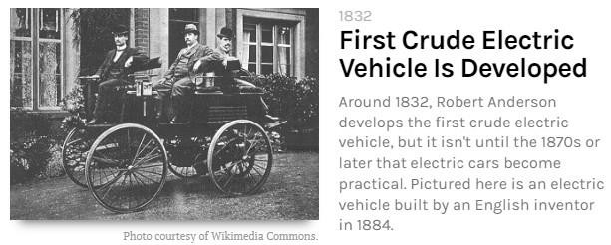

Slide 6
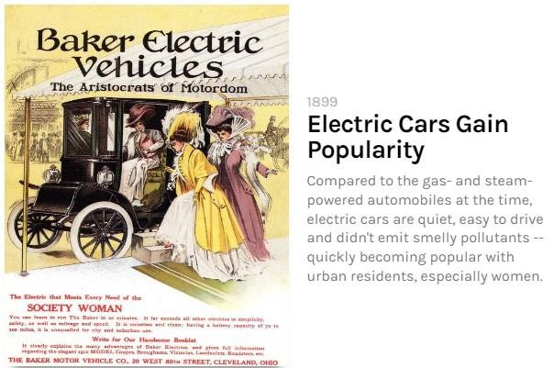

Slide 7
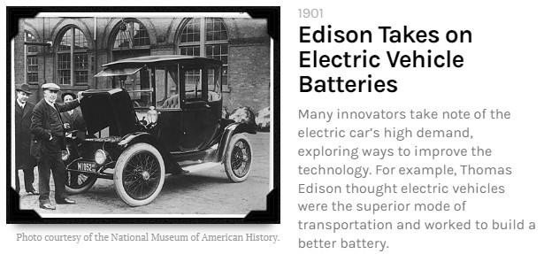

Slide 8
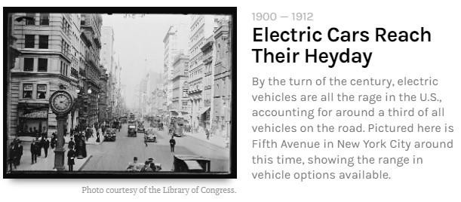

Slide 9
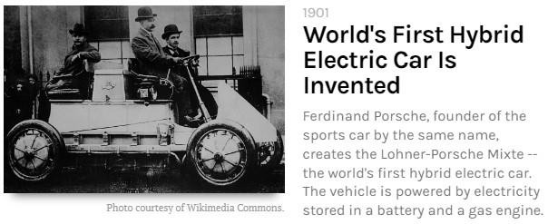

Slide 10
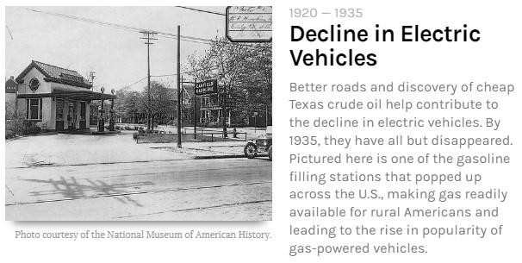

Slide 11
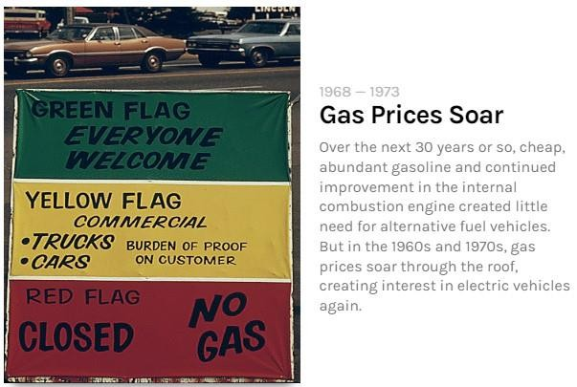

Slide 12
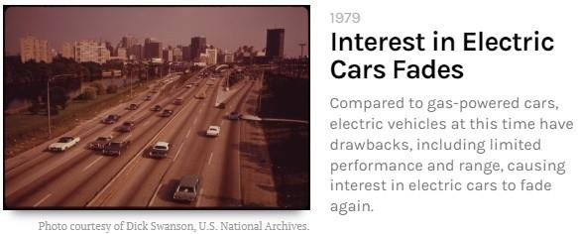

Slide 13
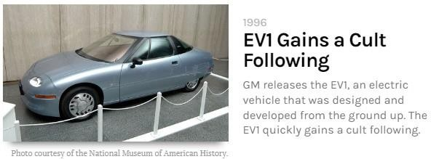

Slide 14
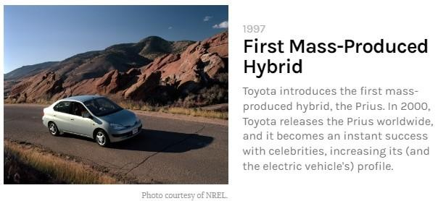

Slide 15
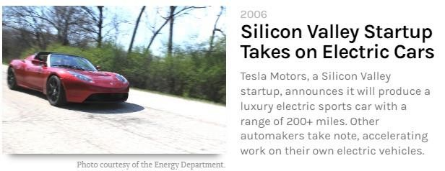

Slide 16
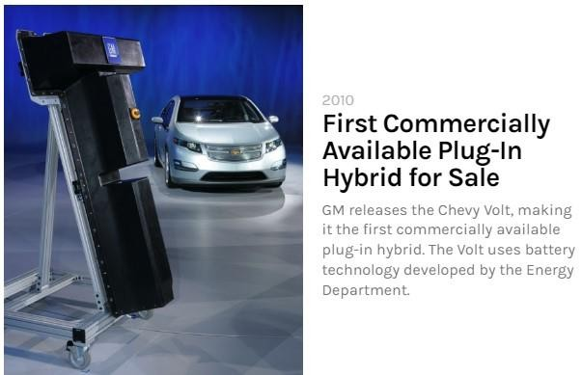

Slide 17
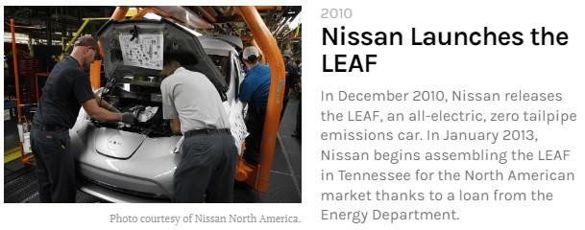

Slide 18
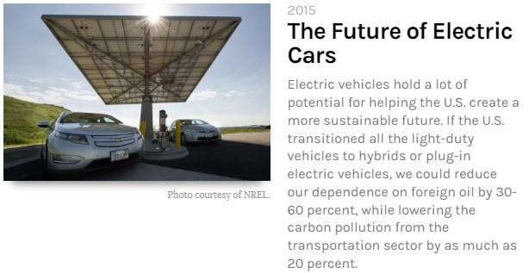

Slide 19
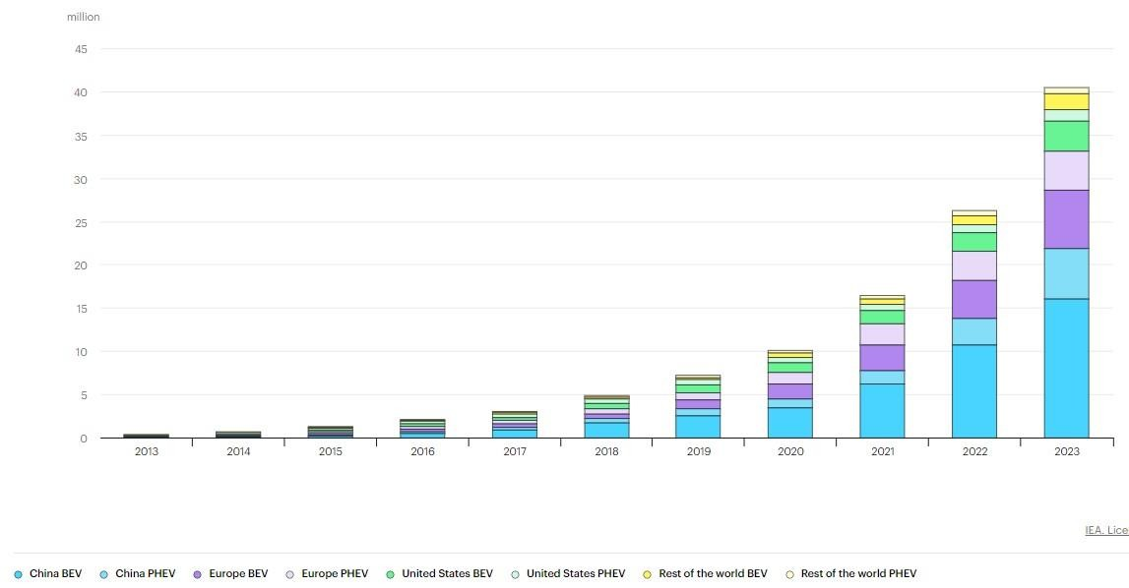
Global EV Sales

Slide 20
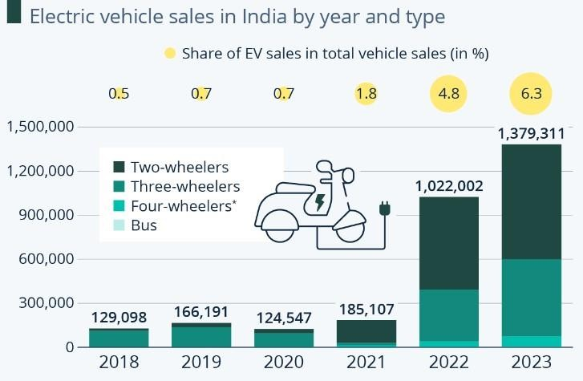

Slide 21
Policies related to EV in India
▶ The adoption of EVs will not only positively impact the country’s economy but also help in achieving India’s target of net zero emissions by 2070. To facilitate smooth growth in the sector and achieve the ambitious target of having EV sales penetration of 30% of private cars, 70% of commercial cars, 40% of buses and 80% of two and three-wheelers by 2030, the government is taking several steps:

Slide 22
Policies related to EV in India
▶ Faster Adoption and Manufacturing of (Hybrid &) Electric Vehicles in India (FAME India) Scheme was launched in 2015 to reduce dependency on fossil fuel and to address issues of vehicular emissions. Currently, Phase-II of the scheme has been implemented with an outlay of INR 10,000 Cr ($ 1.2 Bn) for a period of 5 years commencing from April 1, 2019. Out of total budgetary support, about 86% of the fund has been allocated to create demand for EVs in the country by supporting 7000 e-Buses, 5 lakh e-3 Wheelers, 55000 e-4 Wheeler Passenger Cars (including Strong Hybrid) and 10 lakh e-2 Wheelers.

Slide 23
Policies related to EV in India
▶ Production Linked Incentive (PLI) Scheme for the Automotive Sector, launched in September 2021 with a budgetary outlay of INR 25,938 Cr ($ 3.1 Bn) to boost domestic manufacturing of advanced automotive technology (AAT) products and attract investments in the automotive manufacturing value chain. The SOP details that the scheme has two parts: Champion OEM, which will make electric or hydrogen-powered vehicles, and Component Champions, which will make high-value and high-tech components. The scheme has attracted a proposed investment of INR 74,850 Cr ($ 9 Bn) against the target estimate of investment of INR 42,500 Cr ($ 5.1 Bn) over a period of five years.

Slide 24
Policies related to EV in India
▶ PLI Scheme for National Programme on Advanced Chemistry Cell (ACC) Battery Storage was launched in 2021 to enhance India’s manufacturing capabilities for the manufacture of ACC in India with an outlay of INR 18,100 Cr ($ 2.1 Bn) for seven years (including two years of gestation period). The incentive will be disbursed thereafter over a period of five years on the sale of batteries manufactured in India. So far, three companies have been selected with a manufacturing capacity of 30 Gwh.

Slide 25
Policies related to EV in India
▶ Additionally, the government has taken the following measures to provide impetus to green mobility further:
▶ The Union Budget 2023-24 extended the customs duty exemption to the import of capital goods and machinery required for the manufacture of lithium-ion cells for batteries used in electric vehicles.
▶ GST on electric vehicles has been reduced from 12% to 5%; GST on chargers/ charging stations for electric vehicles has been reduced from 18% to 5%.
▶ Both commercial as well as private battery-operated vehicles are given green
license plates and are exempted from permit requirements.

Slide 26
Policies related to EV in India
▶ Waiver on road tax on EVs, which in turn will help reduce the initial cost of EVs.
▶ To expand and strengthen the Public Electric Vehicle Charging Infrastructure across the nation, the Ministry of Power issued the revised consolidated Guidelines and Standards. The guidelines involves private players to instal EV charging stations. In this direction, the Oil Marketing Companies have announced the setting up of 22,000 EV charging stations in prominent cities and on national highways across the country.

Slide 27
Policies related to EV in India
▶ On March 15, 2024, the Indian government approved a new US$500- million-worth Electric Vehicle (EV) Policy, offering range of incentives with the intention of drawing investments from global EV companies and positioning India as a prime manufacturing hub for state-of-the-art EVs.
▶ Other objectives include providing Indian consumers with access to cutting-edge EV models, expanding the Make in India ecosystem, lowering costs of production, reducing oil import, reducing air pollution in urban areas, and fostering a competitive domestic auto manufacturing industry.

Slide 28
Policies related to EV in India
▶ India’s new EV Policy’s entails the following eligibility criteria and incentives
on offer:
▶ Minimum investment of INR 41.5 billion ( US$500 million) required, with no
maximum limit on investment.
▶ Manufacturing timeline set at three years to establish facilities and commence commercial production of EVs, with a mandatory target of achieving 25 percent domestic value addition (DVA) by the third year and 50 percent DVA by the fifth year.
▶ Customs duty of 15 percent (as applicable to CKD units) with a minimum cost, insurance and freight (CIF) value of US$35,000 and above, for a five-year period, contingent upon setting up manufacturing facilities within three years.

Slide 29
Policies related to EV in India
▶ The duty foregone on the total number of EV allowed for import would be limited to the investment made or INR 64.84 billion, whichever is lower. A maximum import limit of 40,000 EVs at the rate of not more than 8,000 per year will be permissible for investments of US$800 million or more. The carryover of unutilized annual import limits, however, will be permitted.
▶ Investment commitments must be backed by a bank guarantee, which will be invoked in case of non-compliance with DVA and minimum investment criteria.

Slide 30
Policies related to EV in India
▶ The EV Policy offering is in line with India’s ambitious goal of targeting 30 percent of new vehicle sales to be electric by 2030. Despite electric cars representing only 1.3 percent of total car sales in 2022, the Indian government is keen to push for EV production.
▶ The new EV Policy seeks to convince reluctant or undecided global car manufacturers into entering the Indian market. Tesla is facing challenges due to its lack of entry-level vehicles and aging product lineup, leading to declining demand and increased competition from rivals like China’s BYD.

Slide 31
Regulations related to EV in India
▶ Central Motor Vehicle Rules (CMVR), 1989: The CMVR set out the minimum technical requirements for vehicles that are sold in India, including EVs. The CMVR also specify the safety and emission standards that EVs must meet.
▶ Faster Adoption and Manufacturing of Electric Vehicles (FAME-II) scheme: The FAME-II scheme provides incentives to both EV manufacturers and consumers. For manufacturers, the scheme provides subsidies on the production of EVs and their components. For consumers, the scheme provides subsidies on the purchase of EVs. The FAME-II scheme also includes provisions for the development of charging infrastructure for EVs.

Slide 32
Regulations related to EV in India
▶ Production Linked Incentive (PLI) scheme for EVs: The PLI scheme for EVs provides financial incentives to EV manufacturers to invest in India and manufacture EVs and their components domestically. The PLI scheme has an outlay of INR 25,938 crore for the period 2021-2028.
▶ Charging Infrastructure for Electric Vehicles Guidelines, 2022: The Charging Infrastructure for Electric Vehicles Guidelines, 2022 provide a framework for the setting up and operation of public charging stations in India. The guidelines also specify the technical standards that charging stations must meet.

Slide 33
Needs and Importance of Electric Vehicle
▶ Electric cars are better for the environment
▶ Key to reduce Carbon footprint & Urban pollution
▶ Runs on cheaper Electricity
▶ Fossil fuels are diminishing
▶ Electrical Energy can be generated by renewable sources like solar, Hydro Electric etc., which renews continuously
▶ Transportation of fuel is difficult and costly, whereas transportation of electricity can be easily done through T&D lines

Slide 34
Needs and Importance of Electric Vehicle
▶ Electricity can be made available to remote areas, through line conductors, where other fuel is difficult to supply
▶ Electrical Vehicles are only option for underground transport system

Slide 35
Advantages of Electric Vehicles
▶ Lower running costs
▶ Low maintenance cost
▶ Zero Tailpipe Emissions
▶ Tax and financial benefits
▶ Petrol and diesel use is destroying our planet
▶ Electric Vehicles are easy to drive and quiet
▶ Convenience of charging at home
▶ No noise pollution

Slide 36
Advantages of Electric Vehicles
▶ Can be upgraded just like your phone
▶ Deliver all the torque immediately
▶ EVs are quick to start
▶ Better overall Performance
▶ Electric drivetrains’ compact design allows for increased interior space
▶ Reduced Dependence on Oil
▶ Efficient and superior Regenerative braking is possible

Slide 37
Disadvantages of Electric Vehicles
▶ Limited Driving Range
▶ Battery Life and Degradation
▶ Charging Infrastructure Worries
▶ Long Charging Times
▶ Low Top Speeds
▶ More Expensive to Buy
▶ Limited Model Availability
▶ Environmental Impact of Battery Production

Slide 38
Electric Vehicle (EV)
▶ An electric vehicle (EV) is one that operates on an electric motor, instead of an internal-combustion engine that generates power by burning a mix of fuel and gases.

Slide 39
Types of EVs
▶ Hybrid Electric Vehicle (HEV)
▶ Hybrid electric vehicles are powered by an internal combustion engine and one or more electric motors, which uses energy stored in batteries.
▶ A hybrid electric vehicle cannot be plugged in to charge the battery.
▶ The battery is charged through regenerative braking and by the internal combustion engine.
▶ In regenerative braking, the electric motor/generator captures energy normally
lost during braking
▶ The extra power provided by the electric motor can potentially allow for a smaller engine.

Slide 40
Types of EVs
▶ The battery can also power auxiliary loads and reduce engine idling when stopped.
▶ Together, these features result in better fuel economy without sacrificing
performance.

Slide 41
Types of EVs
▶ Plug-in Electric Vehicle (PEV)
▶ A plug-in electric vehicle (PEV) is any motor vehicle that can be recharged from any external source of electricity, such as wall sockets, and the electricity stored in the Rechargeable battery packs drives.
▶ Plug-in Electric Vehicles can be further categorized into
▶ Battery electric vehicles (BEVs)
▶ Plug-in Hybrid Electric vehicles, (PHEVs)

Slide 42
Types of EVs
▶ Battery Electric Vehicles
▶ A battery electric vehicle (BEV), pure electric vehicle, only-electric vehicle or all- electric vehicle is a type of electric vehicle (EV) that exclusively uses chemical energy stored in rechargeable battery packs, with no secondary source of propulsion.
▶ Battery Electric Vehicles (BEV) thus have no internal combustion engine, fuel cell, or fuel tank.
▶ Some of the broad categories of vehicles that come under this category are
trucks, cars, buses, motorcycles, bicycles, forklift etc.

Slide 43
Types of EVs
▶ Plug-in Hybrid Electric Vehicles (PHEV)
▶ A plug-in hybrid electric vehicle (PHEV) is a hybrid electric vehicle whose battery can be recharged by plugging it into an external source of electric power, as well as by its on-board engine and generator.
▶ Most PHEVs are passenger cars, but there are also PHEV versions of commercial vehicles and vans, military vehicles, utility trucks, trains, motorcycles, buses and mopeds.

Slide 44
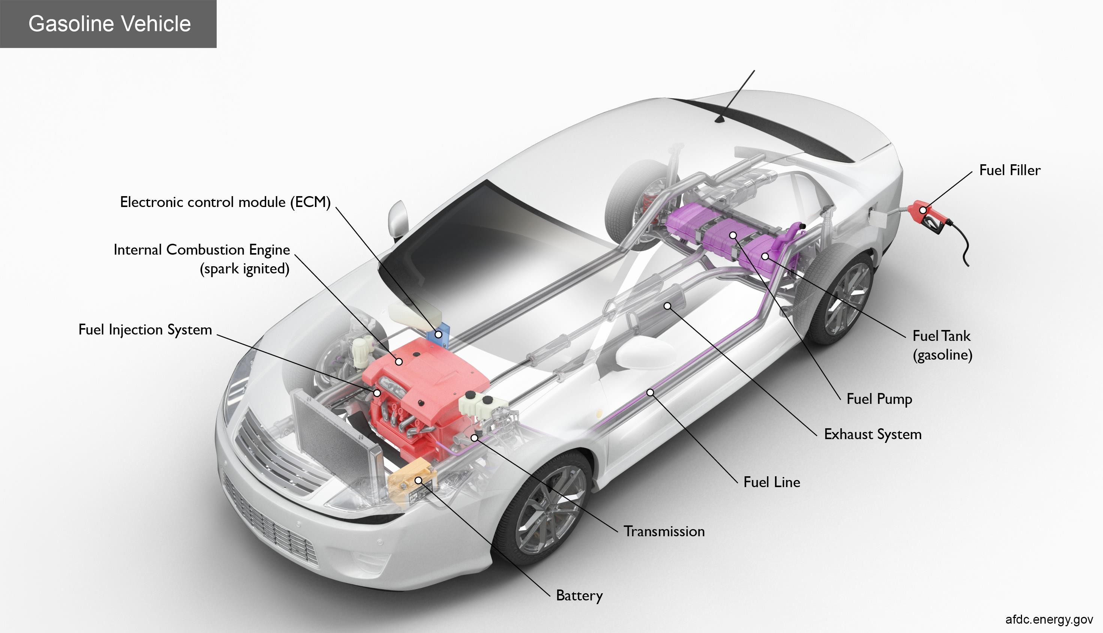

Slide 45
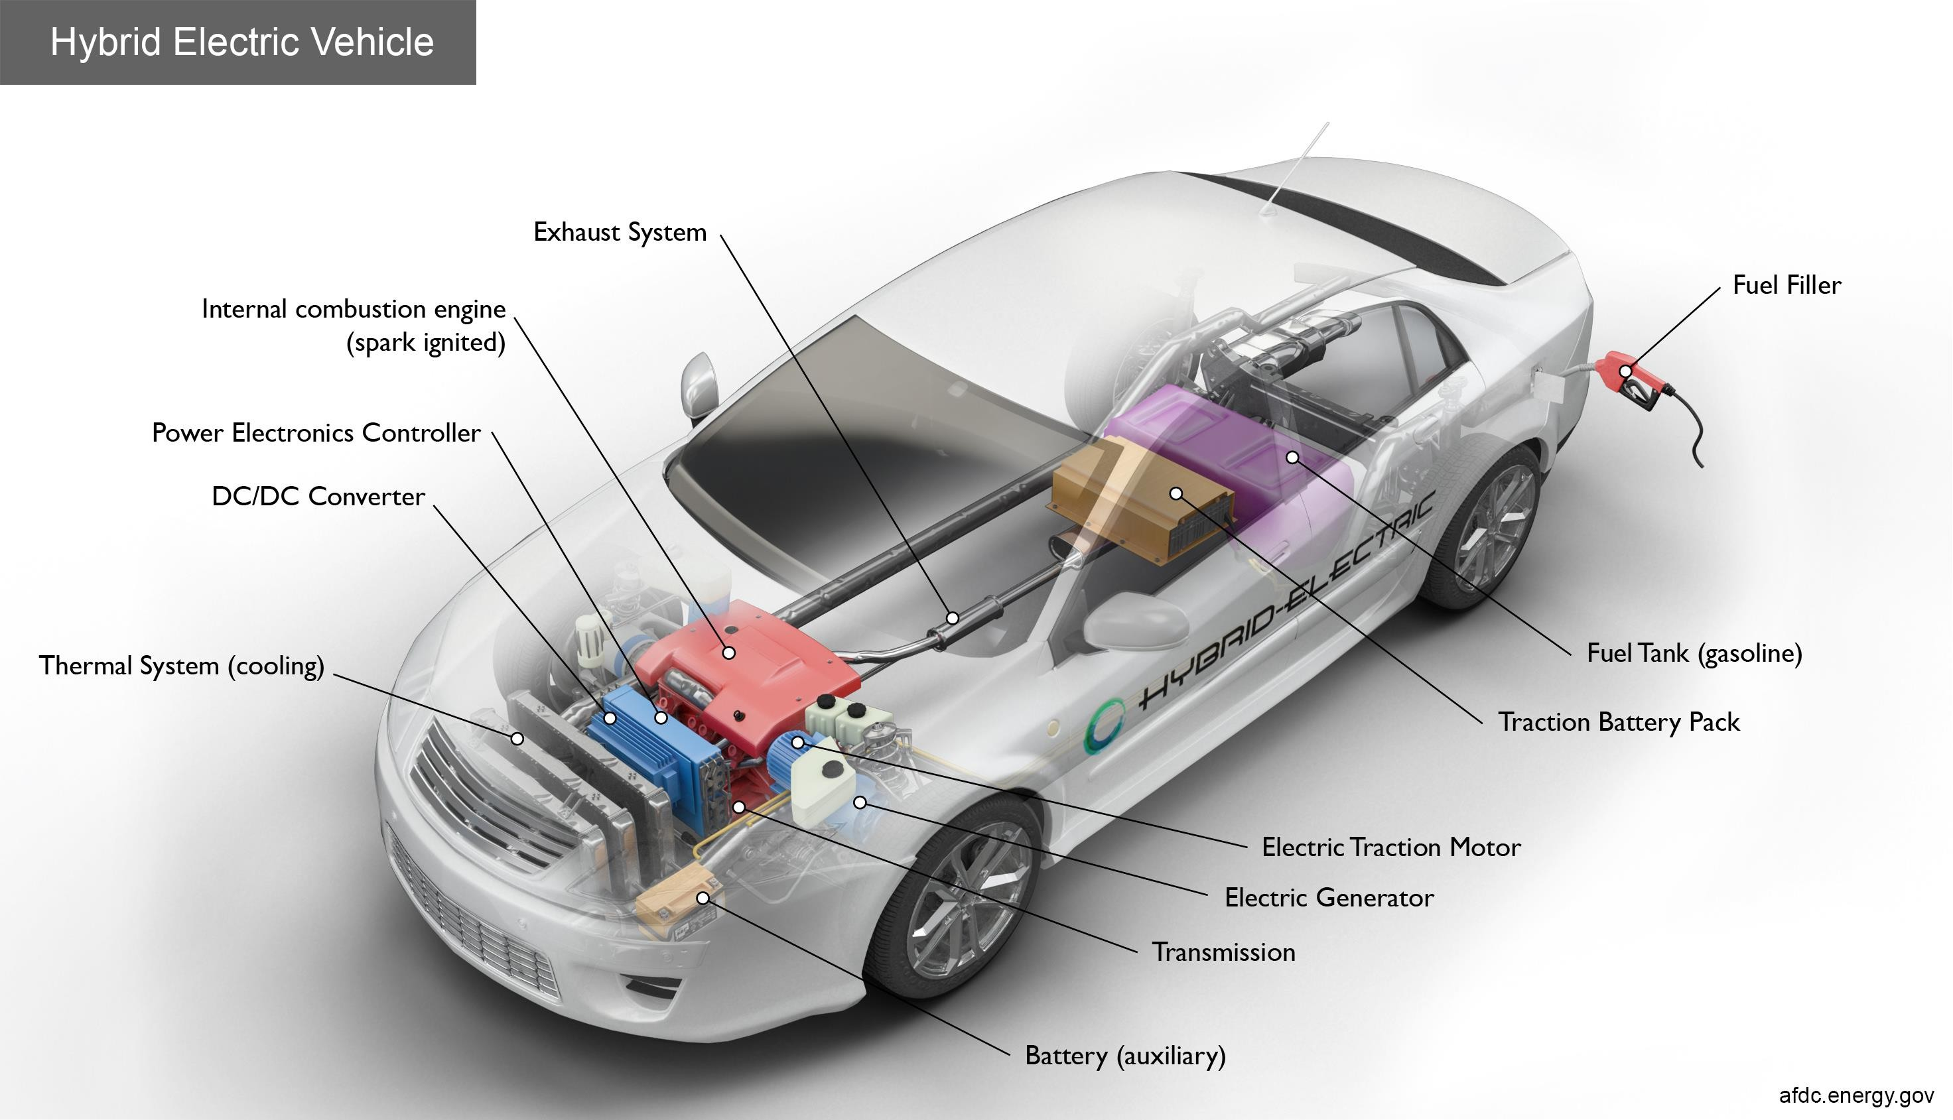

Slide 46
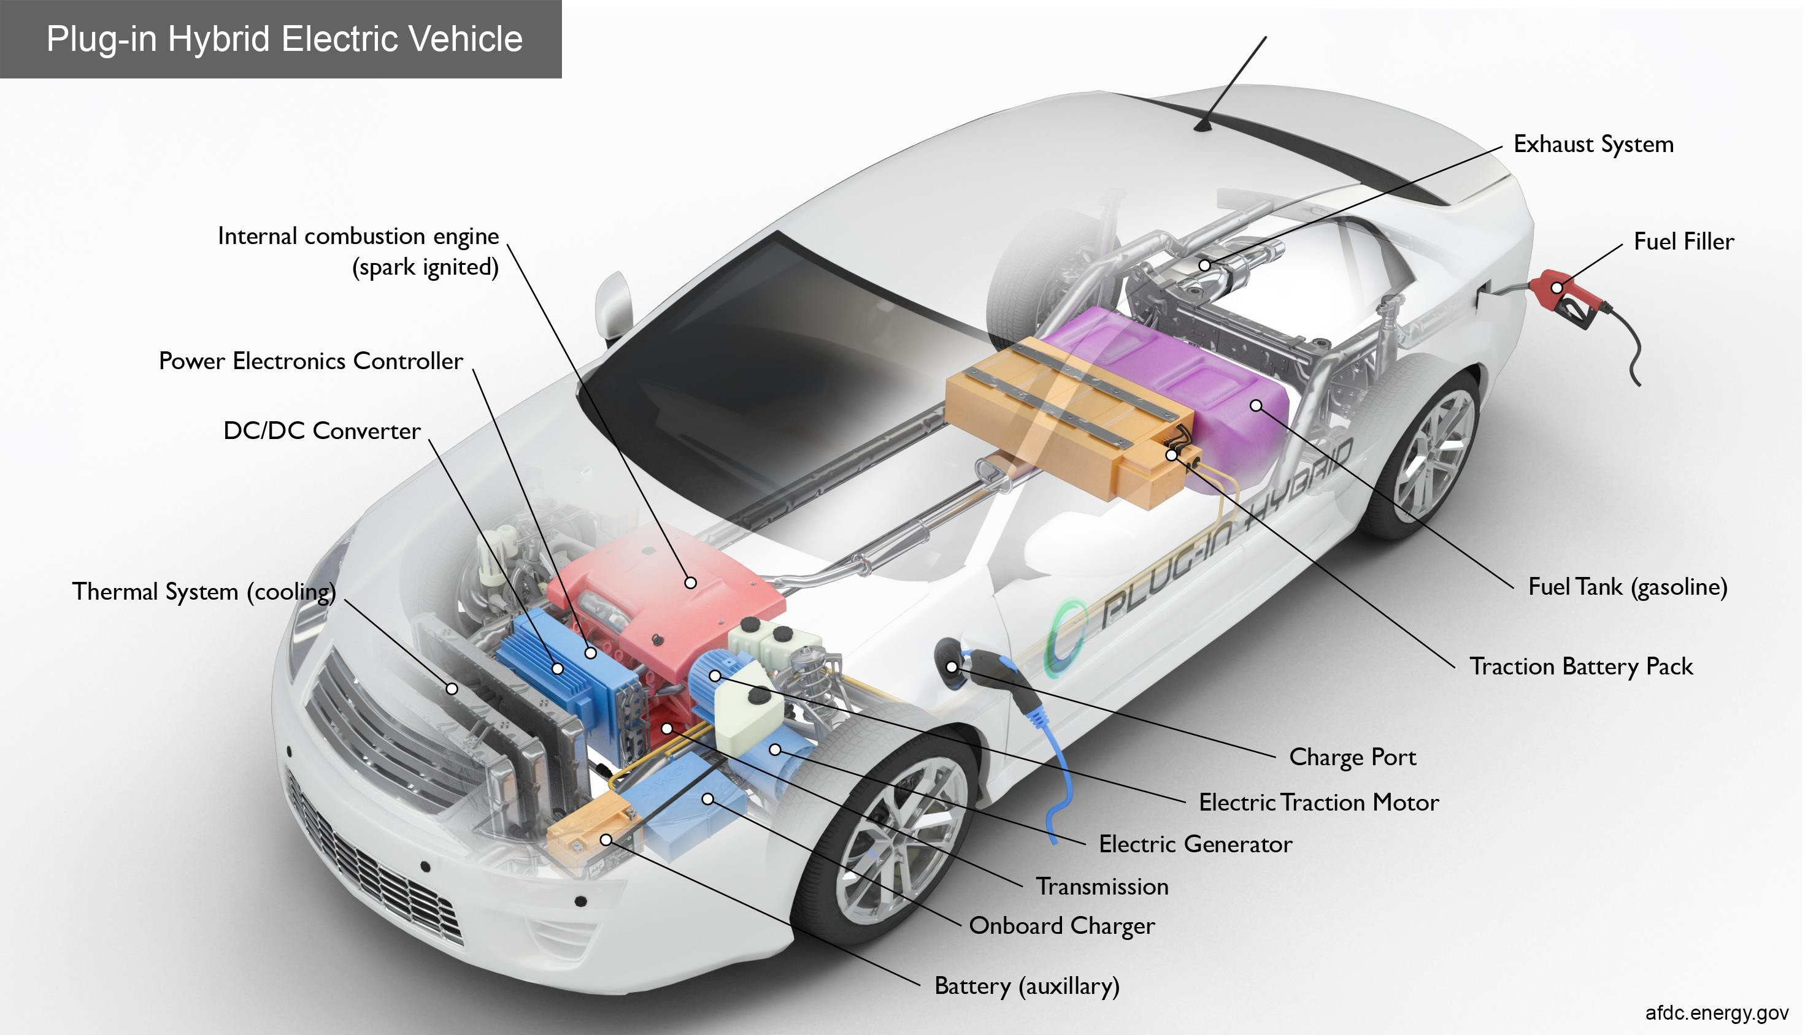

Slide 47
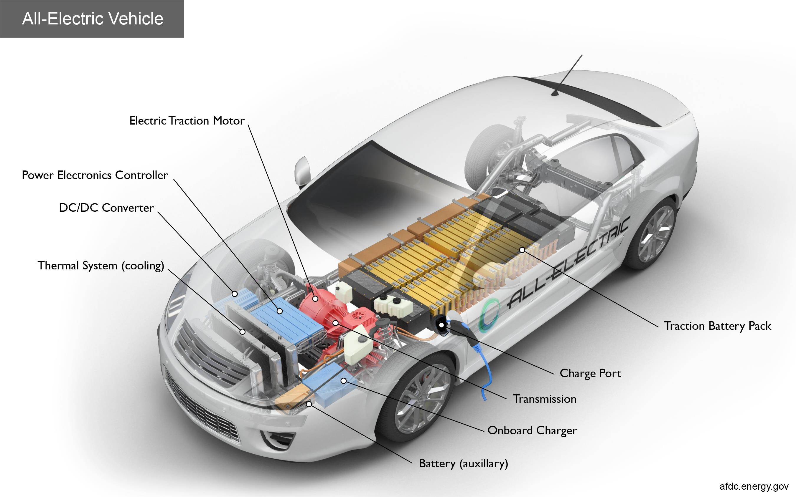

Slide 48
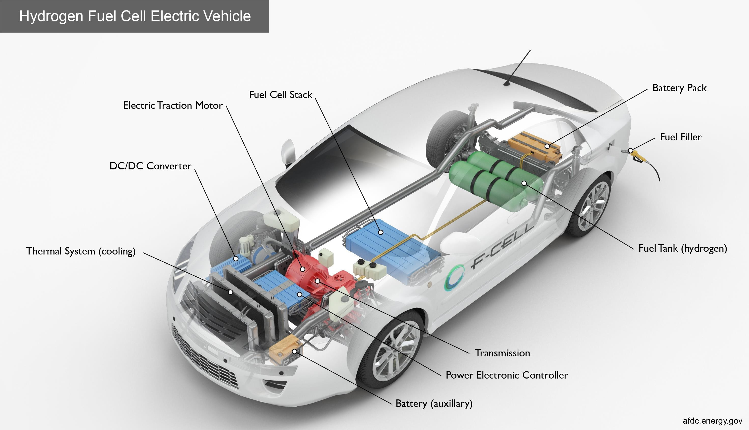

Slide 49
Safety precautions while handling Electric Vehicle
▶ The high voltage system may remain powered for up to 10 minutes after being disabled. The method of disabling the high voltage system is manufacturer specific.
▶ Never assume that the EV is powered down because it is silent.
▶ Never touch, cut or open any orange high voltage power cable or high voltage components without personal protective equipment.
▶ Do not cause any impact that could potentially result in any damage. The electrolyte may be flammable and/or toxic and can be damaging to human tissue.

Slide 50
Safety precautions while handling Electric Vehicle
▶ Do not have any metal objects in your possession while working on the battery.
▶ Do not allow open flames near, apply heat to the EV battery or do not expose to high temperature, e.g. long period in direct sunlight
▶ Do not inhale spray, gas or aerosol emitted from the battery
▶ Avoid contact of battery contents with skin and eyes
▶ Wear suitable protective clothing, gloves and eye/face protection
▶ In case of accident or if you feel unwell, seek medical advice immediately (show label where possible)

Slide 51
Safety precautions while handling Electric Vehicle
▶ Only isolate and dismantle EV vehicle systems in well ventilated areas
▶ Avoid release of battery contents to the environment
▶ Always refer to additional instructions that may be given by the vehicle
manufacturer
▶ If battery material is swallowed and the person is conscious, rinse mouth with water and seek medical advice immediately
▶ The EV battery is heavy, use mechanical assistance during manipulation
▶ In case of misuse or severe damage of Lithium Ion batteries there is a potential risk of heat, fire or degassing

Slide 52
Safety precautions while handling Electric Vehicle
▶ Components with a strong magnetic field are used in this vehicle.
Operators with medical electric devices such as pacemakers must not carry out EV dismantling as strong magnetic fields can affect the function of the device
▶ Never connect the positive terminal to the negative terminal, and never connect the cell casing to an electrical conductor

Slide 53


