Slide 1
Basics of Digital Electronics

Slide 2



Digital Signals
An electrical signal with two discrete levels (high and low)
Two discrete levels are represented by binary digits 0 and 1
referred as Binary number system.
Gorge Boole introduced binary number system with algebra
developed “Boolean Algebra”
Represented in two different ways
  Positive logic system
Negative logic system

Slide 3

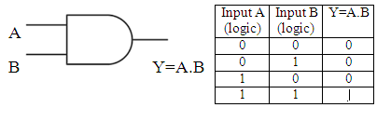
Logic Gates
Basic logic gates
  AND gate
    Logical Multiplication
    Two input gate shown

Slide 4
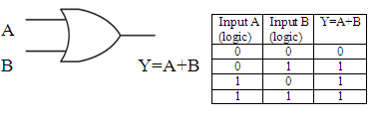

Basic logic gates
  OR gate
    Logical Addition
    Two input gate shown
NOT/Inversion gate
  Logical inversion
  Single input single output gate

Slide 5


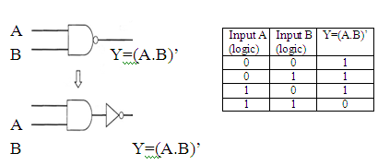
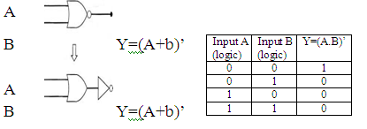
Universal logic gates
  NAND gate
    Two input gate shown
NOR gate
  Two input gate shown

Slide 6


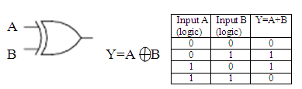
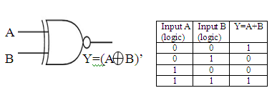
Special gates
  Ex-OR gate
    Two input gate shown
Ex-NOR gate
  Two input gate shown

Slide 7

Boolean Algebra
Mathematician George Boole developed
rules for manipulation of binary variables.
Rules :
  A+0=A
  A+1=1
  A+A=A
  A+A’=1
  A.0=0
  A.1=A
  A.A=A
  A.A’=0
  A.(B+C)=AB+AC

Slide 8
Boolean Algebra
A+BC=(A+B).(A+C)
A+A.B=A
A.(A+B)=A
A+A’.B=A+B
A.(A’+B)=A.B
A.B+A’.B’=A
(A+B).(A+B’)=A
A.B+A.C’=(A+C).(A’+B)
(A+B).(A’+C)=AC+A’B
AB+A’C+BC=AB+A’C
(A+B).(A’+C).(B+C)=(A+B).(A’+C)

Slide 9

De Morgan’s Theorem
(A.B)’=A’+B’
(A+B)’=A’.B’

Slide 10
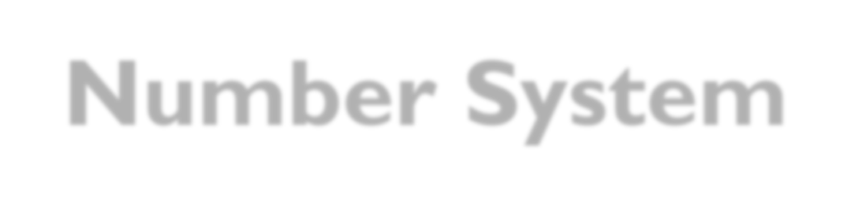
Number System
Number System | Base or radix | Symbols used (d_{i} or d_{-f}) | Weight assigned to position |  | Example
 |  |  | i | -f
Binary | 2 | 0,1 | ₂i | ₂-f | 10101.10
Octal | 8 | 0,1,2,3,4,5,6,7 | ₈i | ₈-f | 3547.25
Decimal | 10 | 0,1,2,3,4,5,6,7 ,8,9 | 10^{i} | ₁₀-f | 974.27
Hexadecimal | 16 | 0,1,2,3,4,5,6,7 ,8,9,A,B,C,D, E,F | 16^{i} | ₁₆-f | FA9.46

Slide 11

Quantities/Counting
Decimal | Binary | Octal | Hexadecimal
0 | 0000 | 00 | 0
1 | 0001 | 01 | 1
2 | 0010 | 02 | 2
3 | 0011 | 03 | 3
4 | 0100 | 04 | 4
5 | 0101 | 05 | 5
6 | 0110 | 06 | 6
7 | 0111 | 07 | 7
8 | 1000 | 10 | 8
9 | 1001 | 11 | 9
10 | 1010 | 12 | A
11 | 1011 | 13 | B
12 | 1100 | 14 | C
13 | 1101 | 15 | D
14 | 1110 | 16 | E
16 | 1111 | 17 | F

Slide 12
Number System conversion
Binary to decimal
  Multiply each bit by 2^{n}, n is the “weight” of the bit
  The weight is the position of the bit, starting from 0 on the right
  Add the results Example (110101)₂ = ( )₁₀
= 1x2⁵+1x2⁴+0x2³+1x2²+0x2¹+1x2⁰
= 32+16+0+4+0+1
= (53)₁₀

Slide 13
Number System conversion
Binary to octal
  Group bits in threes, starting on right
  Convert to octal number
Example
(110101)₂ = ( )₈
= 110 101
= 6 5
= (65)₈

Slide 14
Number System conversion
Binary to hexadecimal
  Group bits in fours, starting on right
  Convert to hexadecimal number
Example
(110101)₂ = ( )₁₆
= 11 0101
= 0011 0101
= (35)₁₆

Slide 15

Number System conversion
Decimal to binary
  Divide by two, keep track of the remainder
  First remainder is bit 0 (LSB, least-significant bit)
  Second remainder is bit 1Group bits in fours, starting on right
Example
(53)₁₀ = ( )₂
= (110101)₂

Slide 16

Number System conversion
Decimal to octal
  Divide by eight, keep track of the remainder
  First remainder is bit 0 (LSB, least-significant bit)
  Second remainder is bit 1Group bits in fours, starting on right
Example
(53)₁₀ = ( )₈
= (65)₈

Slide 17

Number System conversion
Decimal to hexadecimal
  Divide by 16, keep track of the remainder
  First remainder is bit 0 (LSB, least-significant bit)
  Second remainder is bit 1Group bits in fours, starting on right
Example (53)₁₀ = ( )₁₆
=
= (35)₁₆ `

Slide 18
Number System conversion
Octal to binary
  Convert each octal digit to a 3-bit equivalent binary representation
Example
(65)₈ = ( )₂
= 110 101
= (110101)₂

Slide 19
Number System conversion
Octal to decimal
  Multiply each bit by 8^{n}, n is the “weight” of the bit
  The weight is the position of the bit, starting from 0 on the right
  Add the results
Example
(65)₈ = ( )₁₀
= 6x8¹+5x8⁰
= 48+5
= (53)₁₀

Slide 20
Number System conversion
Octal to hexadecimal
  Use binary as an intermediary.
Example
(65)₈ = ( )₁₆
= 110 101
= 11 0101
= 0011 0101
= (35)₁₆

Slide 21
Number System conversion
Hexadecimal to binary
  Convert each hexadecimal digit to a 4-bit equivalent binary representation.
Example
(6A)₁₆ = ( )₂
= 0110 1010
= (1101010)₂

Slide 22
Number System conversion
Hexadecimal to octal
  Use binary as an intermediary.
Example
(6A)₁₆ = ( )₈
= 0110 1010
= 1 101 010
= 001 101 010
= (152)₈

Slide 23
Number System conversion
Hexadecimal to decimal
  Multiply each bit by 8^{n}, n is the “weight” of the bit
  The weight is the position of the bit, starting from 0 on the right
  Add the results
Example
(6A)₁₆ = ( )₁₀
= 6x16¹+Ax16⁰
= 6x16¹+10x16⁰
= 96 + 10
= (106)₁₀

Slide 24
Complement representation
One’s complement format
  In binary number system, each bit is complimented.
Example
(0100101)₂ = (1011010) one’s complement form
Two’s complement format
  In binary number system, each bit is complimented and binary 1 is added.
  Used to represent negative number.
Example
(0100101)₂ = (90)₁₀
= (1011010)₂ one’s complement form
= (1011010 + 1)₂
= (1011011)₂ = (-90)₁₀ 2’s complement

