Slide 1
IECD
5th SEMESTER
ELECTRICAL

Slide 2
Thyristors
Most important type of power semiconductor device.
Have the highest power handling capability. They have a rating of 5000V / 6000A with switching frequencies ranging from 1KHz to 20KHz.

Slide 3

SCR
Symbol of
Silicon Controlled Rectifier

Slide 4
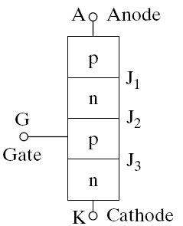
Device Operation
Simplified model of a thyristor

Slide 5
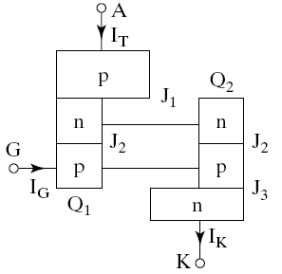
Two Transistor Model of SCR
⇒

Slide 6
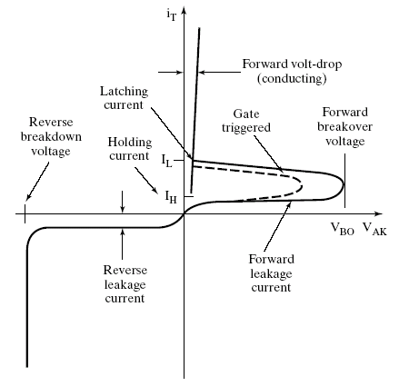
V-I Characteristics

Slide 7
Methods of Thyristor Turn-on
Thermal Turn-on.
Light.
High Voltage.
Gate Current.
dv/dt.

Slide 8
Gate Triggering Methods
Efficient & reliable method for turning on SCR.
Types
  R - Triggering.
  RC - Triggering.
  UJT - Triggering.

Slide 9
R-Triggering
Resistance firing circuit

Slide 10
RC Triggering
RC half-wave trigger circuit

Slide 11
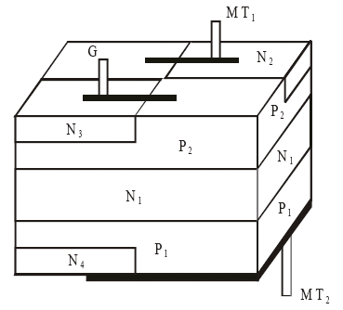
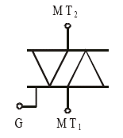
Bidirectional Triode Thyristors (TRIAC)

Slide 12
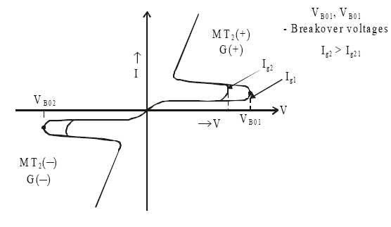
Triac Characteristics

Slide 13
High temperature due to:

Slide 14
Snubber

Slide 15
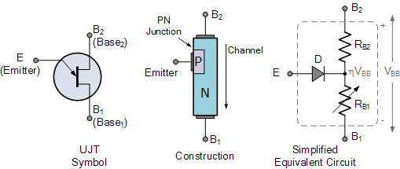
Unijunction Transistor (UJT)
UJT is another solid state three terminal device that can be used in gate pulse, timing circuits and trigger generator applications to switch and control thyristors and triacs for AC power control applications.

Slide 16
Unijunction Transistor (UJT)
Equivalent Circuit: UJT’s have unidirectional conductivity and negative impedance characteristics acting more like a variable voltage divider during breakdown

Slide 17
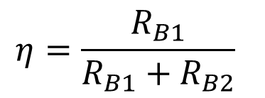
Unijunction Transistor (UJT)
For a Unijunction transistor, the resistive ratio of R_{B1} to R_{BB} is called the intrinsic stand-off ratio (η).
$$η=\frac{R_{B1}}{R_{B1}+R_{B2}}$$
Typical standard values of η range from 0.5 to 0.8 for most common UJT’s.

Slide 18
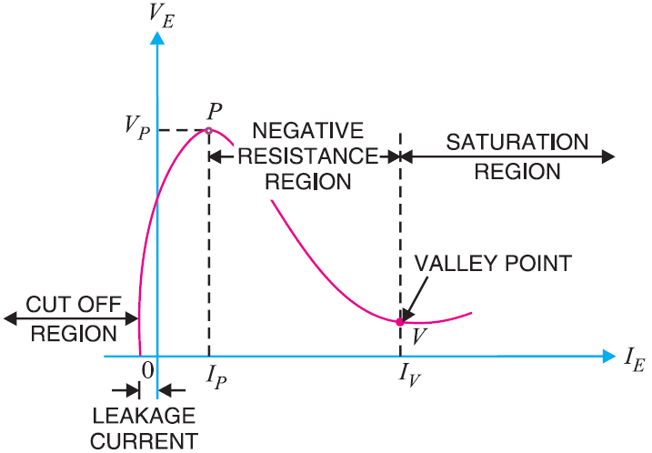
UJT Characteristics

Slide 19
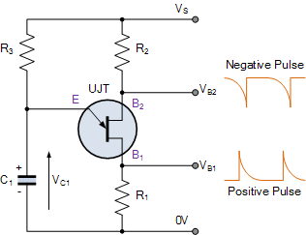
UJT Relaxation Oscillator
In a basic and typical UJT relaxation oscillator circuit, the Emitter terminal of the Unijunction transistor is connected to the junction of a series connected resistor and capacitor.

Slide 20
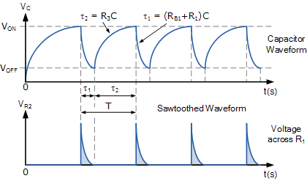

UJT Relaxation Oscillator
$$V_{C}=V_{BB}(1−e^{−t/R_{3}C})$$

Slide 21
Triac Light Dimmer
Light
bulb
a
b
Triac
(front view)
Ingenious
Simple
Efficient
Inexpensive
3.3kΩ
+
V_{an}
(from Variac)
–
MT2
250kΩ linear pot
c
G
Triac
MT1
0.1µF
Bilateral trigger diode (diac)
MT1 MT2 G
n
Light
bulb
Light
bulb
a
b
a
b
+
V_{an}
–
+ 0V –
+
V_{an}
–
+
V_{an}
–
+ V_{an} –
+
0V
–
n
n
Before firing, the triac is an open switch, so that practically no voltage is applied across the light bulb. The small current through the 3.3kΩ resistor is ignored in this diagram.
After firing, the triac is a closed switch, so that practically all of V_{an} is applied across the light bulb.

