Slide 1
Mechanical Engineering
Semester -4th
Workshop Technology (WT) -II

Slide 2
Chapter-1
Cutting Tools and Cutting Materials
1.1 Cutting Tools
1.2 Cutting Tool Materials

Slide 3
INTRODUCTION
Cutting material are shaped with the help of cutting tools into useable form through various process.
The work piece of most different shapes and sizes and of different material are worked.

Slide 4
CUTTING TOOLS
The tools which are used for the purpose of cutting the metal in the desired shape and size are called cutting tools. Eg. High-speed steel, tungsten carbide, cobalt steel cemented carbides, stellite, ceramics and diamond etc.

Slide 5
Classification of Cutting Tools
Single point cutting tools
Multi point cutting tools

Slide 6
Single Point Cutting Tools
When the cutting tool terminates into single point it is termed as a single point tool.
These tools are used on lathes, Shapers, Planers and for boring works.

Slide 7
Multi point cutting tools
These tools are used as milling cutter, Drills, Broaches and for grinding works.
Types :
1) Linear motion tools
2)Rotary motion tools
3) linear and rotary tools

Slide 8
Types of Single Point Cutting Tools
A cutting tool is used either for cutting apart or for removing chips.
Various types of single point cutting tools having a wedge like action find a wide application on lathe machine, shaper, planner and slotter etc.

Slide 9
Tools for Lathe Machine
Turning tool
Facing tool
Chamfering tool
External Threading tool
Internal threading tool
Boring tool

Slide 10
Tools for Planer
Straight and bent roughing tool.
2) Straight, Roundness and goose neck tools.

Slide 11
Tools for Shaper and Slotter
Roughing for CI, Brass or Bronze
Finishing tools for CI brass
Cutting tool for Steel and tough metal
Cutting tool for aluminium and other soft material

Slide 12
Single Point Cutting Tool Geometry
Cutting tool geometry concern with basic tool angles i.e. angles ground on tool to make it efficient in cutting.
A single point cutting tool has only one cutting edge and is widely used in routine workshop.

Slide 13
Parts of Single Point Cutting Tools
Shank
Face
Flank
Heel
Base
Nose
Point

Slide 14
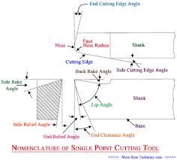
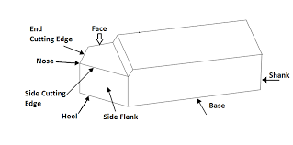
Principal Angles of Single Point Cutting Tool
The different angles provided on a single point cutting tool have a great significance role to play in successful and efficient machining of different metals.

Slide 15
Principal Angles
Rake Angle : Rake angle may be positive, Negative or Zero.
Side Rake Angle
Back Rake or Top Rake angle
Lip Angle
Clearance Angle

Slide 16
Cont..
6) Front Clearance Angle
7) Side Clearance Angle
8) Relief Angle or End Relief Angle
9) Cutting Angle
10) Nose Radius
11) Side cutting edge
12) End cutting edge angle

Slide 17
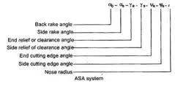
TOOL SIGNATURE
The term TOOL SIGNATURE is used to denote a standardised system of specifying the principal tool angle of a single point cutting tool.
Signature of a tool always stated in the following order:
Back rake angle
Side rake angle
End relief angle

Slide 18
Cont…
4) Side relief angle
5) End cutting edge angle
6) Side cutting edge angle
7) Nose radius

Slide 19
Effect of Tool Signature
It allow chips to flow in a convenient direction.
It reduces the cutting field required to shear the metal and consequently help to increase the tool life and reduces the power consumed.
It improve the surface finish.

Slide 20
Heat Produced during Cutting
Considerable heat during machining process is generated at the cutting edge of the tool due to friction between tool and work and the plastic shearing of the metal in the form of chips, When the tool is machining metal on a machine tool.

Slide 21
Evolution of heat at three Zones
Zone A is the shear zone.
Zone B is the Friction zone.
Zone C is the work tool contact zone.

Slide 22
Effect of Heat produced during Cutting
The heat produced reduce the tool life.
The heat causes the chip material to weld to the tool face due to friction between the chip and tool.
The heat reduces the surface finish.

Slide 23
Prevention of heat produced during cutting
Reduce Friction.
Reduce Temperature.
Reduce Pressure.
Preventing Metal to Metal contact.

Slide 24
Cutting Speed
Cutting speed of cutting tool is defined as the speed at which the cutting edge passes over the material and it is expressed in meter per minute (m/s).

Slide 25
Effect of cutting Speed and Feed
1) Cutting speed has maximum influence on tool life.
2) Tool life decreases as the cutting speed increases.
The feed of a cutting tool is defined as the distance the tool advances into or along the workpiece each time the tool point passes a certain position in its travel over the surface.

Slide 26
Depth of Cut
The depth of cut is defined as the perpendicular distance measured from the machined surface to the under cut surface of the workpiece.
Depth of cut = (d1-d2)/2
Where:
d1=Diameter of the work surface before machining.
d2 = Diameter of the machined surface

Slide 27
Effects of Depth of Cut
Kind of material being cut
Shape and dimension of cutting elements
Type of finish desired
Type of coolant used

Slide 28
Cutting Tool Materials
With a great variety of machine and machining operation in use, there is no single tool material, which fulfil all the factors encountered during machining process.
The relative importance of each item shifts with the nature of product machined i.e. high or low precision cost, the volume of production, the type of machining operation intermittent or continuous.

Slide 29
Properties of Cutting Tool Materials
It should be harder than the material of workpiece.
It should have ability to retain its harness at high temperature called hardness.
It should have the ability to resist shock called toughness.
It should have high resistance against wear to have longer too life.
It should be able to fabricated and shaped easily.

Slide 30
Various Cutting Tool Materials
High speed steel
Tungsten carbide
Cobalt steel
Cemented carbides
Stellite
Cemented oxide or ceramics
Diamond

Slide 31
CHAPTER - 2
LATHE

Slide 32
Introduction
The history of invention of lathe dates back to eighteenth century.
The first useful form of lathe with essential features, was made by Henry Maudslay, a britisher in the year 1797.

Slide 33
Priciple of Turning
Turning in a lathe is to remove excess material from the workpiece to produce a cone shaped or a cylindrical surface.
The work is held between centres during turning operation.

Slide 34
Various Types of Lathe
Speed lathe
Engine lathe or centre lathe
Bench lathe
Tool room lathe
Capstan and turret lathe
Special purpose lathe
Automatic lathe

Slide 35
Classification of various lathe
Speed lathe :
a) Wood working b) Centering
c) Polishing c) spinning
Engine lathe :
a) Belt drive b) individual drive
c) gear head lathe
Special purpose lathe :
a) wheel lathe b) gap bed lathe
c) T-lathe d) Missile lathe

Slide 36
LATHE SPECIFICATION
MAXIMUM LENGTH BETWEEN CENTRES
SWING IN GAP
HEIGHT OF CENTRE
SWING OVER CARRIAGE
SWING OVER BED

Slide 37
DESCRIPTION AND FUNCTION OF PARTS OF LATHE
BED
HEAD STOCK
TAIL STOCK
CARRIAGE
FEED MECHANISM
SCREW OR THREAD CUTTING MECHANISM

Slide 38
BED
The bed of lathe acts as the base on which the different fixed and operating parts of the lathe are mounted. This facilitates the correct relative location of the fixed parts and at the same time provides ways for a well guided and controlled movement of the operating part.

Slide 39
HEAD STOCK
Head stock is that part of lathe which serves as a housing for the driving arrangements. It is permanently fasted to the left hand end of the lathe.

Slide 40
TAIL STOCK
It is located on the inner ways at the right hand end of the bed. It serves the following two main purpose.
It supports the other end of work during machining between centres.
It hold a tool for performing operations such as drilling, reaming and tapping etc.

Slide 41
Carriage
The lathe carriage serves the purpose of supporting, guiding and feeding the tool against the job during the lathe operations.
Saddle
Cross slide
Compound rest
Tool post
Apron

Slide 42
Feed mechanism and Thread Cutting Mechanism
Feed Mechanism : The movement of tool relative to the work is termed as feed. A lathe tool may have three types of feed named as longitudinal, cross and angular.
Thread cutting mechanism : The rotation of lead screw is used to transverse the tool along the work to produce screw thread.

Slide 43
Work holding devices
Holding between centres
Chucks
Collets
Face plate
Mandrels
Rests :
a) steady Rest
b) Follower rest

Slide 44
Lathe Tools
a) Shank f) Face
b) Flank g) Heel
c) Nose h) Rake
d) Back Rake i) Side Rake
e) Side relief j) End relief
k) End cutting edge angle
l)Side cutting edge angle

Slide 45
Lathe operation
To perform different machining operations on lathe, the workpiece is supported and driven by any of the following method :
Workpiece is held between centres and driven by carriers and Cath plates.
Workpiece is held on a mandrel which is supported between centres and driven by carriers and catch plates.
Workpiece is held and driven by chuck or a face plate or an angle plate.

Slide 46
Plain and step turning
Both these operations are simple operations and can be done by holding the job in many different ways. The common methods of holding the work are:
Between centres
On a face plate
In a chuck
On a mandrel

Slide 47
Facing
This operation enables the production of a flat surface through machining at the end of job. In this operation the tool is fed at right angles to the axis of job. Since no longitudinal feed is needed, the carriage is clamped to the bed so that it remains stationary during the operation.

Slide 48
Parting Off
This is also named as cutting off. This operation is employed for cutting away a desired length from the bar stock which is usually need in separating the finished article from it stock.

Slide 49
Taper Turning
A taper is defined as a uniform increase or decrease in diameter of a piece of work measured along its length. In a lath, taper turning means to produce a conical surface by a gradual reduction in diameter from a cylindrical workpiece.

Slide 50
Eccentric Turning
If a cylindrical workpiece has two separate axis of rotation, one being out of centre to the other, the workpiece is termed as eccentric and turning of different surface of the workpiece is known as eccentric turning.

Slide 51
DRILLING
It is an operation of producing a cylindrical hole in a workpiece by the rotating cutting edge of a cutter known as the drill. Drilling on a lathe is performed by any one of the following methods.
The workpiece is held and revolved in a chuck or face plate and the drill is held in tail stock drill holder.
The drill is held and driven by a drill chuck attached to the head stock spindle and the work is held against a pad supported by the tail stock spindle.

Slide 52
Reaming
It is the operation which follow the operation of drilling and boring for the holes in which very high grade of surface finish and dimensional accuracy is needed. The tool used is called the reamer which has multiple cutting edges.

Slide 53
BORING
It is the operation of enlarging and truing a hole produced by drilling, punching, casting or forging. Boring is termed as internal turning. The operation of boring involve enlarging of holes through machining.

Slide 54
THREADING
In threading the thread cutting tools should be very carefully set exactly at the height of centres and normal to the axis of the work. If incorrectly set, the thread angle will not be correct and the flanks formed will not be proper.

Slide 55
KNURLING
The purpose of knurling is to provide an effective gripping surface on a workpiece to prevent it from slipping when operated by hand. Outside surface of measuring instrument, tools and gauges are usually provided with rolled depression on them in order to provide a better grip in a comparison to a smooth surface.

Slide 56
FORM TURNING
Many times it is required to produce parts on a lathe which have neither cylindrical nor tapered surface. Such parts are said to have formed surfaces. For formed surfaces special tools are used which are known as form tool.

Slide 57
SPINNING
Spinning which is the process of forming a thin sheet of metal by revolving the workpiece at high speed and pressing it against a former attached to the head stock spindle.

Slide 58
CUTTING PARAMETERS
In metal working workpiece of different shapes and dimensions and different materials are worked. The different working process are grouped into cutting and non-cutting.
Speed
Feed
Depth of cut
Machining time

Slide 59
LATHE ACCESSORIES
The device which help to improve the efficiency of performing a usual lathe operation is called a lathe accessories. Their selection is governed by the type of job to be made.
Lathe centres
Lathe carriers
Chucks
Face plate

Slide 60
LATHE ACCESSORIES
5. Angle plate
6. Mandrel
7. Steady rate
8. Follow rest
9. Taper turning attachment
10. Tool post grinder
11. Milling attachment
12. Quick change device for tools

Slide 61
CENTRE OR LATHE ACCESORIES
Ordinary centre
Half centre
Ball centre
Pipe centre
Frictionless centre
Inserted bit type centre
Tipped centre

Slide 62
LATHE CARRIERS
These are used in conjunction with the driving plate. There are two type of DOG commonly used and named as straight tail and bent tail. The work to be held is inserted in the ‘V’ shaped hole of the DOG and then firmly secured in position by means of set screw.

Slide 63
CHUCKS
Four jaw independent chucks
Three jaw universal chucks
Air or hydraulic operated chucks
Magnetic chuck
Collect chuck
Combination chuck
Drill chuck

Slide 64
FACE PLATE
It is a circular cast iron disc having a threaded hole at its centre so that it can be screwed to the thread nose of the spindle. It consists of a number of holes and slots by means of which the work can be secured to it.

Slide 65
ANGLE PLATE
It is a cast iron disc having a threaded hole at its centre so that it can be screwed to the thread nose of the spindle.

Slide 66
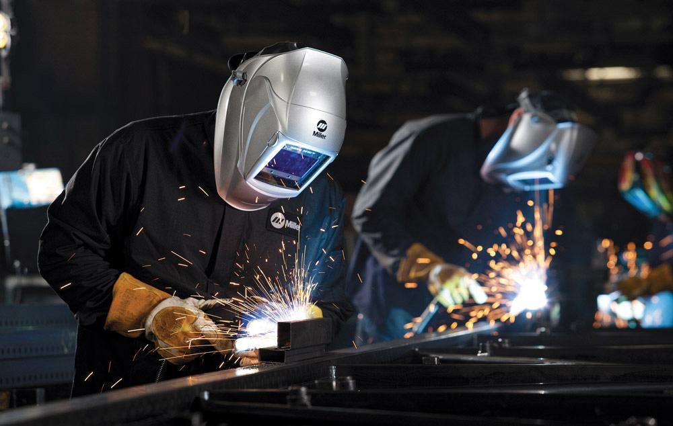
CHAPTER-1 WELDING

Slide 67
WELDING
“The welding is a process of joining two or more, similar or dissimilar metals by heating them to a suitable temperature, with or without the application of pressure, filler materials and flux.”
Welding is used for making permanent joint.
PRINCIPLE OF WELDING :
An ideal joint between two pieces of metal can be made by heating the workpiece to a suitable temperature. In other words, on heating, the materials soften sufficiently so that the surfaces fuse together.
The bonding force holds the atoms, ions or molecules together in a solid. The bonding on contact is achieved only when
The contaminated surface layers on the workpiece are removed.
Recontamination is avoided, and
The two surfaces are made smoot, flat and fit each other exactly.

Slide 68
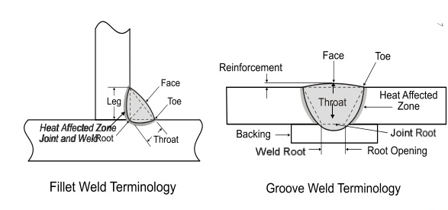
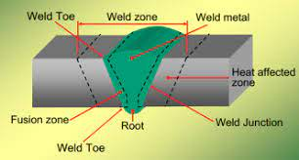
IMPORTANT TERMS RELATING TO WELDING
Weld Bead : The amount of material which is added into the joint in a single pass of welding.
Penetration : It is the depth up to which the metal will be penetrated into the base material.
Reinforcement : It is the height when the metal is projected on, from the weld surface.
Root Gap : It is a minimum distance between two workpieces before joining.
Weld Deposition Rate : It is the amount of material which is added into the joint for unit time. It is expressed in Kg/hr.

Slide 69
Weld Pass : A single movement of the welding torch or electrode along the length of the joint, which results in a bead, is called weld pass.
Weld Puddle: The portion of the welded joint that is melted by the heat of welding is called puddle.
Autogenous Welding : The process of joining similar metals by melting the edges together, without the addition of filler material, is called autogenous welding.
Homogeneous Welding : The process of joining similar metals with the help of filler material, is called homogenous welding.
Heterogeneous Welding : The process of joining dissimilar metals with the help of filler material, is called homogenous welding.
Base Metal : The metal to be joined or cut is termed as the base metal.

Slide 70
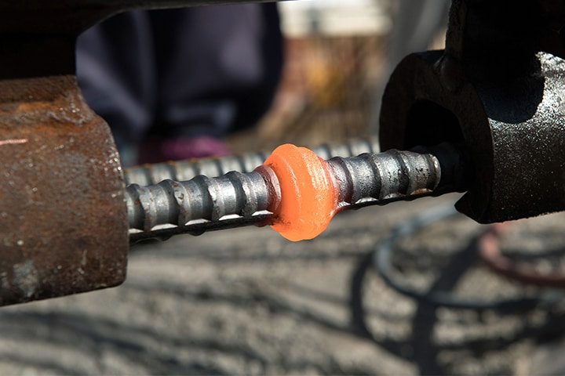
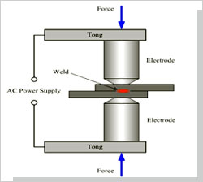
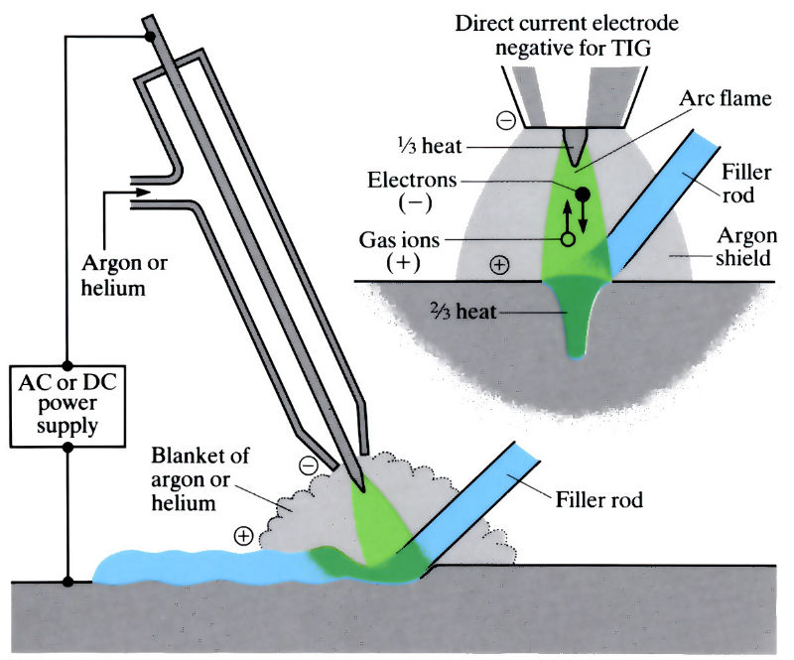
TYPES OF WELDING :
Pressure or Forge or Plastic Welding : in this welding, the workpieces are heated to plastic state and then the workpieces are joined together by applying pressure on them. e.g. Resistance Welding, Forge welding, friction Welding etc.
Fusion Or Non-pressure Welding : in this welding, the edges of workpieces to be joined and the filler material are heated to a temperature above the melting point of the metal and then allowed to solidify. e.g. gas welding, thermit welding etc.

Slide 71
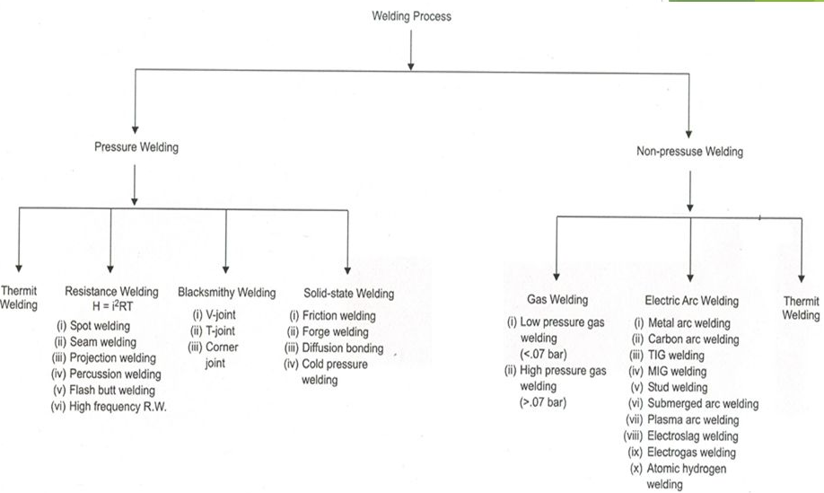
Classification of Welding Process :

Slide 72
ADVANTAGES | DISADVANTAGES
Low manufacturing cost. | Welding setup is required.
2. Welding can be done in any position. | 2. Skilled operator is required.
3. Similar and dissimilar material can be welded. | 3. There is a possibility of welding residual stresses can be developed.
4. It is a permanent joint where strength of the joint is equal to or more than the strength of base metal. | 4. More safety devices are needed.
5.General welding equipment is not very costly. | 5. Welding produces harmful radiations, fumes and spatter.
6. Repair by welding is very easy. | 6. Welding heat produces metallurgical changes.

Slide 73
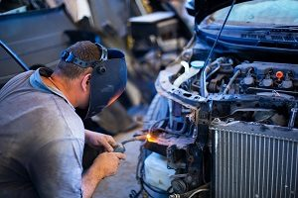
GAS WELDING

Slide 74
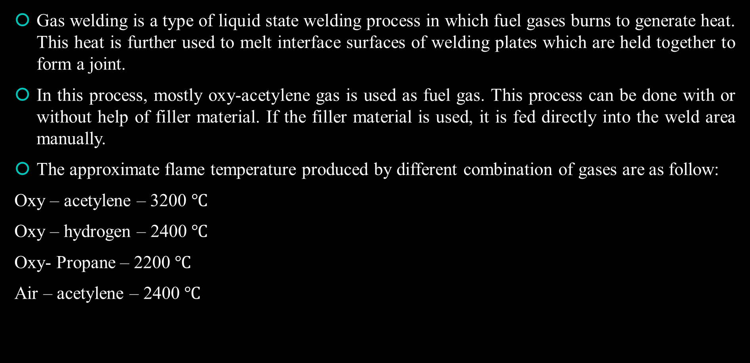
Gas Welding:
Gas welding is a type of liquid state welding process in which fuel gases burns to generate heat. This heat is further used to melt interface surfaces of welding plates which are held together to form a joint.
In this process, mostly oxy-acetylene gas is used as fuel gas. This process can be done with or without help of filler material. If the filler material is used, it is fed directly into the weld area manually.
The approximate flame temperature produced by different combination of gases are as follow:
Oxy – acetylene – 3200 $$℃$$
Oxy – hydrogen – 2400 $$℃$$
Oxy- Propane – 2200 $$℃$$
Air – acetylene – 2400 $$℃$$

Slide 75
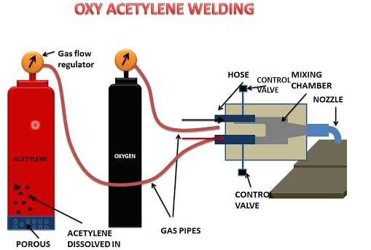
Oxy-acetylene Welding :

Slide 76
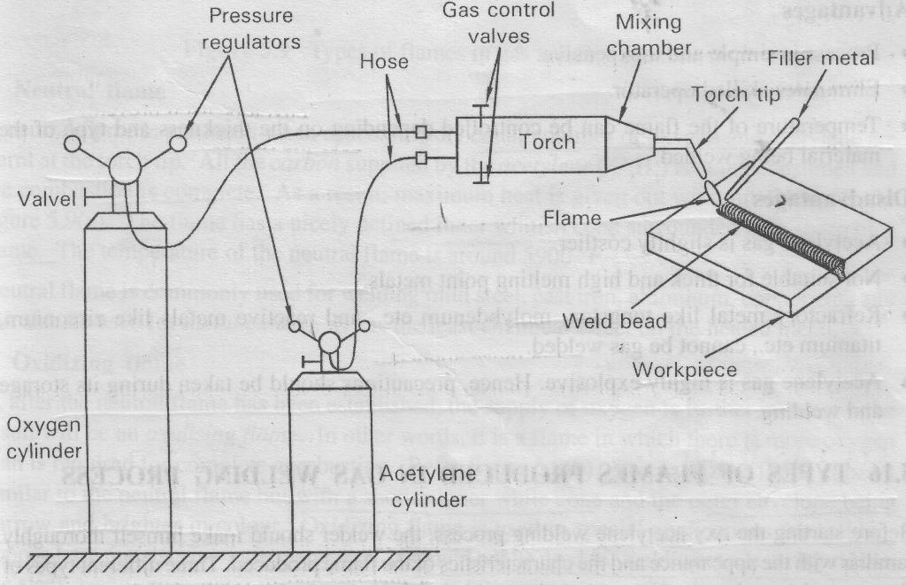
Principle of Operation:
When acetylene is mixed with oxygen in correct proportions in the welding torch and ignited, the flame resulting at the tip of the torch is sufficiently hot to melt and join the parent metal.
The oxy-acetylene flame reaches a temperature of about 3200°C and thus can melt all commercial metals which, during welding, actually flow together to form a complete bond.
A filler metal rod is generally added to the molten metal pool to build up the seam slightly for greater strength.

Slide 77
Description and Operation
The equipment consists of two large cylinders: one containing oxygen at high pressure and the other containing acetylene gas.
Two pressure regulators fitted on the respective cylinders regulates or controls the pressure of the gas flowing from the cylinders to the welding torch as per the requirements.
The welding torch is used to mix both oxygen and acetylene gas in proper proportions and burn the mixture at its tip.
A match stick or a spark lighter may be used to ignite the mixture at the torch tip.
The resulting flame at the tip has a temperature ranging from 3200°C - 3500°C and this heat is sufficient enough to melt the workpiece metal.
Since a slight gap usually exists between the two workpieces, a filler metal is used to supply the additional material to fill the gap.
The filler metal must be of the same material or nearly the same chemical composition as that of the workpiece material.

Slide 78
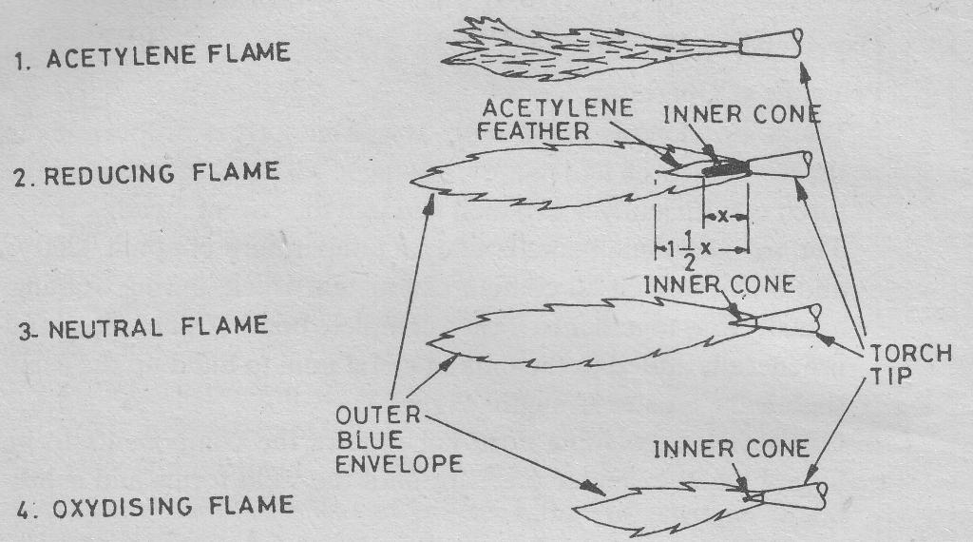
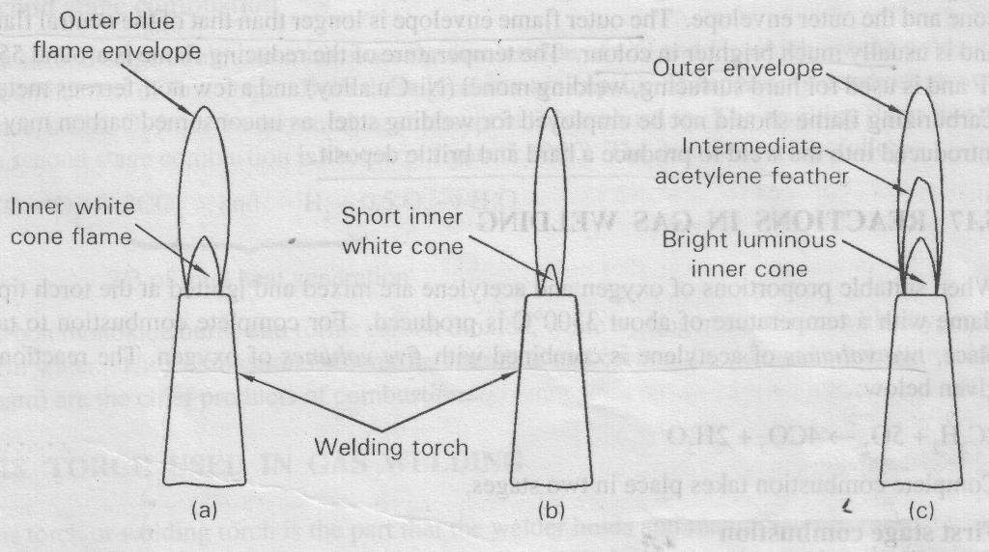
Types of Flames :
Gas flames are divided into three different categories:
Neutral Flame
Oxidising Flame
Carburising Flame

Slide 79

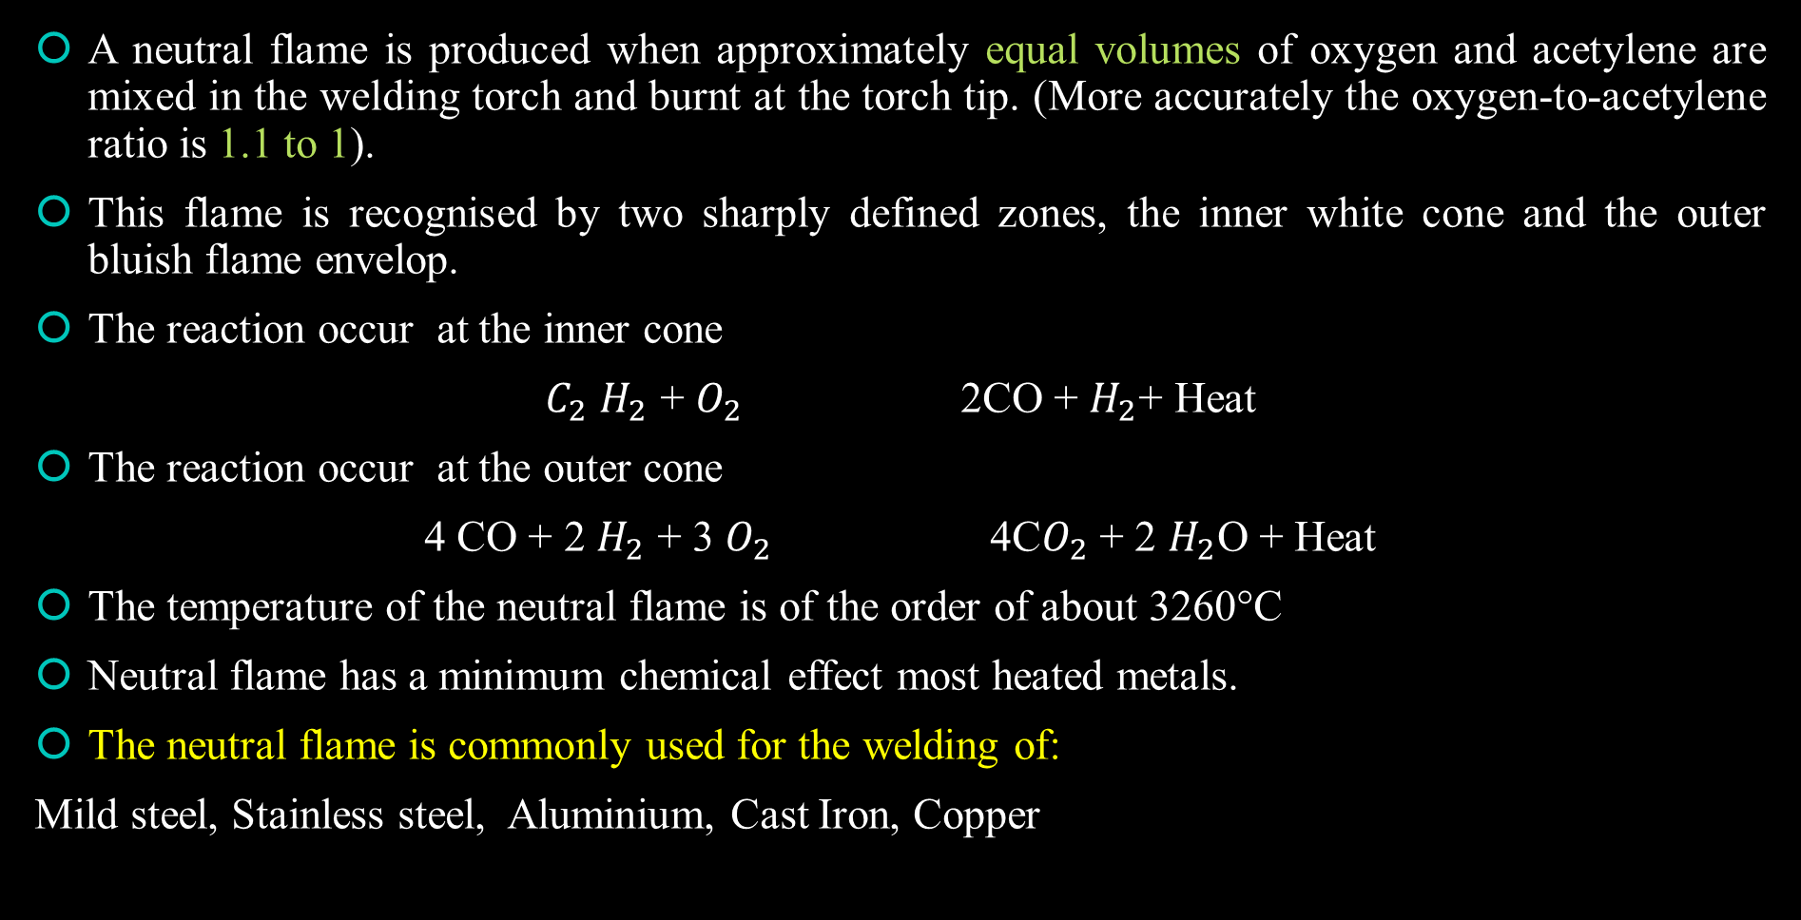
1. Neutral Flame ($$O_{2} :C_{2}H_{2}$$= 1.1: 1)
A neutral flame is produced when approximately equal volumes of oxygen and acetylene are mixed in the welding torch and burnt at the torch tip. (More accurately the oxygen-to-acetylene ratio is 1.1 to 1).
This flame is recognised by two sharply defined zones, the inner white cone and the outer bluish flame envelop.
The reaction occur at the inner cone
$$C_{2}$$ $$H_{2}$$ + $$O_{2}$$ 2CO + $$H_{2}$$+ Heat
The reaction occur at the outer cone
4 CO + 2 $$H_{2}$$ + 3 $$O_{2}$$ 4C$$O_{2}$$ + 2 $$H_{2}$$O + Heat
The temperature of the neutral flame is of the order of about 3260°C
Neutral flame has a minimum chemical effect most heated metals.
The neutral flame is commonly used for the welding of:
Mild steel, Stainless steel, Aluminium, Cast Iron, Copper

Slide 80

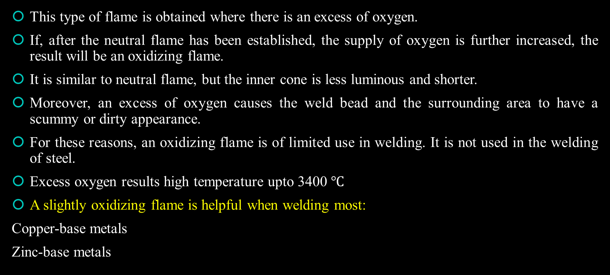
2. Oxidising Flame ($$O_{2} :C_{2}H_{2}$$= 1.5 : 1)
This type of flame is obtained where there is an excess of oxygen.
If, after the neutral flame has been established, the supply of oxygen is further increased, the result will be an oxidizing flame.
It is similar to neutral flame, but the inner cone is less luminous and shorter.
Moreover, an excess of oxygen causes the weld bead and the surrounding area to have a scummy or dirty appearance.
For these reasons, an oxidizing flame is of limited use in welding. It is not used in the welding of steel.
Excess oxygen results high temperature upto 3400 $$℃$$
A slightly oxidizing flame is helpful when welding most:
Copper-base metals
Zinc-base metals

Slide 81
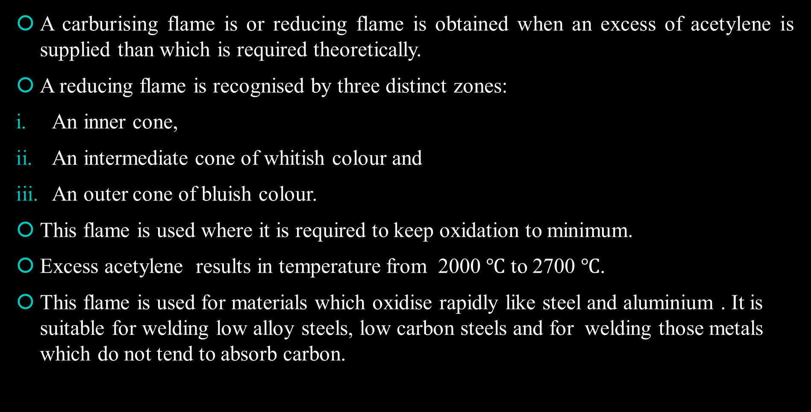
3. Carburising Flame
A carburising flame is or reducing flame is obtained when an excess of acetylene is supplied than which is required theoretically.
A reducing flame is recognised by three distinct zones:
An inner cone,
An intermediate cone of whitish colour and
An outer cone of bluish colour.
This flame is used where it is required to keep oxidation to minimum.
Excess acetylene results in temperature from 2000 $$℃$$ to 2700 $$℃$$.
This flame is used for materials which oxidise rapidly like steel and aluminium . It is suitable for welding low alloy steels, low carbon steels and for welding those metals which do not tend to absorb carbon.

Slide 82
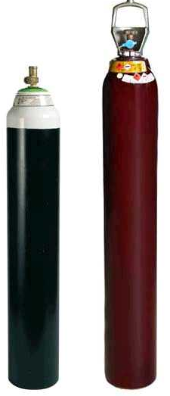
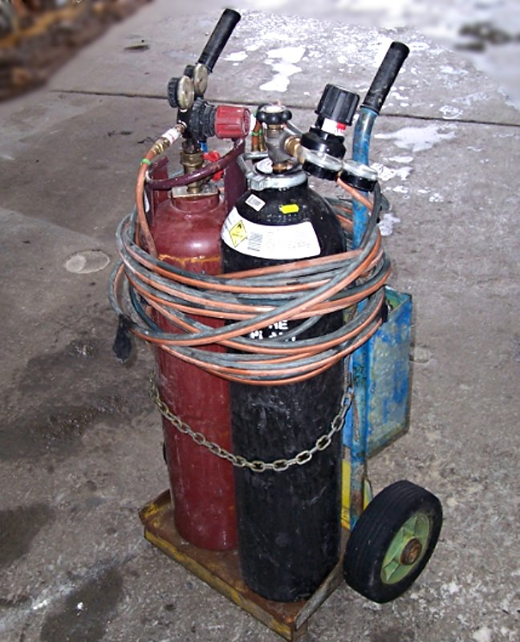
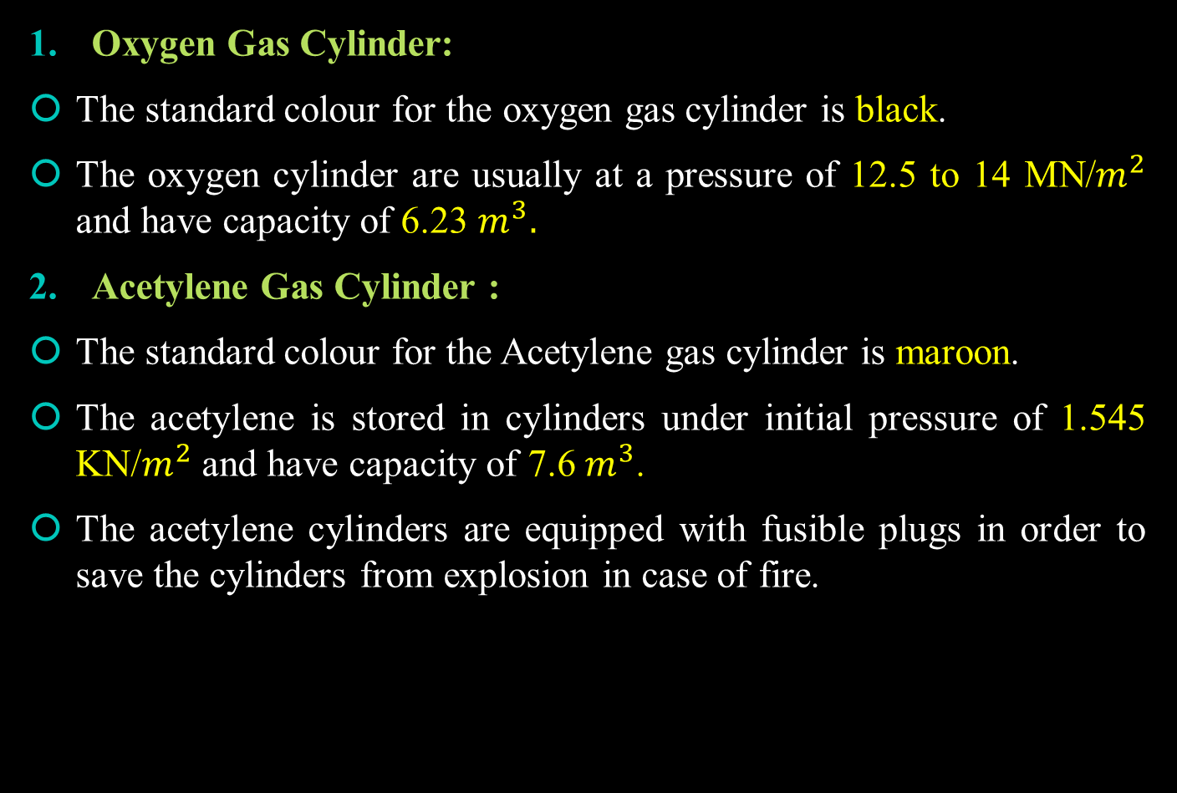
Gas Welding Equipments:
Oxygen Gas Cylinder:
The standard colour for the oxygen gas cylinder is black.
The oxygen cylinder are usually at a pressure of 12.5 to 14 MN/$$m^{2}$$ and have capacity of 6.23 $$m^{3}.$$
Acetylene Gas Cylinder :
The standard colour for the Acetylene gas cylinder is maroon.
The acetylene is stored in cylinders under initial pressure of 1.545 KN/$$m^{2}$$ and have capacity of 7.6 $$m^{3}$$.
The acetylene cylinders are equipped with fusible plugs in order to save the cylinders from explosion in case of fire.

Slide 83
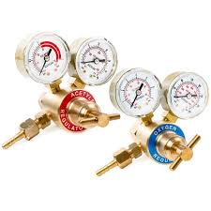
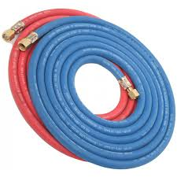
Oxygen and Acetylene Pressure Regulators :
The Purpose of using a gas pressure regulator are :
To reduce the high pressure of the gas in the cylinder to a suitable working pressure and
To provide a steady flow of gas under varying cylinder pressures.
Oxygen and Acetylene Gas Hoses : The hose connects the outlet of the pressure reducing valve and blow pipe.
Rubber tubing is necessary for flexibility, but it should be of highest quality.
Hose colour for supplying oxygen is blue.
Hose colour for supplying Acetylene is Red.

Slide 84
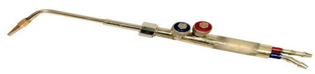
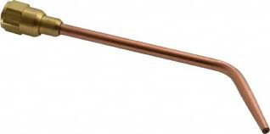
Welding Torch or Blowpipe :
It serves to mix the gases in proper proportion and deliver the mixture to the nozzle or tip where it is burnt.
The welding torch has a handle at one end with two inlet connections for gases. Each inlet has a valve that controls the volume of oxygen or acetylene.
Welding Torch Tip :
The welding torch tip also called nozzle is a device screwed to the end of the blowpipe.
It is that portion of the torch through which the gases pass just prior to their ignition and burning.

Slide 85
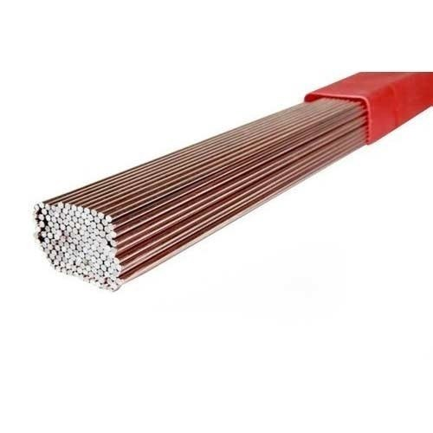
Filler Rods :
Filler rods used in gas welding provide extra metal to the weld by melting the end of the rod.
The filler rods used in welding should have a chemical composition similar to that of the base metal.

Slide 86
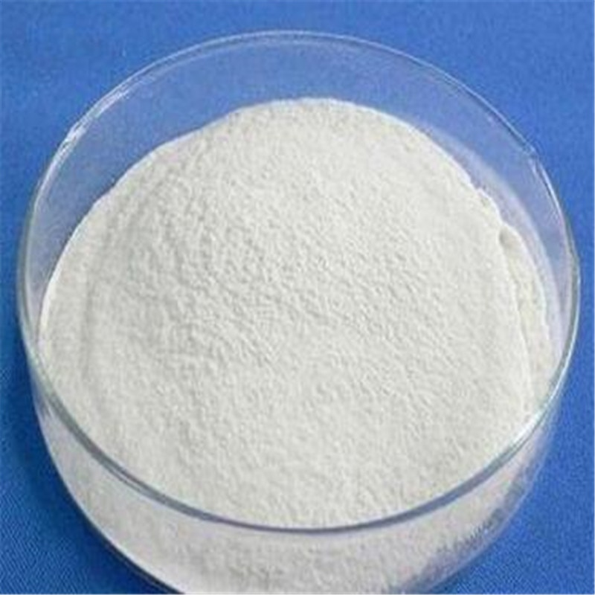
Fluxes:
in gas welding, when metals are heated, the oxygen from the air combines with them and forms oxides. These oxides produce poor quality and low strength welds.
So fluxes are used in order to prevent oxidation and other unwanted chemical reactions during welding.
The fluxes are chemical compounds and form a fusible slag with oxides of most metals at the welding temperature.
The slag floats to the top of the molten metal and does not interfere with the deposition and fusion of filler material.
Spark Lighter :
Goggles and gloves

Slide 87
Advantages of Gas Welding
It is probably the most versatile process. It can be applied to a wide variety of manufacturing and maintenance situations.
Welder has considerable control over the temperature of the metal in the weld zone.
The rate of heating and cooling is relatively slow. In some cases, this is an advantage.
Since the sources of heat and of filler metal are separate, the welder has control over filler-metal deposition rates.
The equipment is versatile, low cost, and usually portable.
The cost and maintenance of the gas welding equipment is low when compared to that of some other welding processes.
Disadvantages of Gas Welding
Heavy sections cannot be joined economically.
Flame temperature is less than the temperature of the arc.
Fluxes used in certain welding and brazing operations produce fumes that are irritating to the eyes, nose, throat and lungs.
Gas flame takes a long time to heat up the metal than an arc.
More safety problems are associated with the handling and storing of gases.
Acetylene and oxygen gases are expensive.

Slide 88
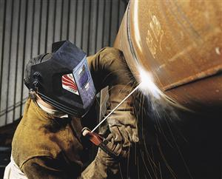
ARC WELDING

Slide 89
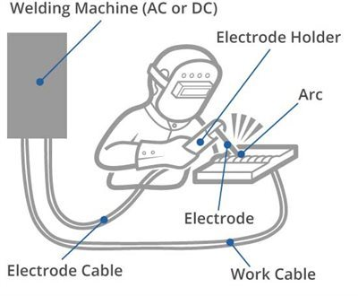
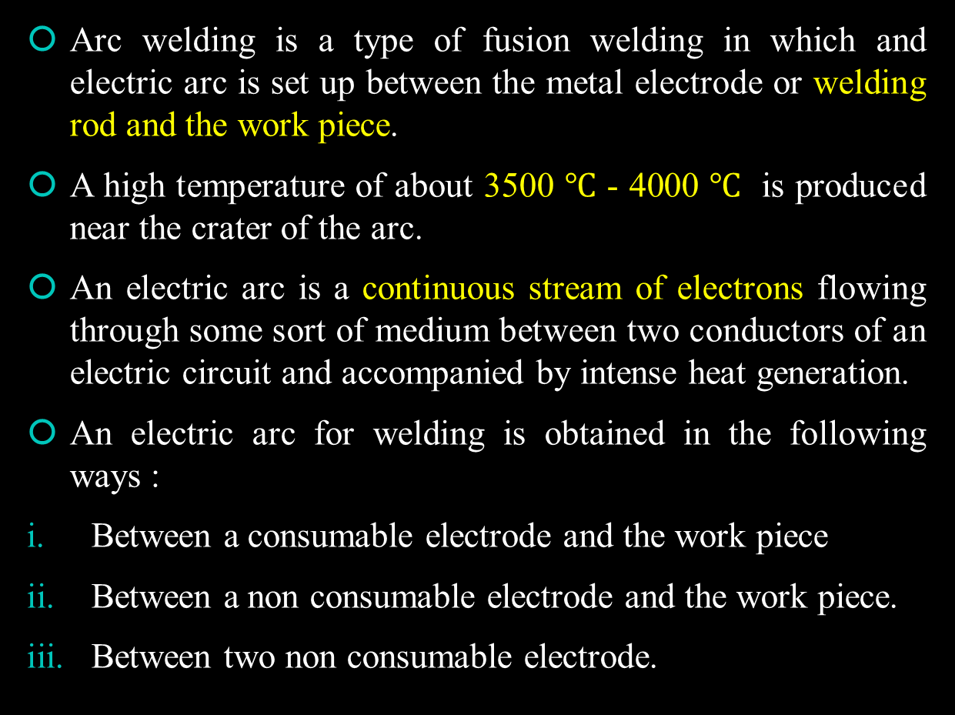
Arc Welding :
Arc welding is a type of fusion welding in which and electric arc is set up between the metal electrode or welding rod and the work piece.
A high temperature of about 3500 $$℃$$ - 4000 $$℃$$ is produced near the crater of the arc.
An electric arc is a continuous stream of electrons flowing through some sort of medium between two conductors of an electric circuit and accompanied by intense heat generation.
An electric arc for welding is obtained in the following ways :
Between a consumable electrode and the work piece
Between a non consumable electrode and the work piece.
Between two non consumable electrode.

Slide 90
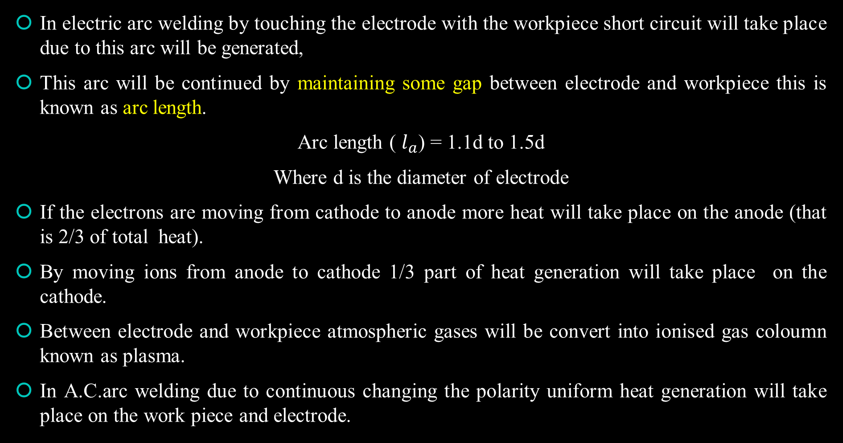
Principle of Operation of Arc Welding:
In electric arc welding by touching the electrode with the workpiece short circuit will take place due to this arc will be generated,
This arc will be continued by maintaining some gap between electrode and workpiece this is known as arc length.
Arc length ( $$l_{a}$$) = 1.1d to 1.5d
Where d is the diameter of electrode
If the electrons are moving from cathode to anode more heat will take place on the anode (that is 2/3 of total heat).
By moving ions from anode to cathode 1/3 part of heat generation will take place on the cathode.
Between electrode and workpiece atmospheric gases will be convert into ionised gas coloumn known as plasma.
In A.C.arc welding due to continuous changing the polarity uniform heat generation will take place on the work piece and electrode.

Slide 91
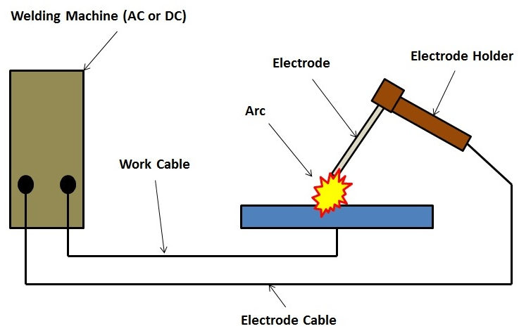
The electrode material can be either a non-consumable material or a Consumable material.
The non-consumable electrode made of tungsten, graphite etc., serve only to strike the arc and is not consumed during the welding process.
Whereas, the consumable electrode which is made of the same material as that of the workpiece metal helps to strike the arc and at the same time melt (gets consumed) and combines with the molten metal of the workpiece to form a weld.

Slide 92
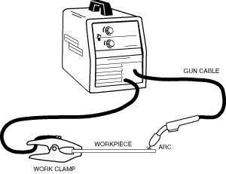
Arc Welding machines
Welding machine produces electric current for welding.
The arc is produced by a low voltage and high amperage electric current.
The current should be sufficient to produce melting of the base metal and filler material while proper voltage is required to maintain the arc.
Welding machine is specially designed to
Provide a wide range of currents according to requirement.
Reduce to high line voltage of 220/440 V to a safer and more suitable range of 40-100V.
Obtain a steady and smooth current.
Obtain a stable voltage
Convert A.C to D.C when D.C welding is desired.

Slide 93
Two types of welding machines may be used:
Direct current (D.C.) welding machine,
Motor generator welding machine
Engine Driven generator welding machine
Rectifier welding machine
Alternating current (A.C.) welding machine: A step down transformer is used in A.C. welding machine. It possesses a primary and secondary circuit. The primary side is connected to main supply and the secondary is connected to electrode and work Tables.

Slide 94
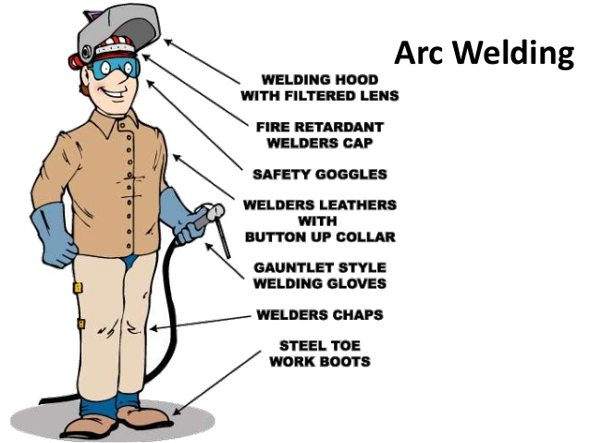
Equipment And Accessories
Goggles,
Face Shield
Apron
Hand gloves
Cleaning tools
Electrode holder
Welding screen
Welding leads
Ground clamps
Welding gauges

Slide 95
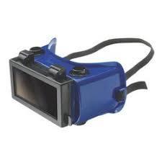
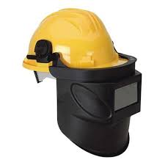
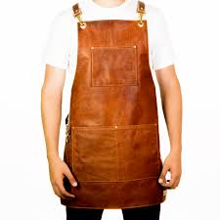
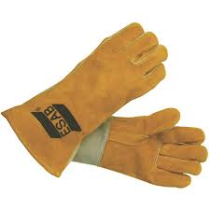
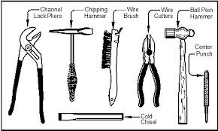
Goggles : the goggles protect the eye from the slag particles deflecting upwards.
Face Shield : A face shield is used to protect the eyes and face of the operator while welding from the radiations of arc, flying sparks.
Apron : the operators protect their clothing from spattering particles by a leather apron.
Hand gloves : Leather and asbestos hand gloves are used to protect the hands from UV and infrared rays, flying sparks, spattering particles and electric shock.
Cleaning tools : a chipping hammer is used to remove spatter and slag which cover the weld area.

Slide 96
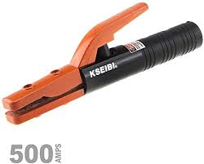
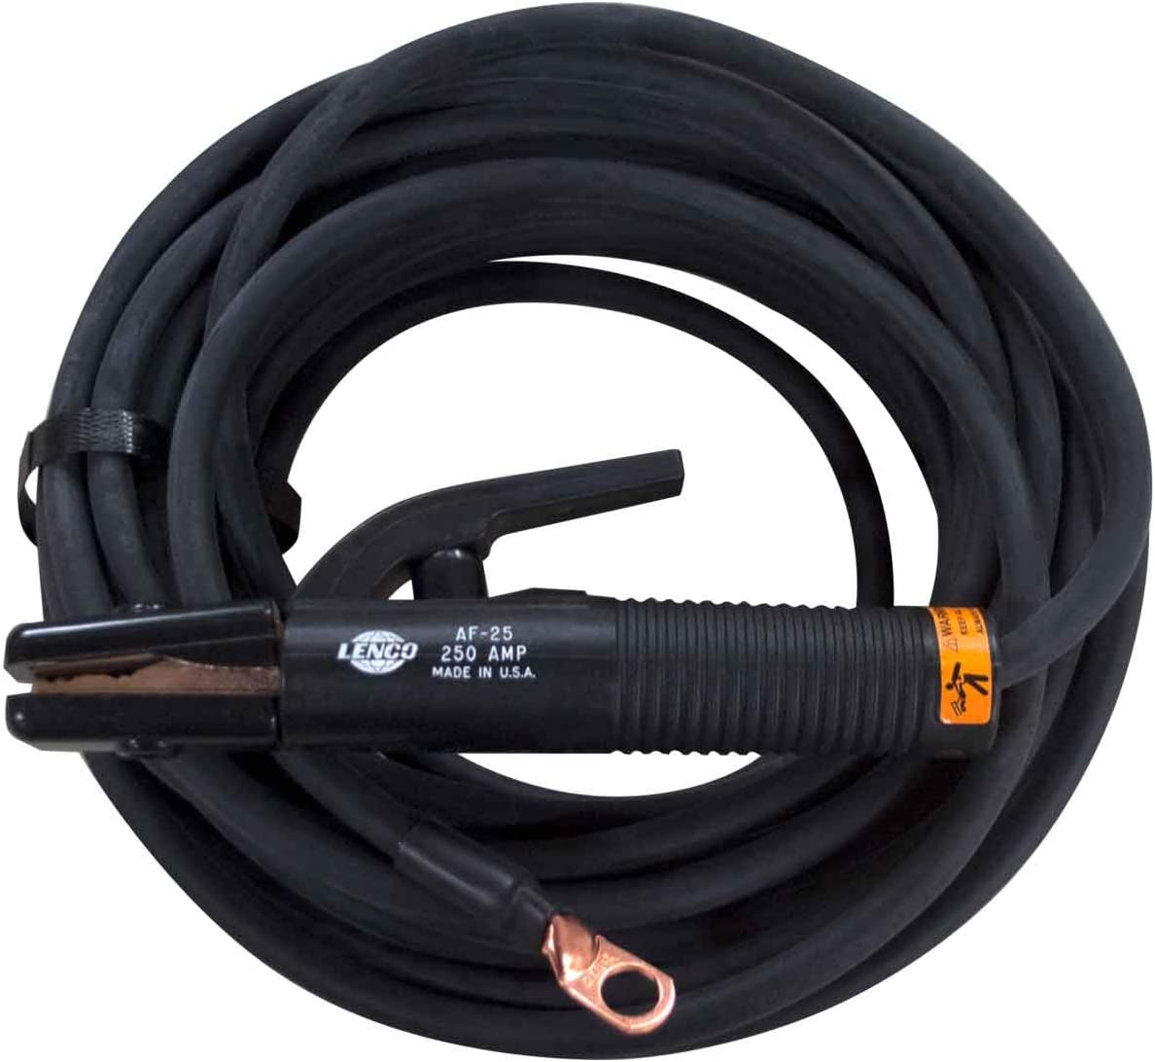
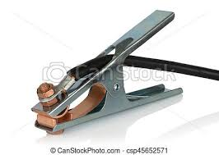
Electrode Holder : it is a simple device used to hold the electrode and transmit the current into it.
Welding leads : in an electric arc welding, two cables are used to complete the electric circuit. One cable connects the welding machine to the electrode holder and is called electrode lead and other makes the connection between the welding source and work and is called work arc ground lead.
Ground Clamps: A ground clamp is a device used to connect the lead to the work. It should provide a good and strong connection and at the same time, be capable of quick and easy attachment and removal .

Slide 97
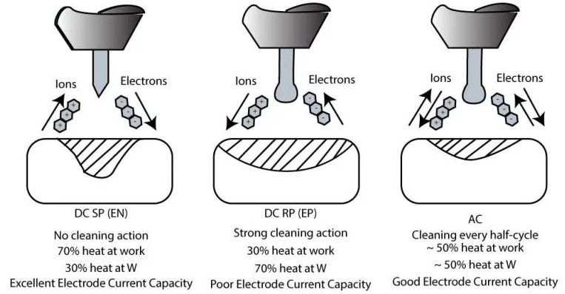
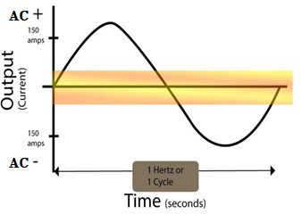
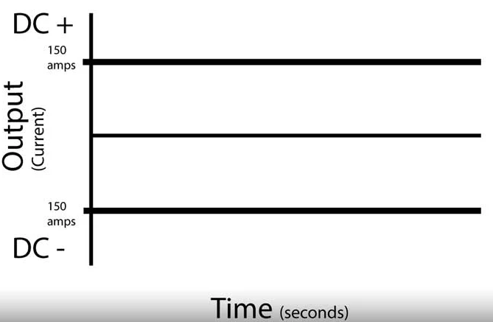
DC and AC Arc Welding
With D.C., greater heat is generated at the positive pole of the arc. In metal arc welding, it is the general practice to connect the work to positive pole of the D.C. generator and filler rod to the negative pole so that the larger mass of metal is melted on the base metal.
On the other hand, the AC welding is gaining considerable ground these days. The efficiency of AC welding transformers is very high and varies from 0.8 to 0.85. further, the electric energy consumption per kg of deposited metal in AC welding is from 3 to 4 kwh which is much lower as compared to DC welding (6 to 10 kwh).

Slide 98
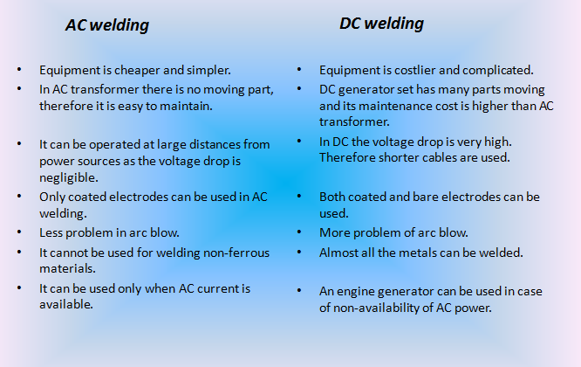
Comparison of AC and DC Arc Welding

Slide 99
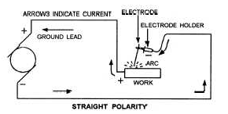
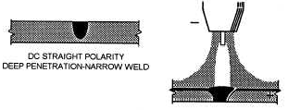
Effect of Polarity:
Most of these welding machines can produce both ac and dc current. The choice of ac or dc depends on the welding characteristics required.
DIRECT CURRENT - A direct-current welding circuit maybe either straight or reverse polarity.
Direct Current Straight Polarity (DCSP) : When the machine is set on straight polarity, the electrons flow from the electrode to the plate, concentrating most of the heat on the work.
DCSP produces a narrow, deep weld. Since the heat is concentrated on the work, the welding process is more rapid and there is less distortion of the base metal. Overall, straight polarity is preferred over reverse polarity because you can achieve better welds.

Slide 100
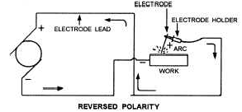

Direct Current Reverse Polarity (DCRP) : With reverse polarity, the flow of electrons is from the plate to the electrode, thus causing a greater concentration of heat at the electrode. Because of this intense heat, the electrode tends to melt off; therefore, direct-current reverse polarity (DCRP) requires a larger diameter electrode than direct-current straight polarity (DCSP).
DCRP forms a wide and shallow weld and is rarely used in the GTAW process. The exception to this is when it is used to weld sections of aluminium or magnesium. DCRP has excellent cleaning power that results from the

Slide 101


Slide 102
Current and voltage regulation:
We receive Ac supply from power mains at 400-440 V, whereas we require a much less voltage for welding.
So we use a step-down transformer which lowers the voltage to about 80-100 V. this voltage is actually required only for striking the arc, but for maintaining the stable arc, we require a still lower voltage of about 30 to 40 V. this is accomplished by means of current regulator by which we can adjust the flow of current and also the resistance and hence, can obtain the desired voltage.

Slide 103

Electrodes :
An electrode is a metallic or non metallic wire rod which is used as terminal in an electric circuit to produce an electric arc. The electrode are also used as filler rods in the metal arc welding process.
Classification of electrodes :
Electrodes
Consumable electrodes
Bare electrodes
Fluxed or lightly coated electrodes
Heavily coated or shielded electrodes
Non-consumable electrodes
Metallic electrodes (Tungsten)
Non-Metallic electrodes (carbon/graphite)

Slide 104
Consumable electrodes : it serves the purpose of filler rod as well as the heat input to the joint. When the arc is obtained with the consumable electrode, the weld metal and the tip of the electrode also get melted under the arc. In this process once arc is initiated, the electrode is continuously consumed.
Bare Electrodes : Bare electrodes are those in which electrode is not coated with the flux. Bare electrodes are used to weld wrought iron and mild steel.
Lightly coated electrodes : Lightly coated electrodes have a thin coating of several tenths of a mm. the weight of the coating is from 1 to 5 percent of the weight of electrode. Purpose of light coating is to increase arc stability.
Heavily coated electrodes : Heavily coated electrodes are those which are coated with flux. Thickness of coating is approx. 1 to 3 mm. most of the welding is done with such electrodes.
Non Consumable electrodes : Non consumable electrodes are those which are not consumed during the welding. When non consumable electrodes ae used, the filler material is added separately. These electrodes are made of carbon, graphite or tungsten.

Slide 105


Selection of Electrode
The selection of electrode for a job is made on the basis of following consideration :
The electrode diameter should not be more than the thickness of the base plate.
The maximum diameter of the electrode for vertical and overhead position is 5 mm.
A thin electrode is recommended for making first run of a thick metal job for better penetration.
It is economical to use large diameter electrodes, but it is difficult to control the arc. The larger diameter electrodes takes more current.
Consumable Electrodes
Non-Consumable Electrodes

Slide 106
BIS Coding of Electrodes
A coding system is used to indicate some characteristics of the electrodes. It is printed on each packet of the electrodes.
It consist of a prefix letter, a code of six digit in numerical and in some cases one or more suffix letters each indicating a specific characteristic of electrode.
E 1 2 1 41 2 P
SUFFIX LETTER :- Special Properties/ Characteristic
PREFIX LETTER :- Method Of Manufacturing Electrodes
SIXTH DIGIT :- Percentage of Elongation
FIRST DIGIT :- Type of Covering
FOURTH AND FIFTH DIGIT :- Welding Current Condition
SECOND DIGIT :- Welding Position
THIRD DIGIT :- Welding Current Condition

Slide 107


Slide 108


Slide 109


Slide 110
Flux For Arc Welding
Oxides present on the metal surface ( if joint is not cleaned properly) or formed during welding may interfere considerably with the welding. These oxides have higher melting point than the base metal. Due to this, “these prevent the proper fusion of base metal. Therefore, it is necessary to add some material to the welding zone which is capable of dissolving the oxides. This material is known as flux.”
The flux reacts with the oxides to form what is known as slag.
The slag has low melting point, is more fluid and is lighter than the molten metal. Due to this, it will float more readily to the surface of molten metal.
Properties of the flux:
It should be capable of dissolving the oxides and other impurities to clean the metal surface,
It should control the flow ability of molten metal.
It should not affect the base metal.
Its melting point and specific gravity should be lower than the base metal.

Slide 111
Requirement of Preheating : Preheating the steel to be welded slows the cooling rate in the weld area. This is necessary to avoid the cracking of weld metal.
Requirement of Post heating : In order to ensure that the material strength of a part is retained after welding, a process called post weld heat treatment (PWHT) is regularly performed. This process reduces residual stress and control the hardness.

Slide 112
Welding Defects :-
Crack
Lack of fusion and Penetration
Porosity/ Pinhole/Blowhole
Underfill
Spatter
Undercutting
Poor Appearance
Overlapping
Inclusion

Slide 113

Crack : -The most serious type of welding defect is a weld crack and it’s not accepted almost by all standards in the industry. It can appear on the surface, in the weld metal or the area affected by the intense heat.
There are different types of cracks, depending on the temperature at which they occur:
Hot cracks. These can occur during the welding process or during the crystallization process of the weld joint. The temperature at this point can rise over 10,000C.
Cold cracks:- Cracks in the base metal usually occur at low temperatures ( around 200 C ) and are known as cold cracks.

Slide 114


Porosity and Blow Holes :Porosity is a group of small voids whereas blow holes or gas pockets are comparatively bigger isolated holes or cavities.
Undercutting : Undercutting is a groove melted into the base metal adjacent to the toe of the weld. This weakens the weld.

Slide 115


Lack of fusion and Penetration: If the molten metal does not mix (fuse) properly with the base metal, the defect is called lack of fusion (or incomplete fusion).
Incomplete penetration occurs when the depth of welded joint is insufficient. Penetration is the distance from top surface of the base plate to the maximum extent of the weld nugget.
Underfill - A condition in which the weld face or root surface extends below the adjacent surface of the base metal.

Slide 116


Spatter: Spatter refers to small particles of metal which are scattered around the weld along its length.
Poor Appearance : If the weld deposit is uneven, width of bead is variable and then the bead is called poor.

Slide 117


Overlapping: This defect arises when molten metal from the electrode flows over the base metal surface and remains there without getting fused (mixed).
Inclusion: Inclusion usually refers to slag, but may be scale or dirt entrapped in the weld deposit during welding. The inclusion due to the contamination of the base metal and the deposited metal by oxides, and high viscosity of slag.

Slide 118
Inspection and Testing of Welding joint:
After completion of welding, a detailed examination of the welded joint is made to find the surface and internal defects. So testing of the welding joint is done.
The testing of welded joint can be divided into the following two categories:
Non-destructive test
Destructive test
Non Destructive test : It is a wide group of analysis techniques used in industries to evaluate the properties of a material, component or a system without causing damage.
Visual check vi. Air pressure test
Magnetic testing vii. Ultra- sonic testing
X-ray method
Hydraulic test
Stethoscope

Slide 119
Visual Check : Visual inspection is a non-destructive testing (NDT) weld quality testing process where a weld is examined with the eye to determine surface discontinuities. It is the most common method of weld quality testing.
Magnetic Testing : The purpose of magnetic testing is to find cracks, porosity, lack of fusion or any other surface discontinuity which may go undetected in a visual inspection.
Magnetic testing depends upon the principle of magnetic field being set up between north and south poles of a magnet. The magnetic field will exist if we place the north pole of one magnet within the range of attraction of south pole of another magnet. Place a test piece on the surface of a magnet. The ends of the test piece become magnetic poles due to induced magnetism. If magnetic fluid, such as iron powder is sprayed on the surface under test, the iron powder will be attracted around the cracks in the surface.

Slide 120
X-ray Method : With the help of this method, we can detect defects below the surface of weld and the materials under test. X-ray tests will show defects such as porosity, cracks, lack of penetration etc. When X-rays are applied to the job under test, the screen will show dark shadows for cracks, porosity etc. the cracks(or porosity) would allow more rays to pass through them.
Hydraulic Test : This test is used for pressure vessels. The water is filled up in the vessels to ensure that there is no leakage. A gauge is fitted in the vessel to read the pressure. Now build up the pressure by a pump and note the pressure in the gauge. Any trace of moisture around the weld indicates a crack or porosity.
Stethoscope : The detector of Doctor’s stethoscope is placed on the weld and the work/job is tapped with small hammer. A clean bell sound will indicate a perfect weld.

Slide 121
Air Pressure Test : The air pressure test is carried out by filling air in the welded vessel. The soapy water is brushed on the weld. The formation of bubbles from any spot will indicate that there is a leakage of air.
Ultra-Sonic Testing : This is very efficient method of testing. High frequency sound waves are passed through the test specimen. Any defects such as cracks, porosity etc. will interrupt the waves and they will be immediately reflected back without completing their intended passage through the material.
Destructive Test : When the test specimen is tested upto destruction for reaching the inside of the weld. It is called destructive test.
Impact test : It is conducted on the standard specimens prepared from the weld and metal pieces. This test is performed on the Izod testing machine. Impact test indicates the toughness. The toughness of the metal is a combination of ductility and strength.
Tensile Test : It is conducted on the standard specimens prepared from the weld and metal pieces. This test is performed on the Universal testing machine. tensile test gives yield point, tensile strength percentage of elongation and reduction in area.
Shear Strength Test : shear strength test can be easily made on lap joints using a tensile testing machine.

Slide 122


Resistance Welding :
It is a welding process in which metal pieces to be welded are first heated to the melting temperature by the resistance of these to flow of electric current and then squeezed by the mechanical pressure to complete the weld. No filler material or flux is added.
Principle of Resistance welding : The principle of resistance welding is that when an electric current passed through the junction of metal pieces to be welded, a high temperature is obtained by resistance of these metal pieces to passage of current.
The heat produced is given by the following relationship:
H = $$I^{2}$$RT
Where H = Total heat generated (J)
I = Electric current (A)
T = Time for which the electric current is passed through the joint (sec)
R = Resistance of the joint ($$Ω$$)
During process heavy current about 15000A is passed over joint with limited area for short time.

Slide 123


In resistance welding, resistance of the joint is the main source of heat. So resistance of the joint is composed of :
1. Resistance of the electrode ( $$R_{1}$$)
2. The contact resistance between the electrode and the workpiece ( $$R_{2}$$)
3. The contact resistance between two work pieces ( $$R_{3}$$)
4. Resistance of the work piece plates ( $$R_{4}$$)
In order to obtain a sound weld and avoid overheating of welding electrode, $$R_{1}$$, $$R_{2}$$ , and $$R_{4}$$ should be kept as low as possible as compared to $$R_{3}$$.

Slide 124


Slide 125


Spot Welding
It is first type of resistance welding and widely used for lap joint of thin metal sheet. It is consist of two electrodes in which bottom electrode is fixed and upper is used for apply pressure. Sheets to be weld are kept in the two electrode .
The pressure is applied over the sheets and current is passed though it so that they get weld. Welding is done due to high current is passed through the metal plates which produce heat.
Applications of spot welding :
Automobile and Aircraft industries
Household steel furnitures.
Containers

Slide 126

Seam Welding :
Seam welding is similar to spot welding except that the metal sheets overlap each other making a continuous weld seam. In this process disk type electrodes are used. It is used to produce continuous type of welding between two sheets. Disk are made up of cupper and current is applied through it. Current is applied in pulse form with proper time interval. Disks are rotate continuously so that metal sheets moves forward. Current can be regulated by timer to produce continuous seam.
Applications
For gas or water tight joints
To manufacture seam welded pipes

Slide 127

Projection Welding:
It is modification of spot welding. In this type one of the sheet is provided with projections and other is plane. These projections are in circular form. There diameter is equal to thickness of plate. Current and pressure is get concentrated at projection areas during process.
During this process sheets to welded are kept between electrodes which made of cupper . Pressure is applied by upper movable electrode and lower is fixed . By passing current these projections are get melted and welding is done.
Applications :
It is used for welding of refrigerator condensers, joining of wires etc.
Welding of stainless steel parts, titanium alloys etc.

Slide 128
Percussion Welding :
In percussion welding, the heat for welding is obtained from an arc produced by a rapid discharge of stored electric energy.
Pressure is applied percussively ( rapidly) during an immediately following the electric discharge.
The electrostatic capacitors are used to store the electrical energy
Procedure :
In this welding process, workpiece to be joined are clamped in a moving plates.
Workpiece are brought near to each other by applying a pressure.
Arc between the workpieces are struck by bringing the workpieces in light contact so that current starts flowing. After that gap is maintained between them to produce the arc.
Pressure is released when the weld cools.
After that, workpieces are unclamped.

Slide 129

Applications
It is used in telephone industries.
It is used for welding fine wires leads to filaments in lamps etc.

Slide 130

Atomic Hydrogen Welding :
Atomic hydrogen welding is a thermo-chemical welding process in which the workpieces are joined by the heat obtained on passing a stream of hydrogen through an electric arc struck between two tungsten electrodes.
The arc supplies the energy for a chemical reaction to take place.
Filler rod may or may not be used during the process.
Figure shows the arrangement for atomic welding process.

Slide 131

Description
The equipment consists of a welding torch with two tungsten electrodes inclined and adjusted to maintain a stable arc.
Annular nozzles around the tungsten electrodes carry the hydrogen gas supplied from the gas cylinders.
AC power source is suitable compared to DC, because equal amount of heat will be available at both the electrodes.
A transformer with an open circuit voltage of 300 volts is required to strike and maintain the arc.
Operation
The workpieces are cleaned to remove dirt, oxides and other impurities to obtain a sound weld. Hydrogen gas supply and welding current are switched ON.
An arc is struck by bringing the two tungsten electrodes in contact with each other and, instantaneously separated by a small distance, say 1.5 mm, such that the arc still remains between the two electrodes.
As the jet of hydrogen gas passes through the electric arc, it dissociates into atomic hydrogen by absorbing large amounts of heat supplied by the electric arc.
(endothermic reaction)
The heat thus absorbed can be released by recombination of the hydrogen atoms into hydrogen molecule (H₂ ).

Slide 132
Recombination takes place as the atomic hydrogen touches the cold workpiece liberating a large amount of heat.
H + H → H₂ + 422kJ (exothermic reaction)
A arc is produced due to the heat liberated during the chemical reaction. A feature of the arc is the speed by which it can deliver heat to the workpiece surface.
The welding torch is moved along the surface to be welded with the arc tip touching the surface.
The heat of the arc melts and fuses the workpiece and the filler metal to form a joint.

Slide 133

Shielded Metal Arc Welding (SMAW)
Shielded metal arc welding (Stick welding, Manual metal arc welding) uses a metallic consumable electrode of a proper composition for generating arc between itself and the parent work piece. The molten electrode metal fills the weld gap and joins the work pieces.
This is the most popular welding process capable to produce a great variety of welds.
The electrodes are coated with a shielding flux of a suitable composition. The flux melts together with the electrode metallic core, forming a gas and a slag, shielding the arc and the weld pool. The flux cleans the metal surface, supplies some alloying elements to the weld, protects the molten metal from oxidation and stabilizes the arc.
The slag is removed after Solidification.

Slide 134
Advantages of Shielded Metal Arc Welding (SMAW):
Simple, portable and inexpensive equipment;
Wide variety of metals, welding positions and electrodes are applicable;
Suitable for outdoor applications.
Disadvantages of Shielded Metal Arc Welding (SMAW):
The process is discontinuous due to limited length of the electrodes;
Weld may contain slag inclusions;
Fumes make difficult the process control.

Slide 135
Submerged Arc Welding :
For welding of high thickness material in a single pass, this technique can be used. Arc is generated between consumable electrode and workpiece.
By supplying very high rate of welding current with direct current reverse polarity (DCRP), Melting rate of electrode is maximum due to this amount of liquid metal in the workpiece will be very high.
By supplying the sufficient amount of the flux slag will be formed on the liquid metal.
By moving the electrode in downward direction arc will be submerged in the slag due to this :
Heat transfer losses from the arc will be reduced.
Weld spatter can be minimized.
Slag inclusion can be reduced.
Weld deposition rate can be increased.
In this welding process, speed of welding is very high.

Slide 136

Limitation :
It can be used I flat position only
Heat affected zone is maximum.
Weld stress will be maximum in the joint.
Application : Ship welding, fabrication of pressure vessels, welding of high thickness metal.

Slide 137


Slide 138


Slide 139

Tungsten Inert Gas Arc Welding (TIG, GTAW) :
Tungsten Inert Gas Arc Welding (Gas Tungsten Arc Welding) is a welding process, in which heat is generated by an electric arc struck between a tungsten non-consumable electrode and the work piece.
The weld pool is shielded by an inert gas (Argon, helium, Nitrogen) protecting the molten metal from atmospheric contamination.
The heat produced by the arc melts the work pieces edges and joins them. Filler rod may be used, if required.
Tungsten Inert Gas Arc Welding produces a high quality weld of most of metals. Flux is not used in the process.

Slide 140
Advantages of Tungsten Inert Gas Arc Welding (TIG, GTAW):
Weld composition is close to that of the parent metal;
High quality weld structure
Slag removal is not required (no slag);
Thermal distortions of work pieces are minimal due to concentration of heat in small zone.
Disadvantages of Tungsten Inert Gas Arc Welding (TIG, GTAW):
Low welding rate;
Relatively expensive;
Requires high level of operators skill.
Applications :
This technique can be used for welding of Al, Mg and its alloy in aerospace and automobile industries.

Slide 141

Metal Inert Gas Welding (MIG, GMAW):
Metal Inert Gas Welding (Gas Metal Arc Welding) is a arc welding process, in which the weld is shielded by an external gas (Argon, helium, CO2, argon + Oxygen or other gas mixtures).
Consumable electrode wire, having chemical composition similar to that of the parent material, is continuously fed from a spool to the arc zone. The arc heats and melts both the work pieces edges and the electrode wire. The fused electrode material is supplied to the surfaces of the work pieces, fills the weld pool and forms joint.
Due to automatic feeding of the filling wire (electrode) the process is referred to as a semi-automatic. The operator controls only the torch positioning and speed.

Slide 142
Advantages of Metal Inert Gas Welding (MIG, GMAW):
Continuous weld may be produced (no interruptions);
High level of operators skill is not required;
Slag removal is not required (no slag);
Disadvantages of Metal Inert Gas Welding (MIG, GMAW):
Expensive and non-portable equipment is required;
Outdoor application are limited because of effect of wind, dispersing the shielding gas.
Applications :
This technique can be used for welding of high thickness material made-up of Al, Mg and cooper and its alloys in automobile and aerospace industries.

Slide 143

Thermit Welding (TW):
Thermit Welding is a welding process utilizing heat generated by exothermic chemical reaction between the components of the thermit (a mixture of a metal oxide and aluminium powder). The molten metal, produced by the reaction, acts as a filler material joining the work pieces after Solidification.
Thermit Welding is mainly used for joining steel parts, therefore common thermit is composed from iron oxide (78%) and aluminium powder (22%).
The proportion 78-22 is determined by the chemical reaction of combustion of aluminium:
8Al + Fe3O4 = 9Fe + 4Al2O3 + Heat ( 3088 $$℃$$ )
The combustion reaction products (iron and aluminium oxide) heat up to 4500°F (2500°C). Liquid iron fills the sand (or ceramic) mould built around the welded parts, the slag (aluminium oxide), floating up , is then removed from the weld surface.
Thermit Welding is used for repair of steel casings and forgings, for joining railroad rails, steel wires and steel pipes, for joining large cast and forged parts.

Slide 144


Advantages of Thermit Welding:
No external power source is required (heat of chemical reaction is utilized);
Very large heavy section parts may be joined.
Disadvantages of Resistance Welding:
Only ferrous (steel, chromium, nickel) parts may be welded;
Slow welding rate;
High temperature process may cause distortions and changes in Grain structure in the weld region.
Weld may contain gas (Hydrogen) and slag contaminations.
Applications : Repair works of Railway rails.

Slide 145

Electroslag Welding (ESW)
Electroslag Welding is a welding process, in which the heat is generated by an electric current passing between the consumable electrode (filler metal) and the work piece through a molten slag covering the weld surface.
Prior to welding the gap between the two work pieces is filled with a welding flux. Electroslag Welding is initiated by an arc between the electrode and the work piece (or starting plate). Heat, generated by the arc, melts the fluxing powder and forms molten slag. The slag, having low electric conductivity, is maintained in liquid state due to heat produced by the electric current.
The slag reaches a temperature of about 3500°F (1930°C). This temperature is sufficient for melting the consumable electrode and work piece edges. Metal droplets fall to the weld pool and join the work pieces.
Electroslag Welding is used mainly for steels.

Slide 146

Advantages of Electroslag Welding:
High deposition rate - up to 45 lbs/h (20 kg/h);
Low slag consumption (about 5% of the deposited metal weight);
Low distortion;
Unlimited thickness of work piece.
Disadvantages of Electroslag welding:
Coarse grain structure of the weld;
Low toughness of the weld;
Only vertical position is possible.
Application :
Heavy plates, forgings and castings can be easily butt welded.
High carbon steels, medium carbon steels, alloy steels such as stainless steels and nickel alloys can be welded.

Slide 147
Electron Beam Welding (EBW)
Electron Beam Welding is a welding process utilizing a heat generated by a beam of high energy electrons. The electrons strike the work piece and their kinetic energy converts into thermal energy heating the metal so that the edges of work piece are fused and joined together forming a weld after Solidification.
For welding of high strength and high melting point materials with more precession ( Accurate ) joint this technique can be used.
From the cathode electron will be released in different direction they will be directed towards anode by using electrodes. Due to movement of electron from cathode to anode they will be accelerated.
The elections coming from different directions will be conversed as a single ray of electron beam, by using magnetic focusing lens and the electron beam is focusing on the workpiece at a given point due to this energy concentrated on the workpiece is very high and it is passing through the workpiece to the maximum depth.

Slide 148

Advantages of Electron Beam Welding (EBW):
Tight continuous weld;
Low distortion;
Narrow weld and narrow heat affected zone;
Filler metal is not required.
Disadvantages of Electron Beam Welding (EBW):
Expensive equipment;
High production expenses;
X-ray irradiation.

Slide 149
Ultrasonic Welding :
It is a process of joining metal pieces held together under pressure by the application of very high frequency vibratory energy. The welding equipment consist of two units:
A power source which converts frequency from 60 cycle/s to high frequency of 20,000 to 60,000 cycles/s.
A transducer to change high frequency electrical power into vibratory energy.
This welding is used for joining of 1mm or less then 1 mm of thickness of the sheets.
The components to be joined are clamped between the welding tip and the anvil and then the pressure is applied to hold them in close contact.
Then the energy is supplied and the materials are heated at the point of contact due to internal friction to nearly 35 % of their melting. Thereafter, bonding of the workpiece surfaces takes place.
The amount of frequency and pressure to be exerted depends upon the type and size of material.

Slide 150
Advantages :
It is used for welding of thin material.
Plastic can easily joined.
It is fast process.
The equipment is simple and reliable.
Welding of dissimilar metals is possible.
Disadvantages:
High thickness materials can not be welded.
The equipment used has short life.
Costly and expensive equipment.
Applications : Fabrications of diodes, transducers, in electronic industries, welding of armatures winding.

Slide 151
Rolling
Metal Forming Process

Slide 152



Rolling:
“The process of plastically deforming metals by passing it between rolls is known as rolling.”
Passing a Piece of metal between two revolving cylinders called rolls. These compress the metal, increase its length and reduce its cross-sectional area.

Slide 153



Slide 154
Principle or elementary theory of Rolling :
Rolling is a process of passing the hot ingot through two rolls which are rotating in opposite direction at a uniform peripheral speed. The space between the rolls is adjusted to conform to desired thickness of the rolled section.
Grain structure of the metal changes, when ingot passes through the rolls. As a result of squeezing, the grains are elongated in the direction of rolling and the velocity of material at exit is higher than that at entry. After crossing the stress zone, the grain start refining in case of hot rolling, not in cold rolling.
The metal contacts each of the two rolls as arc AB, which is known as arc of contact. The angle made by this arc at the centre of roll is known as angle of contact or angle of bite. The process of rolling is made possible by the friction.
The pressure exerted over the metal by the rolls is not uniform throughout, but varies. It is minimum at both the extremities and maximum at a point somewhere between.

Slide 155

The line CP representing the maximum pressure is called the neutral or no slip line an the point C is known as no slip point or point of maximum pressure. At C point, the surface of metal and rolls move at the same speed.
Before reaching the neutral point C i.e. from A to C, the metal moves slower than the rolls and the frictional force acts in the direction to draw the metal piece into the rolls.
After crossing neutral point C i.e. from C to B, the metal moves faster than the roll surface, and the friction opposes the travel.

Slide 156
Types of Rolling:
Rolling is of two types:
Hot rolling : Rolling which occurs above the recrystallization temperature of the material is known as hot rolling.
Hot rolling is used mainly to produce sheet metal or simple cross sections, such as rail tracks.
It will reduce the average grain size of metal, this improves the strength of material.

Slide 157


Cold Rolling : It is a process in which rolling of metal is done below recrystallisation temperature or at room temperature.
This is used to provide smooth surface finish and close tolerances.
Sometimes, hot rolled products are cold rolled to improve the surface finish and dimensional tolerances.
In cold rolling, more forces are needed because rolling is done at room temperature.

Slide 158

Types of rolling mills:
Two high rolling mills :- This type of mill has two rollers. Both the roller revolves at same speed but in opposite direction. The space between the rollers can be adjusted by raising or lowering the upper roll which is adjustable.
Based on the direction of feed available, two high rolling mills are further divided into types :-
Non-Reversing two high rolling mill: In this type of rolling mill, the rolls can rotate in one direction only and hence the workpiece can be feeded from one direction only.
Reversing two high rolling mill: In this type of rolling mills, the rolls can rotate in both direction forward and reverse and hence the workpiece can be feeded from both the direction.

Slide 159


Three High Rolling Mills :- This type of rolling mills consists of three rolls arranged one above other as shown in figure. The direction of rotation of upper and lower rolls are same but the middle roll rotates in the opposite direction. This type of rolling mills are used for rolling of continuous passes in a rolling sequence without reversing the drives. This results in a higher rate of production then the two-high rolling mill.
Four High Rolling Mill :- In this type of rolling machine, two rolls are in direct contact with the workpiece and the other two rolls are used as backup rolls. The two rolls which are in direct contact with the workpiece are smaller than backup rolls and are called working rolls. Backup rolls are used to prevent the deflection of the smaller rolls, which otherwise would result in thickening of rolled plates at the centre.

Slide 160


Cluster Rolling Mill :- In this type of rolling mill, each of working roll is backed up by two or more larger backup rolls. These rolls are arranged as shown in figure. This rolling mill are used in rolling hard thin materials. For rolling hard thin materials, it may be necessary to employ work rolls of very small diameter but of considerable length . In such cases adequate support of the working rolls can be obtained by using a cluster-mill.
Continuous Rolling Mill :- It consists of a number of non reversing two-high rolling mills arrange one after other. So that the material can be passed through all of them in sequence. It is suitable for mass production work only, because for smaller quantities quick changes of setup will be required and they will consume lot of labour and work.

Slide 161

Planetary Rolling Mill :- In this type of rolling mill, a large backup roller is surrounded by many planetary working rolls. Each planetary rolls gives constant reduction. It is used to reduce large thickness of single pass of steel strip. Its rolling capacity is more than cluster rolling mill but less than rolling mill.

Slide 162


Thread rolling:
It is a cold working process for producing threads on the external surface of the workpiece by rolling it between hard flat plates known as threading dies.
The threads are formed by rotating or squeezing the cylindrical workpiece between threading dies.
The working surface of dies are the reverse form of threads to be formed on the workpiece.

Slide 163
Roll Passes:
The final products such as plates, sheets etc. are obtained in a number of passes starting from billets or slabs.
For rolling the flat products, plain cylindrical rolls are used, but for round sections, grooved rolls are used.
The roll pass sequence can be broadly categorised into three types:
Break down passes: These are used for reducing the cross-sectional area nearer to what is desired. These would be the first to be present in the sequence.
Roughing passes: in these passes, the cross-section gets reduced, but along with it, the shape of rolled material comes nearer to final shape.
Finishing passes: these are the final passes which give the required shape to the rolled section.

Slide 164

Types of rolls:
Roll has either plain body or consist of a collars and grooves on its body.
Structural shapes like rails, channels, angles etc. are produced by successive passes through grooved rolls to give desired shapes.
But sheets, plates and strips are produced by successive passes through plain cylindrical rolls.

Slide 165

Rolling defects:

Slide 166



