Slide 1
THERMODYNAMICS- II

Slide 2
INTRODUCTION
I.C ENGINES:- It is a device which converts the chemical energy of fuel into thermal energy and then uses this energy to produce mechanical work.

Slide 3
I.C.Engine Terms

Slide 4
I.C. ENGINES TERMS
Cylinder Bore
Piston Area
Dead Centre
Crank Radius
Displacement Volume
Clearance Volume
Compression Ratio
Piston Speed
Stroke

Slide 5
TYPES OF I.C. ENGINES
(a). External Combustion Engines:- The engine in which combustion of fuel take place outside the engine cylinder known as external combustion engine. E.g. steam engine , steam turbine (b).Internal Combustion Engine :-The engine in which the combustion of fuel take place inside the engine cylinder is known as internal combustion engine. E.g. Petrol engine , gas engine and diesel engine.

Slide 6
Cross Section Of Spark Ignition Engine

Slide 7
VARIOUS PARTS OF I.C. ENGINES
Cylinder
Cylinder Head
Piston
Piston Ring
Gudgeon Pin
Connecting Rod
Crank Shaft
Valves
Fly Wheel
Cam Shaft
Spark Plug
Carburettor
Fuel Injector
Fuel Injection Pump

Slide 8
Four Stroke Petrol Engine

Slide 9
TYPES OF STROKE CYCLE ENGINES
1. Four stroke cycle engines:- The engine which requires four stroke of piston or two revolutions of the crank shaft to complete the working cycle is known as four stroke cycle engines. 2. Two stroke cycle engines:- The working cycle is complete in two stroke of piston in one revolution of the crankshaft.

Slide 10
Two Stroke Petrol Engine

Slide 11
Diesel Cycle
The diesel cycle was developed by Rudolph Diesel with the aim to obtain higher thermal efficiency at higher compression ratio. This cycle consists of two adiabatic processes ,one constant pressure process and on constant volume process.

Slide 12
Diesel Cycle

Slide 13
Fuel Supply In Petrol Engine

Slide 14
Concept Of Carburetion
Carburetion: The process of breaking up and mixing of the fuel is called carburetion.
●To complete this process of Carburetion, the device provided is named as carburettor.
◆Vaporisation: It is the change of state of the liquid to vapour, whereas ‘atomisation’ is a mechanical breaking up of the liquid fuel into small particles, so that every particle of the fuel is surrounded by air.

Slide 15
Air fuel Ratio(A/F Ratio)
The ratio in which air is mixed with fuel for the purpose of combustion is called air fuel ratio.
Air and fuel are mixed to form three different types of mixture:-
Chemically correct mixture
Rich mixture
Lean mixture

Slide 16
Types of carburettors:-
Updraught type.
Downdraught type.
Horizontal type.

Slide 17
Mixture requirements at different conditions
These various requirements lf SI engine are as follow:-
1)Air fuel ratio during starting.
2)Air fuel ratio during economy running.
3)Air fuel ratio for power range.
4)Air fuel ratio during acceleration.
5)Air fuel ratio for maximum economy of fuel

Slide 18
Simple Carburettor

Slide 19
Functions of carburettor
A carburettor should perform the following functions:-
1)Maintain a small reserve of petrol under a constant head.
2)Vaporise the liquid fuel by means of engine suction and to perform uniform mixture with the air.
3)Supply the correct mixture of air and fuel according to the load requirements of engine.
4) Provide rich mixture for starting of engine and during acceleration.

Slide 20
Applications of simple carburettor:-
The applications are:-
1)It is fitted on small stationary petrol engine to run at constant speed.
2)It is also fitted on small portable petrol engine for agriculture and horticulture sector.

Slide 21
MPFI System

Slide 22
MPFI System:-
MPFI Stands for ‘Multi point fuel injection’.This system injects fuel into individual cylinders of the engine based upon commands obtained from’Engine Control Unit’
◆There are two types of fuel injection in MPFI System:-
1)Port Injection.
2) Throttle body Injection.

Slide 23
MPFI System:-
MPFI Stands for ‘Multi point fuel injection’.This system injects fuel into individual cylinders of the engine based upon commands obtained from’Engine Control Unit’
◆There are two types of fuel injection in MPFI System:-
1)Port Injection.
2) Throttle body Injection.

Slide 24
FUEL SYSTEM OF DIESEL ENGINE

Slide 25
COMPONENTS OF A FUEL INJECTION SYSTEM
(1). FUEL TANK,
(2). FUEL FEED PUMP,
(3). FUEL INJECTION PUMP,
(4). FUEL INJECTOR,
(5). FUEL FILTER.

Slide 26
FUEL TANK
Fuel tank is used to store the fuel.

Slide 27
FUEL FEED PUMP
The purpose of the fuel feed pump is to supply the fuel from the fuel tank to the injection pump

Slide 28
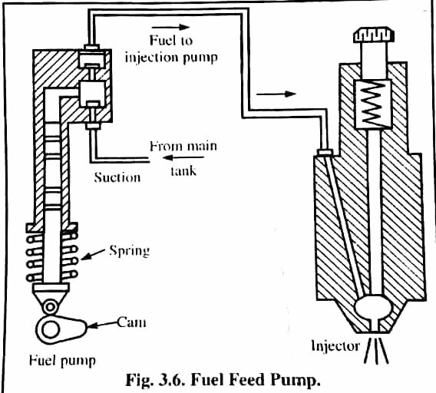
Fuel Feed Pump

Slide 29
FUEL INJECTION PUMP
The purpose of fuel injection pump is to meter the correct quantity of fuel and deliver it at the correct time to the engine cylinder according to the varying load and speed requirements.

Slide 30
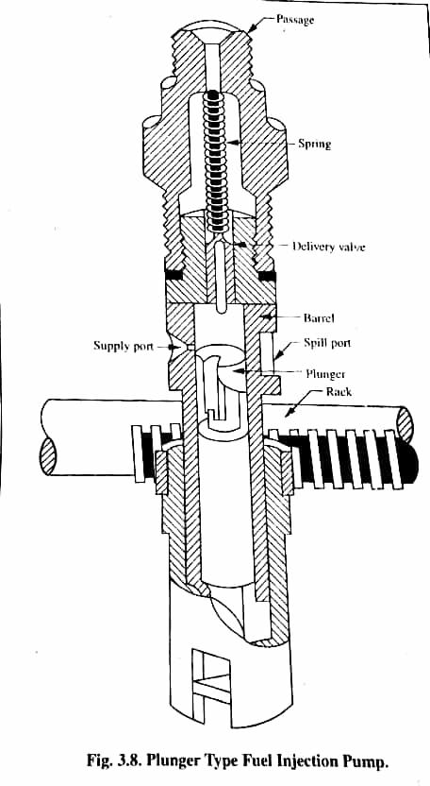
Plunger Type Fuel Injection

Slide 31
TYPES OF FUEL INJECTION PUMP
There are two types of fuel injection pumps:-
(1). Distribution type fuel injection pump
(2) Plunger type fuel injection pump

Slide 32
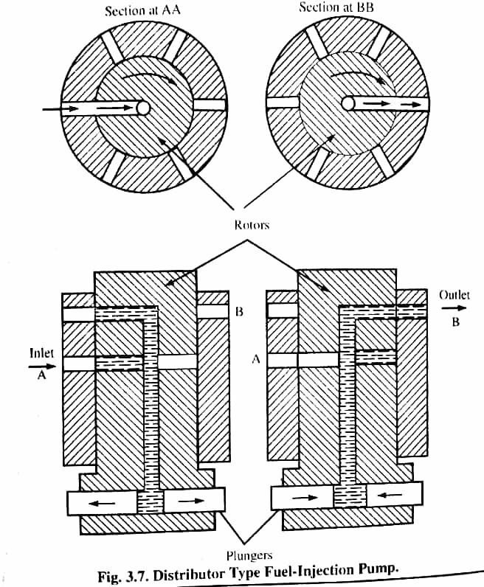
Distributor Type Fuel Injection System

Slide 33
FUEL INJECTOR OR ATOMISER
A nozzle mounted on the combustion chamber which supplies the fuel to the engine cylinder in the form of a fine spray is known as a fuel injector or atomizer or fuel valve or nozzle or sprayer.

Slide 34
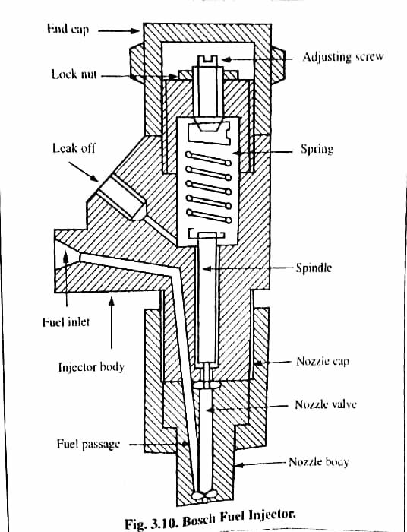
Fuel Injector Or Atomiser

Slide 35
COMPONENTS OF FUEL INJECTOR
(1). A NEEDLE VALVE,
(2). A COMPRESSION SPRING,
(3). A NOZZLE,
(4). AN INJECTOR BODY.

Slide 36
NOZZLE
Nozzle is that part of an injector through which the liquid fuel is sprayed into the combustion chamber.

Slide 37
TYPES OF NOZZLE
The usual types of injection nozzles are discussed below:-
(a) Single hole nozzle,
(b) Pintle nozzle,
(c) Multi-hole nozzle,
(d) Circumferential orifice nozzle,
(e) Pintaux nozzle.

Slide 38
(A) SINGLE HOLE NOZZLE
This is the simplest type of the nozzle. It consists of a single hole bored centrally through the nozzle body and closed by the needle valve.

Slide 39
(B) PINTLE NOZZLE
The stem of nozzle valve is extended to form a pin or pintle which ends through the mouth of the nozzle. T he size and shape of pintle can be varied according to requirement.

Slide 40
(C) MULTI-HOLE NOZZLE
It consists of a number of holes bored in the tip of the nozzle. This type of nozzle finds extensive use in automobile engines having open combustion chambers. The number of holes varies from 4 to 18

Slide 41
(D) CIRCUMFERENTIAL NOZZLE
The injected fuel particles tend to project in the form of plane with wide angle cone. The purpose of this is to obtain maximum possible area of fuel which comes into the contact with the air in the combustion chamber.

Slide 42
(E) PINTAUX NOZZLE
When an auxiliary hole is provided at the nose of a pintle nozzle, it is called pintaux nozzle. The auxiliary hole supplies fuel in the upstream direction during the idling or at the starting of the engine.

Slide 43
IGNITION SYSTEM OF I.C. ENGINES

Slide 44
BATTERY IGNITION SYSTEM
Most of the modern spark ignition engines use this system. The required components of a battery ignition system are as follows:-
1.A battery of 6 to 12 volts,
2.Ignition switch,
3.Ignition coil with a ballast resistor,
4.Distributor,
5.Contact breaker,
6.Condenser,
7.Spark plug.

Slide 45
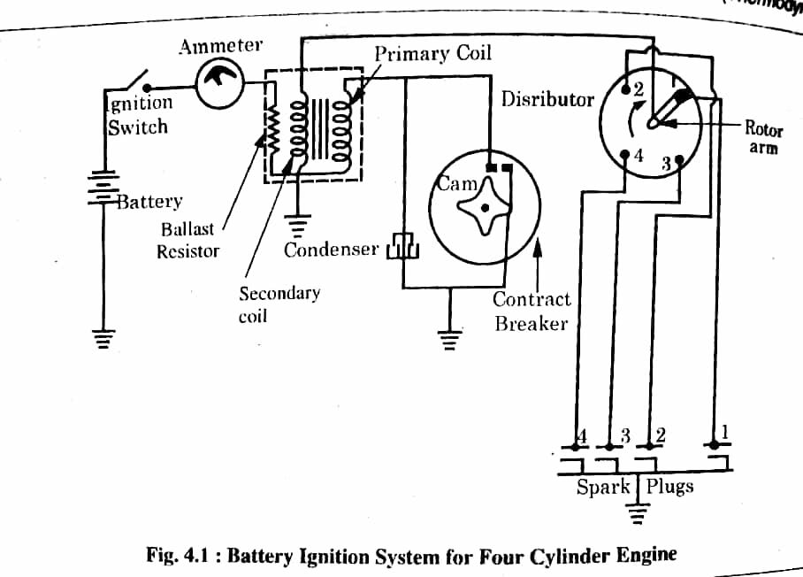
Battery Of Ignition System

Slide 46
OPERATION OF A BATTERY IGNITION SYSTEM
The primary ignition circuit starts from the battery and passes through the ignition switch, ammeter, primary winding and contact breaker points to the ground. A condenser is also connected in parallel to the contact breaker points. One end of the condenser is ground and the other end is connected to the contact breaker arm.
The secondary ignition circuit starts from the ground and passes through the secondary winding, distributor and spark plugs to the ground. It is not connected with the primary ignition circuit.

Slide 47
ADVANTAGES
It provides a good spark at low speeds.
It is cheap.
Maintenance cost is very less except the cost of battery.
It can be used easily on buses and cars.

Slide 48
LIMITATIONS
The primary voltage decreases as the engine speed increases.
Maintenance cost of battery is high.
The engine cannot be started if the battery is discharged.

Slide 49
MAGNETO IGNITION SYSTEM
The principle of magneto ignition system is similar to battery ignition system except that the magnetic field in the core of primary and secondary winding is produced by a rotating magnet. As the magnet rotates, the magnetic field is produced in the coils. Magnetic flux varies from a positive maximum to negative maximum and vice-versa.the fast variation of magnetic field induces a current in the primary winding of coil. But this fast variation of field is not enough to induce high voltage required for sparking. Therefore, for rapid breakdown of magnetic flux, the breaker points and the condenser are provided in the circuit as in case of battery ignition system.

Slide 50
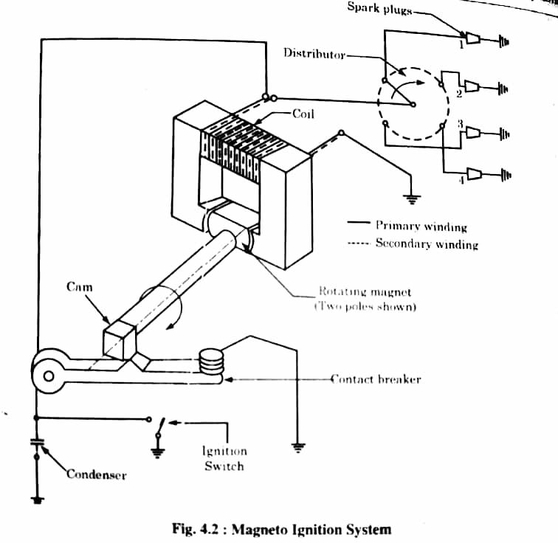
Magneto Ignition System

Slide 51
ADVANTAGES
It is best for high speed vehicles.
It is less expensive.
This system is favoured for two wheelers due to light weight and low maintenance.

Slide 52
DISADVANTAGES
Since the wiring carries a very high voltage, therefore, thus there is a strong possibilityof causing engine misfire due to leakage.
To avoid above problem, the high tension wires need suitable shielding.
At low speeds, it develops poor quality of spark at the time of starting.

Slide 53
APPLICATIONS
It is used in racing cars.
It is preferred for two wheelers.

Slide 54
TESTING OF I.C ENGINES
..

Slide 55
ENGINE POWER-INDICATOR AND BRAKE POWER
INDICATED HORSE POWER:
The actual power produce inside the cylinder or cylinders of the engine is called indicated power or indicated power of the engine. it is generally abbreviated as I.H.P.
BRAKE HORSE POWER
The net power produced at the crankshaft of an engine is called brake power or brake horse power.

Slide 56
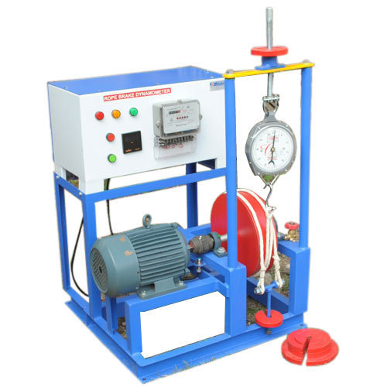
ROPE BRAKE DYNAMOMETER

Slide 57
Rope Brake Dynamometer
It is a device for measuring brake power of an engine

Slide 58
Rope Brake Dynamometer
It consist of one, two or more ropes wrapped over the brake drum keyed to the shaft of the engine.
The upper end of the rope is attached to a spring balance (s) while the lower end carries a dead weight (w).
In some case to prevent the slipping of the rope over the drum 3 to 4 wooden block are placed at circumference of drum
If high power is produced, then heat is generated due to friction between rope and drum. To prevent this pulley is provided with internal flanges on the rim of drum forming channel for flow of water to cool the drum

Slide 59
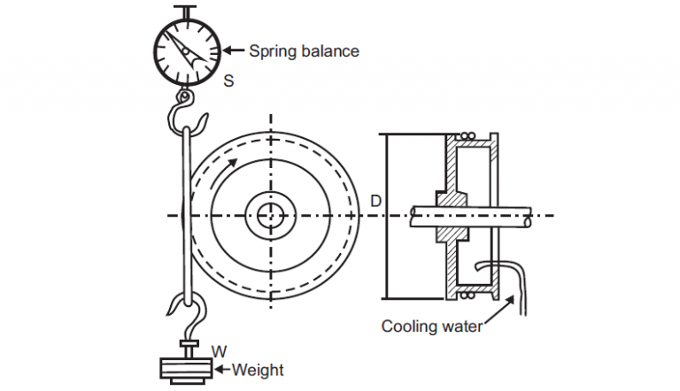
Front and side view of Brake Rope Dynamometer

Slide 62
Morse test
The method of finding I.H.P. of each cylinder , in a multi cylinder I.C. engine without the use of indicator is called Morse test.
This method is adopted to calculate the IHP of the high speed multi cylinder I.C engines. The brake power of the engine is measured by cutting off each cylinder. In petrol engine, the cylinder engine is cut off by shorting the sparkplug , Where as in the case of diesel engine, this is done by cutting off the fuel supply to the required cylinder.

Slide 63
Before we performed Morse test following point is taken into mind
Dynamometer is a device to find out the amount of power over the crankshaft of engine called as brake power.
The dynamometer finds how much torque is available over the crankshaft.
The angular speed of crankshaft is measured by a device called tachometer.
The brake power is given by= torque * angular velocity.
Friction inside the engine cylinder is depend upon angular speed of crankshaft i.e more the speed more the frictional power vice-versa.

Slide 64
Morse test : Let us consider a four cylinder engine. First of all, the brake power of the engine, when all cylinders in operation, is measured accurately by means of a brake dynamometer at constant speed and load. Now, one of cylinder say no. 1 is cut off. The speed of engine decreases and in order to bring the speed back to original speed, the load on engine is reduced. When the original speed with all cylinders working except no. 1is achieved, the brake power is again measured.
In the similar way, each cylinder is cut-off one by one and brake power of the remaining three cylinders is determined .

Slide 65
When cylinder 1 is cut-off
Here B1 is the brake horse power of remaining three cylinder.
Now

Slide 66
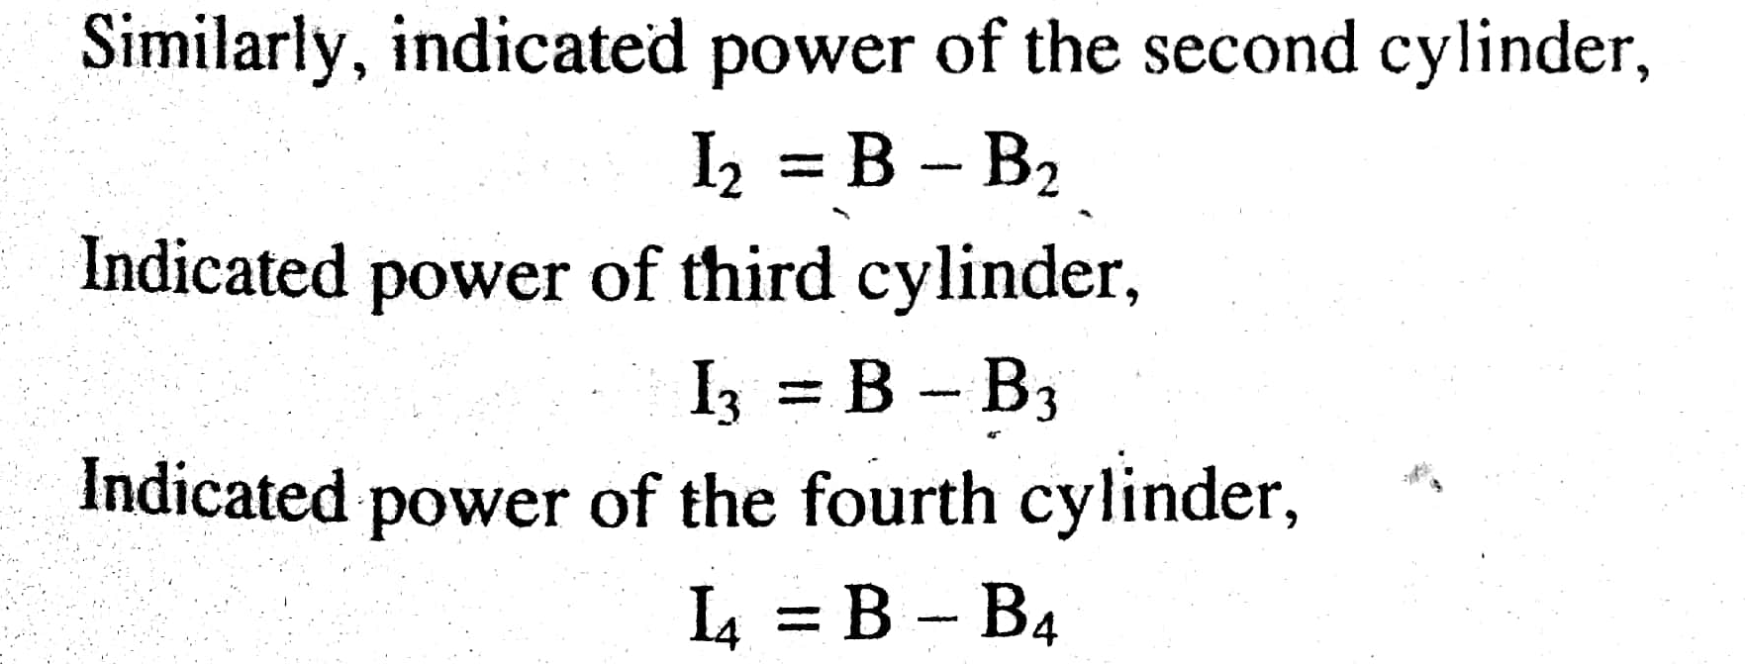
Now total indicated power can be obtained by adding the indicated power of each individual cylinder

Slide 67
Heat balance sheet
A statement which shows the distribution of the heat supplied to the engine is known as heat balance sheet. The performance of an engine and heat distributed by it is generally given by heat balance sheet.

Slide 68
Heat balanced sheet
A statement which shows the distribution of the heat supplied to the engine is known as heat balanced sheet.
HEAT SUPPLIED PER MINUTE | KJ | % AGE | HEAT EXPENDITURE PER MINUTE | KJ | % AGE
( a) Heat supplied by the Combustion of fuel |  | 100 | (b) Heat equivalent of brake power ( c) Heat lost to cooling water ( d) Heat lost to exhaust gases ( e) unaccounted heat | --- --- --- | --- --- ---
Total |  | 100 |  |  | 100

Slide 69
Concept of pollutants in S.I. and C.I. engines
Pollutant | Major source in Atmosphere | Major harmful effects
CO HC Nox SO2 | Automobiles 93%, power generation etc. 7% Automobiles 57%, petroleum refining use of solvents etc. 43% Automobiles 39%, factories, power generation, petroleum refining etc. 61% Automobiles(diesel) 1%, factories, power generation, heating system etc. 99% | Hinders the exchange of oxygen in the blood and causes carbon monoxide poisoning effect. Irritates the lining of the respiratory organs. Irritates the eyes, nose and throat Irritates respiratory system membranes and causes inflammation of the wind pipe.

Slide 70
Methods of reducing pollution in I.c. engines
Combustion chamber shape optimization
Improvement in air intake system
Optimization of compression ratio
Optimization of fuel supply system.

Slide 71
Alternative fuels for IC engines

Slide 72
Advantages of Alternative fuels

Slide 73
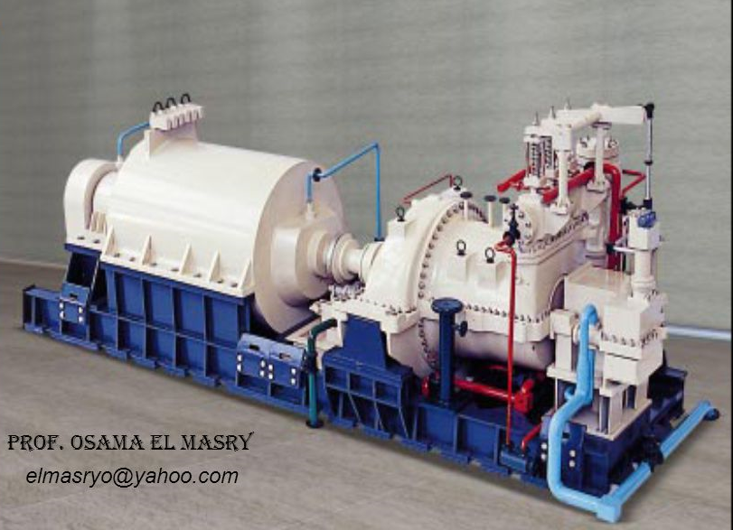
STEAM TURBINES AND STEAM CONDENSERS
Steam Turbine Steam condenser

Slide 74
Steam Turbine :- A steam turbine is a device that extracts thermal energy from pressurized steam and uses it to do mechanical work on a rotating output shaft.
Function :- A steam turbine called a prime mover operates, initially with the steam energy of the steam to transform into kinetic energy by means of nozzle. Then this kinetic energy of the resulting jet is converting into mechanical energy.
Uses :- Steam turbine are mainly used for power generation in thermal plants.

Slide 75
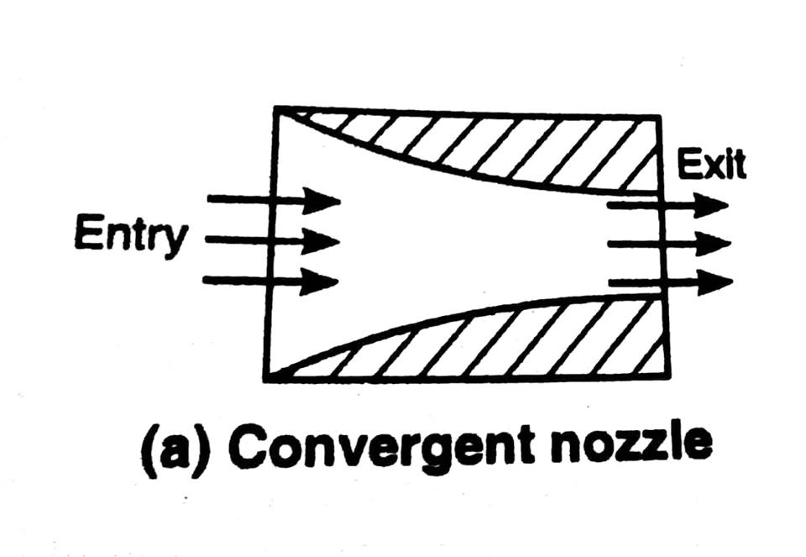
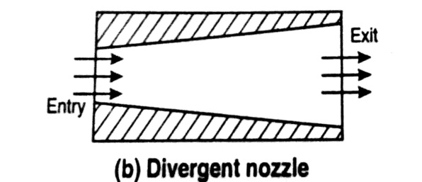
Steam Nozzle :- A device of varying cross-sectional area in which heat energy of steam is converted into kinetic energy is called a steam nozzle.
Convergent Nozzle:- In this nozzle
cross-sectional
area of nozzle decrease from entrance to
exit.
Application:- This nozzle is used for compressible fluids.
Divergent Nozzle:- In this nozzle
cross- sectional
area of nozzle increase from entrance to exit.

Slide 76
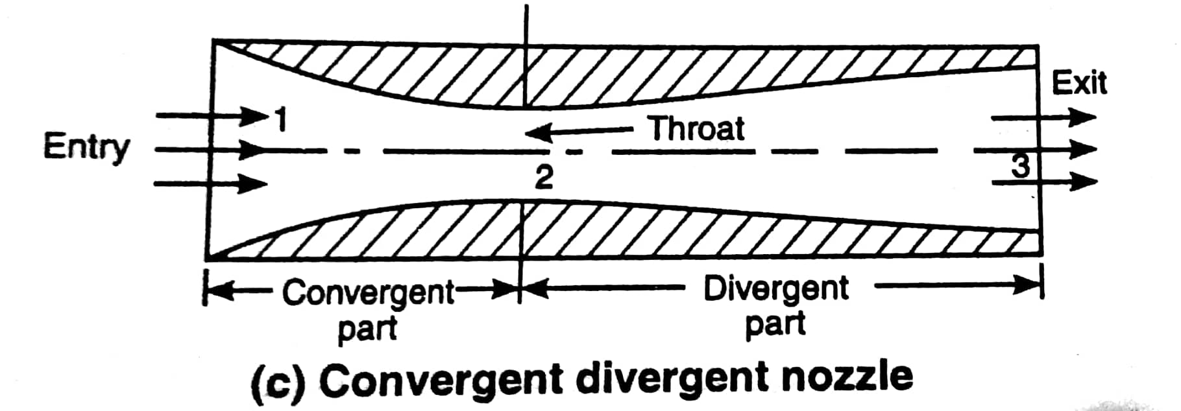
Application:- This nozzle is used when back pressure is less than critical pressure.
3. Convergent Divergent Nozzle :- In this nozzle cross-sectional area of nozzle is first decrease and then increase from entrance to throat to exit.
Application :- This nozzle is
used when back pressure is less
than critical pressure.

Slide 77
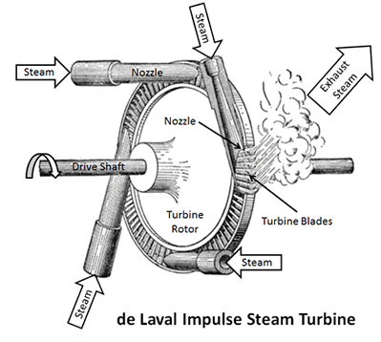
steam turbine :- Steam turbine are classified as
1. Impulse turbine :-In impulse turbine, the steam turbine comes out at a very high velocity through the fixed nozzle, the strikes the blade fixed on the periphery of a rotor. The blades changes the steam flow without changing the pressure.
Simple impulse turbine :- It consist of one set of nozzle and one set of moving blades. The expansion of steam from its initial pressure to final pressure take place in one set of nozzle. Due to

Slide 78
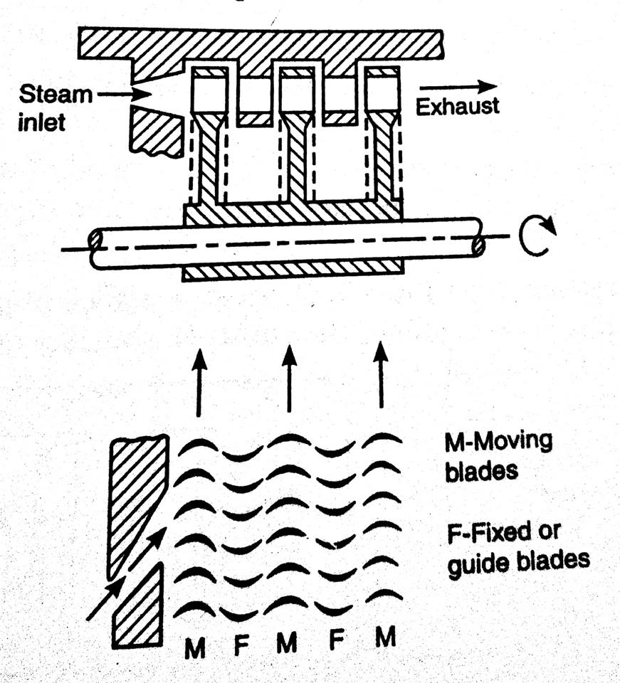
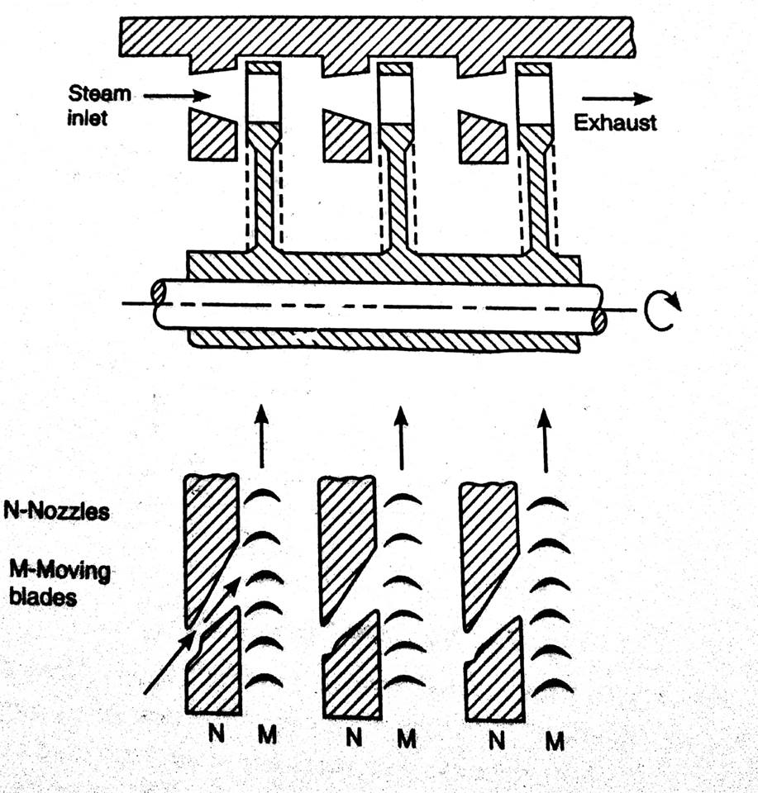
the high pressure drop in the nozzle, the velocity of stream increase in the nozzle which are arranged around the wheel at 20 with the wheel tangent.
Compound impulse turbine :-The method in which multiple system of rotor are keyed to a common shaft in series and the steam pressure or jet velocity is absorbed in stages as it flows over the rotor blades is called compounding.
Velocity compounding pressure compounding

Slide 79
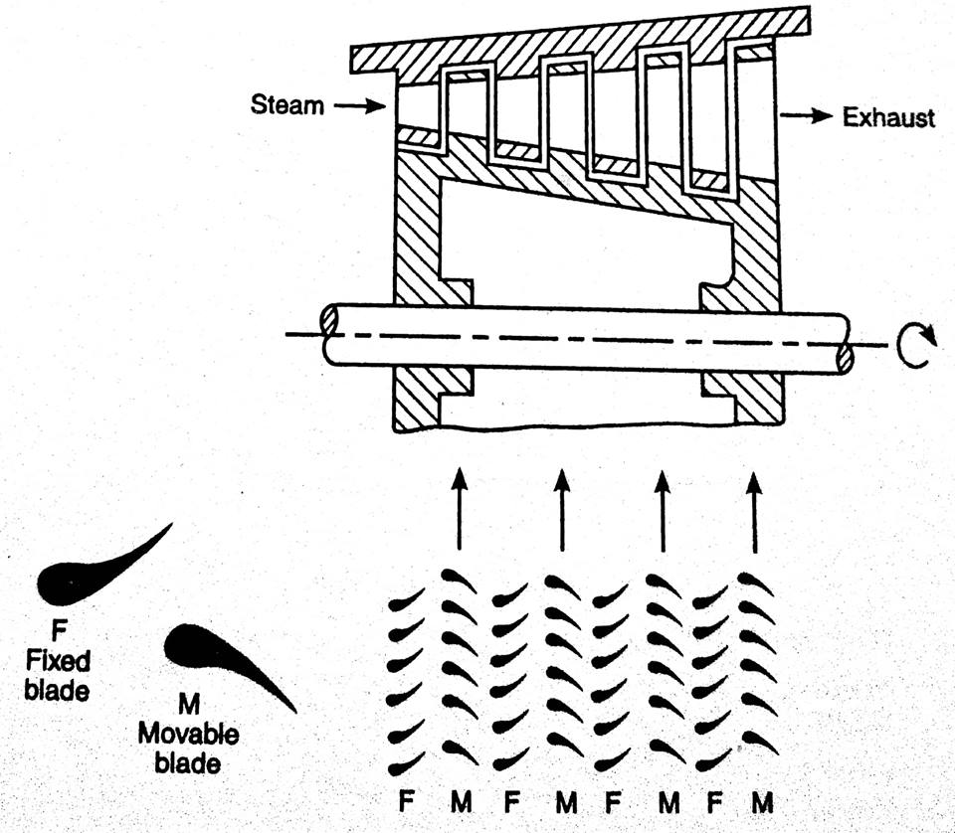
2. Reaction Turbine :- A turbine in which the steam pressure decrease gradually while expanding through the moving blades as well as while passing through blades or nozzle is called a reaction turbine. It consist of a large number of stages and each stage consist of set of fixed and moving blades.

Slide 80
Steam Condenser :- A closed vessel in which steam is condensed by abstracting heat and the pressure is maintained below atm. Pressure is known as steam condenser.
Function :- 1. It reduce back pressure of an engine /turbine and the work performed per kg of steam during expansion is increased.
2. The exhaust steam when condensed in condenser
It become free form impurities and it can directly used as feed water for boiler.
3. involve the expenditure of power to operate pump to pump condensate from the condenser to steam generator.

Slide 81
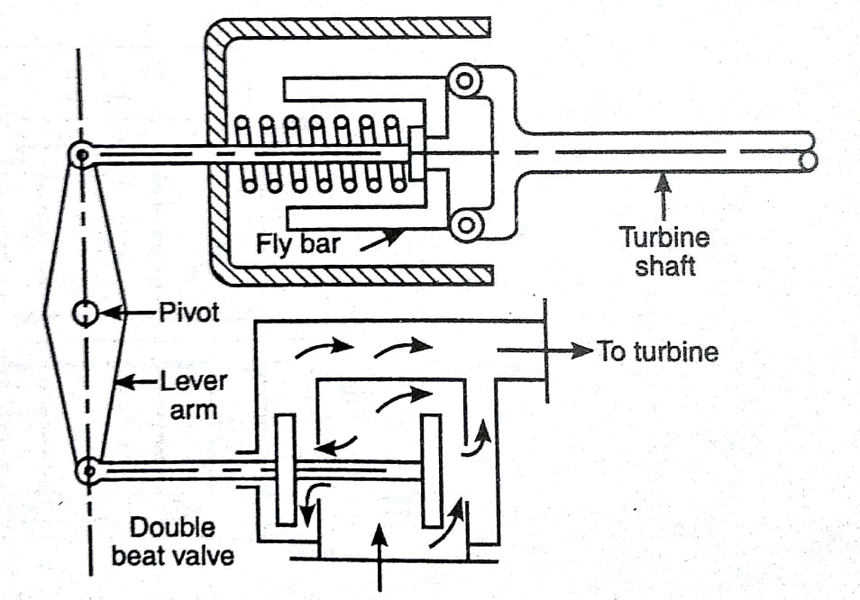
Governing of Steam turbines :- The method to maintain the speed of the turbine constant irrespective of variation of load on the turbine is called Governing of stem turbine. The various method of governing of steam turbine are
Throttle governing:- It has a
double beat valve in the way of
steam flow to turbine. When load on
turbine increase its speed tends
to decrease. Under that condition fly
bar move inward which in turn
actuate the lever arm and control
double beat valve towards max. flow of
steam supply to turbine for constant speed and vice –versa.

Slide 82
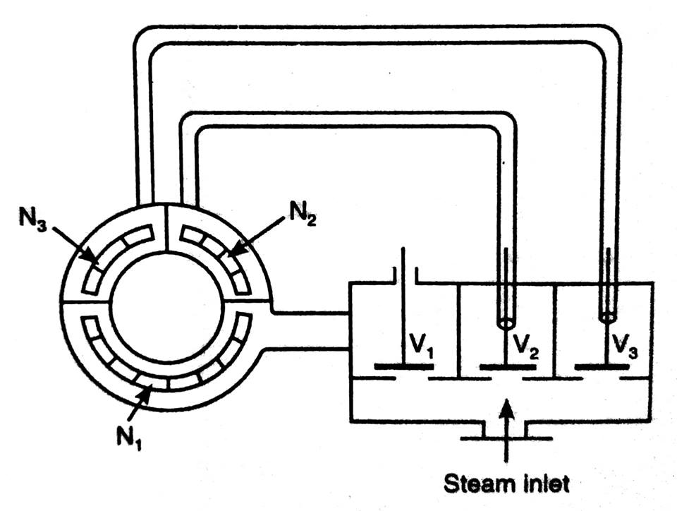
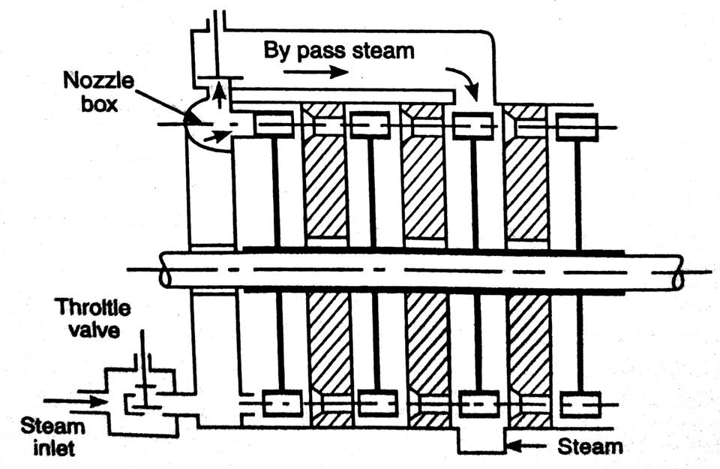
2 Nozzle Control Governing :- Here nozzle are grouped and supply of steam to each group is
controlled by regulating the valves.
Under full load condition regulating
valve is fully open. When load on
turbine Varies than supply of stem to
group of Nozzle is also varied to restore
the original Speed.
3 Bypass Governing :- In this case the
steam flowing to turbine first enter the
turbine chest through a valve, controlled
by the speed governor. For high load a
bypass line is provided for the steam from
the first stage nozzle box into a latter
stage where work output increase

Slide 83
Element of Condensing Plant :-
1. A condenser
2. A condensate pump
3. A dry air pump
4. A feed water pump
5. A cooling water pump
6. cooling tower and cooking pond
7. Atmospheric relief valve

Slide 84
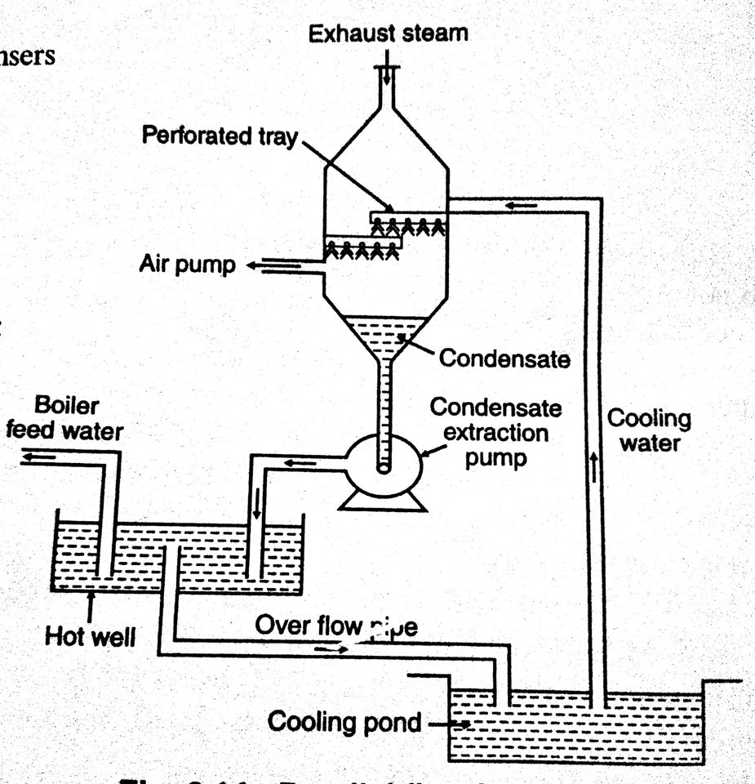
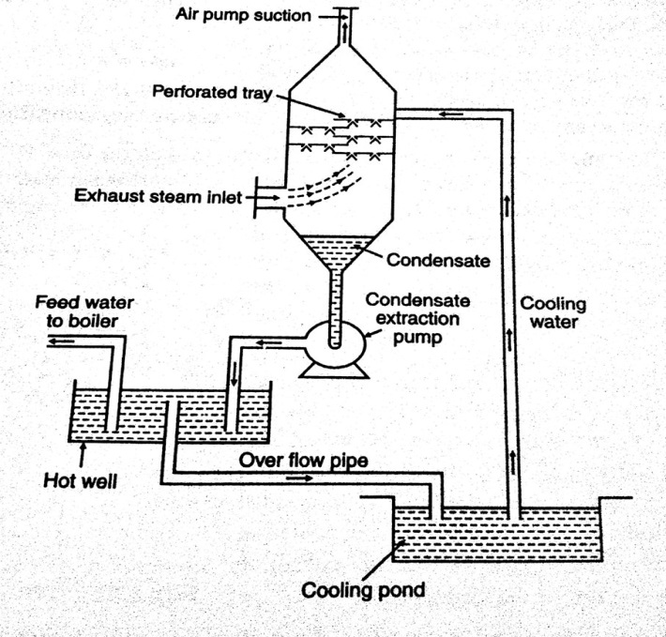
classification of steam condenser :- Steam condenser are classified in two categories as follows
1. Jet Condenser :- In a jet condenser, the steam to be condensed and the cooling water comes in direct contact. The temperature of condensate is same as that of cooling water leaving the condenser.
The jet condenser is sub divided in two types
Parallel flow jet condenser low level contra flow jet condenser

Slide 85
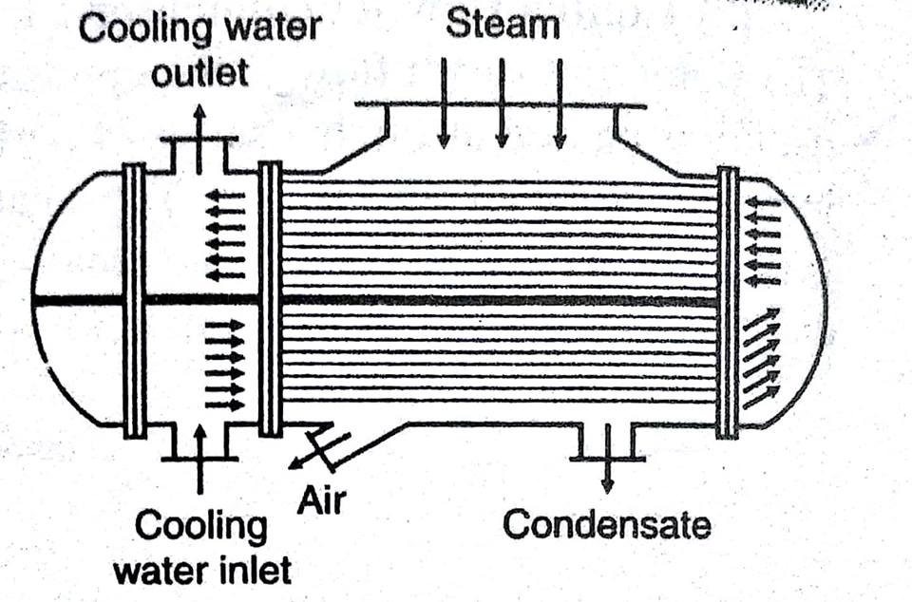
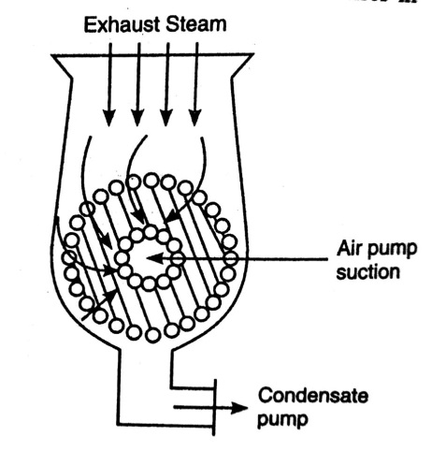
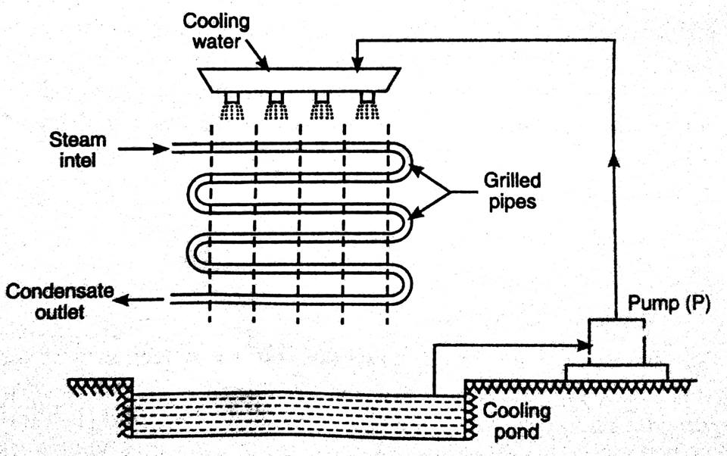
2. Surface Condenser :- In this type of condenser, the exhaust steam and the cooling water do not come in direct contact with each other. It is generally used when large quantity of inferior water is available and good quantity of feed water to the boiler.
The surface condenser is sub divided into as follows
Down flow surface condenser Central flow condenser Evaporative condenser

Slide 86
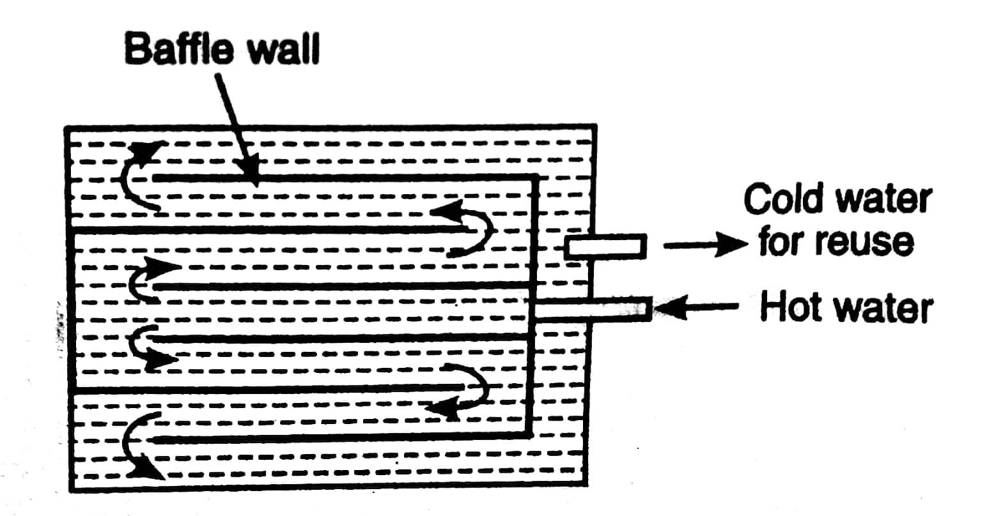
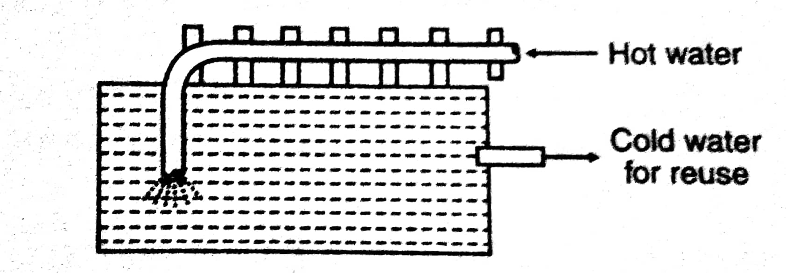
Cooling pond :- The simplest method of removing heat from the cooling water consist of cooling it in an open is called cooling pond.
The cooling pond are of two type:
Directed flow cooling pond Non-directed flow cooling pond

Slide 87
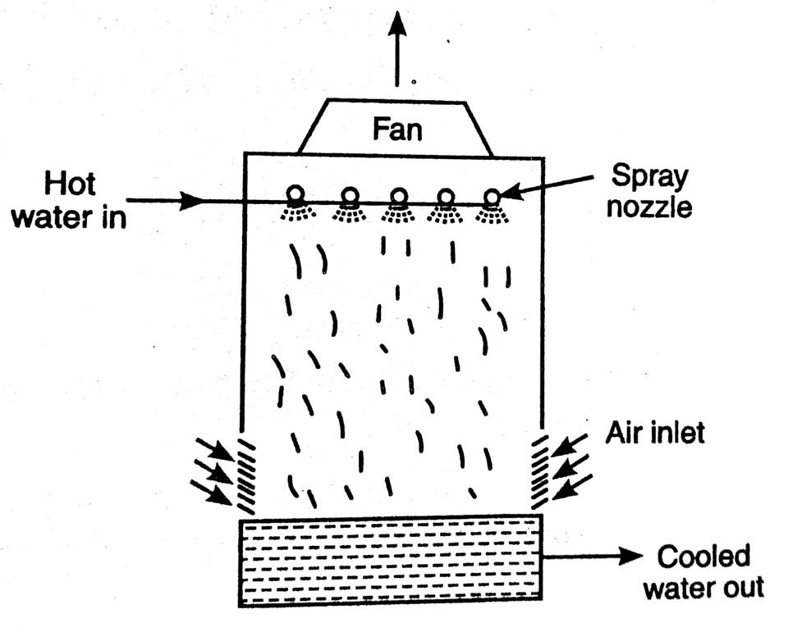
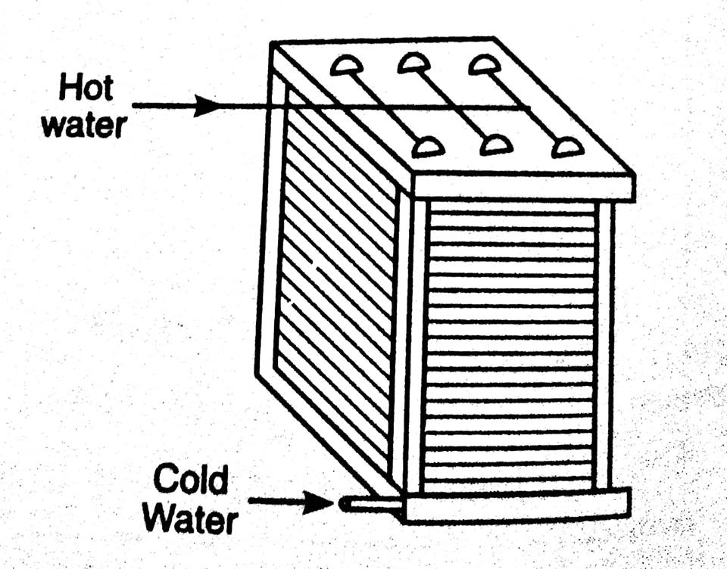
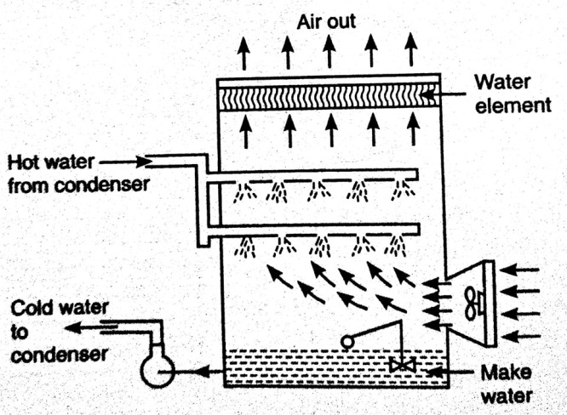
Cooling Tower :- In cities where the land is very expensive, the cooling tower are used for cooling water as they can be installed on the roof of the power plant.
According to the method of air circulation, the cooling pods are classified as:
Natural draft cooling water Forced draft cooling water Induced draft cooling
water

Slide 88
GAS TURBINES AND JET PROPULSION
..

Slide 89
CLASSIFICATION, OPEN CYCLE GAS TURBINE AND CLOSED CYCLE GAS TURBINE:-
The gas turbines are classified into two main types:-
Constant pressure combustion gas turbine.
Constant volume combustion gas turbine.
N.B. constant pressure combustion gas turbine is further classified as :-
Constant pressure open cycle gas turbine and
Constant pressure closed cycle gas turbine.

Slide 90
APPLICATIONS AND LIMITATIONS OF GAS TURBINE:-
APPLICATIONS:-
SUPER CHARGING:- For supercharging heavy duty diesel engines and aviation gasoline engines, a small gas turbine is run by the exhaust gases which drives the super charger.
ELECTRIC POWER GENERATION:- Gas turbines are used for electric power generation because of the ability to get started and brought up to full load quickly and less cost of installation and maintenance.

Slide 91
MARINE FIELD:- The gas turbine is used for ship propulsion. Unlike in a power plant using steam turbine, no boilers, water storage tanks and distillation plants are requires.
RAILWAY:- The gas turbine is used for locomotive propulsion.
ROAD TRANSPORT:- So long as the application of gas turbines to road transport is concerned, a number of small gas turbine cars are successfully manufactured and tested.
TURBO JET AND TURBO PROPELLER ENGINES:- The gas turbine is used in turbo jet and turbo propeller engines. It supplies power only to drive the compressor in the turbojet engines, where as it drives the propeller in addition to the compressor in turbo propeller engines.

Slide 92
LIMITATIONS OF GAS TURBINES:-
Material used is expensive because it bears high temperature.
The life of the unit is comparatively shorter.
The unit gives more noise than other power producing units.

Slide 93
Open cycle gas turbine

Slide 94
OPEN CYCLE CONSTANT PRESSURE GAS TURBINE: GENERAL LAYOUT, P-V AND T-S DIAGRAM AND WORKING OF GAS TURBINE:-
It consists of a compressor, combustion chamber, turbine, generator and a motor. The turbine is started with the help of a motor. The air is drawn into the compressor from the atmosphere at point 1. after compression it is delivered to the combustion chamber at point 2. The combustion chamber is made of double casing. The primary air which is one fourth of the total air delivered by the compressor is used for the combustion of the fuel. The fuel oil enters the inner casing through the burner. It is injected at constant pressure in the combustion chamber. The remaining three fourth air known as secondary air flows through the annular space between the inner and the outer casing of the combustion chamber. The heat is added by burning

Slide 95
The fuel into the air in the combustion chamber at constant pressure and the temperature of the products of the combustion rises to about 2000 C. But the temperature that turbine blades can withstand is about 650 C to 900C. Therefore, it becomes necessary to dilute the products of combustion by admitting additional compressed air which is about three to six times.
WORKING OF GAS TURBINE:- The cycle of operation of a gas turbine is as follows :
(a) 1-2’ isentropic compression : Atmospheric air at pressure p1 and temperature T1 is drawn into the compressor and compressed isentropically to pressure P2 and temperature T2.

Slide 96
(b) 2'- 3 constant pressure heating : The heat is added by direct burning of the fuel at constant pressure P2 and the temperature of the products of combustion rises to T3 in the combustion chamber.
(c) 3-4‘ Isentropic expansion : The high pressure and high temperature products of gas expands isentropic ally in the turbine from pressure P2 to P4.
(d) 4’-1 constant pressure heat rejection : The products of combustion are exhausted at constant pressure P4 = P1 and the cycle is completed.

Slide 98
CONSTANT PRESSURE CLOSED CYCLE GAS TURBINE, P-V AND T-S DIAGRAM AND WORKING:-
The compressed air from the compressor is passed via heat exchanger to the air heater where it is further heated to high pressure and temperature and finally flows through the turbine and develops the work. The hot air coming out from the turbine is cooled to its original temperature in the cooler, before entering the compressor. Thus the same air is circulated through the plant. Part of the power developed in the turbine is utilized to drive the compressor and the rest is available as useful work to generate power. The electric motor helps to start the plant initially.

Slide 99
WORKING OF GAS TURBINE:-
The sequence of operation of the cycle of a gas turbine is as follows :
(a) The process 1-2 is the isentropic compression in the compressor.
(b) The process 2-3 is the heating of air at constant pressure in the heat exchanger.
(c) The process 3-4 is the isentropic expansion of the air in the turbine.
(d) The process 4-1 is the cooling of air at constant pressure in the cooling chamber.

Slide 100
PRINCIPLE OF OPERATION OF RAM-JET ENGINE AND TURBO JET ENGINE, APPLICATION OF JET ENGINE:-
RAM OR RAM JET ENGINE :-
It is very simple in construction and operation. It has no compressor and turbine and the compression of air takes place by ramming effect. It consists of following three major components:-
Diffuser system
Combustion chamber
Exhaust nozzle

Slide 101
JET PROPULSION:-
The gas turbines occupy a prominent place in the propulsion of aircrafts, missiles and space ships. The reaction of the jet of gases which are discharged behind with a high velocity produces the necessary propulsive work based on Newton’s third law of motion.
There are 2 main categories of jet propulsion engines:-
(a) Atmospheric jet engines and
(b) Rockets

Slide 102
Atmospheric jet engines depend on atmospheric air for the combustion of fuel whereas in rocket engines, the fuel and the oxidizer are stored in the body of the unit and it is independent of the atmospheric air.
The gas turbines used in different aircraft units can be classified into :
Turbo jet unit and
Turbo propeller unit
APPLICATION OF JET ENGINES :-
Jet engines or turbojet engine are generally used in high speed fighters and air lines.

Slide 103
ROCKET ENGINE – ITS PRINCIPLE OF WORKING AND APPLICATIONS:-
A rocket engine like a jet engine generates thrust by the jet of exhaust gases issuing our at high velocity at the rear. A rocket differs from the jet engine as the former carries all its supplies of oxygen in addition to the fuel with it, whereas the latter is dependent upon a continuous feed of atmospheric oxygen. Two types of fuels are used in the rocket, the solid fuel and the liquid fuel. In solid fuel rocket, the oxygen is carried in the form of chemicals which are mixed with the fuel. But in the liquid fuel rocket, the oxygen is carried in separate fuel tanks.

Slide 104
PRINCIPLE OF WORKING :-
In a rocket engine , large quantity of gases are generated by the combustion of suitable propellants.
It has following four parts:-
Combustion chamber
Exhaust nozzle
Control valves
Injection system

Slide 105
APPLICATIONS:-
Signalling and fire work display : Small solid fuel rockets are used for signalling purpose and fire works display.
Research : Rockets are being used in the meteorological research of upper atmosphere like composition of air, temperature, pressure, humidity, ozone layer, wind speeds and ultra-violet radiation radiation etc.
For satellites : The satellites are sent by the rockets into the outer space for information like navigational signals for the ships and transmit television shows across the oceans.

Slide 106
For space ships:- The rockets are used for the space ships to drive out of earth’s atmosphere and gravitational pull to explore the possibility of flights to the moon and other planets.
Other use:- In the near future, rockets may be used to carry passengers, letters and fright etc. from one place to another.

Slide 107
&
THANK YOU

