Slide 1
ENTREPRENEURSHIP

Slide 2
Meaning of Entrepreneurship:-
1.The activity of setting up a business or businesses, taking on financial risks in the hope
of profit.
2.The capacity and willingness to develop, organize and manage a business venture along with any of its risks in order to make a profit.

Slide 3
Need of Entrepreneurship:-
Entrepreneurs Add to National Income.
Entrepreneurs Create Social Change.
Community Development.

Slide 4
Functions of Entrepreneurship:-
Risk-Taking.
Building of Organization.
Decision Making.
Management Control.
Innovation.

Slide 5
Qualities of Entrepreneur:-
1. Disciplined.
2. Confidence.
3. Open Minded.
4. Self Starter.
5. Competitive.
6. Creativity.
7. Determination.
8. Strong people skills.

Slide 6
Sole Proprietorship and Partnership Firm :-
Sole Proprietorship:- A business that legally has no separate existence from its owner. The sole proprietorship is the simplest business form under which one can operate a business. The sole proprietorship is not a legal entity. It simply refers to a person who owns the business and is personally responsible for its debts.
Partnership Firm:- A Partnership Firm is a popular form of business constitution for businesses that are owned, managed and controlled by an Association of People for profit.

Slide 7
Various Institutions Providing Support To Small Entrepreneurs:-
Financial Institutions:-
i. Industrial Development Bank of India (IDBI)
ii. Industrial Finance Corporation of India (IFCI)
iii. Small Industries Development Bank of India (SIDBI)
iv. National Small Industries Corporation Ltd (NSIC)
v. State Small Industries Corporation (SSIC)
vi. Regional Rural Banks (RRBs)
vii. State Financial Corporations (SFCs)
viii. State Industrial Development Corporations (SIDCs)
ix. Cooperative Banks and Gramin Banks

Slide 8
Various Institutions Providing Support To Small Entrepreneurs:-
Institutions for Technical Guidance:-
i. Small Industries Development Organisation (SIDO)
ii. District Industries Centres (DICs)
iii. Technical Consultancy Organisations (TCOs)
iv. Small Industries Service Institutes (SISIs)
v. State Small Industries Development Corporations (SSIDCs)
vi. Industrial Development Corporation (IDC)
vii. Agricultural Promotion and Investment Corporation of Orissa Limited (APICOI)

Slide 9
Various Institutions Providing Support to Small Entrepreneurs:-
Training Institutions:-
i. Small Industries Service Institute (SISI)
ii. National Bank for Agriculture and Rural Development (NABARD)
iii. Council for Advancement of Peoples Action and Rural Technology (CAPART)
iv. District Industries Centre (DIC)

Slide 10
Market Survey and Opportunity Identification

Slide 11
Scanning of the Business Environment:-
Environmental scanning is a process of gathering, analysing, and dispensing information for tactical or strategic purposes. The environmental scanning process entails obtaining both factual and subjective information on the business environments in which a company is operating or considering entering.

Slide 12
Types of Market Survey:-
Focus Groups
Customer-Satisfaction Phone Surveys
Mail-In Surveys
Online Surveys
One-on-One Surveys

Slide 13
Considerations in product selection:-
Present Market.
Scope of Growth of Market.
Costs.
Availability of main production factors.
Risks.

Slide 14
Factors for Sales Forecasting:-
Changes in technology.
Government policies.
Factors related to the concern itself.
Competition.

Slide 15
Methods used for Forecasting the Demands:-
1. Survey of Buyer’s Intentions.
2. Collective Opinion or Sales Force Composite Method.
3. Trend Projection.
4. Executive Judgment Method.
5. Economic Indicators.
6. Controlled Experiments.
7. Expert’s Opinions.

Slide 16
Assessment of demand and supply in potential areas of growth(sales forecasting):-
Sales forecasting is the process of estimating future sales. Accurate sales forecasts enable companies to make informed business decisions and predict short-term and long-term performance. Companies can base their forecasts on past sales data, industry-wide comparisons, and economic trends.

Slide 17
PROJECT REPORT PREPARATION
INTRODUCTION
A Project Report is a document which provides details on the overall picture of the proposed business. The project report gives an account of the project proposal to ascertain the prospects of the proposed plan/activity.

Slide 18
CONTENTS OF PROJECT REPORT
Promoter’s Profile
Location
Land & Building
Plant & Machinery
Production Process
Other Utilities
Raw Materials etc…..

Slide 19
1. PRILIMINARY PROJECT REPORT
Preliminary Project Report is a formal document that describes specific activities, events, occurrences, or subjects of a project to explain progress of the project up to a certain point in time schedule.

Slide 20
2.DETAILED PROJECT REPORT
Detailed project report is a complete document for investment decision-making, approval, planning. Detailed project report is base document for planning the project and implementing the project. Detailed project report is base document for planning the project and implementing the project.

Slide 21
PROJECT APPRAISAL
Project Appraisal is a multi-dimensional analysis of the project i.e. a complete scanning of a project.
Project appraisal is the process of assessing, in a structured way, the case for proceeding with a project or proposal, or the project's viability.

Slide 22
STAGE OF PROJECT APPRAISAL
ECONOMICAL ANALYSIS
FINANCIAL ANALYSIS
TECHNICAL FEASIBILITY
MANAGERAIL COMPETENCE
COMMERCIAL ANALYSIS

Slide 23
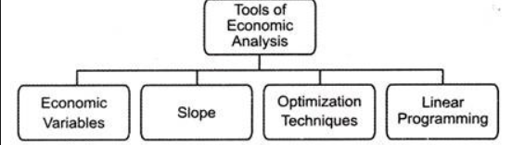
ECONOMICAL ANALYSIS
The study of forces that determine the distribution of scarce resources.

Slide 24
ECONOMICAL ASPECTS
Increased Employment
Increased output
ECONOMIC ASPECTS
Increased service
Increased Government revenue
Higher earnings
Improved income distribution
Higher standard of living
Increased National Income

Slide 25
FINANCIAL ANALYSIS
Financial analysis is the examination of financial information to reach business decisions.
Financial analysis is the process of evaluating businesses, projects, budgets and other finance-related entities to determine their performance and suitability.

Slide 26
Financial Soundness
Efficient Operation
Financial Aspects
Cost Of Production
Return on Investment
Prospects Of Marketing
Profitability
Effective Control
Budgeting
pricing

Slide 27
Technical Feasibility:-
Technical feasibility is the complete study of the project in terms of input, processes, output, fields, programs and procedures.
Technical feasibility study is used to determine the viability of an idea, such as ensuring a project is legally and technically feasible as well as economically justifiable.

Slide 28
BUSSINESS PROCESS CYCLE
CASH
WORK IN PROGRESS
FINISHED GOODS
SALES
RAW MATERIALS

Slide 29
LEADRERSHIP

Slide 30
Meaning of Leadership:-
Leadership is not a person or a position. It is a complex moral relationship between people based on trust, obligation, commitment, emotion and a share vision of the good.
Leadership is process where by an individual influences a group of individuals to achieve.

Slide 31
Need of Leadership:-
To create confidence among employees.
To motivate the employees.
To build morale as high morale leads to higher productivity an organizational stability.
To define objectives of organization.
To create team-spirit among employees.
To run the organisation efficiently and economically.
To develop a sense of participation among workers.
To handle difficult situation.

Slide 32
Qualities of a Good Leader:-
Honesty and Integrity
Confidence
Inspire others
Commitment and Passion
Good Communicator
Accountability
Delegation and Empowerment
Creativity and Innovation
Empathy
Decision Making Capabilities

Slide 33
Functions of Leadership:-
1. Priority on needs
2. Focus on actions
3. Motivation
4. Guidance
5. Result oriented
6. Flexible leadership role
7. Clear understanding of individual responsibilities
8. Organizing
9. Controlling
10. Setting an example

Slide 34
Manager vs Leader:-
Manager : A manager is a person who manages the organisation such that he is responsible for planning, organisation, direction, co-ordination and control.
Leader : A leader is a person who influences his followers to achieve a specified goal. He is a man with vision and inspires his followers in such a way that it becomes their vision.

Slide 35
Comparison Chart:-
Basis | Leader | Manager
1.Approach | Sets direction | Plans details
2.Subordinates | Followers | Employees
3.Decision | Facilitates decision | Makes decision
4.Focus | People | Process and procedure
5.People | Aligns people | Organizes people
6.Aim | Growth & development | Attainment of the required result

Slide 36
Types of Leadership:-
1. Autocratic or Authoritarian Leadership: An autocratic leader centralizes power and decision making in himself. He gives order, assigns tasks and duties without consulting the employees. The leader takes full authority and assumes full responsibilities.
2. Democratic or Participative Leadership: It is decentralize authority. It is characterized by consulting with subordinates and their participation in the formulation of plans and policies. He encourages participation in decision making.
3. Laissez-faire or Free-rein Leadership: It avoid power and responsibilities. This type of leader passes on the responsibilities for decision making to his subordinates. He gives no direction and allows the group to establish its own goals and work out its own problems.

Slide 37
MOTIVATION
Motivation is the word derived from the word ’motive’ which means needs, desires, wants or drives within the individuals. It is the process of stimulating people to actions to accomplish the goals.
Motivation is the reason for people's actions, desires, and needs. Motivation is also one's direction to behaviour, or what causes a person to want to repeat a behaviour.

Slide 38
CHARACTERISTICS OF MOTIVATION:-
Motivation is a Psychological Concept.
Motivation affects the Whole Individual, not part of Him /Her.
Motivation is an Unending Process.
Motivation is a complex phenomenon.
Motivation is different from Satisfaction, Inspiration, and Manipulation.
Motivation is different from mental strength.

Slide 39
IMPORTANCE OF MOTIVATION :-
Improves Performance Level.
Helps to Change Negative or Indifferent Attitudes of Employees.
Reduction in Employee Turnover.
Helps to Reduce Absenteeism in the Organisation.
Reduction in Resistance to Change.

Slide 40
FACTOR AFFECTING MOTIVATION :-
Achievement
Advancement
Growth
Recognition
Work itself
Job security
Salary
Technical supervision

Slide 41
THEORIES OF MOTIVATION :-
Maslow need hierarchy theory
Herzberg’s theory of motivation
McGregor's X and Y theory

Slide 42
MASLOW NEED HIERARCHY THEORY :-
The Maslow’s Need Hierarchy is given by Abraham Maslow, who has explained the strength of certain needs at the different point of time. Maslow has given a framework that helps to understand the strength of needs and how a person moves from one need to the other. These needs are arranged in the hierarchical form as shown below:

Slide 43
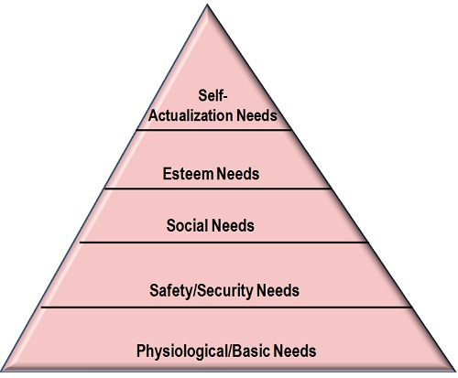
MASLOW NEED HIERARCHY THEORY :-

Slide 44
HERZBERG’S THEORY OF MOTIVATION :-
In this context, the study was conducted wherein the experiences and feelings of 200 engineers and accountants were analysed. They were asked to share their previous job experiences in which they felt “exceptionally good” or “exceptionally bad.” Through this study, Herzberg concluded that there are two job conditions independent of each other that affect the behaviour differently.

Slide 45
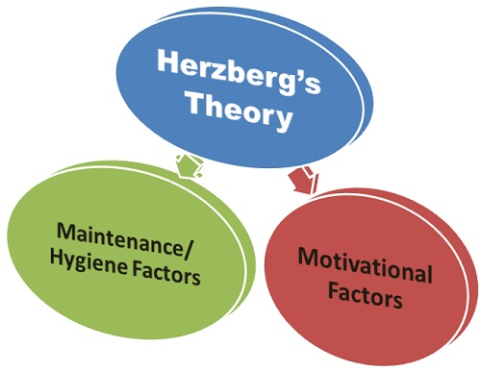
The first set of job conditions has been referred to as maintenance or hygiene factor. The second set of job conditions is referred to as motivational factors.

Slide 46
McGregor's X and Y theory :-
Theory X and Theory Y are theories of human motivation and management. These two theories describe contrasting models of workforce motivation applied by managers in human resource management, organizational behaviour, organizational communication and organizational development.

Slide 47
X and Y theory:-
X - THEORY
Y - THEORY
Dislike their work.
Avoid responsibility and need constant direction.
Have to be controlled, forced and threatened to deliver work.
Need to be supervised at every step.
Happy to work on their own initiative.
More involved in decision making.
Self-motivated to complete their tasks
Enjoy taking ownership of their work.

