Slide 1
Estimation of Material Cost
Subject – Estimating & Costing
Chapter 5 - Estimation of Material Cost
Delivered By Ankit Panghal

Slide 2
Cost Estimating
Definition :- It may be defined as the process of determining probable cost of the product before the start of manufacture.
Purpose :- The purpose of cost estimating is to find the cost of the manufacturing operations and to assist in setting the price for the product.

Slide 3
Components of Job Estimation
Design Cost
Drafting Cost
R&D Cost
Material Cost
Labour Cost
Inspection Cost
Cost of tool, jigs, fixtures, etc.
Overhead Cost

Slide 4
Estimation of Material Cost
It Plays an important role in determining total production cost
Proper precaution must be taken in determining the material cost.
Under estimation and over estimation both are harmful.
Material cost=Direct material cost +Indirect material cost

Slide 5
Procedure for calculation of Material Cost
Divide the product into simple parts to find the volume
Finally , the material cost is calculated as follow:
Material Cost = Cost per unit weight x weight of the material
Calculate weight of material as follow:
Weight = volume x density
Find the volume of complete product by adding volumes of all parts
Calculate the volume of each part
Neglect the corners and small fillets and take suitable approximation

Slide 6
Formulae of Mensuration

Slide 8
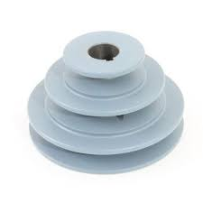
Some problems related to Estimation of material cost
Problem 1. Estimate the weight of cast iron step pulley as shown in fig. take density of cast iron as 7.2 g/${cm}^{3}$.
10cm 10 cm 10 cm
25 cm
18cm
D
6cm
12 cm
C
B
A

Slide 9
Solution :- Step 1 – Break the stepped pulley in four parts A,B,C and D .
Step 2 - find the volume of each part
Volume of part A , $V_{A}$ =$\frac{π}{4}$ x ${25}^{2}$ x 10 = 4908.7 ${cm}^{3}$
Volume of part B , $V_{B}$ =$\frac{π}{4}$ x ${18}^{2}$ x 10 = 2544.7 ${cm}^{3}$
Volume of part C , $V_{C}$ =$\frac{π}{4}$ x ${12}^{2}$ x 10 = 1131 ${cm}^{3}$
Volume of hole D , $V_{D}$ =$\frac{π}{4}$ x ${25}^{2}$ x 10 = 848.2 ${cm}^{3}$

Slide 10
Step 3- find the total volume of pulley
Total volume of pulley, V = $V_{A}$+ $V_{B}$+ $V_{C}$ -$V_{D}$
= 4908.7+2544.7+1131-848.2
= 7736.2 ${cm}^{3}$
Step 4- find the Weight of pulley
Weight of pulley = total volume of pulley x Density of material
= 7736.2 x 7.2 x ${10}^{−3}$
= 55.7 kg Ans

Slide 11
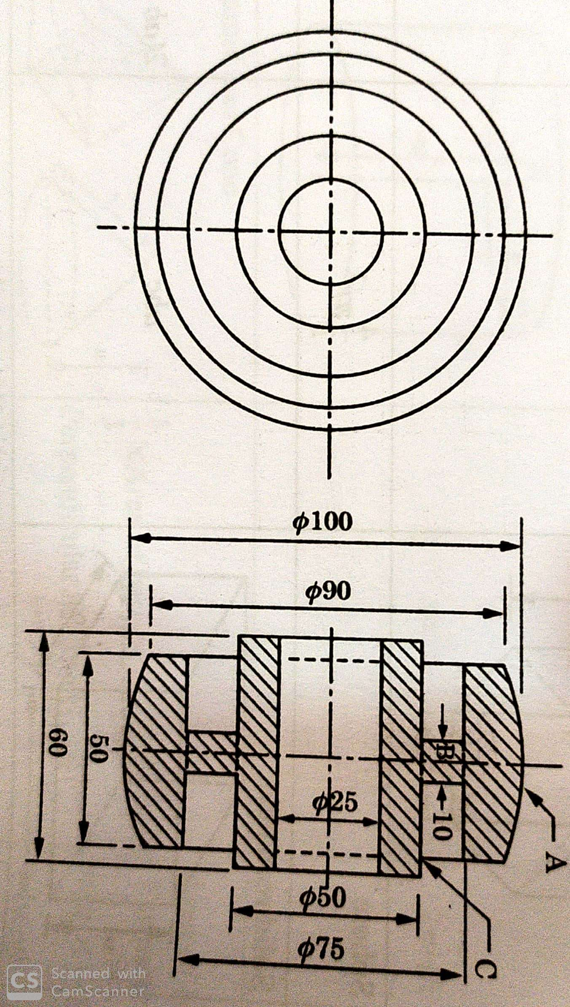
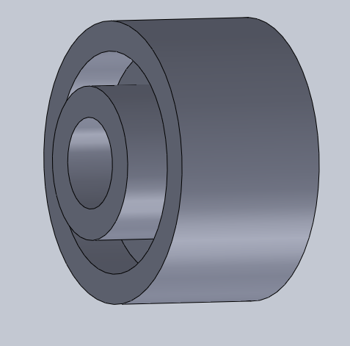
Problem 2- Estimate the weight of cast iron pulley as shown in fig. take density of the material as 7.2 g/ ${cm}^{3}$.Also find out the material cost of pulley if the material cost is Rs. 50/- per kg.

Slide 12
Step -1 Break up the pulley in three simple parts A, B and C.
Step 2 - find the volume of each part
Volume of part A , $V_{A}$ = $\frac{π}{4}$ x ${(100}^{2}$ - ${75}^{2})$x 50
= 171806 ${mm}^{3}$
Volume of part B , $V_{B}$ = $\frac{π}{4}$ x ${(75}^{2}$ - ${50}^{2})$x 10
= 24544 ${mm}^{3}$
Volume of part C , $V_{C}$ =$\frac{π}{4}$ x${(50}^{2}$ - ${25}^{2})$x 60
= 88357 ${mm}^{3}$

Slide 13
Step 3- find the total volume of pulley
Total volume of pulley, V = $V_{A}$+ $V_{B}$+ $V_{C}$
= 171806+24544+88357
= 284707 ${mm}^{3}$ = 284.707 ${cm}^{3}$
Step 4- find the Weight of pulley
Weight of pulley = total volume of pulley x Density of material
= 284.707 x 7.2 x ${10}^{−3}$ = 2.05 kg
Step 5 - Find the material cost of pulley
material cost of pulley = weight of pulley x material cost per unit weight
= 2.05 x 50 = Rs. 102.50

Slide 14
Problem 3 – Find out the weight of 8 mild steel spindles shown in fig. Also find out the weight of scrap if they are turned out from a mild steel rod of 30 mm diameter. Take facing and parting off allowances as 1 mm and 5 mm respectively. Assume that 12 mm length of rod is required for grip in chuck. Take density of mild steel is 7.8 g/ ${cm}^{3}$

Slide 15
Step -1 Break up the Spindle into four simple parts A, B C, and D.
Step 2 - find the volume of each part
Volume of part A , $V_{A}$ = $\frac{π}{4}$ x ${20}^{2}$x 30 = 9425 ${mm}^{3}$
Volume of part B , $V_{B}$ = $\frac{π}{4}$ x ${25}^{2}$x 35 = 17181 ${mm}^{3}$
Volume of part C , $V_{C}$ =$\frac{π}{4}$ x${15}^{2}$x 75 = 13254 ${mm}^{3}$
Volume of part D , $V_{D}$= volume of Frustum of cone of diameters 20 mm and 25 mm and height 10mm
=$\frac{h}{3}$ x ( $a_{1}$+ $a_{2}$+ $\sqrt{a_{1}a_{2}}$)
h= height of frustum of cone
$a_{1}$, $a_{2}$= Area of two ends

Slide 16
Volume of part D , $V_{D}$= $\frac{10}{3}$ x $\frac{π}{4}$(${20}^{2}$+${25}^{2}$+ $\sqrt{{20}^{2} x {25}^{2}}$)
= 3992 ${mm}^{3}$
Step 4- find the total volume of Spindle,
V = $V_{A}$+ $V_{B}$+ $V_{C}$ -$V_{D}$
= 9425+17181+3992-13254
= 17344 ${mm}^{3}$ = 17.344 ${cm}^{3}$
Step 5 - Weight of spindle = volume of spindle X Density of spindle
= 17.344 x 7.8 = 135.3 g

Slide 17
Weight of 8 Spindles = 135.3 x 8 = 1082.4 g
To find out Weight of scrap, weight of mild steel rod is to be calculated.
Length of one spindle = 75 mm
Length of 8 spindles = 75 x 8 = 600 mm
Length required for facing 16 faces = 16 x 1 = 16 mm
Length required for parting off 8 times = 8 x 5=40 mm
Length required for holding ( for last job ) = 12 mm
Total length = 600+16+40+12 = 668 mm

Slide 18
Volume of rod required = $\frac{π}{4}$ x ${30}^{2}$x 668
= 472181 ${mm}^{3}$ = 472.181 ${cm}^{3}$
Weight of rod required = 472.181 x 7.8 = 3683 g
Weight of Scrap = 3683- 1082.4 = 2600.6 g = 2.6 kg

Slide 19
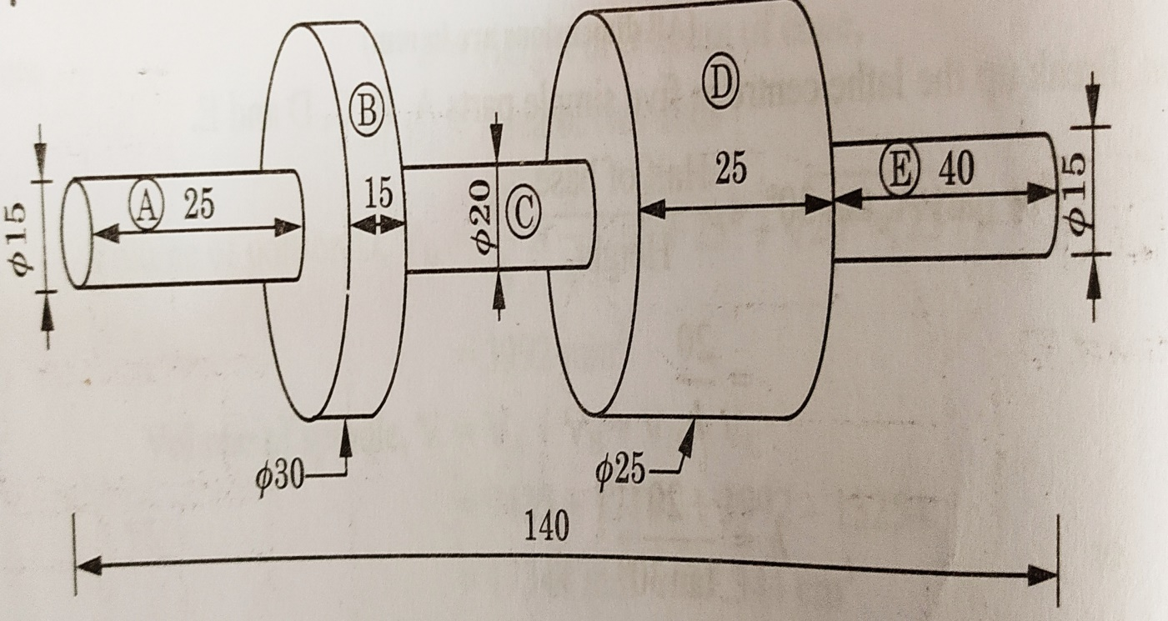
Problem - 4 Estimate the weight of M.S shaft as shown in fig. the material density 7.675 g/ ${cm}^{3}$.

Slide 20
Solution :- Step 1 – Break up the shaft in five simple parts A,B,C, D and E .
Step 2 - find the volume of each part
Volume of part A , $V_{A}$ =$\frac{π}{4}$ x ${15}^{2}$ x 25 = 4417.864 ${mm}^{3}$
Volume of part B , $V_{B}$ =$\frac{π}{4}$ x ${30}^{2}$ x 15 = 10602.875 ${mm}^{3}$
Volume of part C , $V_{C}$ =$\frac{π}{4}$ x ${20}^{2}$ x 35 = 10995.574 ${mm}^{3}$
Volume of part D , $V_{D}$ =$\frac{π}{4}$ x ${25}^{2}$ x 25 = 12271.846 ${mm}^{3}$
Volume of part E , $V_{E}$ =$\frac{π}{4}$ x ${15}^{2}$ x 40 = 7068.583 ${mm}^{3}$

Slide 21
Step- 3 Total volume of M.S Shaft =
4417.864+10602.875+10995.574+12271.846+7068.583
= 45356.742 ${mm}^{3}$ = 45.356 ${cm}^{3}$
Weight of M.S shaft = 45.356 x 7.675 = 348.107 g
= 0.348 kg Ans

