Slide 1
Computer Organization and
Architecture
Prepared By:- Poonam

Slide 2
OBJECTIVES
After reading this chapter, the reader should be able to:
Distinguish between the three components of a computer hardware.
List the functionality of each component.
Understand memory addressing and calculate the number of bytes for a specified purpose.
Distinguish between different types of memories.
Understand how each input/output device works.

Slide 4
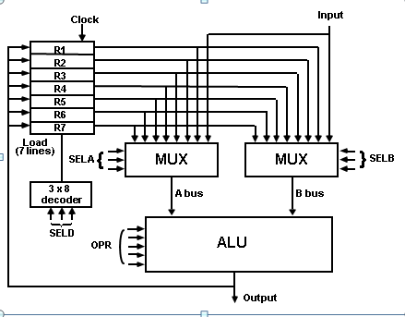
GENERAL REGISTER ORGANISATION

Slide 5
ADDRESSING
MODES
Addressing Modes:
* Specifies a rule for interpreting or modifying the
address field of the instruction (before the operand
is actually referenced)
•
•
* Variety of addressing modes
•
•
•
•
to give programming flexibility to the user
to use the bits in the address field of the instruction efficiently

Slide 6
TYPES OF ADDRESSING MODES
Implied Mode
Address of the operands are specified implicitly in the definition of the instruction
- No need to specify address in the instruction
- EA = AC, or EA = Stack[SP],
EA: Effective Address.
Immediate Mode
Instead of specifying the address of the operand, operand itself is specified
- No need to specify address in the instruction
However, operand itself needs to be specified
Sometimes, require more bits than the address
Fast to acquire an operand
Register Mode
Address specified in the instruction is the register address
Designated operand need to be in a register
Shorter address than the memory address
Saving address field in the instruction
Faster to acquire an operand than the memory addressing
EA = IR(R) (IR(R): Register field of IR)

Slide 7
TYPES OF ADDRESSING MODES
Register Indirect Mode
Instruction specifies a register which contains the memory address of the operand
Saving instruction bits since register address
is shorter than the memory address
Slower to acquire an operand than both the register addressing or memory addressing
EA = [IR(R)] ([x]: Content of x)
Auto-increment or Auto-decrement features: Same as the Register Indirect, but:
- When the address in the register is used to access memory, the
value in the register is incremented or decremented by 1 (after or the execution of the instruction)
before

Slide 8
TYPES OF ADDRESSING MODES
Direct Address Mode
Instruction specifies the memory address which can be used directly to the physical memory
Faster than the other memory addressing modes
Too many bits are needed to specify the address for a large physical memory space
- EA = IR(address), (IR(address): address field of IR)
Indirect Addressing Mode
The address field of an instruction specifies the address of a memory that contains the address of the operand
When the abbreviated address is used, large physical memory can addressed with a relatively small number of bits
Slow to acquire an operand because of an additional memory
EA = M[IR(address)]
location
be
access

Slide 9
PROGRAM
INTERRUPT
Types of Interrupts:
External interrupts
External Interrupts initiated from the outside of CPU and Memory
I/O Device -> Data transfer request or Data transfer complete
Timing Device -> Timeout
Power Failure
Internal interrupts (traps)
Internal Interrupts are caused by the currently running program
Register, Stack Overflow
Divide by zero
OP-code Violation
Protection Violation
Software Interrupts
Both External and Internal Interrupts are initiated by the computer Hardware. Software Interrupts are initiated by texecuting an instruction.
Supervisor Call -> Switching from a user mode to the supervisor mode
-> Allows to execute a certain class of operations which are not allowed in the user mode

Slide 10
RISC:
REDUCED INSTRUCTION
SET COMPUTERS
Historical Background
IBM System/360, 1964
The real beginning of modern computer architecture
Distinction between Architecture and Implementation
Architecture: The abstract structure of a computer
seen by an assembly-language programmer
Compiler μ-program
High-Level Language
Instruction Set
Architecture
Hardware
Implementation
Continuing growth in semiconductor memory and microprogramming
-> A much richer and complicated instruction sets
=> CISC(Complex Instruction Set Computer)
Arguments advanced at that time
Richer instruction sets would simplify compilers
Richer instruction sets would alleviate the software crisis
move as much functions to the hardware as possible
close Semantic Gap between machine language and the high-level language
Richer instruction sets would improve the architecture quality

Slide 11
CHARACTERISTICS OF RISC
Common RISC Characteristics
Operations are register-to-register, with only LOAD and STORE accessing memory
The operations and addressing modes are reduced Instruction formats are simple
More characteristics are as:
Relatively few instructions
Relatively few addressing modes
Memory access limited to load and store instructions
All operations done within the registers of the CPU
Fixed-length, easily decoded instruction format
Single-cycle instruction format
Hardwired rather than microprogrammed control

Slide 12
COMPLEX
INSTRUCTION
SET COMPUTERS: CISC
High Performance General Purpose Instructions
Characteristics of CISC:
A large number of instructions (from 100-250 usually)
Some instructions that performs a certain tasks are not used frequently.
Many addressing modes are used (5 to 20)
Variable length instruction format.
Instructions that manipulate operands in memory.

Slide 13
MAJOR COMPONENTS OF CPU
Storage Components:
Registers Flip-flops
Execution (Processing) Components:
Arithmetic Logic Unit (ALU):
Arithmetic calculations, Logical computations, Shifts/Rotates
Transfer Components:
Bus
Control Components:
Control Unit
Register File
ALU
Control Unit

Slide 14
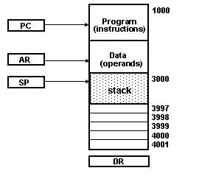
MEMORY STACK ORGANIZATION
1000
_{PC (in} Program₎
structions
Data
stack
Memory with Program, Data, and Stack Segments
AR
- A portion of memory is used as a stack with a processor register as a stack pointer
- PUSH:
SP ← SP - 1 M[SP] ← DR
DR ← M[SP]
SP ← SP + 1
- POP:
- Most computers do not provide hardware to check stack overflow (full stack) or underflow(empty stack)

Slide 15
INSTRUCTION FORMAT
Instruction Fields
OP-code field - specifies the operation to be performed
Address field - designates memory address(s) or a processor register(s)
Mode field
- specifies the way the operand or the effective address is determined
The number of address fields in the instruction format depends on the internal organization of CPU
- The three most common CPU organizations:
Single accumulator organization:
ADD X /* AC ← AC + M[X] */
General register organization:
ADD | R1, R2, R3 | /* R1 ← R2 + R3 */
ADD | R1, R2 | /* R1 ← R1 + R2 */
MOV | R1, R2 | /* R1 ← R2 */
ADD | R1, X | /* R1 ← R1 + M[X] */
Stack organization: PUSH X
ADD
/* TOS ← M[X] */

Slide 16
THREE, AND TWO-ADDRESS INSTRUCTIONS
Three-Address Instructions:
Program to evaluate X = (A + B) * (C + D) :
MUL X, R1, R2 /* M[X] ← R1 * R2 */
Results in short programs
Instruction becomes long (many bits)
Two-Address Instructions:
Program to evaluate X = (A + B) * (C + D) :
ADD | R1, A, B | /* R1 ← M[A] + M[B] | */
ADD | R2, C, D | /* R2 ← M[C] + M[D] | */
MOV | R1, A | /* R1 ← M[A] | */
ADD | R1, B | /* R1 ← R1 + M[B] | */
MOV | R2, C | /* R2 ← M[C] | */
ADD | R2, D | /* R2 ← R2 + M[D] | */
MUL | R1, R2 | /* R1 ← R1 * R2 | */
MOV X, R1
/* M[X] ← R1
*/

Slide 17
ONE, AND ZERO-ADDRESS INSTRUCTIONS
One-Address Instructions:
Use an implied AC register for all data manipulation
Program to evaluate X = (A + B) * (C + D) :
LOAD A /* AC ← M[A] */
ADD B /* AC ← AC + M[B]
*/
STORE T /* M[T] ← AC */
LOAD C /* AC ← M[C] */
ADD D /* AC ← AC + M[D]
*/
*/
MUL T /* AC ← AC * M[T]
STORE X /* M[X] ← AC */
Zero-Address Instructions:
Can be found in a stack-organized computer
Program to evaluate X = (A + B) * (C + D) :
PUSH PUSH ADD PUSH PUSH ADD MUL POP
A B
C D
/* TOS ← A
/* TOS ← B
/* TOS ← (A + B)
/* TOS ← C
/* TOS ← D
*/
*/
*/
*/
*/
/* TOS ← (C + D) */
/* TOS ← (C + D) * (A + B) */
X
/* M[X] ← TOS */

Slide 18
MULTIPROCESSOR
A multiprocessor is a computer system with two or more central processing units (CPUs), with each one sharing the common main memory as well as the peripherals. This helps in simultaneous processing of programs.
The key objective of using a multiprocessor is to boost the system’s execution speed, with other objectives being fault tolerance and application matching.
Benefits of using a multiprocessor include:
Enhanced performance
Multiple applications
Multiple users
Multi-tasking inside an application
High throughput and/or responsiveness
Hardware sharing among CPUs

Slide 19
DIFFERENT WAYS OF
USING A MULTIPROCESSOR
As a uniprocessor, such as single instruction, single data (SISD)
Inside a single system for executing multiple, individual series of instructions in multiple perspectives, such as multiple instruction, multiple data (MIMD)
A single series of instructions in various perspectives, such as single instruction, multiple data (SIMD), which is usually used for vector processing
Multiple series of instructions in a single perspective, such as multiple instruction, single data (MISD), which is used for redundancy in failsafe systems and, occasionally, for describing hyper-threading or pipelined processors

Slide 20
PIPELINING
Pipelining is the process of accumulating instruction from the processor through a pipeline. It allows storing and executing instructions in an orderly process. It is also known as pipeline processing.
Pipelining is a technique where multiple instructions are overlapped during execution. Pipeline is divided into stages and these stages are connected with one another to form a pipe like structure. Instructions enter from one end and exit from another end.
Pipelining increases the overall instruction throughput.
In pipeline system, each segment consists of an input register followed by a combinational circuit. The register is used to hold data and combinational circuit performs operations on it. The output of combinational circuit is applied to the input register of the next segment.

Slide 21
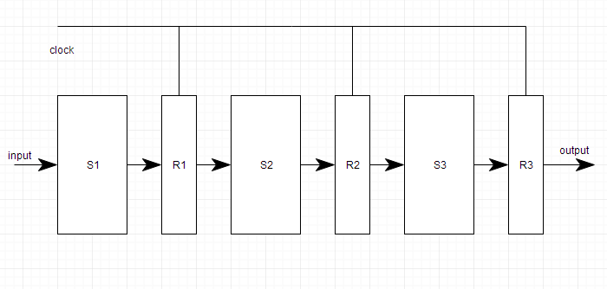
Pipeline system is like the modern day assembly line setup in factories. For example in a car manufacturing industry, huge assembly lines are setup and at each point, there are robotic arms to perform a certain task, and then the car moves on ahead to the next arm.

Slide 22
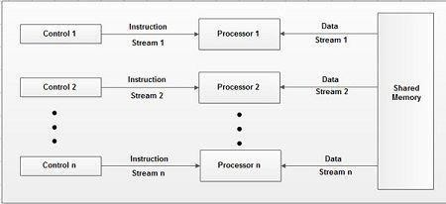
MIMD COMPUTERS
MIMD computers are consisting of 'n' processing units; each with its own stream of instruction and each processing unit operate on unit operates on a different piece of data. MIMD is the most powerful computer system that covers the range of multiprocessor systems. The block diagram of MIMD computer is shown.

Slide 23
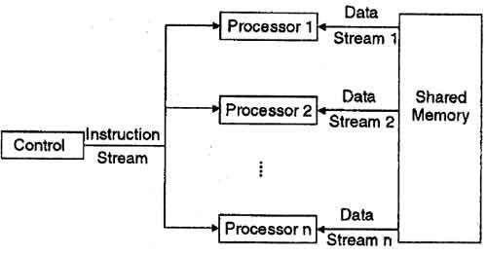
SIMD COMPUTERS
SIMD computers are consisting of ‘n' processing units receiving a single stream of instruction from a central control unit and each processing unit operates on a different piece of data. Most SIMD computers operate synchronously using a single global dock. The block diagram of SIMD computer is shown below:
•

Slide 24
THANK YOU

