Slide 1
Session: Aug 2022-23
5th SEMESTER
Section A&B
G.P LOHARU,HARYANA
E-CONTENTS
Machine Design

Slide 2
LEARNING OUTCOMES
Be
At the end of this course, students will be able to:
Explain
Explain the terms related to design.
Use
Use codes and standards for designing a component.
Select
Select material for designing a component.
Interpret
Interpret the various causes of design failures.
Design
Design shaft on the basis of strength and rigidity.
Design
Design various machine elements (key, joint, flange coupling and screwed joints) .

Slide 3
INTRODUCTION
Machine design may be defined as the creation of new and better machines.
Existing machine are also made to improve.
TYPES OF MACHINE DESIGN:
New design
Development design
Adapative design

Slide 4
NECESSITY OF MACHINE DESIGN
To create new and better machines
For faster production
For automation of industries
For innovation of new products
To convert existing design into new design

Slide 5
Design of Shaft
A shaft is a rotating member usually of circular cross-section (solid or hollow), which transmits power and rotational motion.
Machine elements such as gears, pulleys (sheaves), flywheels, clutches, and sprockets are mounted on the shaft and are used to transmit power from the driving device (motor or engine) through a machine.

Slide 6
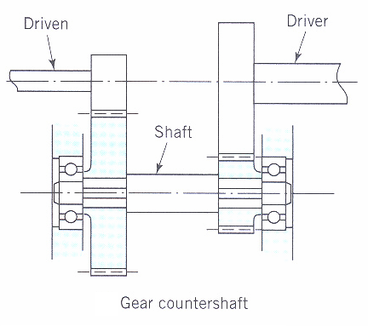
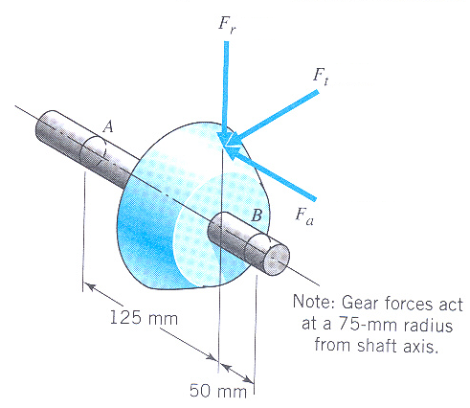
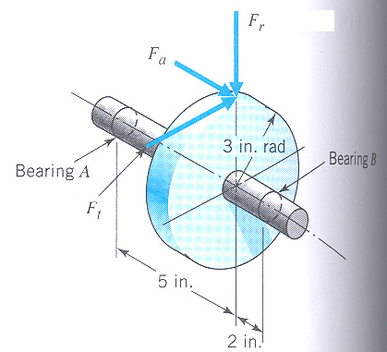
COMBINED BENDING AND TORSION LOADS ON SHAFT: SHAFT CARRYING GEARS.
From power and rpm find the torque (T), which gives rise to shear stress.
From Torque (T) and diameter (d), find F_{t} = 2T/d. From F_{t} and pressure angles of gears you can find F_{r} and F_{a}.
F_{r} and F_{t} are orthogonal to each other and are both transverse forces to the shaft axis, which will give rise to normal bending stress in the shaft. When shaft rotates, bending stress changes from tensile to compressive and then compressive to tensile, ie, completely reversing state of stress.
F_{a} will give rise to normal axial stress in the shaft.

Slide 7
Power, torque & speed
For linear motion:
Power = F.v (force x velocity)
For rotational motion
Power P = Torque x angular velocity
= T (in-lb).ω (rad/sec) in-lb/sec
= T.(2 π n/60) in-lb/sec [n=rpm]
= T.(2 π n/(60*12*550)) HP [HP=550 ft-lb/sec]
= T.n/63,025 HP
or, T= 63,025HP/n (in-lb), where n = rpm
Similarly, T= 9,550,000kW/n (N-mm), where n = rpm

Slide 8
Shear (τ) and bending (σ) stresses on the outer surface of a shaft, for a torque (T) and bending moment (M)
For solid circular section:
For hollow circular section:

Slide 9
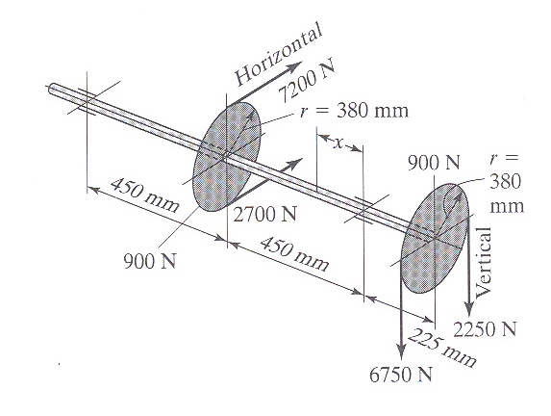
Loads on shaft due to pulleys
Pulley torque (T) = Difference in belt tensions in the tight (t₁) and slack (t₂) sides of a pulley times the radius (r), ie
T = (t₁-t₂)xr
Left pulley torque
T₁ = (7200-2700)x380=1,710,000 N-mm
Right pulley has exactly equal and opposite torque:
T₂ = (6750-2250)x380=1,710,000 N-mm
F_{V2}
Bending forces in vertical (F_{v}) and horizontal (F_{H}) directions:
At the left pulley: F_{V1}=900N; F_{H1}=7200+2700 = 9900N
At the right pulley: F_{V2}=900+6750+2250=9900N; F_{H2}=0

Slide 10
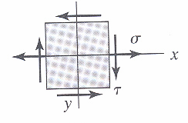
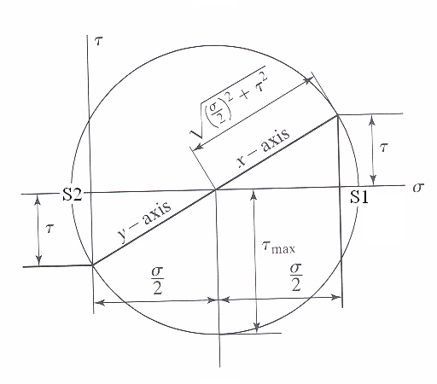
PRINCIPAL NORMAL STRESSES AND MAX DISTORTION ENERGY FAILURE CRITERION FOR NON-ROTATING SHAFTS
The stress at a point on the shaft is normal stress (s) in X direction and shear stress (t) in XY plane.
From Mohr Circle:
Max Distortion Energy theory:
Putting values of S₁ & S₂ and simplifying:
This is the design equation for non rotating shaft

Slide 11
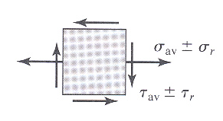
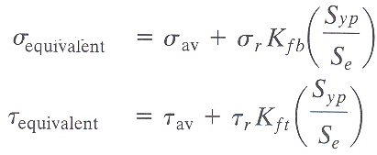
DESIGN OF ROTATING SHAFTS AND FATIGUE CONSIDERATION
The most frequently encountered stress situation for a rotating shaft is to have completely reversed bending and steady torsional stress. In other situations, a shaft may have a reversed torsional stress along with reversed bending stress.
The most generalized situation the rotating shaft may have both steady and cyclic components of bending stress (s_{av},s_{r}) and torsional stress (t_{av},t_{r}).
From Soderberg’s fatigue criterion, the equivalent static bending and torsional stresses are:
Using these equivalent static stresses in our static design equation, the equation for rotating shaft is:

Slide 12
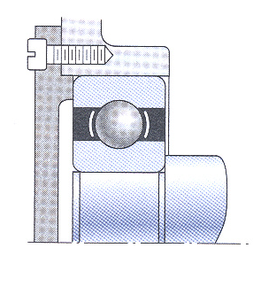
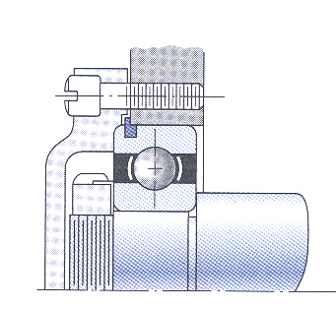
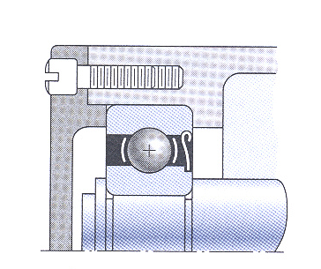
Bearing mounting considerations and stress concentration

Slide 13
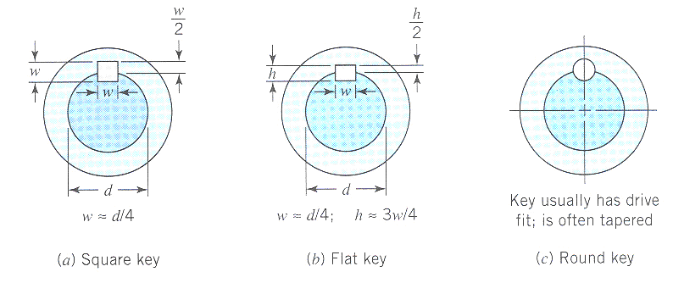
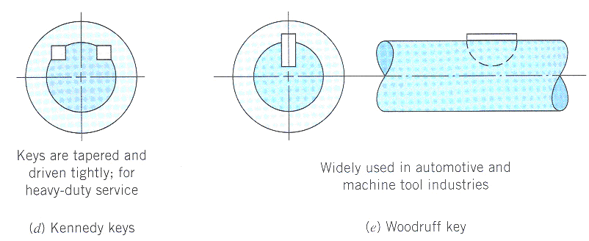
Various types of keys for transmitting torque

Slide 14
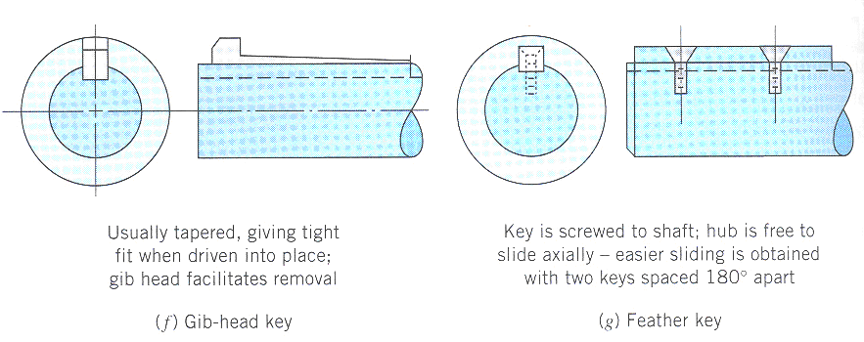
Other common types of keys

Slide 15
DESIGN OF TEMPORARY JOINTS

Slide 16
Design of Socket And Spigot
Cotter Joint
Part Number | Name of Part
1 | Shaft or Rod
2 | Socket
3 | Spigot
4 | Cotter
5 | Socket Collar
6 | Spigot Collar

Slide 17
1. Failure of Shaft or Rod Under Tensile Stress

Slide 18
2. Failure of Socket Under Tension

Slide 19
3. Failure of Socket Collar Under Shear Stress

Slide 20
4. Failure of Socket Coller Under Crushing

Slide 21
5. Failure of Spigot Under Tension

Slide 22
6. Failure of Spigot Under Crushing

Slide 23
7. Failure of Spigot Under Shear

Slide 24
8. Failure of Cotter Under Shear

Slide 25
9. Failure of Spigot Collar Under Crushing

Slide 26
10. Failure of Spigot Collar Under Shear

Slide 27
Design of Knuckle Joint
d1 | d
d2 | 2d
d3 | 1.5d
t | 1.25d
t1 | 0.75d
t2 | 0.5d

Slide 28
1. Failure of Rod In Tension
Area of Failure
Stress Indused

Slide 29
2. Failure of Knuckle Pin Under Shear
Area of Failure
Stress Indused

Slide 30
3. Failure of Double Eye Under Tension
Area of Failure
Stress Indused

Slide 31
4. Failure of Double Eye Under Shear
Area of Failure
Stress Indused

Slide 32
5. Failure of Double Eye Under Crushing
Area of Failure
Stress Indused

Slide 33
6. Failure of Single Eye Under Tension
Area of Failure
Stress Indused

Slide 34
7. Failure of Single Eye Under Shear
Area of Failure
Stress Indused

Slide 35
8. Failure of Single Eye Under Crushing
Area of Failure
Stress Indused

Slide 37
WHAT IS RIVET?
A rivet is a round rod of circular cross- section. It consists of two parts HEAD and SHANK.
HEAD
SH ANK
TAIL
Metals commonly used for rivets are Mild steel, wrought iron, copper and aluminium alloys etc.

Slide 38
WHAT IS RIVETING
Riveting is the process of forming a riveted joint. For this, a rivet is first placed in the hole drilled through the two parts to be joined.
Then the shank end is made into a rivet head by applying pressure

Slide 39
PROCESS OF RIVETING

Slide 40
USE OF RIVETS
Riveted joints are permanent fastenings and riveting is one of the commonly used method of producing rigid and permanent joints. Manufacture of boilers, storage
These joints are also used to fasten rolled steel sections in structural works, such as bridge and roof trusses

Slide 41
EXAMPLES SHOWING RIVET JOINTS B/W TWO METALS

Slide 42
DIMENSIONS OF RIVETS.

Slide 43
TYPES OF RIVET

Slide 44
TYPES OF RIVETED JOINTS
There are two types of riveted joints.
RIVETED LAP JOINT
RIVETED BUTT JOINT

Slide 45
EXAMPLE OF RIVETED LAP JOINT

Slide 46
EXAMPLE OF RIVETED BUTT JOINT

Slide 49
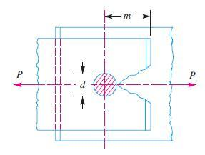
FAILURES OF A RIVETED JOINT
Failures of a Riveted Joint:
A riveted joint may fail in the following ways : 1. Tearing of the plate at an edge. A joint may fail due to tearing of the plate at an edge as shown in Fig. This can be avoided by keeping the margin, m = 1.5d, where d is the diameter of the rivet hole.

Slide 50
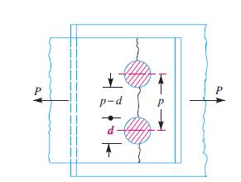
Tearing of the plate across a row of rivets
Due to the tensile stresses in the main plates, the main plate or cover plates may tear off across a row of rivets as shown in Fig. In such cases, we consider only one pitch length of the plate, since every rivet is responsible for that much length of the plate only.
The resistance offered by the plate against tearing is known as tearing resistance or tearing strength or tearing value of the plate. Let p = Pitch of the rivets, d = Diameter of the rivet hole, t = Thickness of the plate, and σt = Permissible tensile stress for the plate material. We know that tearing area per pitch length, At=(p–d)t ∴ Tearing resistance or pull required to tear off the plate per pitch length, Pt=At.σt=(p–d)t.σt When the tearing resistance (Pt) is greater than the applied load (P) per pitch length, then this type of failure will not occur.

Slide 51
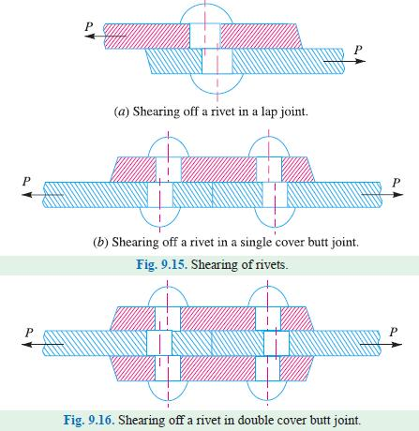
Shearing of the rivets.

Slide 52
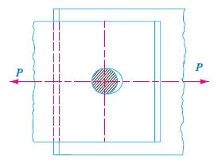
Crushing of the plate or rivets
The resistance offered by a rivet to be crushed is known as crushing resistance or crushing strength or bearing value of the rivet. Let d = Diameter of the rivet hole, t = Thickness of the plate, σc = Safe permissible crushing stress for the rivet or plate material, and n = Number of rivets per pitch length under crushing. We know that crushing area per rivet (i.e. projected area per rivet),
Ac = d.t ∴ Total crushing area = n.d.t and crushing resistance or pull required to crush the rivet per pitch length, Pc = n.d.t.σc When the crushing resistance (Pc) is greater than the applied load (P) per pitch length, then this type of failure will occur.

Slide 53
Design of flange coupling

Slide 54
A coupling is a device used to connect two shafts together at their ends for the purpose of transmitting power.

Slide 55
Flange coupling. This type of coupling has pins and it works with coupling bolts. The rubber or leather bushes are used over the pins.

Slide 56
Steps of design Rigid flang coupling
Step:1 Calculate the diameter torque to be transmitted –Mt-
use the equation.
Step:
2
Calculate the diameter of the shaft-d-use the equation
(Assume di=0) Round off the shaft diameter to R20
series.

Slide 57
Step: Based on the diameter of shaft calculated select the
3 coupling and Note down its dimensions.
Step: CHECKING FOR SHEAR STRENGTH OF THE BOLT. 4
Calculate Ft- Refer P.7.106 use equation Ft=2Mt/D₂
Calculate [Ft] use equation Ft
Use equation [Ft] = n x d²/4 x [τ] ; Where [τ] is allowable shear stress of shaft material.
Compare Ft and [Ft]
For safer Design Ft ≤ [Ft] ; If Ft >[Ft] select Next higher coupling and repeat the procedure from step 3 until Ft ≤ [Ft]

Slide 58
Step: CHECKING FOR BEARING STRENGTH OF THE BOLT
5 5.1) Note down the value of (σb)
5.2) Calculate (Ft) ; use the equation [Ft] = nd₂ b [σb] 5.3) Compare Ft & (Ft)
For safer design F (Ft)
If Ft> (Ft) select Next higher coupling and repeat the Step 3 & Step 5 Ft ≤ [Ft]
Step: Draw a neat sketch of the coupling with dimensions.
6 2. Compare the allowable torque (Mt) with the
actual torque Mt
For safer design Mt ≤ [Mt]
If Mt ≤ [Mt] then increase the width & thickness or
length of the key to Next higher standard values and repeat from Step 10.1 until Mt ≤ [Mt]
Step:7 Draw a neat sketch of the coupling with dimensions.
If flange coupling satisfies all the strength requirements, then it is selected for the application.

Slide 59
DESIGN OF SCREW JOINT

Slide 60
SCREW THREAD A screw thread is formed by cutting helical grooves on a cylinderical surface

Slide 61
Thread Standards and Definitions
Pitch – distance between adjacent threads. Reciprocal of threads per inch
Major diameter – largest diameter of thread
Minor diameter – smallest diameter of thread
Pitch diameter – theoretical diameter between major and minor diameters, where tooth and gap are same width
Fig. 8–1

Slide 62
Standardization
The American National (Unified) thread standard defines basic thread geometry for uniformity and interchangeability
American National (Unified) thread
UN normal thread
UNR greater root radius for fatigue applications
Metric thread
M series (normal thread)
MJ series (greater root radius)

Slide 63
Standardization
Coarse series UNC
General assembly
Frequent disassembly
Not good for vibrations
The “normal” thread to specify
Fine series UNF
Good for vibrations
Good for adjustments
Automotive and aircraft
Extra Fine series UNEF
Good for shock and large vibrations
High grade alloy
Instrumentation
Aircraft

Slide 64
Standardization
Basic profile for metric M and MJ threads shown in Fig. 8–2
Tables 8–1 and 8–2 define basic dimensions for standard threads
Fig. 8–2

Slide 65
Diameters and Areas for Metric Threads

Slide 66
Diameters and Areas for Unified Screw Threads
Table 8–2

Slide 67
Tensile Stress Area
The tensile stress area, A_{t} , is the area of an unthreaded rod with the same tensile strength as a threaded rod.
It is the effective area of a threaded rod to be used for stress
calculations.
The diameter of this unthreaded rod is the average of the pitch diameter and the minor diameter of the threaded rod.

Slide 68
Square and Acme Threads
Square and Acme threads are used when the threads are intended to transmit power
Fig. 8–3
Table 8-3 Preferred Pitches for Acme Threads

Slide 69
Mechanics of Power Screws
Power screw
Used to change angular motion into linear motion
Usually transmits power
Examples include vises, presses, jacks, lead screw on lathe
Fig. 8–4

Slide 70
Mechanics of Power Screws
Find expression for torque required to raise or lower a load
Unroll one turn of a thread
Treat thread as inclined plane
Do force analysis
Fig. 8–5
Fig. 8–6
Shigley’s Mechanical Engineering Design

Slide 71
Mechanics of Power Screws
For raising the load
For lowering the load
Fig. 8–6

Slide 72
Mechanics of Power Screws
Eliminate N and solve for P to raise and lower the load
Divide numerator and denominator by cosλ and use relation
tanλ = l /π d_{m}

Slide 73
Raising and Lowering Torque
Noting that the torque is the product of the force and the mean radius,

Slide 74
Self-locking Condition
If the lowering torque is negative, the load will lower itself by
causing the screw to spin without any external effort.
If the lowering torque is positive, the screw is self-locking.
Self-locking condition is π f d_{m} > l
Noting that l / π d_{m} = tan λ, the self-locking condition can be seen to only involve the coefficient of friction and the lead angle.

Slide 75
Power Screw Efficiency
The torque needed to raise the load with no friction losses can be found from Eq. (8–1) with f = 0.
The efficiency of the power screw is therefore

Slide 76
Power Screw Safe Bearing Pressure

Slide 77
Head Type of Bolts
Hexagon head bolt
Usually uses nut
Heavy duty
Hexagon head cap screw
Thinner head
Often used as screw (in threaded hole, without nut)
Socket head cap screw
Usually more precision
applications
Access from the top
Machine screws
Usually smaller sizes
Slot or philips head common
Threaded all the way
Fig. 8–9
Fig. 8–10
Shigley’s Mechanical Engineering Design

Slide 78
Machine Screws
Fig. 8–11

Slide 79
Hexagon-Head Bolt
Hexagon-head bolts are one of the most common for engineering applications
Standard dimensions are included in Table A–29
W is usually about 1.5 times nominal diameter
Bolt length L is measured from below the head

Slide 80
Threaded Lengths
English
Metric

Slide 81
Nuts
See Appendix A–31 for typical specifications
First three threads of nut carry majority of load
Localized plastic strain in the first thread is likely, so nuts should
not be re-used in critical applications.
End view
Washer-faced,
regular
Chamfered both
sides, regular
Washer-faced,
jam nut
Chamfered
both sides,
jam nut
Fig. 8–12

Slide 82
Effective Grip Length for Tapped Holes
For screw in tapped hole, effective grip length is

Slide 83
THANK YOU

