Slide 1
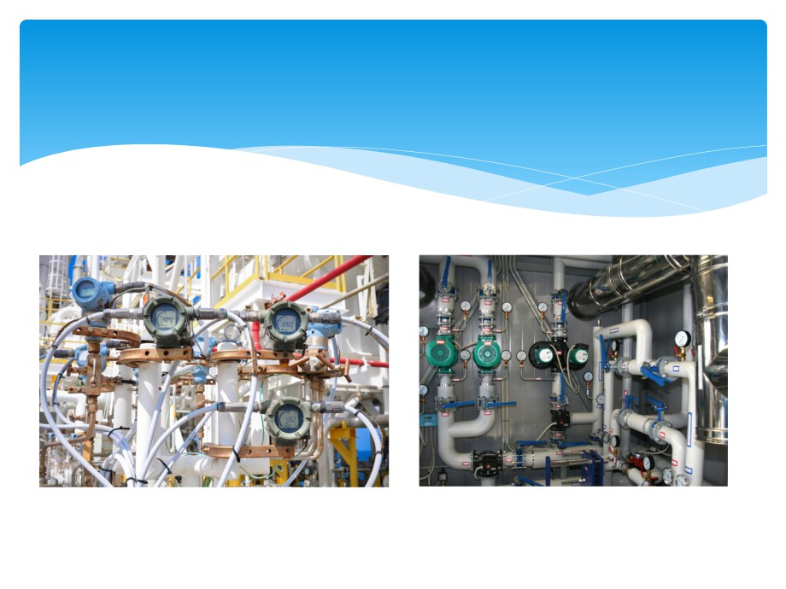

Electrical Measuring
Instruments and
Instrumentation
By :- Mrs. Renu Bala

Slide 2

TOPICS
LCR METERS
Power Measurements in 3 phase circuit by
(a) Two wattmeter method
(b) Three wattmeter method
Transducer
Measurements of Temperature

Slide 3
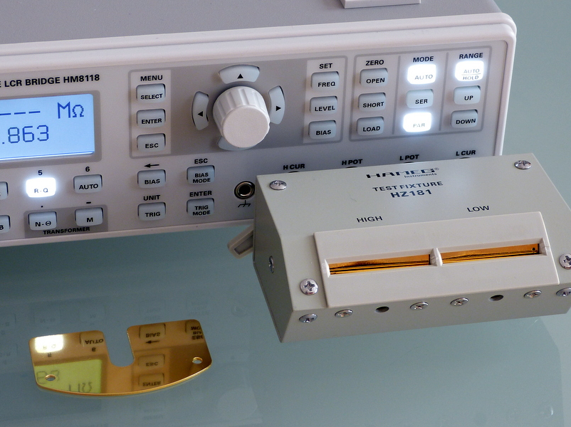
LCR meter
An LCR meter is a type of electronic test equipment used to measure the inductance (L), capacitance (C), and resistance (R) of an electronic component.

Slide 4
Advantages of an LCR meter
1. One thing that is evident is that it is compact and a three in one sort of a measuring unit which is obviously preferable.
2. Other than this it is also worth mentioning here that an LCR meter is quite accurate and gives the readings with a high precision.
3. It can also tell about the angle between the voltage and the current measure if needed.
4. It is easy to calibrate and quick to use, the user just needs to connect the two probes of the meter to the DUT as shown below:

Slide 5
Transducer
This article is about an engineering device. For the similarly
named concept in computer science, see Finite state
transducer.
 A transducer is a device that converts energy from one
form to another. Usually a transducer converts a signal in
one form of energy to a signal in another.
 Transducers are often employed at the boundaries of
automation, measurement, and control systems, where
electrical signals are converted to and from other physical
quantities (energy, force, torque, light, motion, position,
etc.). The process of converting one form of energy to
another is known as transduction.

Slide 6
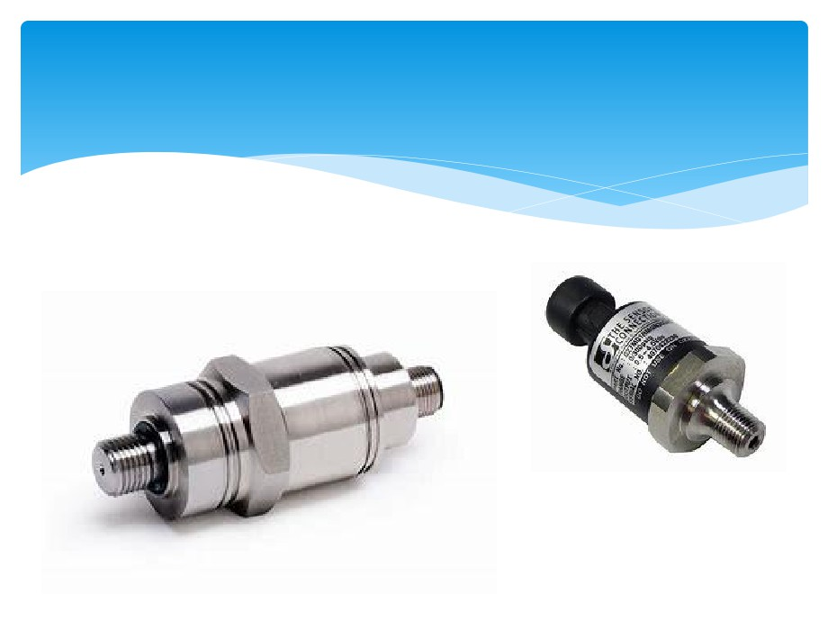

Slide 7
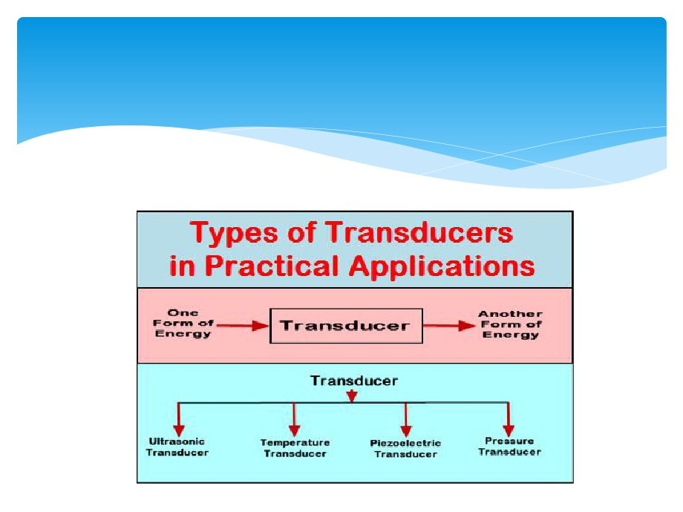
various types of transducer

Slide 8
measurement of strain gauge
A strain gauge is a device used to measure strain on an
object. Invented by Edward E. Simmons and Arthur C. Ruge
in 1938, the most common type of strain gauge consists of
an insulating flexible backing which supports a metallic foil
pattern. The gauge is attached to the object by a suitable
adhesive, such as cyanoacrylate.[1] As the object is
deformed, the foil is deformed, causing its electrical
resistance to change. This resistance change, usually
measured using a Wheatstone bridge, is related to the
strain by the quantity known as the gauge factor.

Slide 9
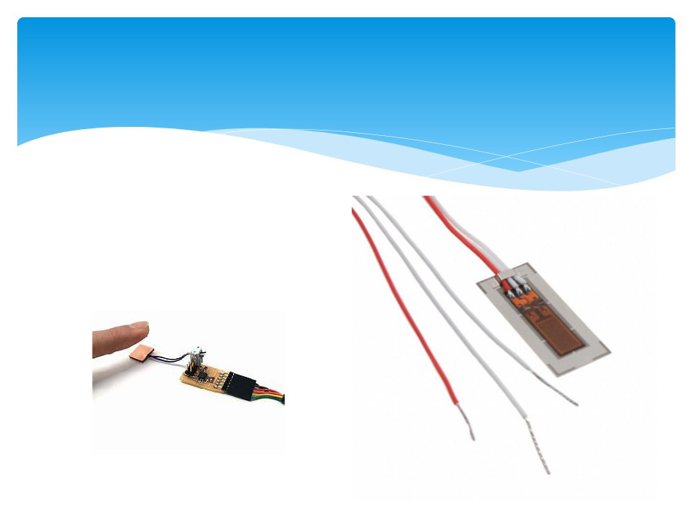
strain gauge

Slide 10
force measurement
In physics, a force is any interaction that, when unopposed, will change the motion
of an object. A force can cause an object with mass to change its velocity (which
includes to begin moving from a state of rest), i.e., to accelerate. Force can also be
described intuitively as a push or a pull. A force has both magnitude and direction,
making it a vector quantity. It is measured in the SI unit of newtons and
represented by the symbol F.
 The original form of Newton's second law states that the net force acting upon an
object is equal to the rate at which its momentum changes with time. If the mass of
the object is constant, this law implies that the acceleration of an object is directly
proportional to the net force acting on the object, is in the direction of the net
force, and is inversely proportional to the mass of the object.
 Concepts related to force include: thrust, which increases the velocity of an object;
drag, which decreases the velocity of an object; and torque, which produces
changes in rotational speed of an object. In an extended body, each part usually
applies forces on the adjacent parts; the distribution of such forces through the
body is the internal mechanical stress. Such internal mechanical stresses cause no
acceleration of that body as the forces balance one another. Pressure, the
distribution of many small forces applied over an area of a body, is a simple type of
stress that if unbalanced can cause the body to accelerate. Stress usually causes
deformation of solid materials, or flow in fluids.

Slide 11
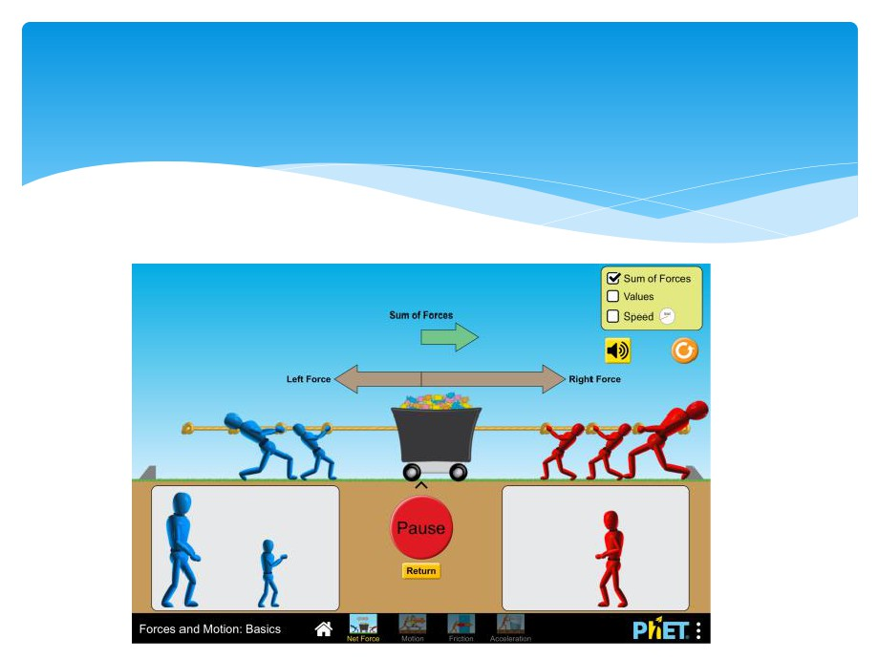

Slide 12
torque measurement
 Torque, moment, or moment of force is rotational force.
Just as a linear force is a push or a pull, a torque can be
thought of as a twist to an object. In three dimensions, the
torque is a pseudovector; for point particles, it is given by
the cross product of the position vector (distance vector)
and the force vector.

Slide 13
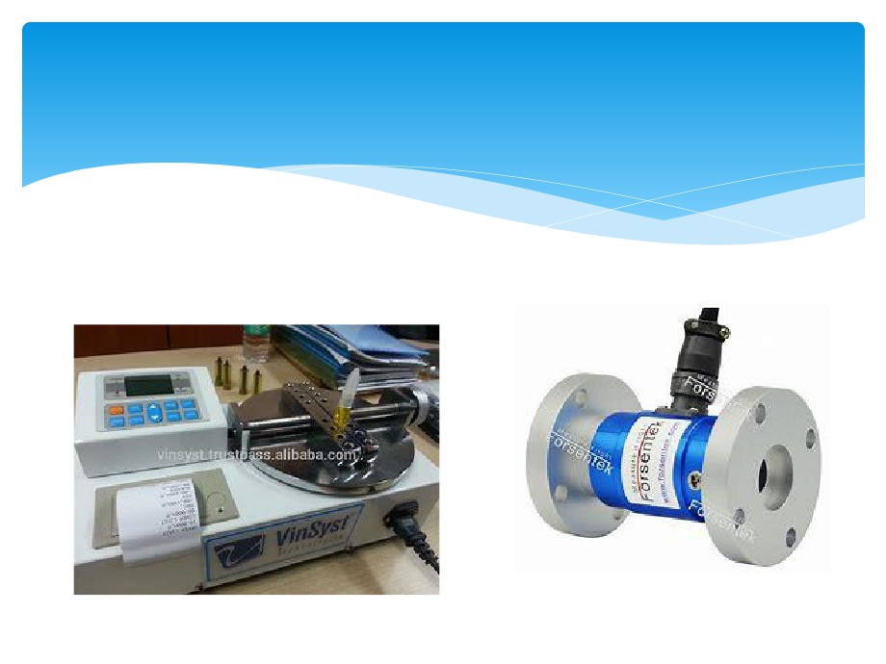
Devices

Slide 14
pressure measurement
Pressure measurement is the analysis of an applied force by a fluid (liquid or gas) on a
surface. Pressure is typically measured in units of force per unit of surface area. Many
techniques have been developed for the measurement of pressure and vacuum.
Instruments used to measure and display pressure in an integral unit are called
pressure gauges or vacuum gauges. A manometer is a good example as it uses a
column of liquid to both measure and indicate pressure. Likewise the widely used
Bourdon gauge is a mechanical device which both measures and indicates and is
probably the best known type of gauge.
 A vacuum gauge is a pressure gauge used to measure pressures lower than the
ambient atmospheric pressure, which is set as the zero point, in negative values (e.g.:
-15 psi or -760 mmHg equals total vacuum). Most gauges measure pressure relative to
atmospheric pressure as the zero point, so this form of reading is simply referred to
as "gauge pressure". However, anything greater than total vacuum is technically a
form of pressure. For very accurate readings, especially at very low pressures, a
gauge that uses total vacuum as the zero point may be used, giving pressure readings
in an absolute scale.
 Other methods of pressure measurement involve sensors which can transmit the
pressure reading to a remote indicator or control system (telemetry).

Slide 15
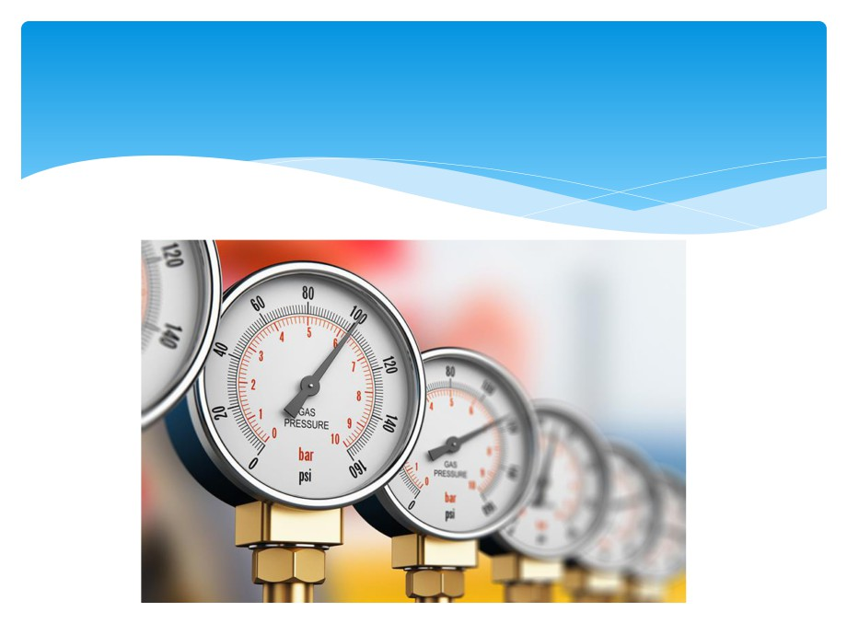
Pressure measuring device

Slide 16
pressure cell
Rheology under pressure is used to simulate process
conditions, to measure above the boiling point, or to
prevent sample evaporation. The pressure cell
specifications are therefore tailored to each application. In
the petrochemical industries, high pressures of up to 1000
bar and temperatures of up to 300 °C are required,
whereas work with low-viscosity solvents requires a
sensitive, yet fully closed system. To cover these diverse
applications, a range of different pressure cells and
measuring systems is available.

Slide 17
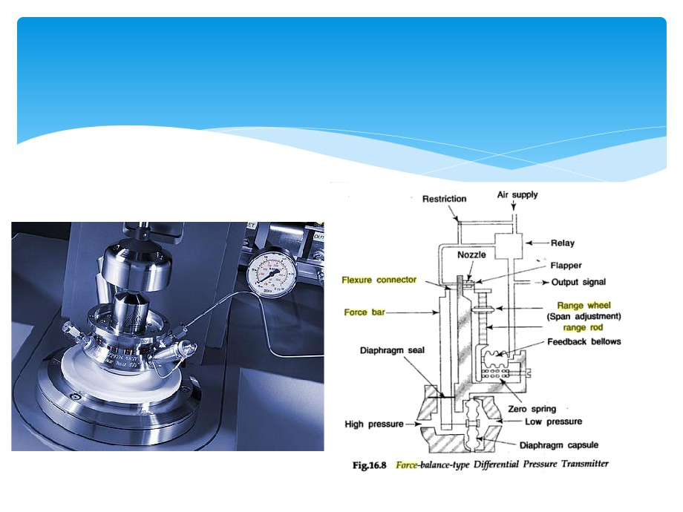

Slide 18
flow measurement
Flow measurement is the quantification of bulk fluid
movement. Flow can be measured in a variety of ways.
Positive-displacement flow meters accumulate a fixed
volume of fluid and then count the number of times the
volume is filled to measure flow. Other flow measurement
methods rely on forces produced by the flowing stream as
it overcomes a known constriction, to indirectly calculate
flow. Flow may be measured by measuring the velocity of
fluid over a known area. For very large flows, tracer
methods may be used to deduce the flow rate from the
change in concentration of a dye or radioisotope.

Slide 19
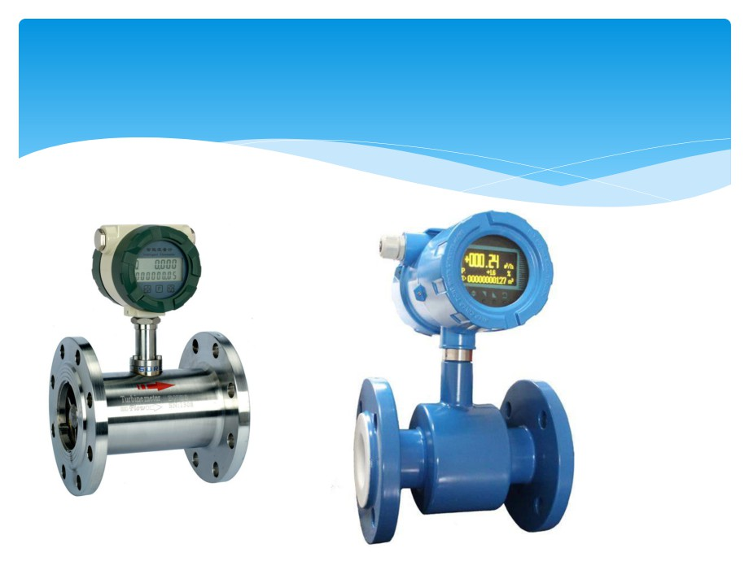

Slide 20
Ultrasonic flow meter
Principle
 Density is measured according to absorption method. A
radioactive source (Cs-137) contained in a lead-shield, steel-
enclosed housing is mounted on one side of pipe with a
scintillation detector on the opposite side. Gamma energy
emitted from the source passes through the pipe and the
process material. The amount of energy reaching the
detector changes with the density change of the material
being measured. Density is determined based on energy
attenuation and fluid concentration or solid content is
calculated via density

Slide 21
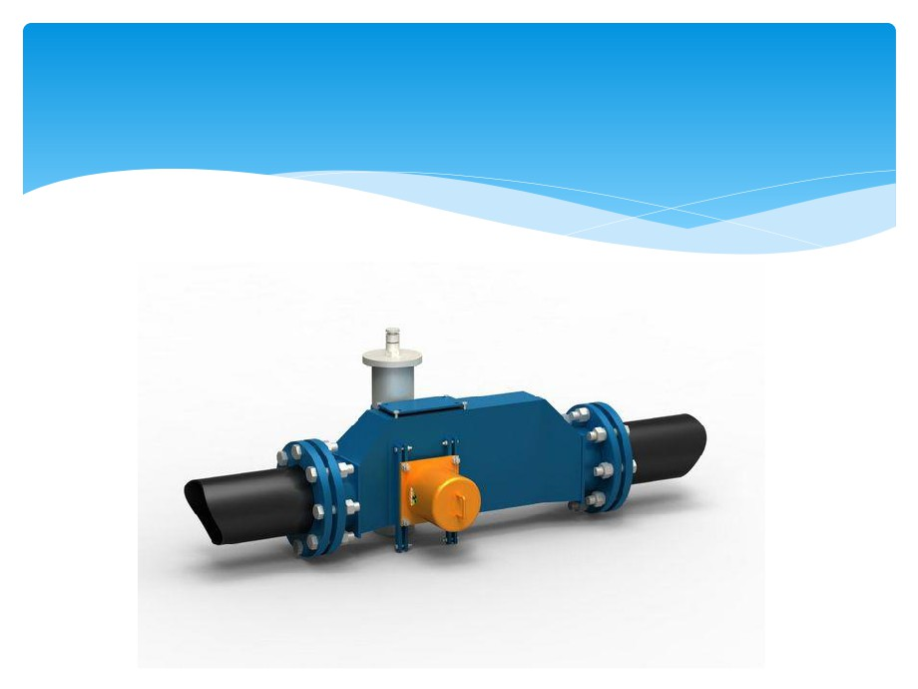

Slide 22
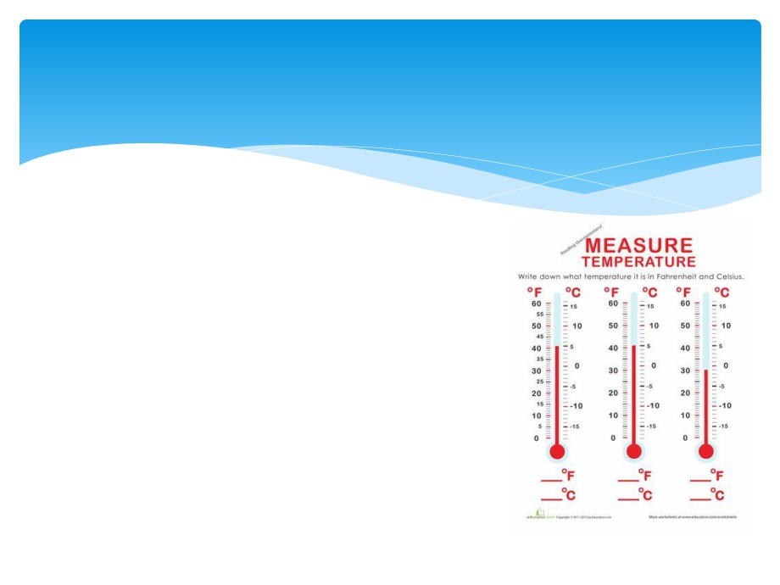
Measurement of temperature
Temperature measurement, also
known as thermometry, describes
the process of measuring a current
local temperature for immediate or
later evaluation. Datasets consisting
of repeated standardized
measurements can be used to assess
temperature trends

Slide 23
Thermocouple
 A thermocouple is an electrical device consisting of two dissimilar
electrical conductors forming electrical junctions at differing
temperatures. A thermocouple produces a temperature-dependent
voltage as a result of the thermoelectric effect, and this voltage can be
interpreted to measure temperature. Thermocouples are a widely used
type of temperature sensor
 Commercial thermocouples are inexpensive, interchangeable, are
supplied with standard connectors, and can measure a wide range of
temperatures. In contrast to most other methods of temperature
measurement, thermocouples are self powered and require no external
form of excitation. The main limitation with thermocouples is accuracy;
system errors of less than one degree Celsius (°C) can be difficult to
achieve.
 Thermocouples are widely used in science and industry. Applications
include temperature measurement for kilns, gas turbine exhaust, diesel
engines, and other industrial processes. Thermocouples are also used in
homes, offices and businesses as the temperature sensors in
thermostats, and also as flame sensors in safety devices for gas-powered
appliances

Slide 24
pH meter
A pH meter is a scientific instrument that measures the
hydrogen-ion activity in water-based solutions, indicating
its acidity or alkalinity expressed as pH. The pH meter
measures the difference in electrical potential between a
pH electrode and a reference electrode, and so the pH
meter is sometimes referred to as a "potentiometric pH
meter". The difference in electrical potential relates to the
acidity or pH of the solution. The pH meter is used in many
applications ranging from laboratory experimentation to
quality control.

Slide 25
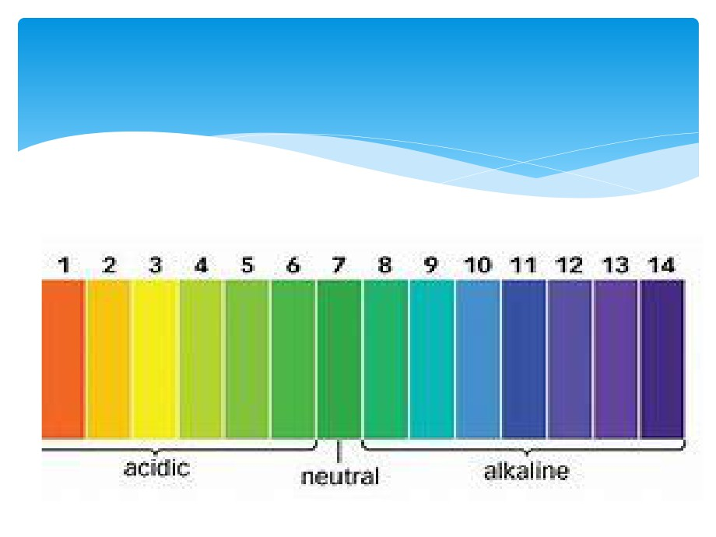

Slide 26
pH
In chemistry, pH (potential of hydrogen) is a numeric scale used to specify the
acidity or basicity of an aqueous solution. It is approximately the negative of the
base 10 logarithm of the molar concentration, measured in units of moles per
liter, of hydrogen ions. More precisely it is the negative of the base 10 logarithm
of the activity of the hydrogen ion.Solutions with a pH less than 7 are acidic and
solutions with a pH greater than 7 are basic. Pure water is neutral, at pH 7 (25 °C),
being neither an acid nor a base. Contrary to popular belief, the pH value can be
less than 0 or greater than 14 for very strong acids and bases respectively.
 Measurements of pH are important in agronomy, medicine, biology, chemistry,
agriculture, forestry, food science, environmental science, oceanography, civil
engineering, chemical engineering, nutrition, water treatment and water
purification, and many other applications.
 The pH scale is traceable to a set of standard solutions whose pH is established
by international agreement. Primary pH standard values are determined using a
concentration cell with transference, by measuring the potential difference
between a hydrogen electrode and a standard electrode such as the silver
chloride electrode. The pH of aqueous solutions can be measured with a glass
electrode and a pH meter, or an indicator

Slide 27
Vibration
Vibration is a mechanical phenomenon whereby oscillations occur about an
equilibrium point. The word comes from Latin vibrationem ("shaking,
brandishing"). The oscillations may be periodic, such as the motion of a
pendulum—or random, such as the movement of a tire on a gravel road.
 Vibration can be desirable: for example, the motion of a tuning fork, the reed in a
woodwind instrument or harmonica, a mobile phone, or the cone of a
loudspeaker.
 In many cases, however, vibration is undesirable, wasting energy and creating
unwanted sound. For example, the vibrational motions of engines, electric motors,
or any mechanical device in operation are typically unwanted. Such vibrations
could be caused by imbalances in the rotating parts, uneven friction, or the
meshing of gear teeth. Careful designs usually minimize unwanted vibrations.
 The studies of sound and vibration are closely related. Sound, or pressure waves,
are generated by vibrating structures (e.g. vocal cords); these pressure waves can
also induce the vibration of structures (e.g. ear drum). Hence, attempts to reduce
noise are often related to issues of vibration.

Slide 28
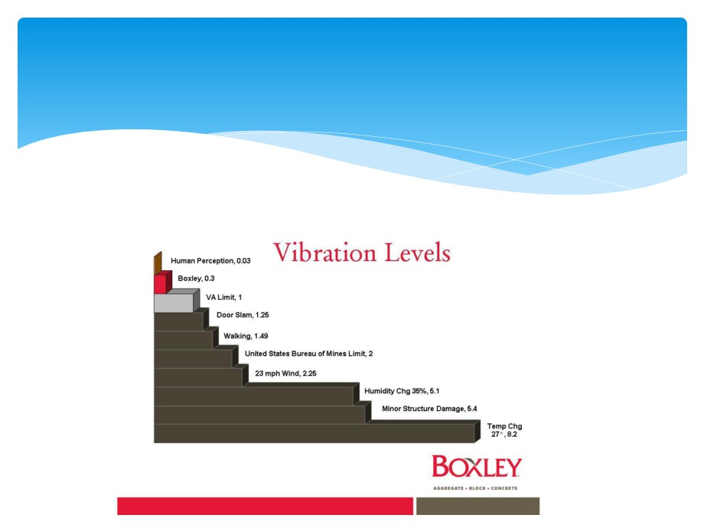
Vibration level

Slide 29
Two Wattmeter Method of Power Measurement
Two Wattmeter Method can be employed to measure the power in a 3 phase, three wire star or delta connected the balanced or unbalanced load. In Two wattmeter method the current coils of the wattmeter are connected with any two lines, say R and Y and the potential coil of each wattmeter is joined on the same line, the third line i.e. B

Slide 30
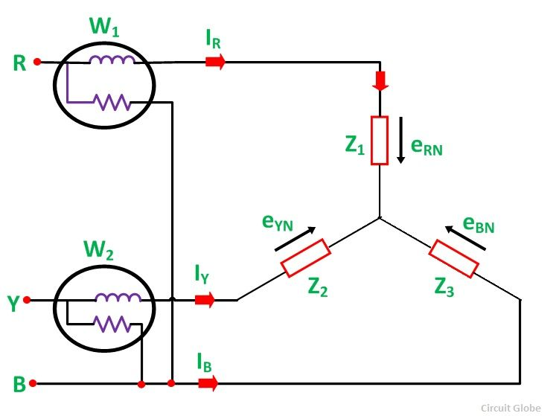
The total instantaneous power absorbed by the three loads Z1, Z2 and Z3, are equal to the sum of the powers measured by the Two wattmeters, W1 and W2.

Slide 31
Measurement of Power by Two Wattmeter Method in Star Connection

Slide 32



Considering the above figure (A) in which Two Wattmeter W1 and W2 are connected, the instantaneous current through the current coil of Wattmeter, W1 is given by the equation shown below.
Instantaneous potential difference across the potential coil of Wattmeter, W1 is given as
Instantaneous power measured by the Wattmeter, W1 is

Slide 33



The instantaneous current through the current coil of Wattmeter, W2 is given by the equation
Instantaneous potential difference across the potential coil of Wattmeter, W2 is given as
Instantaneous power measured by the Wattmeter, W2 is

Slide 34
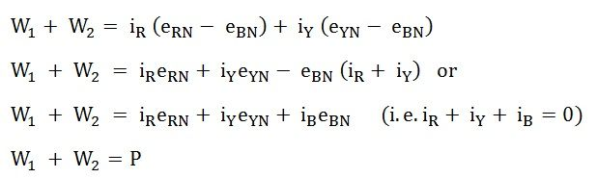
Therefore, the Total Power Measured by the Two Wattmeters W1 and W2 will be obtained by adding the equation (1) and (2).
Where P – the total power absorbed in the three loads at any instant

Slide 35
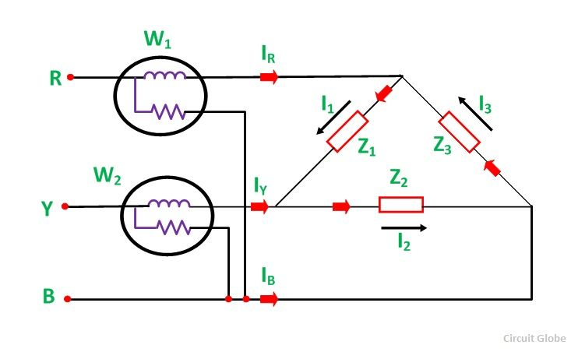
Measurement of Power by Two Wattmeter Method in Delta Connection
Considering the delta connected circuit shown in the figure below.

Slide 36




The instantaneous current through the coil of the Wattmeter, W1 is given by the equation
Instantaneous Power measured by the Wattmeter, W1 will be
Therefore, the instantaneous power measured by the Wattmeter, W1 will be given as
The instantaneous current through the current coil of the Wattmeter, W2 is given as

Slide 37


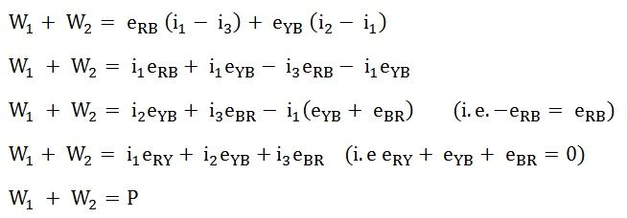
The instantaneous potential difference across the potential coil of Wattmeter, W2 is
Therefore, the instantaneous power measured by Wattmeter, W2 will be
Hence, to obtain the total power measured by the Two Wattmeter the two equations, i.e. equation (3) and (4) has to be added
Where P is the total power absorbed in the three loads at any instant

Slide 38
Measurement of Three Phase Power: Three Wattmeter Method
Three Wattmeter method is employed to measure power in a 3 phase, 4 wire system.However, this method can also be employed in a 3 phase, 3 wire delta connected load, where power consumed by each load is required to be determined separately.
The connections for star connected loads for measuring power by Three wattmeter method is shown below.

Slide 39
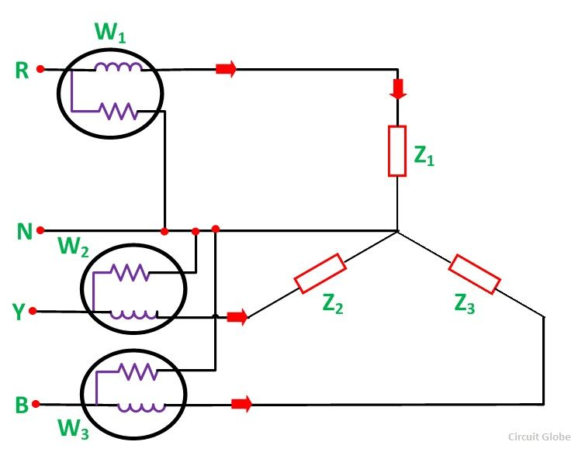

Slide 40

The pressure coil of all the Three wattmeters namely W1, W2 and W3 are connected to a common terminal known as the neutral point. The product of the phase current and line voltage represents as phase power and is recorded by individual wattmeter.
The total power in a Three wattmeter method of power measurement is given by the algebraic sum of the readings of Three wattmeters. i.e

Slide 41
Where
W1 = V1I1
W2 = V2I2
W3 = V3I3
Except for 3 phase, 4 wire unbalanced load, 3 phase power can be measured by using only Two Wattmeter Method

